Slide 1

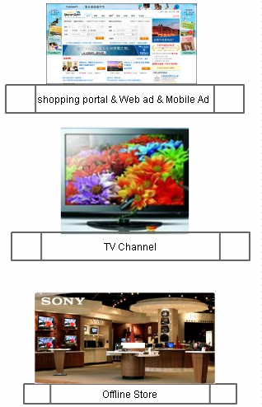


Activity Driven E-commerce System (target for highest conversion rate from offline experience , social, reverse group buying)
Seller Benefit
ADES
user online-offline info collection system
User blog and weixin interactive system
E-commerce (reserve group buying) portal system
Seller total package solution system
Offline interaction system
User behavior & BI system
Ad Real time bidding sub-system
online
Benefit from online and typically offine experience and services, receive feedback
user value BI from system & re-use
No need maintain own system to keep active user
telephone
Consumer Benefit
Real experience , real service feeling
Social with other and sellers through discussion board
Reverse group buyging with social benefit
My cloud pocket for product linked with customer support
Online
Offline
offline

Slide 2
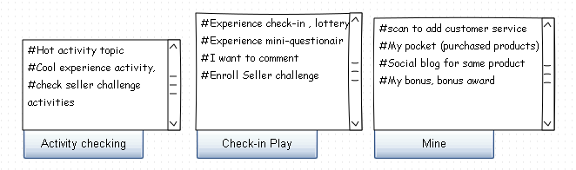
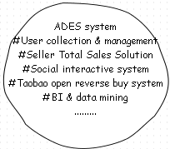
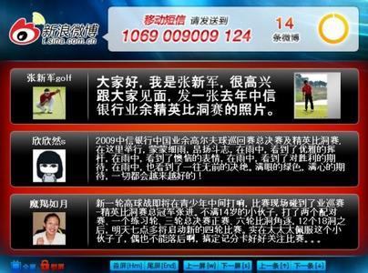
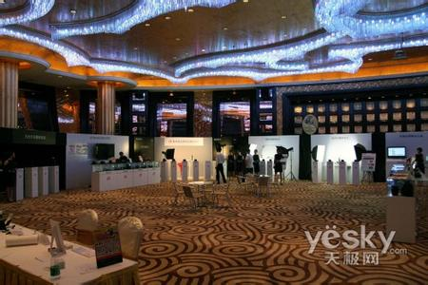
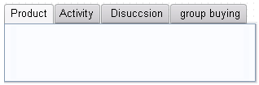
System Prototype
Consumer entry – 微信 weixin
WAP page
Sony L39h remote control DSC camera
Nearby experience store, check-in win gift
Feature description, video
Seller support challenge, 1000 80% discount within 2 weeks
Customer service number
Check-in code
Interactive board
Seller experience area
Seller entry – WEB CRM

Slide 3
Service Flow
Online
Online refund of reverse buying
Receive product
Online find & Browse
Continue monitor
Check hot activity topic, and add to my favor
Check what & where is the activities
Check Cool feature
Call customer service
Online check-in activities
View interactive discussion and participate and share
Check reverse group buying status, share with friend
scan code to check counterfeit
Scan code to add customer service
Add product into my pocket
Social and comment with society with same product
Interactive board and experience area will excite shop popularity
Engaged in discussion and sharing
Reverse purchase will trigger order and sharing
Collect user information
Weixin scan for credit
Weixin scan for lottery
Experience and feedback
Get engage with interactive board
Order and (start reverse group buying)
Customer support realize the service feeling
Social with same product blog will enhance the user experience and notify improvement to seller
Offline
Offline Browse
Offline Experience
Offline Purchase.
Customer service
Call & weixin

Slide 4
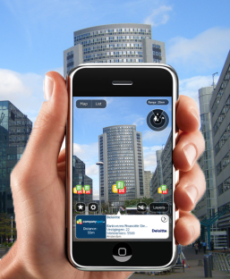
Current advantage
seller
Entrance
Activity driven commerce operation system (target for highest conversion rate)
user online-offline info collection
User blog and weixin interactive portal
E-commerce (reserve groupon) portal
Seller system
User behavior BI system
WEB: Qunar vacation & group-buying channel
网站
No need maintain operation system to keep user active
Benefit from both online and typically offine experience store
user value collection & re-use
TV: fashion, High-tech channel
电话
Online
Store: SONY store
consumer
线下
Real experience and sharing.
Service feeling from seller though discussion board, linked customer service
My unified cloud pocket(browse, favorite, purchased)
Offline
AR

Slide 5
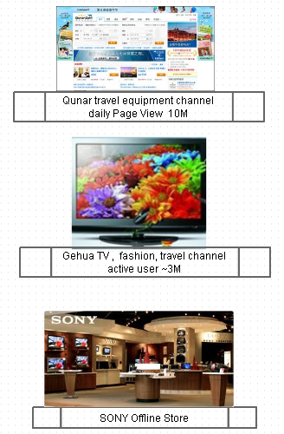
Current partner and pilot target Pilot with L39H & DSC camera to Check the conversion rate change
Entrance
ADES Pilot
user online-offline info collection system
User blog and weixin interactive system
E-commerce (reserve group buying) portal system
Seller solution pilot system
Offline interaction system
Seller Benefit
Excite popularity
Check Conversion rate
Pilot reserve group buying
Collect user info from online & offline
Consumer
Online
Offline
Get experience with SONY wireless control device
Get discount if reverse buying success.

