Slide 1

Data Visualization use D3 . js
Notes:
2020

Slide 2
Browser-Based UI
Browser
HTML -> Structure
CSS -> Appearance
Font
Background
Image
Color, Size, Position
javascript (JS) -> Logic
Control Everything
in the Browser
Library, Ex:

Slide 3
HTML5 Example

Slide 4
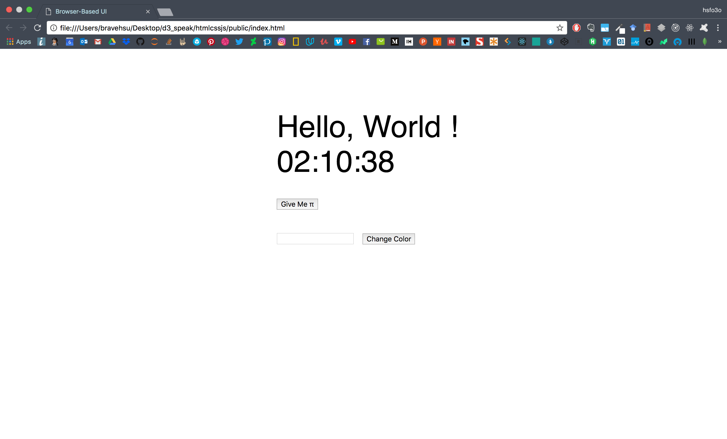

Slide 5
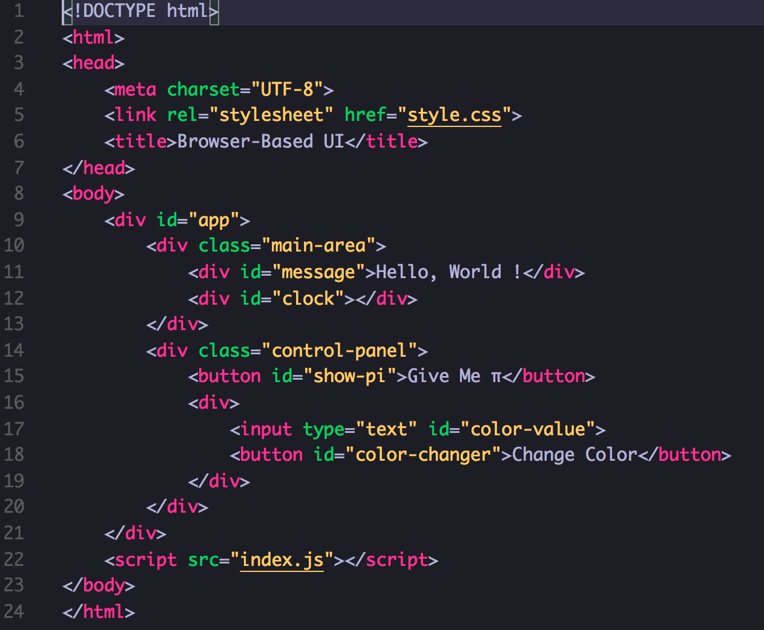
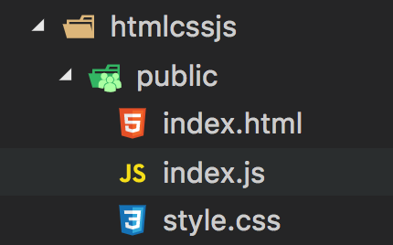
Example

Slide 6
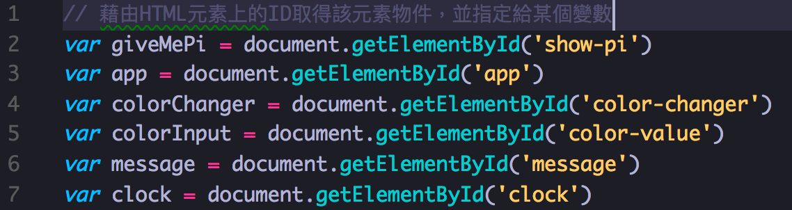
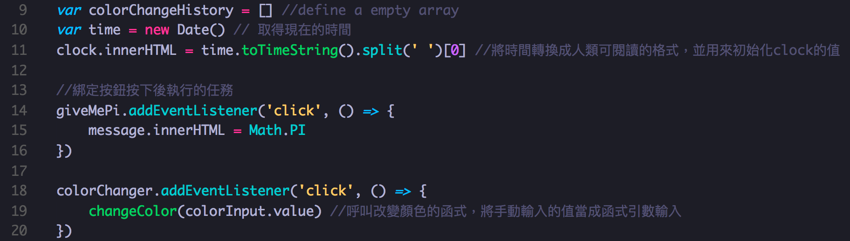
Example - index.js

Slide 7
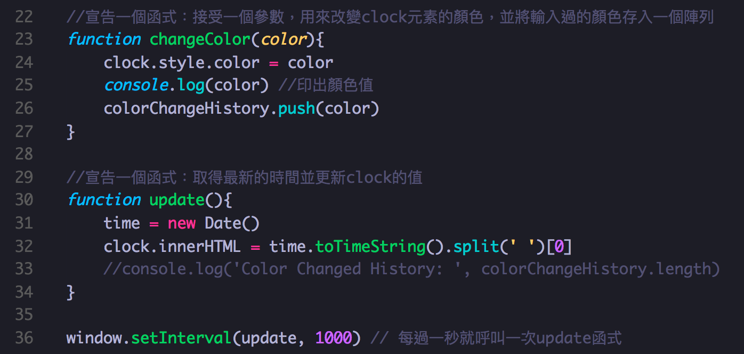
Example - index.js

Slide 8
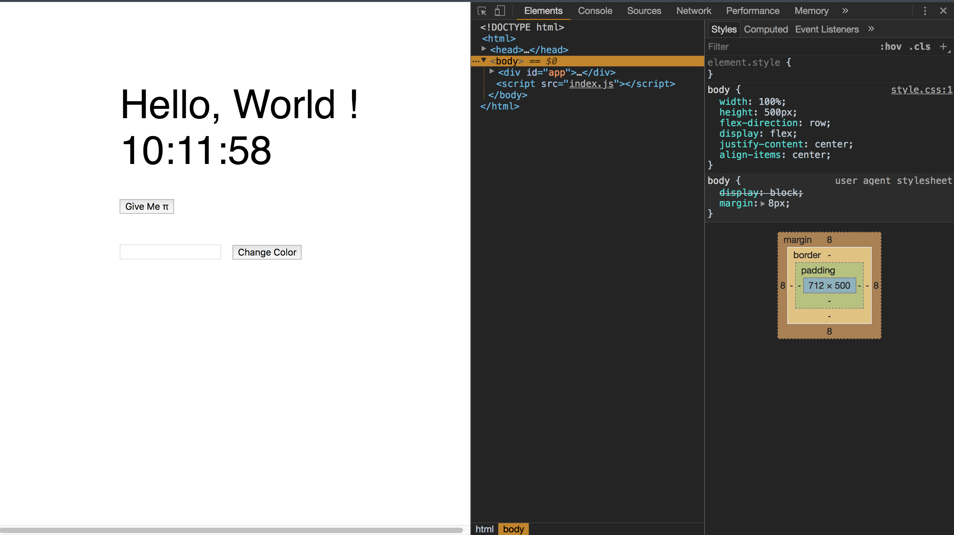
Example - Debug

Slide 9
Example
https://codepen.io/hsfo3o/pen/BrNoOg
Some Resources:
Codecademy: https://www.codecademy.com/catalog/subject/web-development
MDN : https://developer.mozilla.org/zh-TW/

Slide 10
What is D3.js
A JavaScript Library
Help you Making Data-Driven Document
-> Control your Document(HTML+CSS) by Data

Slide 11
D3.js
Selection + modifier function
SVG to Bar Chart
Dealing with Data
Many Useful Function
Interaction (To Be Continue …)

Slide 12
D3.js – Selection
Selecting a single element
Selecting multiple elements
Function chaining
Modifier Function

Slide 13
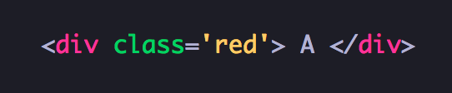
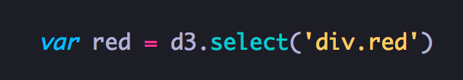
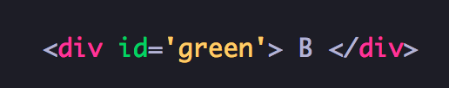

D3.js - Selecting a single element
Keyword: css selector
Notes:
同一個頁面上的兩個元素不能有相同的id屬性值（否則該值就不是唯一）

Slide 14
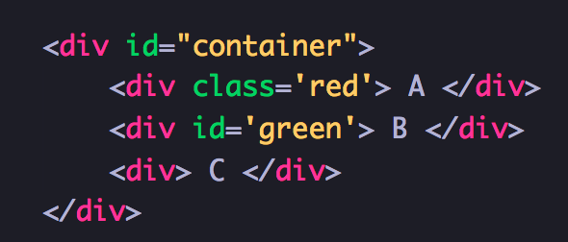

D3.js - Selecting multiple elements

Slide 15
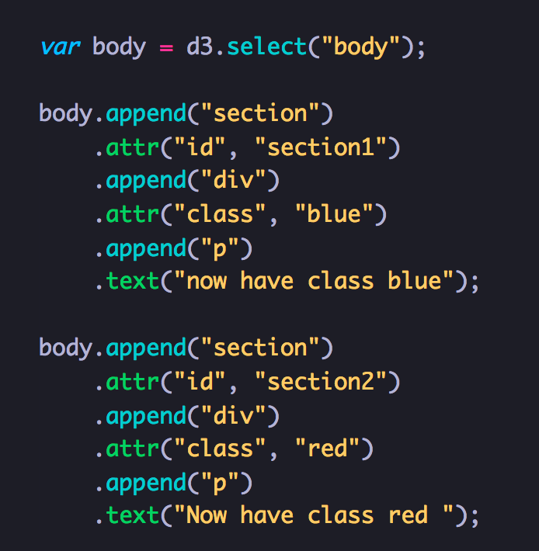
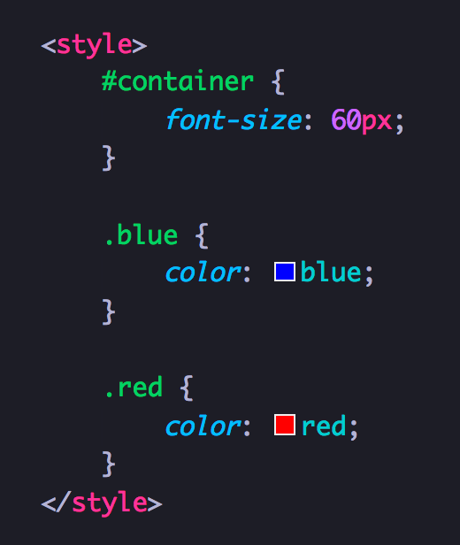
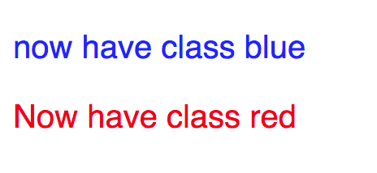
D3.js - Function chaining
CSS

Slide 16

D3.js – Modifier Function
After selecting elements, use the selection’s transformation methods to affect document content.
Selection.style() / Selection.text() / Selection.html() / Selection.classed() / Selection.attr()
Notes:
https://github.com/d3/d3-selection/blob/v1.4.1/README.md#modifying-elements

Slide 17
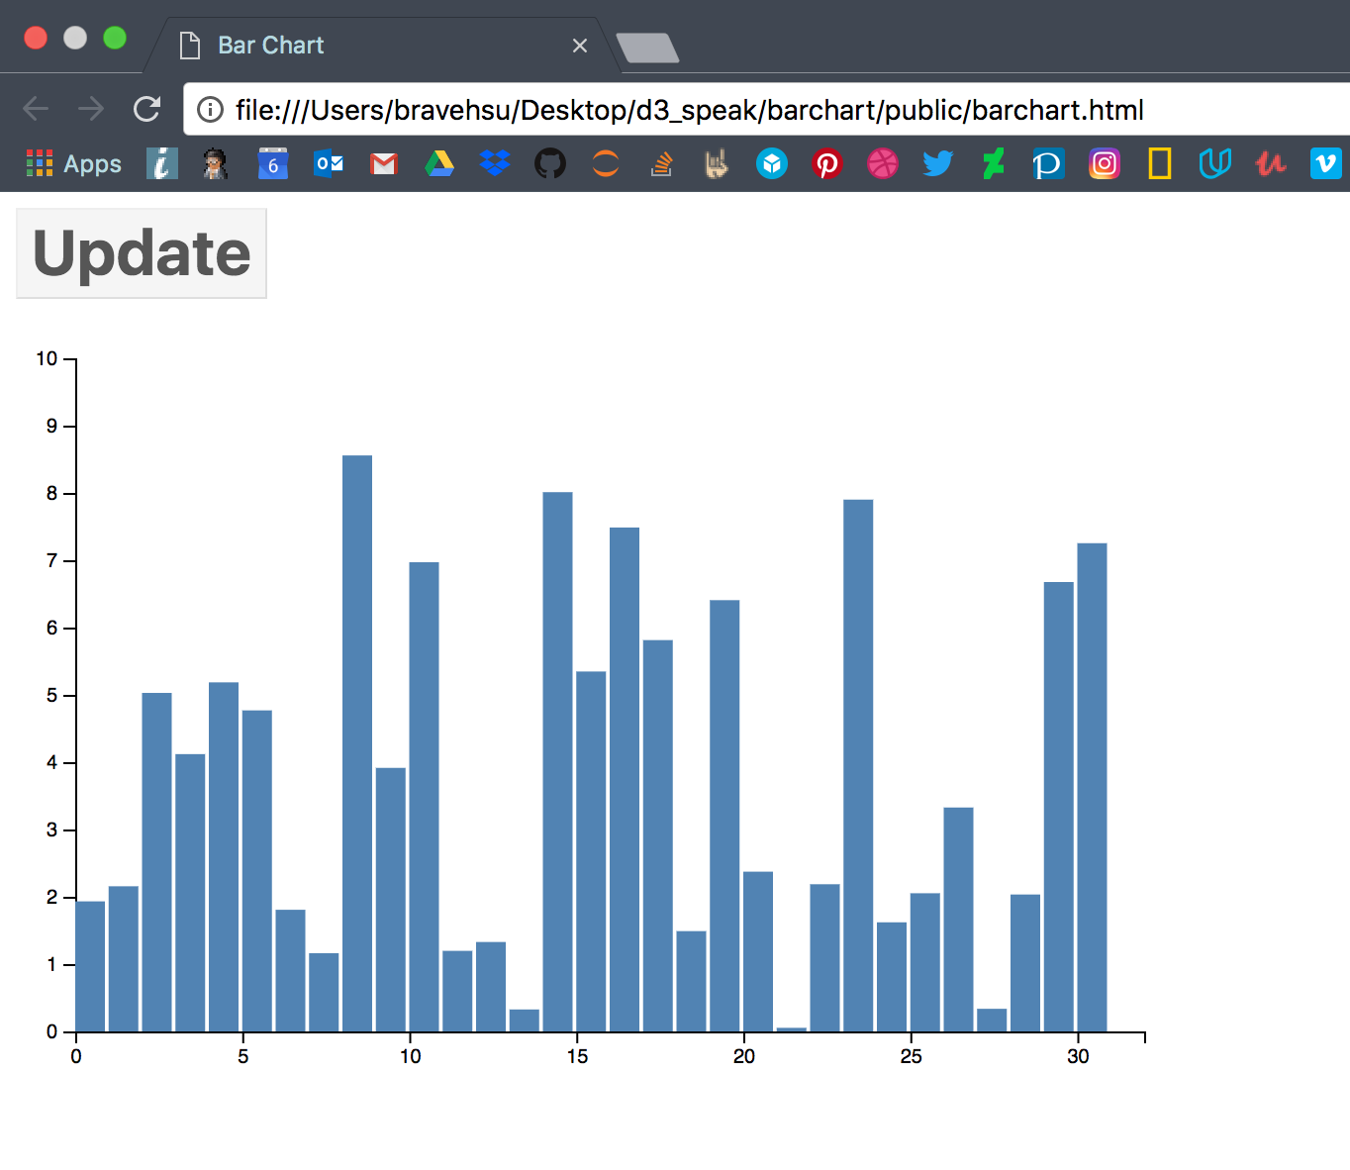
D3.js – Example

Slide 18
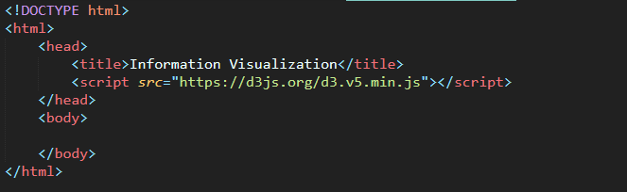
D3.v5.min.js
引用 D3.JS

Slide 19
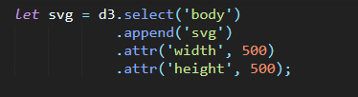
Set SVG
選定元素，設定成SVG
設定SVG長度與寬度

Slide 20
SVG Rectangle - <rect>
<svg width="400" height="110"> <rect width="300" height="100" style="fill: rgb(0,0,255); stroke-width: 3;stroke: rgb(0,0,0)" /> </svg>
<svg width="400" height="180"> <rect x="50" y="20" width="150" height="150" style="fill: blue; stroke: pink; stroke-width: 5; fill-opacity: 0.1; stroke-opacity: 0.9" /> </svg>

Slide 21
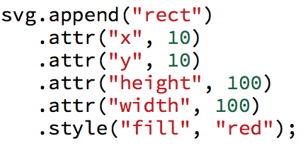
Draw Rectangle
設定Rectangle
Rectangle基本屬性包含
XY座標
長度與寬度
顏色
等等。。。
Notes:
svg.append("rect")
.attr("x", 10)
.attr("y", 10)
.attr('width', 100).attr('height', 100)
.style("fill", "red");

Slide 22

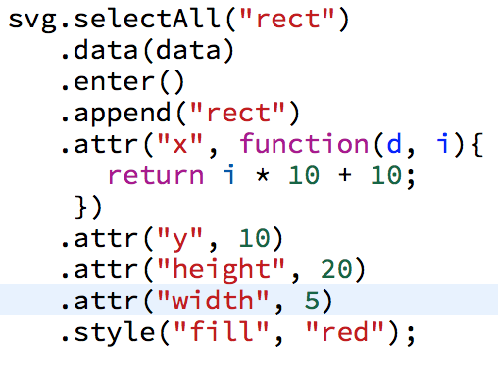

Data
設定data
10筆資料 10個方形
Notes:
var data = [1535, 3081, 2494, 9078, 9843, 6856, 234, 529, 6729, 2321];
svg.selectAll("rect")
.data(data)
.enter()
.append("rect")
.attr("x", function(d, i) {return i*10+10;})
.attr("y",10)
.attr('height', 20)
.attr('width', 5)
.style("fill", "red");

Slide 23
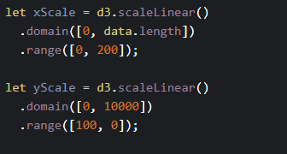
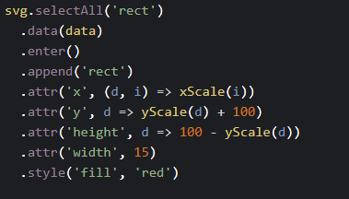
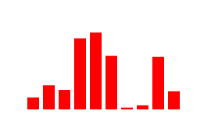
Draw bar chart
透過設定Scale Function
輕鬆地將bar chart的長度以及XY座標值找出來

Slide 24
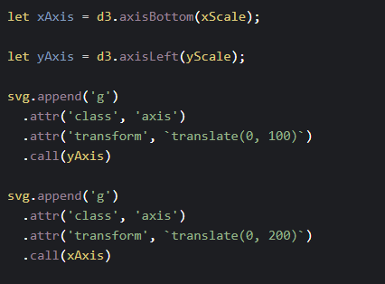
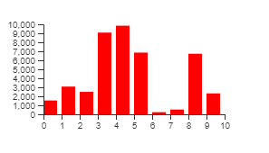
Draw bar chart
Notes:
Source code : https://codepen.io/sean721721721/pen/KKpZEYY

Slide 25
D3.js – Dealing with Data
enter()
data()
exit()
merge()

Slide 26
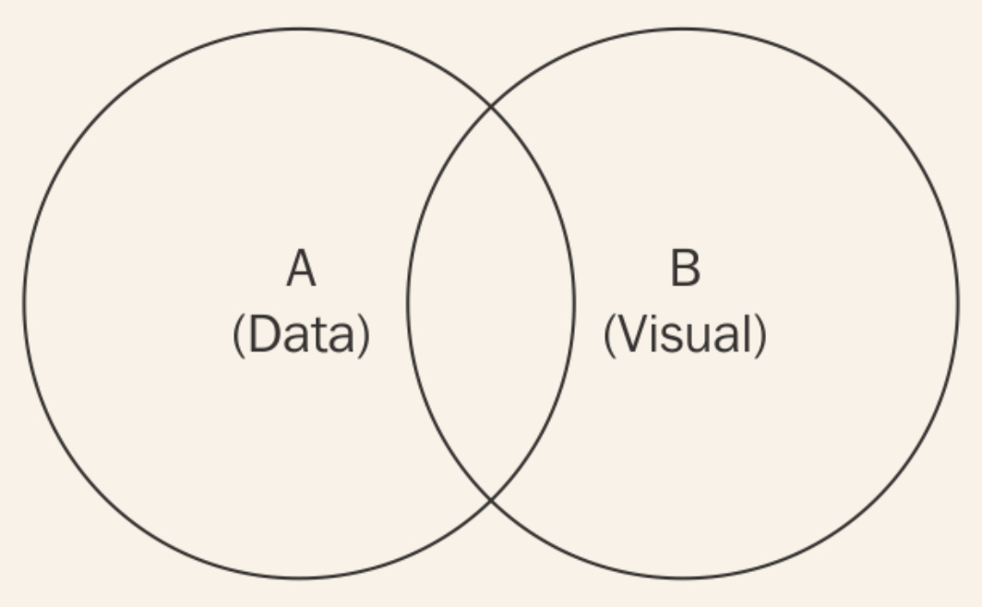
D3.js – Dealing with Data

Slide 27
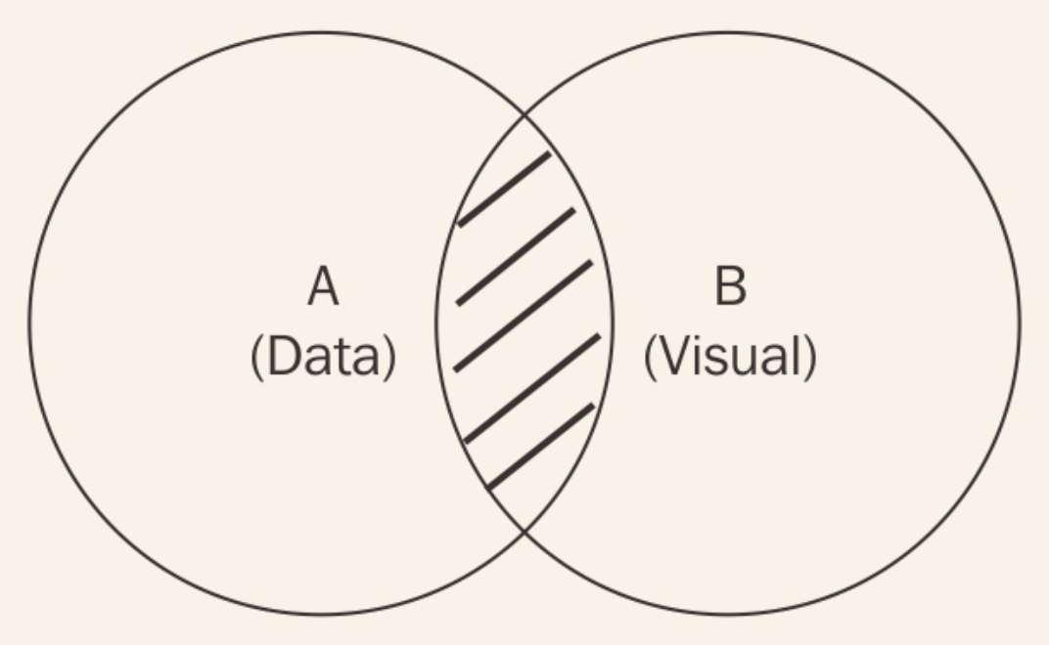
D3.js – data()
How can I find all visual elements that currently represent their corresponding data point?
-> selection.data(data)
Return new selection contains all data-bound element

Slide 28
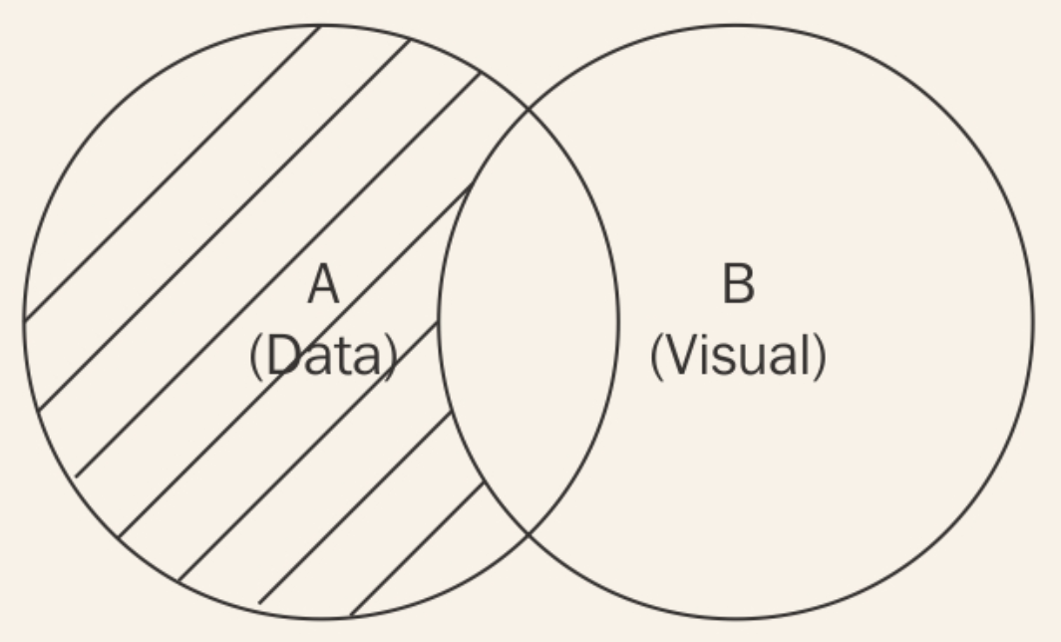
D3.js – enter()
How can I target data points that have not yet been visualized?
-> selection.data(data).enter()
Return new selection of all data that has not represented

Slide 29
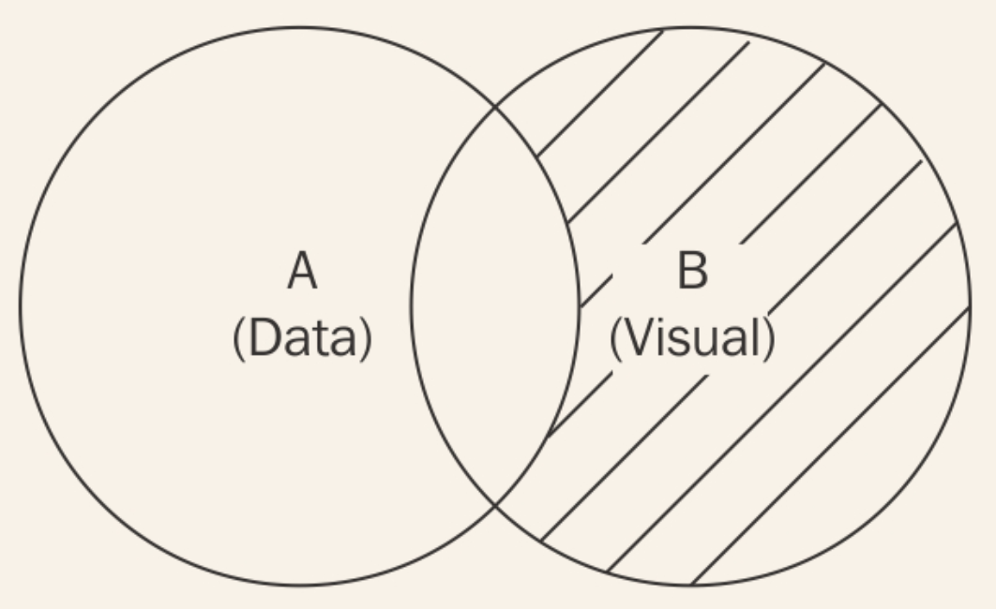
D3.js – exit()
When you remove some data, their will be some data-bound element need to be removed too.
-> selection.data(data).exit()
Return new selection contains all visual element that are no longer bound by valid data.

Slide 30
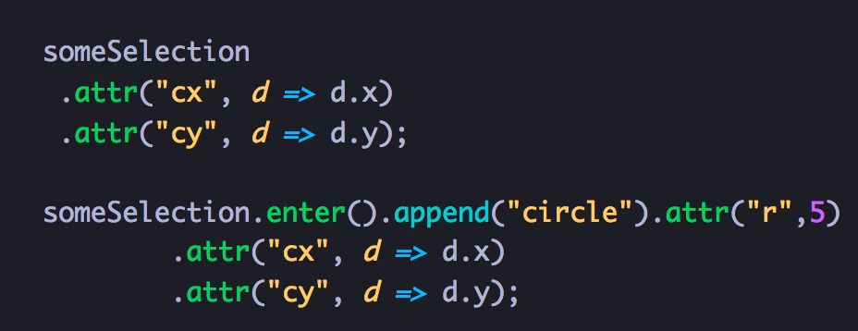
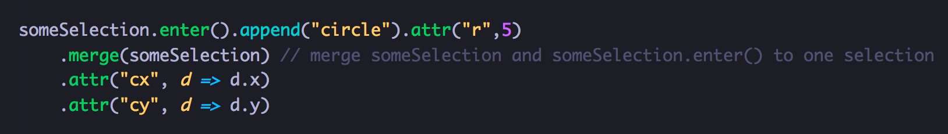
D3.js – merge()

Slide 31
D3.js – Useful Function
Working with Array
Scale
Interpolater
And More … https://github.com/d3/d3/blob/master/API.md

Slide 32
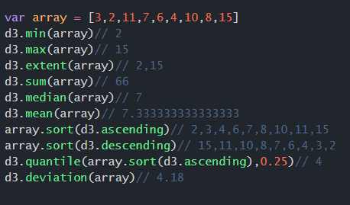
D3.js – Working with Array
Notes:
Quantile 分位數

Slide 33
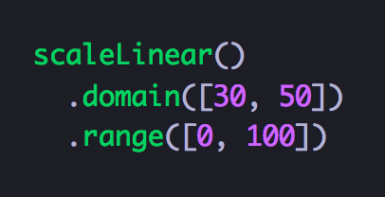
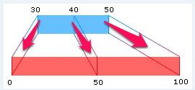
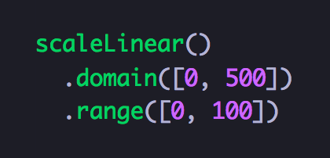
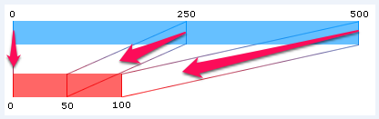
D3.js – Scale

Slide 34
D3.js – More Example
Codepen search d3:
https://codepen.io/search/pens?q=d3&limit=all&type=type-pens
D3js.org:
https://github.com/d3/d3/wiki/Gallery
Observable:
https://observablehq.com/explore

