Slide 1
Problem Statement and Understanding
Houses are one of the necessary need of each and every person around the globe and therefore housing and real estate market is one of the markets which is one of the major contributors in the world’s economy. It is a very large market and there are various companies working in the domain. Data science comes as a very important tool to solve problems in the domain to help the companies increase their overall revenue, profits, improving their marketing strategies and focusing on changing trends in house sales and purchases. Predictive modelling, Market mix modelling, recommendation systems are some of the machine learning techniques used for achieving the business goals for housing companies.
A US-based housing company named Surprise Housing has decided to enter the Australian market. The company uses data analytics to purchase houses at a price below their actual values and flip them at a higher price. For the same purpose, the company has collected a data set from the sale of houses in Australia. The company is looking at prospective properties to buy houses to enter the market. We are required to build a model using Machine Learning in order to predict the actual value of the prospective properties and decide whether to invest in them or not. For this company wants to know:
• Which variables are important to predict the price of variable?
• How do these variables describe the price of the house?

Slide 2
Problem Statement and Understanding
We are required to model the price of houses with the available independent variables. This model will then be used by the management to understand how exactly the prices vary with the variables. They can accordingly manipulate the strategy of the firm and concentrate on areas that will yield high returns. Further, the model will be a good way for the management to understand the pricing dynamics of a new market.

Slide 3
EDA Steps
Identifying sources of the data.
Analysing the data.
Cleaning and processing the data.
Selecting most important features.
Writing down findings and observations.
Using different models to train the data.
Selecting best fitted model for predictions.
Predicting outcome for test data.

Slide 4
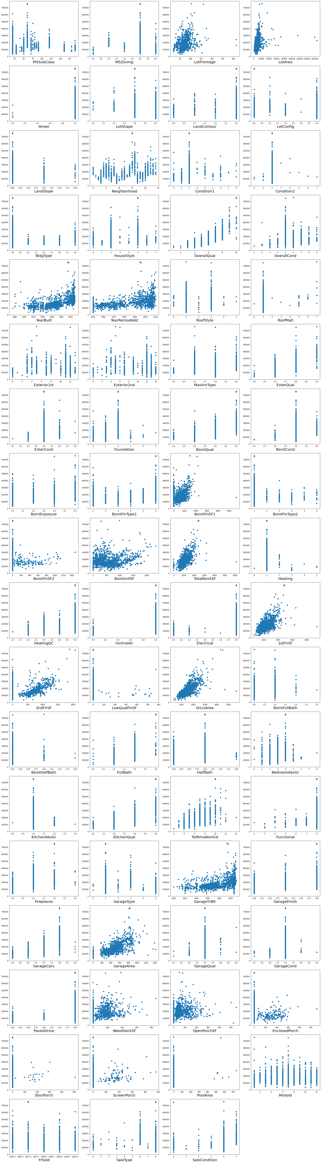
Visualizations
Scatter Plot: -
Observations:
• OverallQual, YearBuilt, YearRemodAdd, ExterQual, BsmtQual, TotalBsmtSF, 1stFlrSF, GrLivArea, FullBath, KitchenQual, TotRmsAbvGrd, GarageFinish, GarageCars and GarageArea columns have high co-relation with Label.
• MSSubClass, LandContour, LotConfig, LandSlope, Condition2, BldgType, OverallCond, MasVnrType, ExterCond, BsmtFinType2, BsmtFinSF2, LowQualFinSF, BsmtHalfBath, 3SsnPorch, YrSold and SaleType columns have Low/No co-relation with Label.

Slide 5
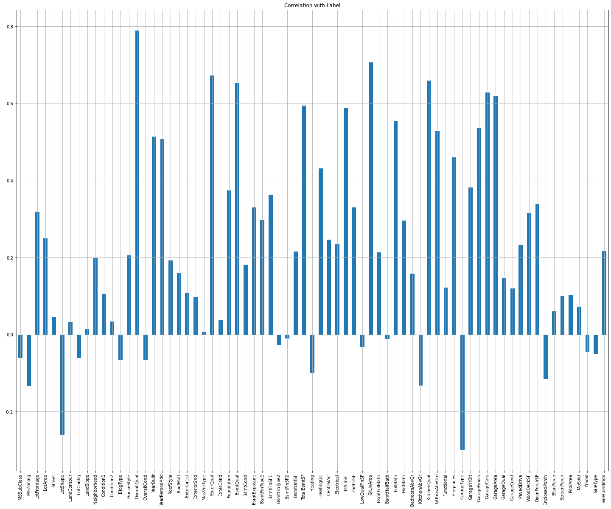
Visualizations
2. BarPlot: -
Observations:
• OverallQual, YearBuilt, YearRemodAdd, ExterQual, BsmtQual, TotalBsmtSF, 1stFlrSF, GrLivArea, FullBath, KitchenQual, TotRmsAbvGrd, GarageFinish, GarageCars and GarageArea columns have high co-relation with Label.
• MSSubClass, LandContour, LotConfig, LandSlope, Condition2, BldgType, OverallCond, MasVnrType, ExterCond, BsmtFinType2, BsmtFinSF2, LowQualFinSF, BsmtHalfBath, 3SsnPorch, YrSold and SaleType columns have Low/No co-relation with Label.

Slide 6
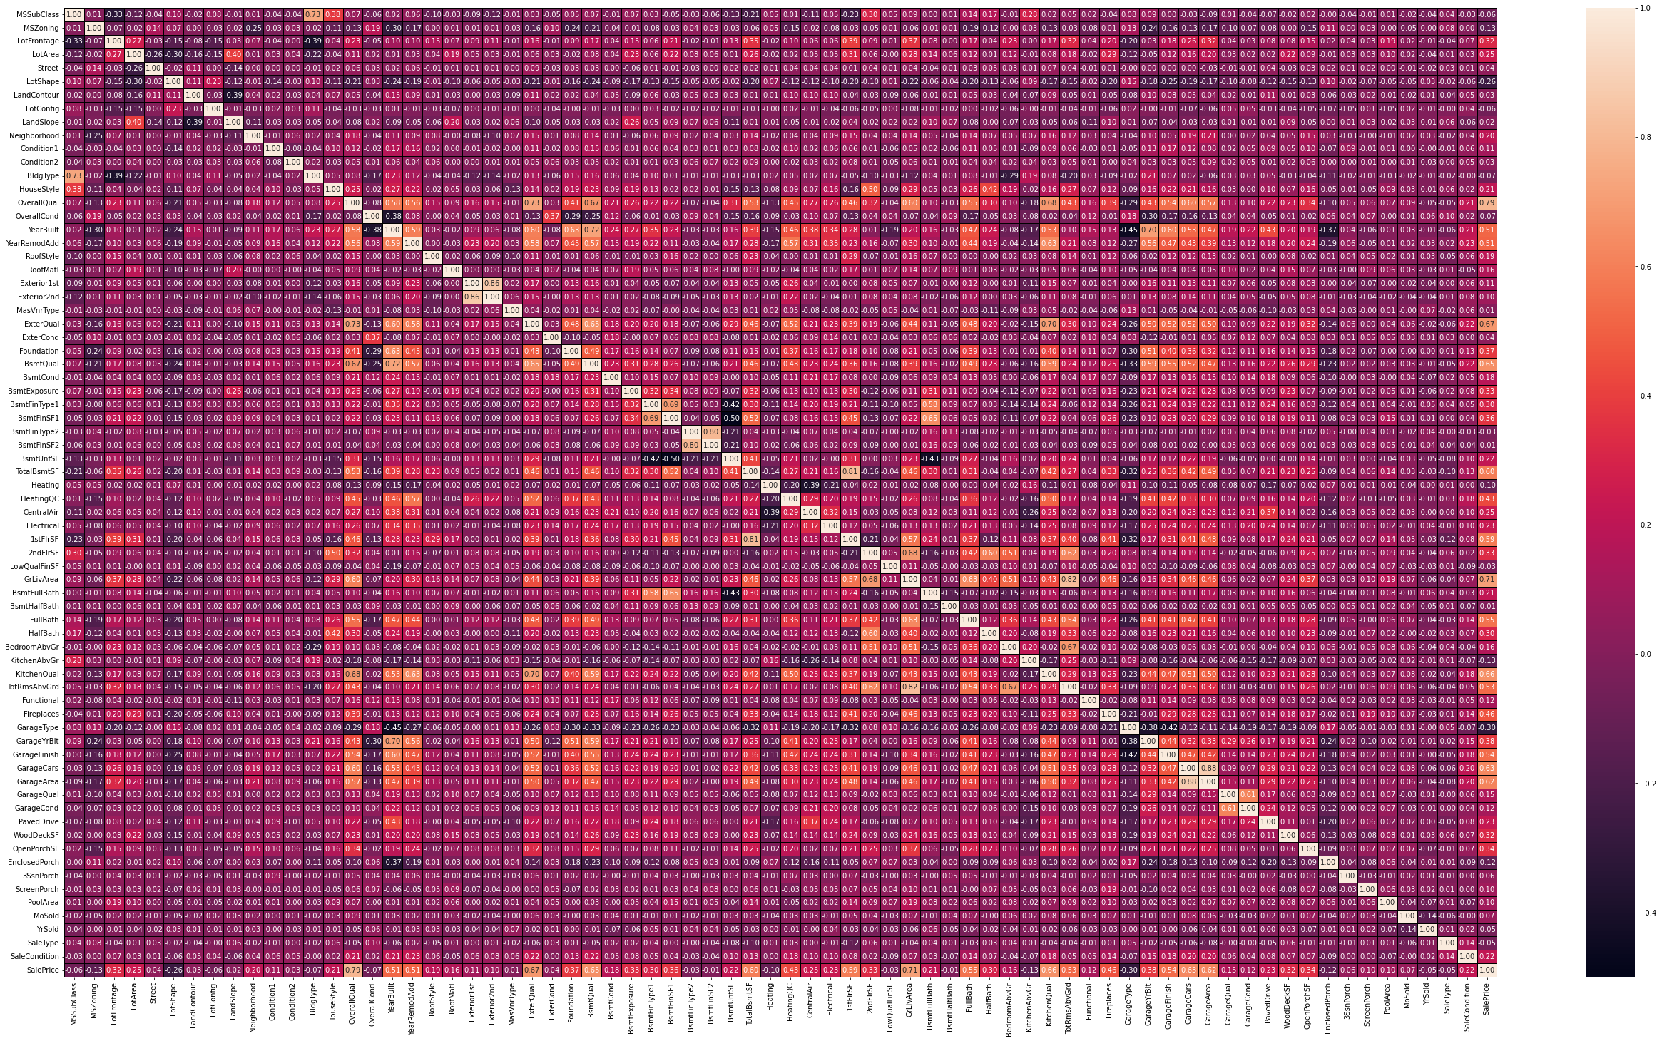
Visualizations
3. HeatMap: -
Observations:
• Multicollinearity problem does not exist in this database.

Slide 7
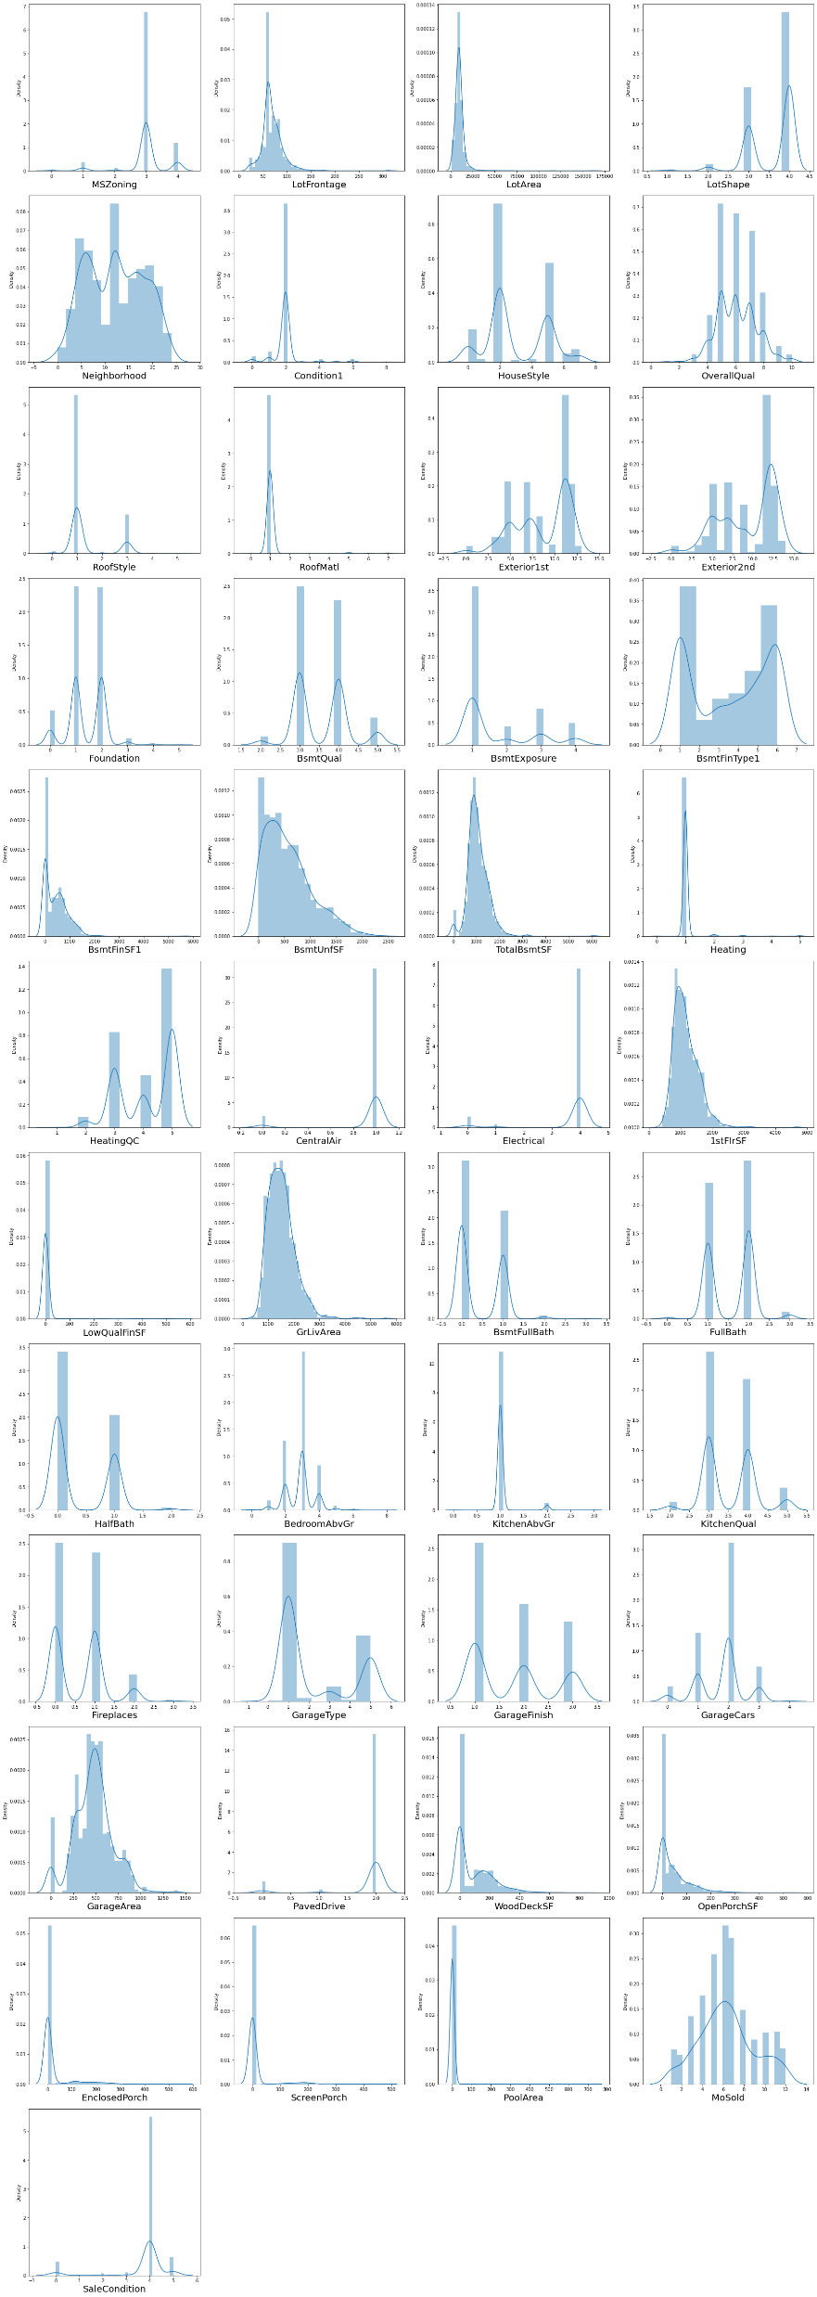
Visualizations
4. Distribution Plot: -
Observations:
• Not considering skewness of categorical data columns.
• LotFrontage, LotArea, BsmtFinSF1, BsmtUnfSF, TotalBsmtSF, 2ndFlrSF, LowQualFinSF, WoodDeckSF, OpenPorchSF, EnclosedPorch, ScreenPorch and PoolArea columns have skewness.

Slide 8
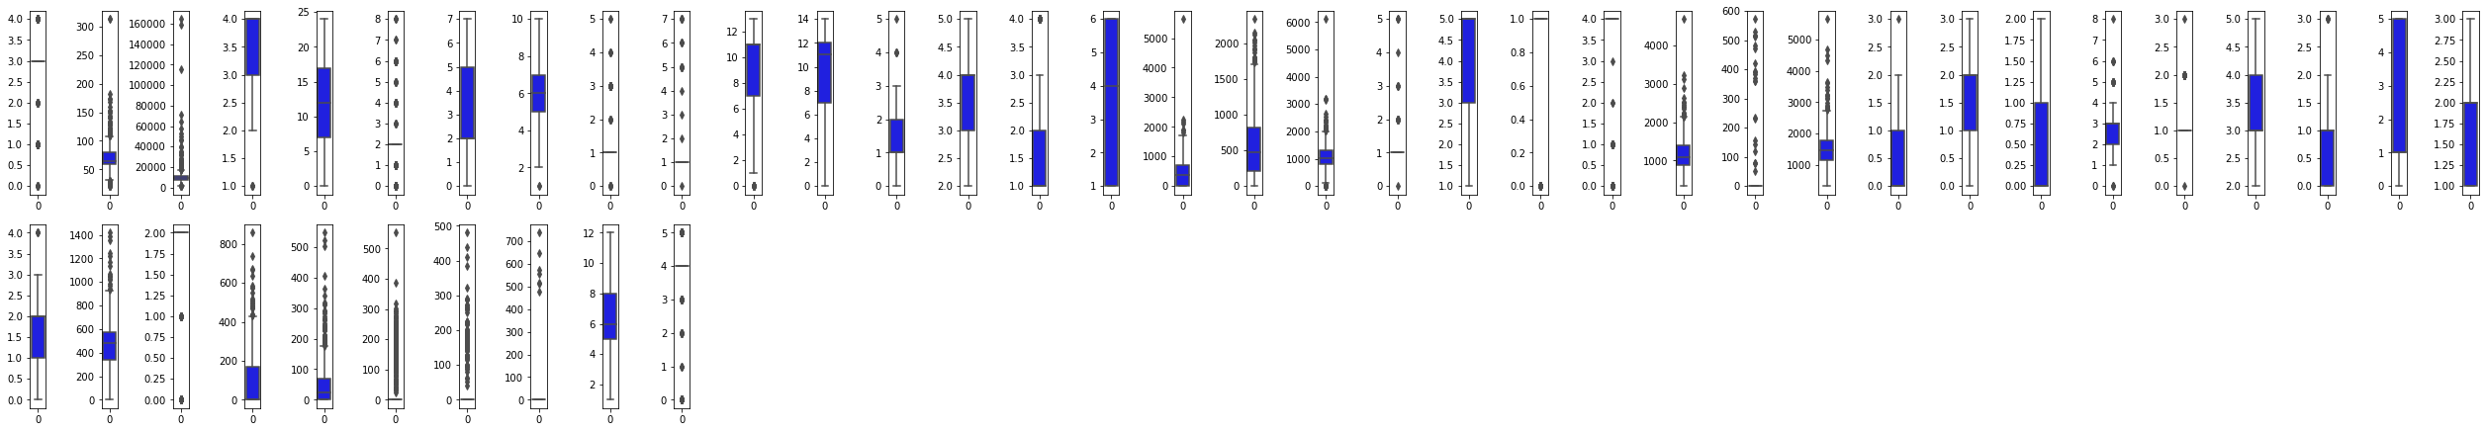
Visualizations
5. Box Plot: -
Observations:
• LotFrontage, LotArea, BsmtFinSF1, BsmtUnfSF, TotalBsmtSF, 1stFlrSF, LowQualFinSF, GrLivArea, GarageArea, WoodDeckSF, OpenPorchSF, EnclosedPorch, ScreenPorch and PoolArea columns have outliers.

Slide 9
Steps and Assumptions
Checked the data type of each column.
Changed the Object data type to Integer.
Checked whether the data has any Null Values and fill those Null values using Mean and Mode method.
Checked whether the data is categorical data or continuous data.
There are many categorical columns which has ratings and level of agreement and disagreement. Updated Those string ratings to Integer.
E.g: -
'Ex' – Excellent = 5
'Gd' – Good = 4
'TA' - Average/Typical = 3
'Fa' - Fair = 2
'Po' - Poor = 1
'NA' – Not Applicable = 0
Encoded remaining Object data type columns to integer using encoder technique.
Checked the co-relation of features with label i.e SalePrice.
Checked the Multicollinearity between features.
Checked the VIF score of features.
Checked the Distribution of data.
Identified and removed outliers those are not allowed above and below the specific limit.
Used Power transformation to remove the skewness from data.

Slide 10
Model Dashboard
Identification of possible problem
The data was not structured and organized hence cleaned the data using various data cleaning and pre-processing techniques.
There are many outliers present in the data hence removed outliers
There was a skewness in the data hence have removed the skewness from the data.
Scaled the data using Standard Scalar to make the data standardized to build a model.
Testing of Identified Approaches
These are the algorithms which have been used to train and test data.
LinearRegression
DecisionTreeRegressor
AdaBoostRegressor
GradientBoostingRegressor
RandomForestRegressor
KNeighborsRegressor
Support Vector Regression

Slide 11
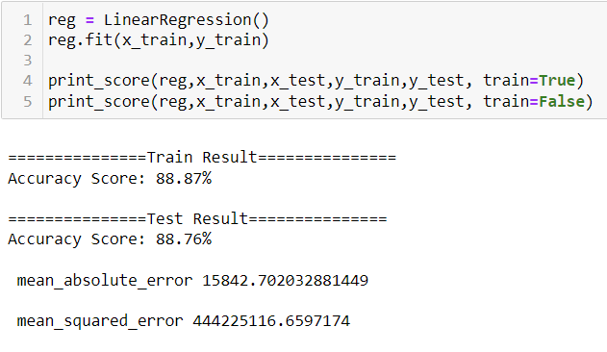
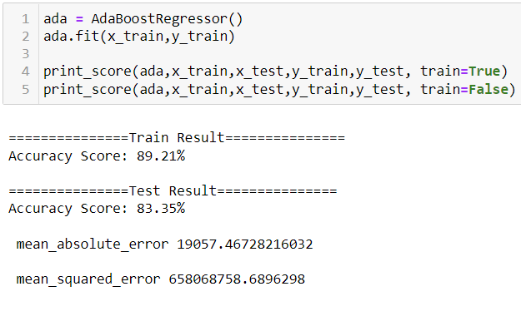
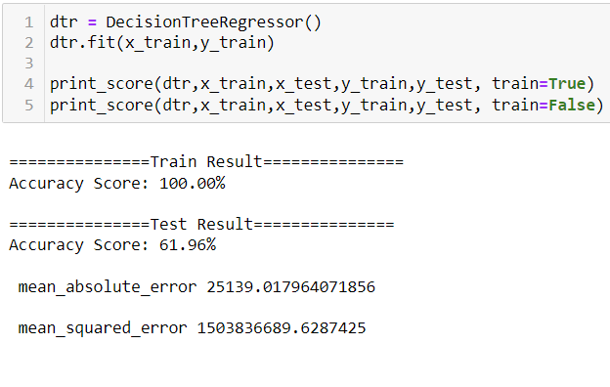
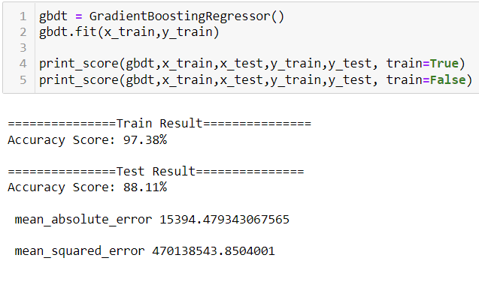
Model Dashboard
1. LinearRegression: -
2. DecisionTreeRegressor: -
3. AdaBoostRegressor: -
4. GradientBoostingRegressor: -

Slide 12
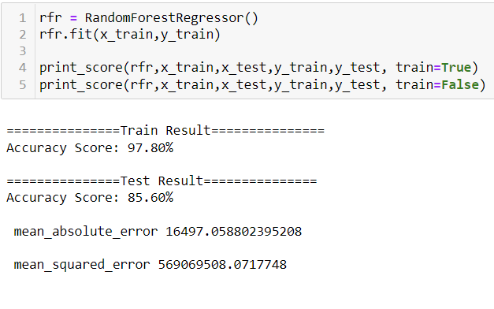
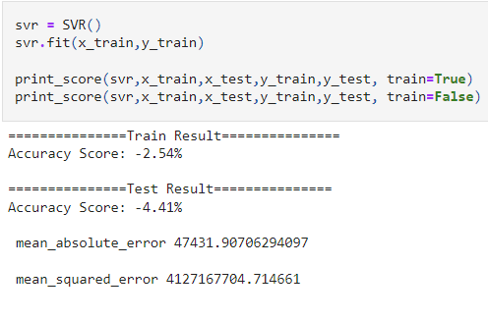
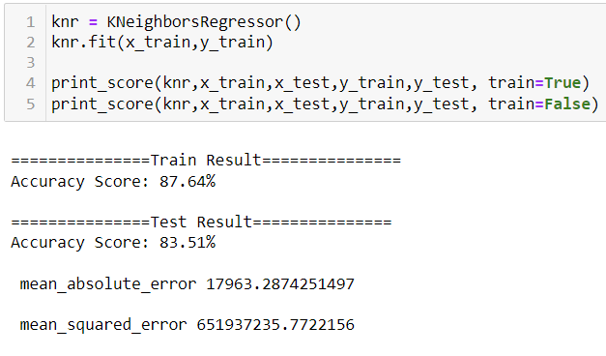
Model Dashboard
5. RandomForestRegressor: -
6. KNeighborsRegressor: -
7. Support Vector Regression: -

Slide 13
Finalized Model
Key Findings and Conclusions of the Model
Selecting LinearRegression model since the Accuracy score i.e., 88.87% and test scores i.e., 88.76 % are greater and close to each other.
mean_absolute_error is also low for LinearRegression model.
LinearRegression model is not overfitted since r2_score of LassoCV and RidgeCV is same and close to test score i.e., 88.76%.

Slide 14
Conclusion
Interpretation of the Results
Below is the list of highly influencing features or variables to predict the sales price of the house.
1. OverallQual = It is very important that the house should be built with good quality materials and this column rates the overall material and finish of the house.
2. YearBuilt = It is important that the construction should be new as it increases to life of the house and this column shows the original year of construction.
3. YearRemodAdd = It is important that if the construction is old then it should be remodel to increase its lifespan and this column shows the remodel date.
4. ExterQual = It is important to use good quality material for exterior of the house and this column evaluates the quality of the material on the exterior.
5. BsmtQual = The price of the house is also depending upon the height of the basement and this column shows the height of the basement.
6. TotalBsmtSF = The price of the house is also depending upon total square feet of basement area and this column shows the basement area.
7. 1stFlrSF = If the house has 1 floor, then the price of the house increases and this column shows the first-Floor square feet.
8. GrLivArea = More the above grade (ground) living area square feet more will be the price of the house and GrLivArea contains the information of living area square feet.
9. FullBath = Number of full bathrooms affects the price of the house and this column shows the number of full bathrooms.
10. KitchenQual = Quality of kitchen is very important. A top-rated kitchen quality can increase the price of the house and this column shows the Quality of kitchen.
11. TotRmsAbvGrd = high number of rooms will lead to high prices and this column gives the count of total rooms.
12. GarageFinish = People want their garages to be fully finished and this result in high price of the house. This column shows the condition of the garage.
13. GarageCars = It is important to know how much cars a house owner can park in his garage and this column gives that count.
14. GarageArea = Large area of garage results in increasing of house price and this column provides information about garage area in feet.

Slide 15
Conclusion
Learning Outcomes of the Study in respect of Data Science
Data Cleaning helps to convert unorganized and unstructured data into structured data which will be used to make findings.
Data visualization helps understand and analyse the data.
Model building helps to predict outcomes, in this case LinearRegression model fits perfect for this dataset.
While doing pre-processing the high VIF problem arises as many highly co-related features have high VIF score.

