Slide 1
LarryAgyeiMG226FinalProject
File created on: 12/11/23 5:59:18 PM EST

Slide 2
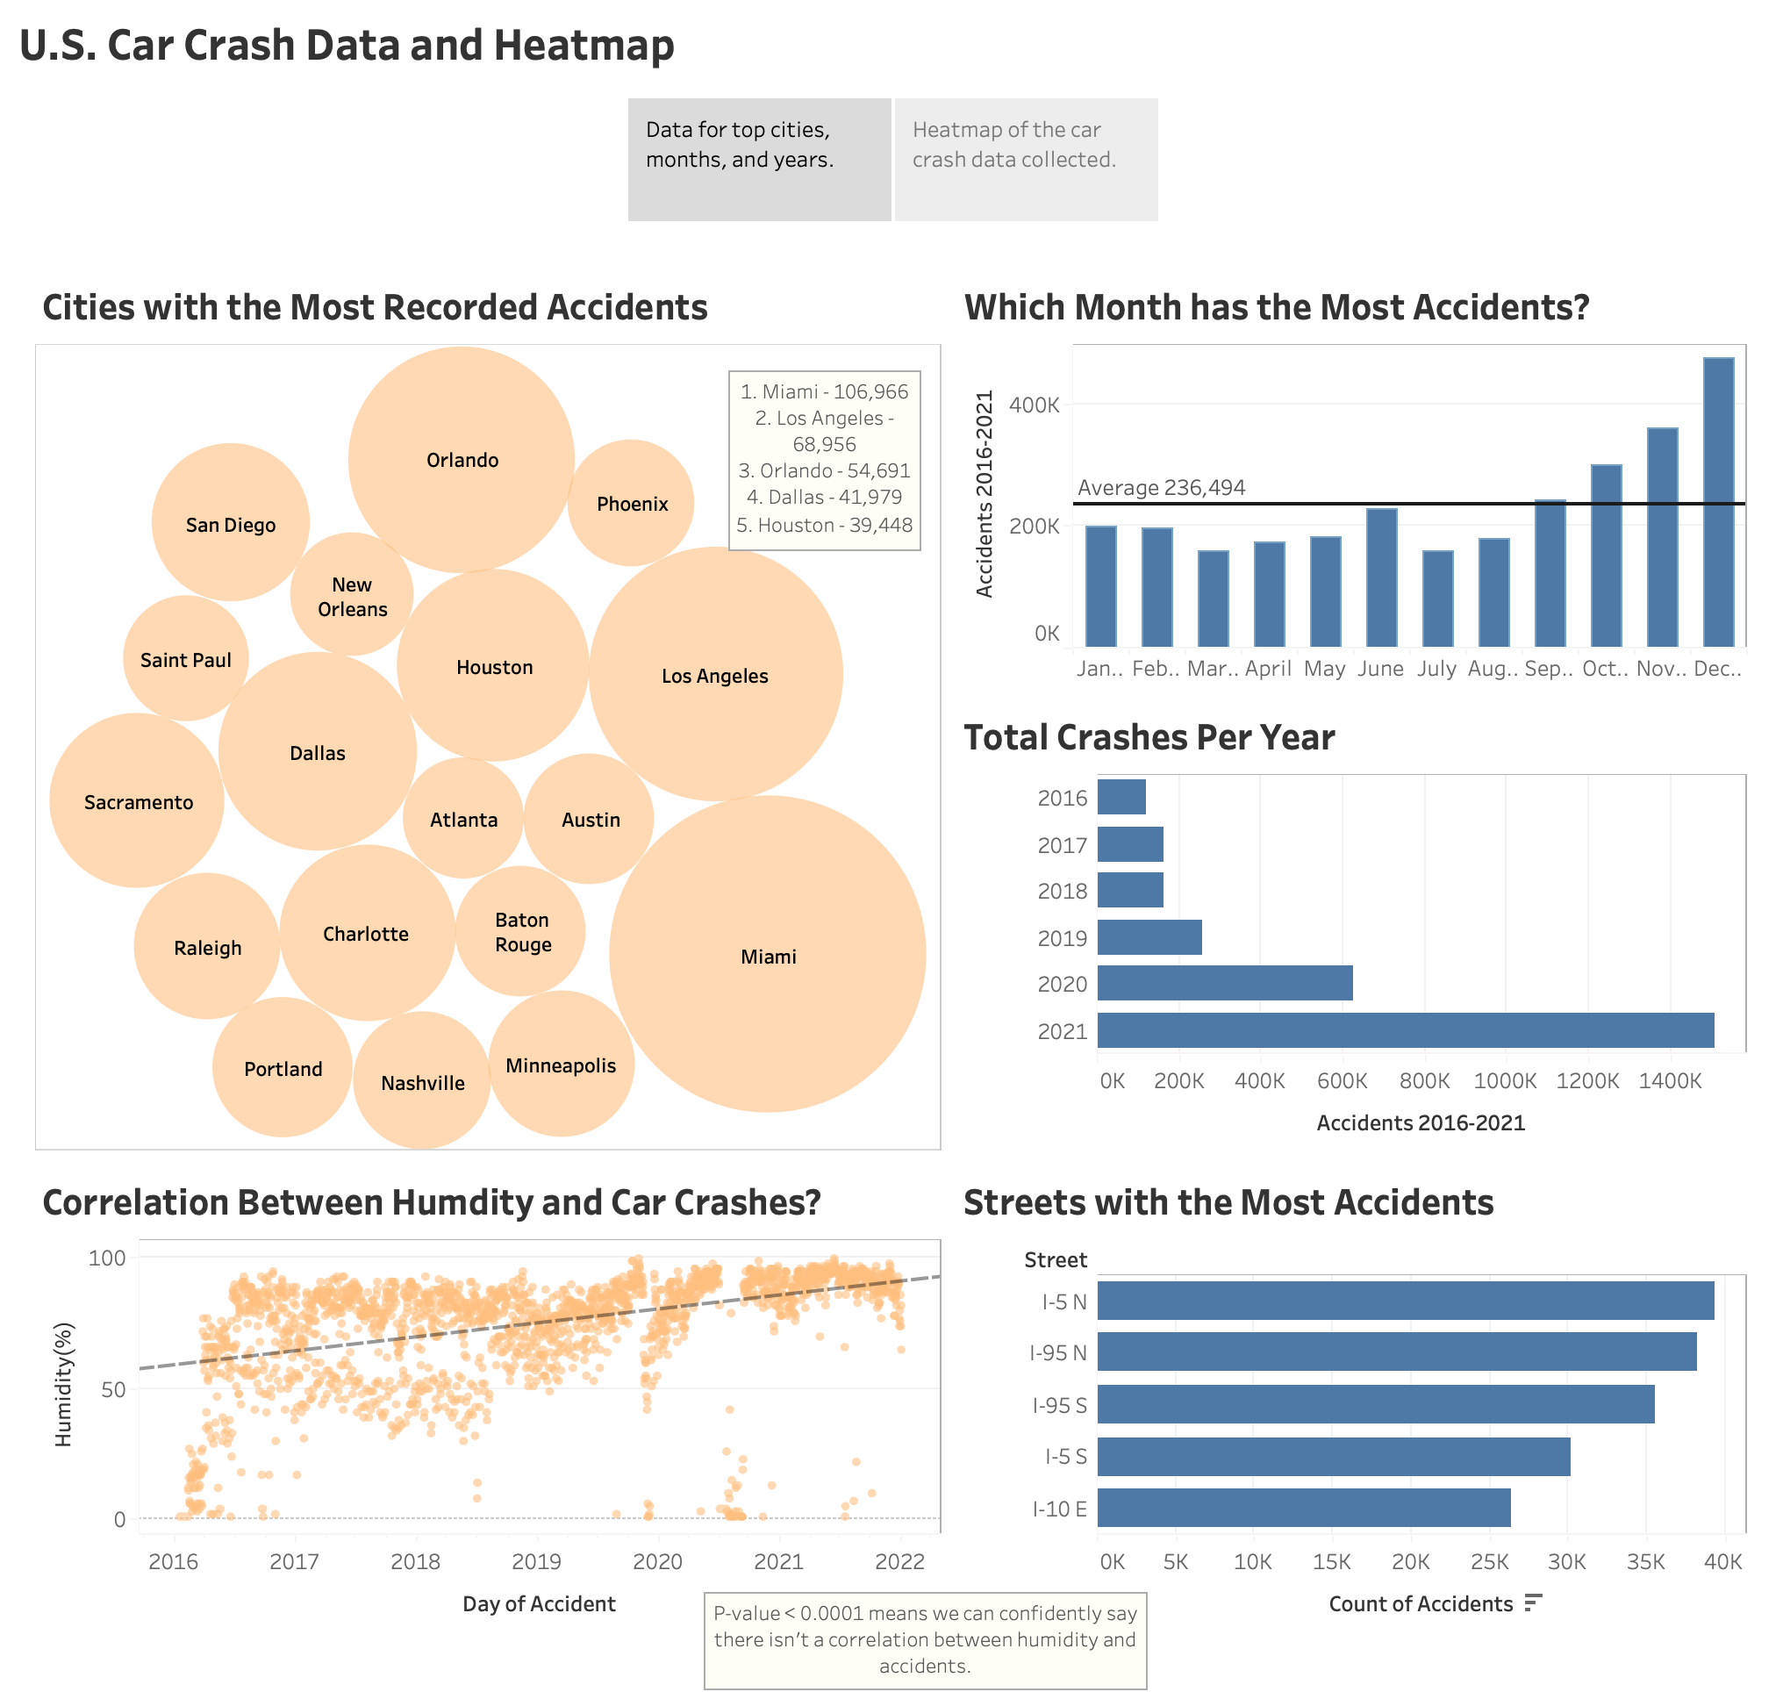

Slide 3
