Slide 1
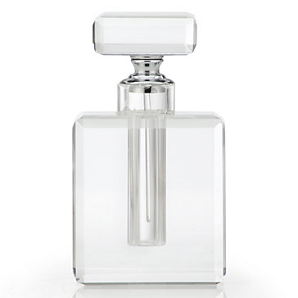

by Larry Kraus

Slide 2
Overview
Sass = “Syntactically Awesome Style Sheets”
A CSS extension which adds capability and conciseness
Dries out your CSS
Adds modularity
Best use: projects/sites with large CSS files

Slide 3
How to Use Sass
Install it (command line:)
gem install sass
sass –v should return “Sass 3.4.22 (Selective Steve)”
Tell Sass which folder to watch
sass --watch app/sass-directory
This will take your preprocessed Sass file and convert it to CSS

Slide 4
Features Outline
Dries out your CSS
Variables
Nesting
Mixins
Extend/Inheritance
Adds Modularity
Partials
Import

Slide 5
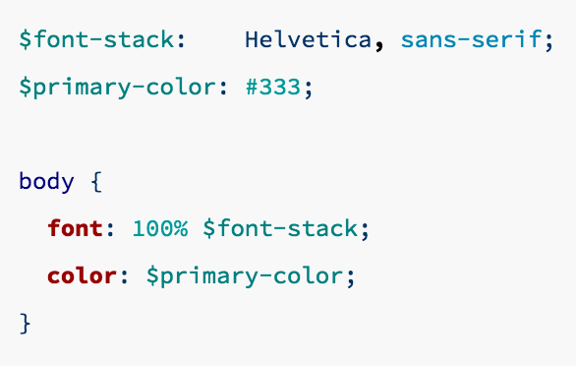
Keep it DRY - Variables
Utilize variables to save space + brain power
Ex. GAred (color) or GAfont

Slide 6
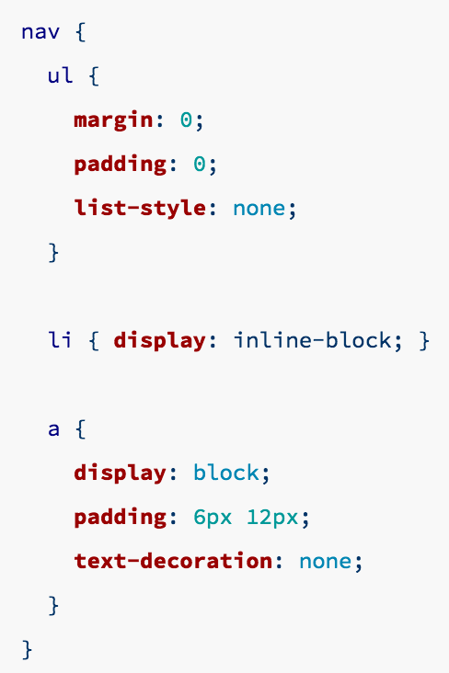
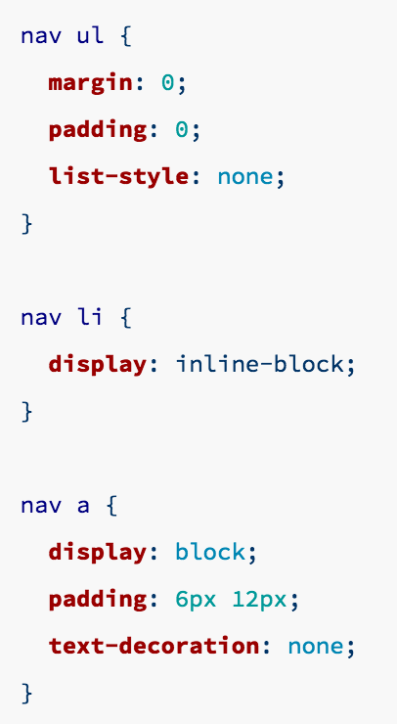
Keep it DRY - Nesting
Nesting makes your parent/child element relationships more clear, visually

Slide 7
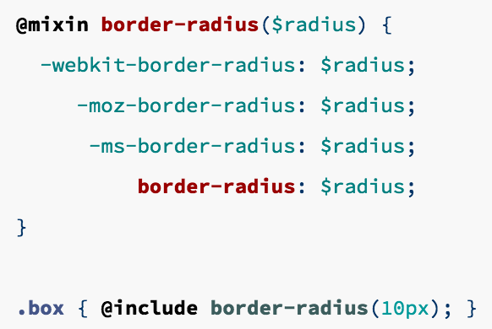
Keep it DRY - Mixins
Similar to variables, mixins help save space
Great for vendor prefixes

Slide 8
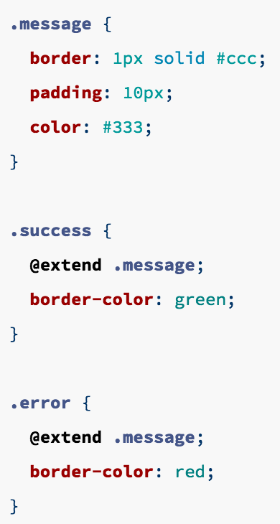
Keep it DRY – Extend (Inheritance)
Great feature which really helps to dry out your code

Slide 9
Modularity - Partials
Envision the CSS for an enterprise level site, there may be 10,000+ lines of code
Allows you to break up one gigantic file into multiple (ex. header, footer, navbar, landing page, about page etc.)
Keeps everything more organized
Easier when working with other devs
Uses import function, but less bloated
Ex. _partial.scss

Slide 10
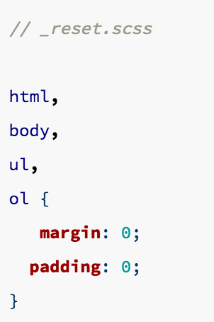
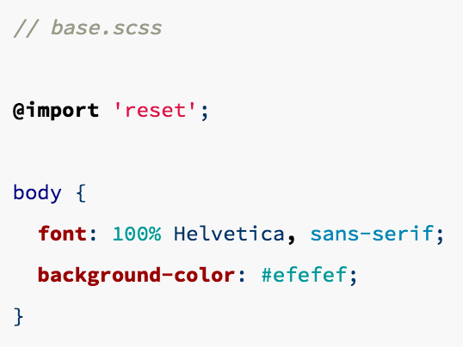
Modularity - Import
This function brings in partials to a Scss file – less helpful than partials

Slide 11
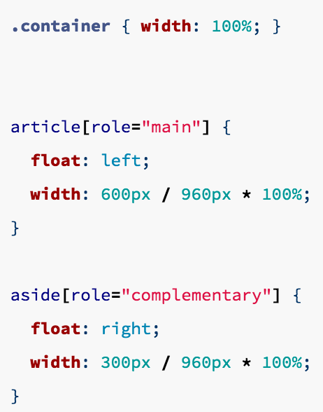
Bonus Feature – Operators
REALLY hate doing math stuff? (like Zeb)
This could be helpful to show your work when you may need to make changes later

Slide 12
Time to See that sass in action…

