Slide 1
Practicum 1
Msc. Data Science: Regis University
By
Olanrewaju Salami

Slide 2
Introduction
This project is designed to perform analysis on real life oil and gas production data using R and Spotfire.
In other to increase or improve oil and gas production volume, the completion/Reservoir engineers perform what is known as completion trials. The completion trial is carried out by either increasing the amount of proppant (sand) pumped or the number of perforation stages during fracking. When the proppant or stages is increased based on well or production zone, the production output is monitored and a positive result of increasing this parameters will be the new standard for the production zone.

Slide 3
Project Objective
Identify Highest Oil producing zone
Determine Trend in Production over time
III
Rank Well by Production output and perform K Clustering
II
I
IV
Predict number of wells requiring Stage Increase

Slide 4
Overview of Data Set
The dataset used in this project is a public dataset from IHS.
IHS is an oil and gas data repository for oil and gas company producing in the United State.
This dataset is for an organization known as HESS, and data used is a production data from 1959 to 2017.
The data contain 47, 800 observations and 53 variables.
Data was reduced to eight variable for Predictive Analysis.

Slide 5
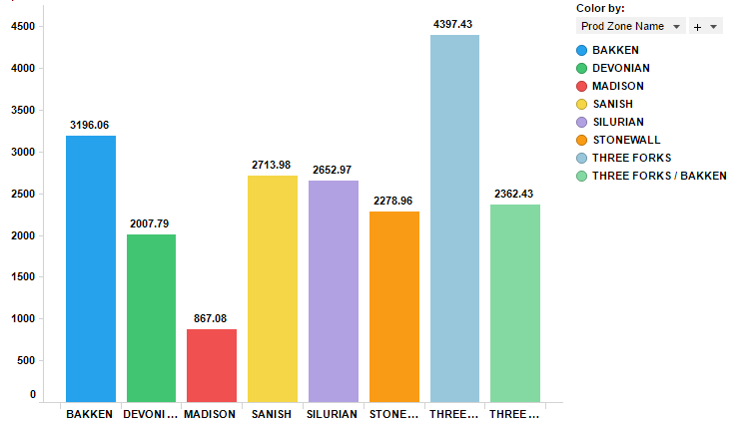
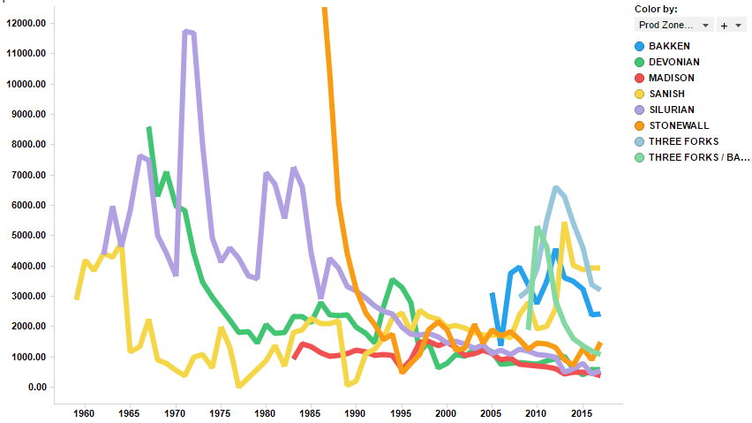
Identify Highest Oil Prod zone and Trends
Bar Chart of Liquid Vs Prod Zone
Production Volume by Year
Avg(Liquid)
Avg(Liquid)
Prod Zone
Year

Slide 6
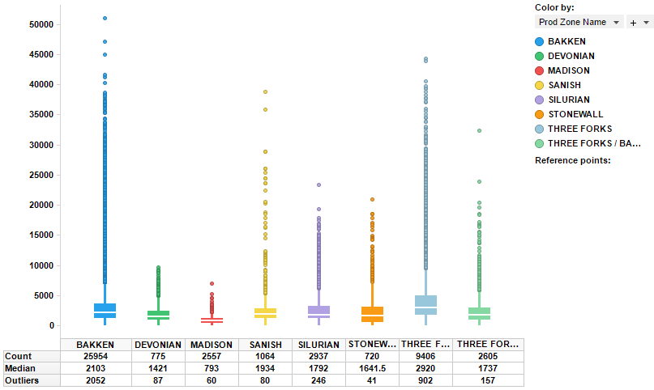
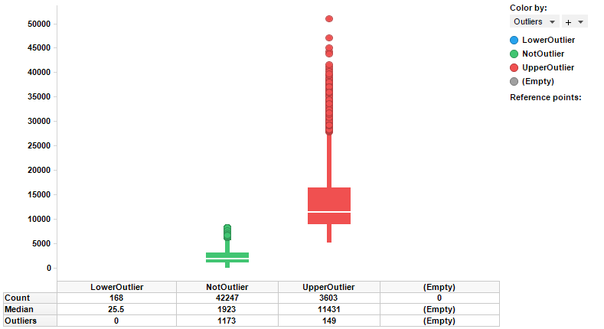
Detecting Outliers
Box Plot of Liquid Vs Prod Zone
Detecting outliers
Avg(Liquid)
Liquid
Prod Zone
Outliers
Notes:
The left plot shows the production volume by production zone and identify the median and outliers.
The right plot shows the production volume by the number of available outliers based on upper, lower or no outliers.

Slide 7
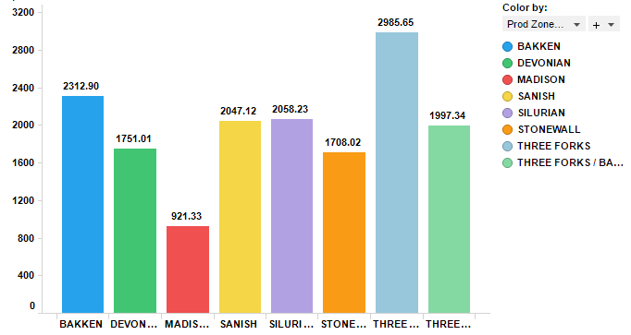
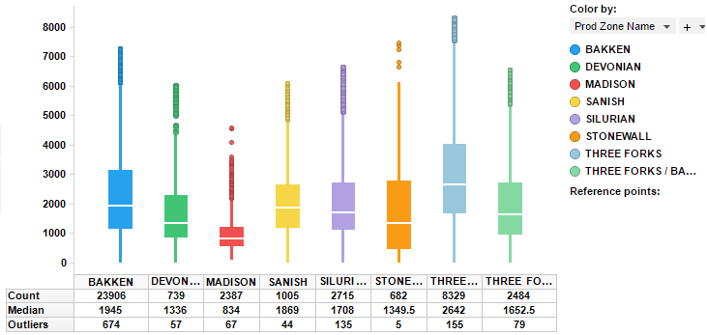
Outlier Treatments
Univariate approach For a given continuous variable, outliers are those observations that lie outside 1.5 * IQR, where IQR, the ‘Inter Quartile Range’ is the difference between 75th and 25th quartiles.
Bar Chart of Liquid Vs Prod Zone
Box Plot of Liquid Vs Prod Zone
Avg(Liquid)
Avg(Liquid)
Prod Zone
Prod Zone
Notes:
Why outliers treatment is important?
Because, it can drastically bias/change the fit estimates and predictions. Outliers in data can distort predictions and affect the accuracy, if you don’t detect and handle them appropriately especially in regression models.
Univariate approach For a given continuous variable, outliers are those observations that lie outside 1.5 * IQR, where IQR, the ‘Inter Quartile Range’ is the difference between 75th and 25th quartiles. Look at the points outside the whiskers in below box plot.

Slide 8
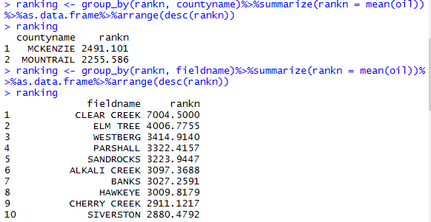
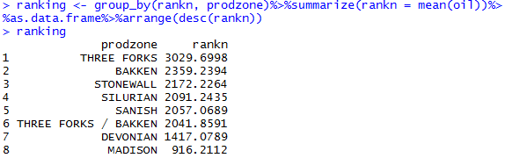
Ranking
We Rank the dataset based on county name, field name and production zone

Slide 9
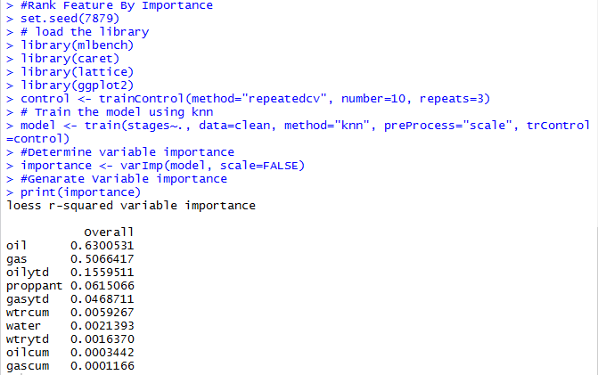
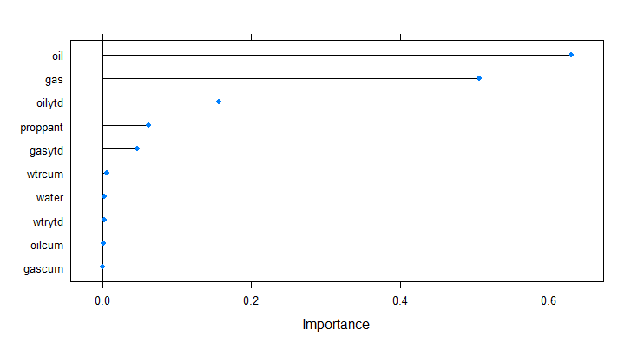
Rank Feature By Importance
How important each variables are to the predictor variable.

Slide 10
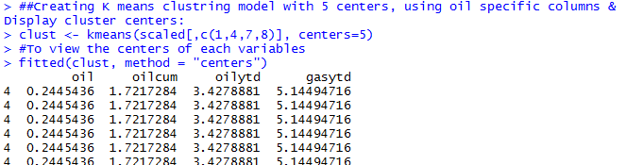
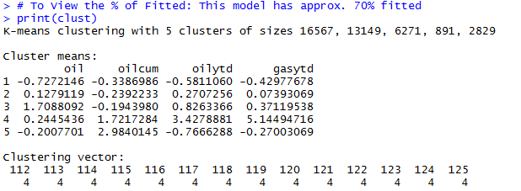
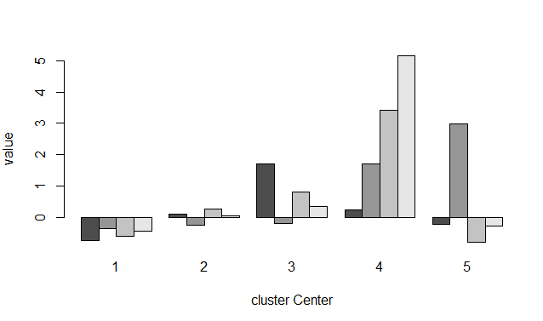
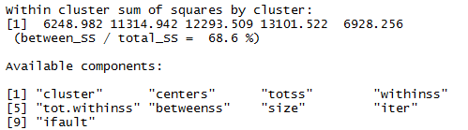
K Means Clustering
Viewing the 5 Clusters; # To View the % of Fitted: This model has approx. 70% fitted
Notes:
k-means clustering aims to partition n observations into k clusters in which each observation belongs to the cluster with the nearest mean, serving as a prototype of the cluster. This results in a partitioning of the data space into Voronoi cells.

Slide 11
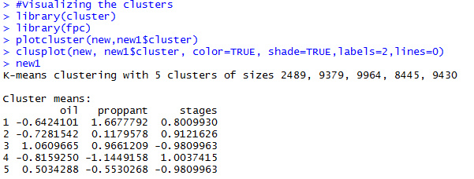

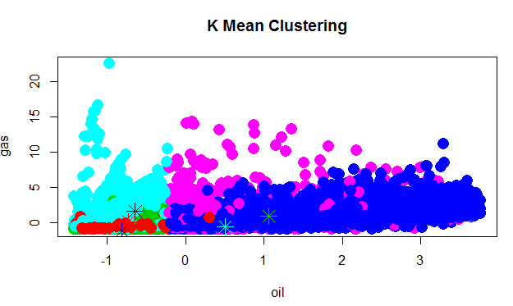

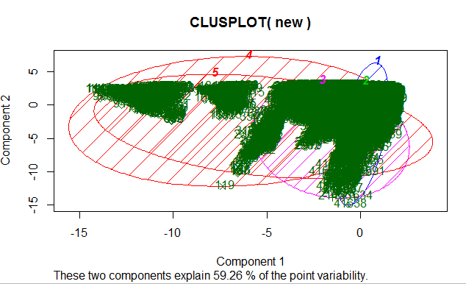
K Means Clustering
Clustering of oil, proppant & stages and their centers
Notes:
K-means works by separating the training data into k clusters. It calculates the centre point (mean) of each cluster, giving k means. New datapoints are clustered based on their distance to all the cluster centres: the nearest cluster is considered the most similar and best fit.

Slide 12
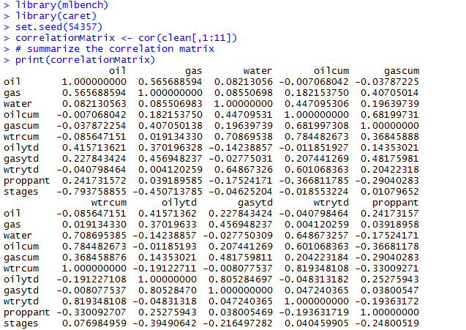
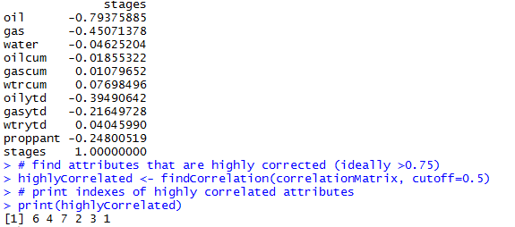
Correlation
We also perform correlation with the dataset and we can see that there is correlation between oil and gas and other parameters
We see correlation between all the variable available for our dataset. Below is also the highly correlated column within the dataset

Slide 13
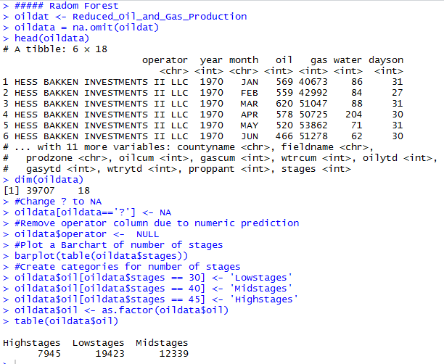
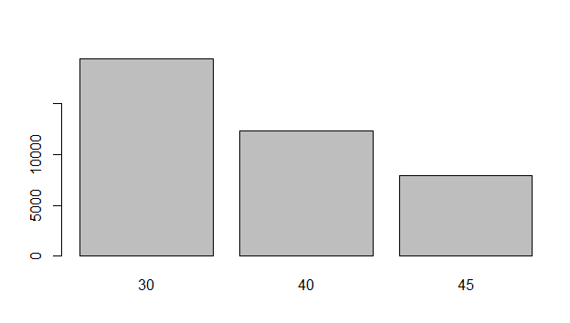
Create Model with Random Forest
Prepare the dataset
BarChart of number of stages
This classifies the number of stages into High, Mid and Low

Slide 14
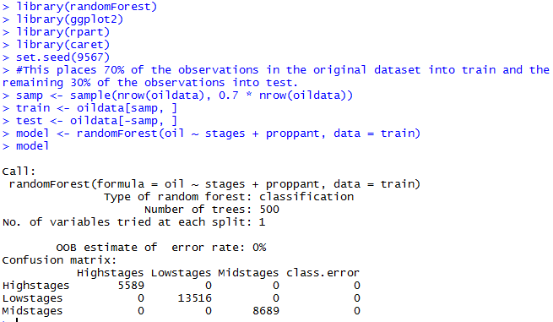
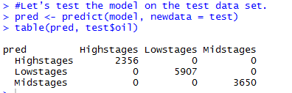


Create Model with Random Forest
Apply Random Forest function to model
Applying the model on the test dataset
Here, we achieved 100% accuracy
Here we can see that the prediction with RF is different from the actual number. #We see 500 trees built, and the model randomly sampled 1 predictor at each split. It also shows a matrix containing prediction vs actual, as well as classification error for each class.

Slide 15
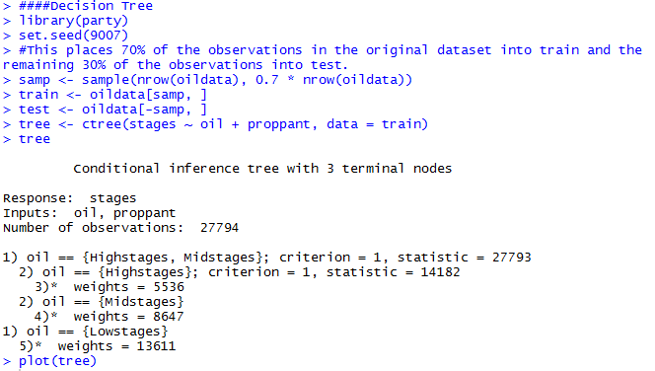
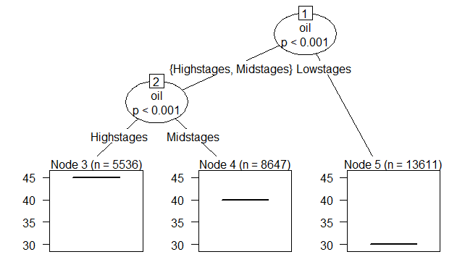
Create Model with Decision Tree
Comparing the result of Tree with RF, we can see that the model predict almost the same value for high, mid and low stages

Slide 16
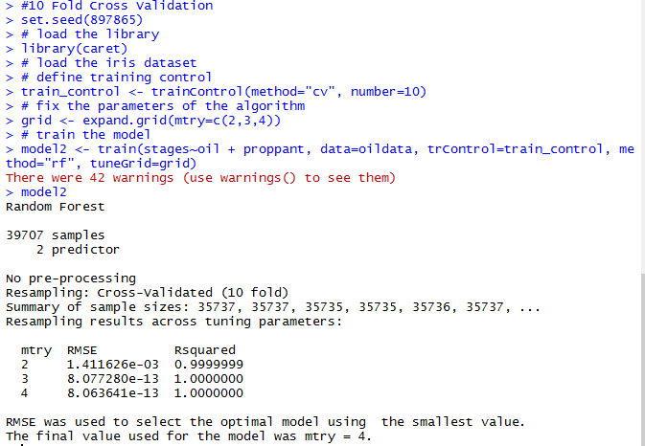
Cross Validation
R-squared has the useful property that its scale is intuitive: it ranges from zero to one, with zero indicating that the proposed model does not improve prediction over the mean model and one indicating perfect prediction. Improvement in the regression model results in proportional increases in R-squared.
Here, we see that R Squared is 100% for all mtry, which indicate that our model improve the prediction over the mean model.
Notes:
R-squared has the useful property that its scale is intuitive: it ranges from zero to one, with zero indicating that the proposed model does not improve prediction over the mean model and one indicating perfect prediction. Improvement in the regression model results in proportional increases in R-squared.
RMSE is usually affected by outlier as it calculate the square of the standard deviation based on the Y axis.

Slide 17
Summary/Conclusion
This project analysis the impact of precative analysis in determine the number of wells that requires certain number of perforation stages based on the volume of proppant and available oil. As we can see, the number of stages that account for high, mid and low were completely different after applying Random forest and Decision Tree as our classifier to the model.
Further analysis could be performed on this project by predicting the number of stages by production zone and on well to well bases. This will allow us to determine the specific amount of stages require per well, and with this understanding, we can prevent spending millions of dollars in carrying out completion trials without result.

