Slide 1
Week 8

Slide 2
Sit-In Lab 2

Slide 3
Sit-In Lab Procedures
Sit according to the seating plan outside the lab
3 questions, 1 hour 40 minutes
When you enter
Do not touch the computer or login to your own accounts.
Listen to instructions by your TAs
No coding during the first 15 minutes
Read problems, ask questions and design algorithm
TA will distribute temporary unix accounts
Display NUS matriculation card for verification
NO LEAVING EARLY
If you finish, you may do your own work
Do NOT talk to anyone else or disturb others

Slide 4
Sit-In Lab Procedures
Code directly on the Unix accounts given
Templates and test cases provided in the account
Only modify the template given, do NOT create additional files
Run check script using command bash check.sh <ClassName>
For example, bash check.sh Boxes
You can directly open any test cases you get wrong to debug
Submission will be done automatically after the lab
Can refer to any hardcopy material
Can refer to Java API on the desktop of the PC
Return the question paper, instruction and account slip at the end of the lab
You are NOT allowed to bring back any of these documents
All documents will be counted before anyone is allowed to leave

Slide 5
Non-Linear Data Structures

Slide 6
Java API PriorityQueue
PriorityQueue<Integer> pq= new PriorityQueue<>();
https://docs.oracle.com/javase/8/docs/api/java/util/PriorityQueue.html
Methods | Description | Speed
isEmpty() size() | Self-explanatory. | O(1)
add(x) offer(x) | Adds an element to the PQ. | O(log N)
peek() | Returns the minimum element. | O(1)
poll() | Returns and removes the minimum element. | O(log N)

Slide 7
Given a PriorityQueue of N elements, what is the worst-case time complexity of removing an arbitrary element?
(i.e. not necessarily the smallest element)
O(1)
O(log N)
O(N)
O(N²)
PriorityQueue<String> nameHeap =
new PriorityQueue<>();
nameHeap.add("Jonathan");
nameHeap.add("Alex");
nameHeap.add("Death");
nameHeap.add("Generic");
// ...
nameHeap.remove("Jonathan");

Slide 8
Given a PriorityQueue of N elements, what is the worst-case time complexity of removing an arbitrary element?
(i.e. not necessarily the smallest element)
O(1)
O(log N)
O(N)
O(N²)
PriorityQueue<String> nameHeap =
new PriorityQueue<>();
nameHeap.add("Jonathan");
nameHeap.add("Alex");
nameHeap.add("Death");
nameHeap.add("Generic");
// ...
nameHeap.remove("Jonathan");

Slide 9
Brief Explanation
I'm looking for "8".
Do I go to the left subtree or the right?
The first step to removing a value is finding it within the heap.
If the value you're looking for is larger than the current node you're looking at, you have to search through both the left and right subtrees.
The value you're looking for could be in either subtree!
You can't narrow it down to one side!
In the worst case, you'll have to look through the entire Heap.
1
5
2
7
6
9
8

Slide 10
Java API PriorityQueue
PriorityQueue<Integer> pq
= new PriorityQueue<>(N, Collections.reverseOrder());
Collections.reverseOrder() is a comparator that will reverse the natural ordering.
The priority queue will be sorted from largest to smallest now.
(a, b) -> {
return -a.compareTo(b); //Negated
}

Slide 11
PriorityQueue Usage (Java classes)
// Ascending order. Smallest integer at the top of the heap.
PriorityQueue<Integer> minHeap = new PriorityQueue<>();
// Descending order. Largest integer at the top of the heap.
PriorityQueue<Integer> maxHeap = new PriorityQueue<>(Collections.reverseOrder());

Slide 12
PriorityQueue Usage – Suppose we have the following class:
class Person implements Comparable<Person> {
String name;
int score;
public Person(String name, int score) {
this.name = name;
this.score = score;
}
@Override
public int compareTo(Person other) {
// Sort by ascending score.
// We can also use "return this.score - other.score;"
return Integer.compare(this.score, other.score);
}
}

Slide 13
PriorityQueue Usage – cont’d
// Person with the lowest score at the top of the heap.
PriorityQueue<Person> minHeap = new PriorityQueue<>();
minHeap.add(new Person("Alice", 69));
minHeap.add(new Person("Bob", 65));
minHeap.add(new Person("Connor", 99));
minHeap.peek(); // Returns ["Bob", 65]
minHeap.poll(); // Removes ["Bob", 65]
minHeap.poll(); // Removes ["Alice", 69]

Slide 14
What if compareTo() is written as follows?
What kind of a heap is pq?
pq is a min-heap. The student with the lowest score is on the top of the heap.
pq is a max-heap. The student with the highest score is on the top of the heap.
class Person implements Comparable<Person> {
// The rest of the "Person" class here.
@Override
public int compareTo(Person other) {
// Alternatively, "return other.score - this.score;"
return Integer.compare(other.score, this.score);
}
}
PriorityQueue<Person> pq = new PriorityQueue<>();

Slide 15
What if compareTo() is written as follows?
What kind of a heap is pq?
pq is a min-heap. The student with the lowest score is on the top of the heap.
pq is a max-heap. The student with the highest score is on the top of the heap.
class Person implements Comparable<Person> {
// The rest of the "Person" class here.
@Override
public int compareTo(Person other) {
// Alternatively, "return other.score - this.score;"
return Integer.compare(other.score, this.score);
}
}
PriorityQueue<Person> pq = new PriorityQueue<>();

Slide 16
PriorityQueue Usage (with Lambdas)
class Person {
String name;
int score;
public Person(String name, int score) {
this.name = name;
this.score = score;
}
}
// Ascending order of scores. Person with lowest score at the top of the heap.
PriorityQueue<Person> minHeap = new PriorityQueue<>((p1, p2) -> p1.score - p2.score);
// Descending order of scores. Person with highest score at the top of the heap.
PriorityQueue<Person> minHeap = new PriorityQueue<>((p1, p2) -> p2.score - p1.score);

Slide 17
PriorityQueue Usage (with Lambdas) cont’d
class Person {
String name;
int score;
public Person(String name, int score) {
this.name = name;
this.score = score;
}
}
// Ascending lexicographical order of names.
// Person with lexicographically smallest name at the top of the heap.
PriorityQueue<Person> minHeap = new PriorityQueue<>((p1, p2) -> p1.name.compareTo(p2.name));
// Descending lexicographical order of names.
// Person with lexicographically largest name at the top of the heap.
PriorityQueue<Person> minHeap = new PriorityQueue<>((p1, p2) -> p2.name.compareTo(p1.name));

Slide 18
Java API HashMap
HashMap<String, Integer> m = new HashMap<>();
https://docs.oracle.com/javase/8/docs/api/java/util/HashMap.html
Methods | Description | Speed
put(k, v) | Adds a key value pair k -> v to the HashMap. If a pair with key k already exists in the HashMap, its value would be replaced with v. | O(1)*
get(k) | Retrieves the value associated with key k. null if the key value pair does not exist. | O(1)*
containsKey(k) | Returns true/false depending whether the key k is in the HashMap. | O(1)*
remove(k) | Removes the mapping for key k. | O(1)*

Slide 19
Java API HashMap
Methods | Description | Speed
containsValue(v) | Returns true/false depending whether the value v is in the HashMap. | O(N)
clear() | Clears the HashMap. | O(N)
entrySet() | Returns a set of key value pairs. Set<Map.Entry<K, V>> Changes are reflected in the map. | O(1)
keySet() | Returns a set of keys. Set<K> Changes are reflected in the map. | O(1)
values() | Returns a collection of values. Collection<V> Changes are reflected in the map. | O(1)
size() isEmpty() | Self explanatory | O(1)

Slide 20
Java API HashSet/HashMap Internals
Hash table implementation requires a hash function.
How does HashSet/HashMap hash the keys?
Every Object has a hashCode function.
Overwritten for Integer, String, Double, etc...
There’s Arrays.hashCode to hash array of primitives or Objects
https://docs.oracle.com/javase/7/docs/api/java/util/Arrays.html#hashCode(boolean[])
Suggested reading:
http://www.baeldung.com/java-hashcode
An example will appear later when discussing Take-home Lab 2.

Slide 21
Java HashMap Usage
HashMap<String, Integer> stringMap = new HashMap<>();
stringMap.put("Hello", 6);
stringMap.put("Guten Tag", 9);
stringMap.put("Konnichiwa", 21);
// Iterate through the entries in the HashMap. for (Map.Entry<String, Integer> entry : stringMap.entrySet()) {
System.out.print("Key=" + entry.getKey());
System.out.println(", Value=" + entry.getValue());
}
Key | Value
Hello | 6
Guten Tag | 9
Konnichiwa | 21

Slide 22
Java HashMap Usage
HashMap<String, Integer> stringMap = new HashMap<>();
stringMap.put("Hello", 6);
stringMap.put("Guten Tag", 9);
stringMap.put("Konnichiwa", 21);
// Iterate through the keys in the HashMap. for (String key : stringMap.keySet()) {
System.out.println("Key=" + key);
}
Key | Value
Hello | 6
Guten Tag | 9
Konnichiwa | 21

Slide 23
Java HashMap Usage
HashMap<String, Integer> stringMap = new HashMap<>();
stringMap.put("Hello", 6);
stringMap.put("Guten Tag", 9);
stringMap.put("Konnichiwa", 21);
// Check if "Hello" is a key in the HashMap.
if (stringMap.containsKey("Hello")) {
// ...
}
Key | Value
Hello | 6
Guten Tag | 9
Konnichiwa | 21

Slide 24
Java HashMap Usage
HashMap<String, Integer> stringMap = new HashMap<>();
stringMap.put("Hello", 6);
stringMap.put("Guten Tag", 9);
stringMap.put("Konnichiwa", 21);
// Update the value of entry with key="Hello" to 20.
stringMap.put("Hello", 20);
Key | Value
Hello | 20
Guten Tag | 9
Konnichiwa | 21

Slide 25
HashSet
If we have no need to associate a key with a value, we can use a HashSet instead.
HashSet<String> stringSet = new HashSet<>();
stringSet.put("Hello");
stringSet.put("Guten Tag");
stringSet.put("Konnichiwa");
// Check if "Hello" is a key in the HashSet.
if (stringSet.contains("Hello")) {
// ...
}
Key
Hello
Guten Tag
Konnichiwa

Slide 26
Introducing Java TreeSet & TreeMap
Both have the same underlying Data Structure: Balanced BST
The actual type of BBST used is a Red-Black Tree
(but you don't need to remember that)
TreeSet is implemented with TreeMap.
Feel free to explore all other important methods of these two Java APIs that implement balanced BSTs.
You may use this for your other programs in the (near) future

Slide 27
Java API TreeMap
TreeMap<String, Integer> m = new TreeMap<>();
https://docs.oracle.com/javase/8/docs/api/java/util/TreeMap.html
Methods | Description | Speed
put(k, v) | Adds a key value pair k -> v to the TreeMap. If a pair with key k already exists in the TreeMap, its value would be replaced with v. | O(log N)
get(k) | Retrieves the value associated with key k. null if the key value pair does not exist. | O(log N)
containsKey(k) | Returns true/false depending whether the key k is in the TreeMap. | O(log N)

Slide 28
Java API TreeMap
Methods | Description | Speed
containsValue(v) | Returns true/false depending whether the value v is in the TreeMap. | O(N)
remove(k) | Removes k if it exists the TreeMap. | O(log N)
entrySet() | Returns a set of key value pairs. Set<Map.Entry<K, V>> Changes are reflected in the map. | O(1)
keySet() | Returns a set of keys. Set<K> Changes are reflected in the map. | O(1)
replace(k, v) replace(k, vOld, vNew) | Replace value of k, only if it exists. Replace value of k, only if it is currently mapped to vOld. | O(log N)
size() isEmpty() | Self explanatory | O(1)
Notes:
Not O(N log N) – it takes O(N) to loop through the entire map

Slide 29
Java API TreeMap
Methods | Description | Speed
ceilingKey(k) | Returns smallest key k_{i} ≥ k | O(log N)
higherKey(k) | Returns smallest key k_{i} > k | O(log N)
floorKey(k) | Returns largest key k_{i} ≤ k | O(log N)
lowerKey(k) | Returns largest key k_{i} < k | O(log N)
firstKey() | Returns smallest key k_{i} | O(log N)
lastKey() | Returns largest key k_{i} | O(log N)
higherKey is successor operation
lowerKey is pre-decessor operation
All these methods return null if there is no such key!
Notes:
Not O(N log N) – it takes O(N) to loop through the entire map

Slide 30
Java API TreeMap
Methods | Description | Speed
headMap(k) | Returns a view of the map of elements with key ≤ k. Important: calling size() on this view is O(N)! | O(1)
tailMap(k) | Returns a view of the map of elements with key ≥ k. Important: calling size() on this view is O(N)! | O(1)
subMap(from, to) | Returns a view of the map of elements with from ≤ key < to. Important: calling size() on this view is O(N)! | O(1)
You can regard a view as a “window” showing only part of the same Binary Search Tree.
Modifying items through the “window” will also modify the main BST and vice versa.
Notes:
Not O(N log N) – it takes O(N) to loop through the entire map

Slide 31
Java TreeMap Usage
TreeMap<String, Integer> stringMap = new TreeMap<>();
stringMap.put("Hello", 6);
stringMap.put("Guten Tag", 9);
stringMap.put("Konnichiwa", 21);
// Iterate through the entries in the TreeMap in order of
// increasing key. for (Map.Entry<String, Integer> entry : stringMap.entrySet()) {
System.out.print("Key=" + entry.getKey());
System.out.println(", Value=" + entry.getValue());
}
Key | Value
Guten Tag | 9
Hello | 6
Konnichiwa | 21

Slide 32
Java TreeMap Usage
TreeMap<String, Integer> stringMap = new TreeMap<>();
stringMap.put("Hello", 6);
stringMap.put("Guten Tag", 9);
stringMap.put("Konnichiwa", 21);
// Update the value of entry with key="Hello" to 2.
stringMap.put("Hello", 2);
Key | Value
Guten Tag | 9
Hello | 2
Konnichiwa | 21

Slide 33
Java TreeMap Usage (cont’d)
TreeMap<Integer, String> integerMap = new TreeMap<>();
integerMap.add(1, "One");
integerMap.add(2, "Two");
integerMap.add(5, "Five");
// Smallest key >= 1: 1. Returns [1, "One"]
Map.Entry<Integer, String> ceilEntry = integerMap.ceilEntry(1);
// Largest key <= 3: 2. Returns [2, "Two"]
Map.Entry<Integer, String> lowerEntry = integerMap.floorEntry(3);

Slide 34
Take Home Lab 2

Slide 35
Take-Home Lab 2
Released last week on IVLE and Codecrunch
3 questions following the exact same format as Sit-In Lab 2
Recursion
Sorting
Non-Linear Data Structures API
Due 22 March 2019, 2359h

Slide 36
Boxes

Slide 37
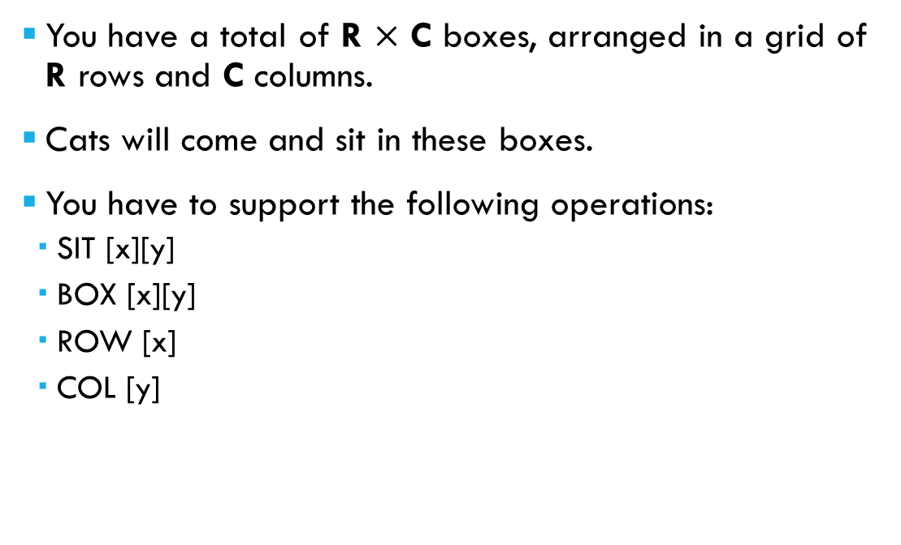
Abridged Problem statement
R=3, C=4
You have a total of R $×$ C boxes, arranged in a grid of R rows and C columns.
Cats will come and sit in these boxes.
You have to support the following operations:
SIT [x][y]
BOX [x][y]
ROW [x]
COL [y]
(0,0) | (0,1) | (0,2) | (0,3)
(1,0) | (1,1) | (1,2) | (1,3)
(2,0) | (2,1) | (2,2) | (2,3)

Slide 38

operation: SIT [x][y]
Records that a cat is now sitting in the box with coordinates ([x], [y]).
You are guaranteed that there was no cat in the box prior to this operation.
E.g.
SIT 1 0
SIT 0 2
(0,0) | (0,1) | (0,2) | (0,3)
(1,0) | (1,1) | (1,2) | (1,3)
(2,0) | (2,1) | (2,2) | (2,3)
(0,2)
(1,0)

Slide 39
operation: BOX [x][y]
Checks if there is a cat sitting in the box with coordinates ([x], [y])
If there is a cat, print "Y". Otherwise, print "N".
E.g.
BOX 1 1 // Print "N"
BOX 0 2 // Print "Y"
(0,0) | (0,1) | (0,2) | (0,3)
(1,0) | (1,1) | (1,2) | (1,3)
(2,0) | (2,1) | (2,2) | (2,3)
(0,2)
(1,0)

Slide 40
operation: row [x]
Checks if there is a cat sitting in any box in row [x].
i.e. Box (x, 0), Box (x, 1), Box (x, 2), ...
If there is a cat, print "Y". Otherwise, print "N".
E.g.
ROW 2 // Print "N"
ROW 0 // Print "Y"
(0,0) | (0,1) | (0,2) | (0,3)
(1,0) | (1,1) | (1,2) | (1,3)
(2,0) | (2,1) | (2,2) | (2,3)
(0,2)
(1,0)

Slide 41
operation: COL [y]
Checks if there is a cat sitting in any box in col [y].
i.e. Box (0, y), Box (1, y), Box (2, y), ...
If there is a cat, print "Y". Otherwise, print "N".
E.g.
COL 2 // Print "Y"
COL 3 // Print "N"
(0,0) | (0,1) | (0,2) | (0,3)
(1,0) | (1,1) | (1,2) | (1,3)
(2,0) | (2,1) | (2,2) | (2,3)
(0,2)
(1,0)

Slide 42
Constraints
Number of operations: 1 ≤ Q ≤ 100,000.
Grid size: 1 ≤ R, C ≤ 10⁹

Slide 43
Start simple
For the most part, this problem is about checking whether or not there are cats in some box(es).
So, the first thing we can try is a Boolean array that represents the entire grid.
boolean[][] boxGrid = new boolean[R][C];

Slide 44
Start simple
For SIT, all we have to do is set the corresponding box to True.
For BOX, all we have to do is check if the corresponding box is True.
// SIT 1 3
boxGrid[1][3] = true;
// BOX 3 3
if (boxGrid[3][3]) {
System.out.println("Y");
} else {
System.out.println("N");
}

Slide 45
Start simple
For ROW, we can simply iterate through the entire row and see if any value is true.
We can do the same thing for COL.
// ROW 5
String output = "N";
for (int col = 0; col < C; ++col) {
if (boxGrid[5][col]) {
output = "Y";
}
}
System.out.println(output);

Slide 46
Start simple
Seems like this passes all the public test cases with ease.
Let's submit it on CodeCrunch!

Slide 47

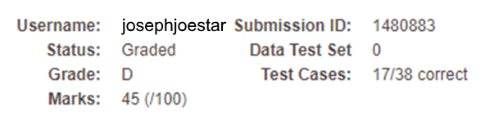


OH NO!

Slide 48

Oh NO!
We're generating a Boolean array of size R $×$ C.
In the worst case, that an array of size 10⁹ $×$ 10⁹.
That's about 1 EXABYTE (1 Billion GB).

Slide 49
Side note
Do note that it takes time to allocate memory.
If you declare an array of size O(N²), that will take O(N²) time.
So even if the rest of your algorithm takes O(N) time, the overall time complexity is O(N²).
So, if you calculate that an algorithm has a higher space complexity than time complexity, you know you're doing something wrong.

Slide 50
Side note
What is the time complexity of this algorithm?
O(1)
O(N)
O(N³)
int foo(int n) {
// Create 3D NxNxN integer array.
int[][][] zaWorld = new int[n][n][n];
// And complete disregard it.
return 0;
}

Slide 51
Side note
What is the time complexity of this algorithm?
O(1)
O(N)
O(N³)
int foo(int n) {
// Create 3D NxNxN integer array.
int[][][] zaWorld = new int[n][n][n];
// And complete disregard it.
return 0;
}
Some smart compilers may optimize this to O(1), but we won't talk about compiler optimizations in CS2040.

Slide 52
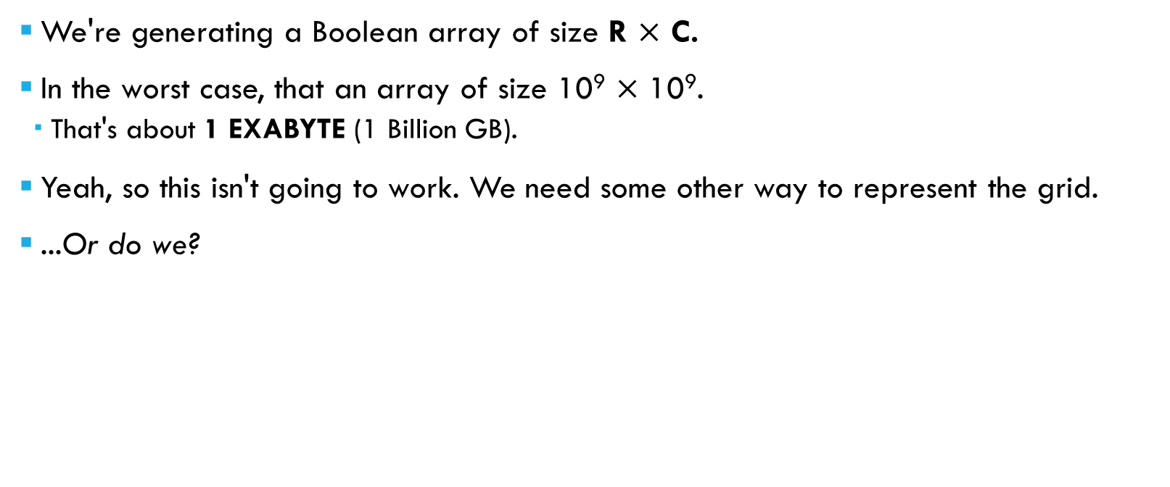
Oh NO!
We're generating a Boolean array of size R $×$ C.
In the worst case, that an array of size 10⁹ $×$ 10⁹.
That's about 1 EXABYTE (1 Billion GB).
Yeah, so this isn't going to work. We need some other way to represent the grid.
...Or do we?

Slide 53
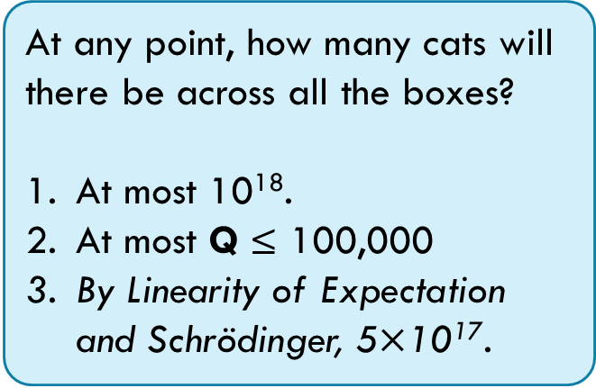
...Do we need the grid?
Suppose we're told that R = 10⁹ and C = 10⁹. (i.e. we have a grid of 10¹⁸ boxes)
At any point, how many cats will there be across all the boxes?
At most 10¹⁸.
At most Q ≤ 100,000
By Linearity of Expectation and Schrödinger, 5$×$10¹⁷.

Slide 54
...Do we need the grid?
Suppose we're told that R = 10⁹ and C = 10⁹. (i.e. we have a grid of 10¹⁸ boxes)
At any point, how many cats will there be across all the boxes?
At most 10¹⁸.
At most Q ≤ 100,000
By Linearity of Expectation and Schrödinger, 5$×$10¹⁷.
Technically, this isn't wrong either →

Slide 55
Store the cats!
class Cat {
int x, y;
public Cat(int x, int y) {
this.x = x;
this.y = y;
}
@Override
public boolean equals(Object o) {
if (!(o instanceof Cat)) {
return false;
}
Cat c = (Cat) o;
return c.x == this.x && c.y == this.y;
}
}
Instead of keeping track of the boxes, we'll just keep track of the cats.
We can use a helper class like this:
Overriding the equals() method helps with simplicity later on.

Slide 56
Algorithm #2
From there, we can store the cats in an ArrayList (or LinkedList).
Now, our operations look like this:
ArrayList<Cat> cats = new ArrayList<>();

Slide 57
Algorithm #2
SIT [x][y] will simply add a new cat to the list of cats.
BOX [x][y] will simply check if the cat exists in the list.
int x = scanner.nextInt();
int y = scanner.nextInt();
cats.add(new Cat(x, y));
int x = scanner.nextInt();
int y = scanner.nextInt();
if (cats.contains(new Cat(x, y))) {
// ...
}

Slide 58
Algorithm #2
ROW [x] can be done by iterating through the cats to see if any cat is sitting in the row we're looking for.
COL [y] is done similarly.
String output = "N";
int x = scanner.nextInt();
for (Cat cat : cats) {
if (cat.x == x) {
output = "Y";
}
}

Slide 59
Algorithm #2
Seems like it works. Let's submit it to CodeCrunch!

Slide 60



OH MY GOD!

Slide 61
Algorithm #2: Time complexity
Let C represent the number of cats currently sitting across all the boxes.
SIT [x][y]
A new Cat will be added to the list of Cats. O(1)
BOX [x][y]
The contains() method in ArrayList iterates through the list of O(C) Cats to see if any Cat in the list equals() the Cat we're looking for.
ROW [x]
Iterate through the list of Cats to see if any are in the [x]-th row. O(C)
COL [y]
Iterate through the list of Cats to see if any are in the [y]-th column. O(C)

Slide 62
Algorithm #2: Time complexity
In the worst case, an operation takes O(C) time.
As discussed previously, there are at most Q cats.
So, the overall time complexity is O(Q²).
Since Q ≤ 100,000, Q² ≤ 10 Billion.
This is too slow; we have to do better.

Slide 63
So, what to do...
For starters, let's look at BOX [x][y].
It takes O(C) time to check for the existence of a Cat inside an ArrayList.
Can we use something else?

Slide 64
Our code for BOX [x][y] looks like this:
Which data structure is the fastest at performing this operation?
ArrayList
LinkedList
HashSet/HashMap/HashTable
TreeSet/TreeMap
PriorityQueue
Aho-Corasick Tree
int x = scanner.nextInt();
int y = scanner.nextInt();
if (cats.contains(new Cat(x, y))) {
// ...
}

Slide 65
Our code for BOX [x][y] looks like this:
Which data structure is the fastest at performing this operation?
ArrayList O(C)
LinkedList O(C)
HashSet/HashMap/HashTable O(1)
TreeSet/TreeMap O(log C)
PriorityQueue O(C)
Aho-Corasick Tree This doesn't even store Cats
int x = scanner.nextInt();
int y = scanner.nextInt();
if (cats.contains(new Cat(x, y))) {
// ...
}
This isn't that bad either
Reminder: C represents the number of cats across all boxes

Slide 66
A Hash table!
If all we need is "existence check", the best data structure is (usually) a Hash Table.
In this case, we only need to check for the existence of a Cat, so a HashSet is sufficient.
There's no need for an associated Value, so we don’t need a HashMap/HashTable.

Slide 67
A Hash table!
class Cat {
int x, y;
public Cat(int x, int y) { ... }
@Override
public boolean equals(Object o) { ... }
@Override
public int hashCode() {
// One of the simplest ways to hash.
// Not perfect, but good enough.
return Objects.hash(x, y);
}
}
Let's modify our Cat helper class.
We need to Hash a Cat based on his row and column
i.e. the x and y value.
Remember that it's important that you have both of these methods overridden when using with a HashSet/Map/Table:
hashCode()
equals(Object)

Slide 68
A Hash table!
We'll now use a HashSet to store the cats.
Now that we're using a HashSet, the BOX operation now runs in O(1) time!
HashSet<Cat> cats = new HashSet<>();
int x = scanner.nextInt();
int y = scanner.nextInt();
if (cats.contains(new Cat(x, y))) {
// ...
}

Slide 69
What about ROW and COL?
We can't use a HashSet<Cat> to see if a Row or Column exists.
There's no way to specify that "I only want to check for the Row and nothing else".
However, both the ROW and COL operations are fairly similar to BOX.
In ROW [x], we're checking if [x] is among the cats' rows.
In COL [y], we're checking if [y] is among the cats' columns.
Can we do something similar?

Slide 70
Have a Hashset of rows!
In BOX, we checked for the existence of a Cat using a HashSet of Cats.
Well, for ROW, let's check for the existence of a row using a HashSet of rows!
All we have to do is update this whenever we're adding a Cat to the CatSet.
i.e. During the SIT operation
We can do the same thing for COL.
HashSet<Integer> rows = new HashSet<>();

Slide 71
SIT 1 0
SIT 1 2
(0,0) | (0,1) | (0,2) | (0,3)
(1,0) | (1,1) | (1,2) | (1,3)
(2,0) | (2,1) | (2,2) | (2,3)
(1,0)
(1,2)
cats:
<1,0>
, <1,2>
rows:
1
cols:
0
, 2

Slide 72
Have a Hashset of rows!
The updated SIT operation now looks like this:
The ROW operation can look like this:
int x = scanner.nextInt();
int y = scanner.nextInt();
cats.add(new Cat(x, y));
rows.add(x);
cols.add(y);
int x = scanner.nextInt();
if (rows.contains(x)) {
// ...
}

Slide 73
Algorithm #3
SIT [x][y]
Insert the Cat <[x], [y]> into the HashSet of Cats.
Insert [x] into the HashSet of rows.
Insert [y] into the HashSet of columns.
BOX [x][y]
Check if the Cat <x, y> exists in the HashSet of Cats.
ROW [x]
Check if x exists in the HashSet of rows.
COL [y]
Check if y exists in the HashSet of columns.

Slide 74
Algorithm #3: Time complexity
SIT [x][y]
Insert the Cat <[x], [y]> into the HashSet of Cats. O(1)
Insert [x] into the HashSet of rows. O(1)
Insert [y] into the HashSet of columns. O(1)
BOX [x][y]
Check if the Cat <x, y> exists in the HashSet of Cats. O(1)
ROW [x]
Check if x exists in the HashSet of rows. O(1)
COL [y]
Check if y exists in the HashSet of columns. O(1)

Slide 75
Algorithm #3: Time complexity
All operations run in (expected) O(1) time.
The overall time complexity is now O(Q).
This should be fast enough.

Slide 76


NIIIICE!

Slide 77
Extension problem
What if we now have an additional operation to support:
What do we need to change (if anything)?
JUMP [x][y]
The cat currently sitting in the box with coordinates ([x],[y]) decides to leave the box and jumps out.
The box with coordinates ([x],[y]) is now empty.

Slide 78
VisualAlgo Quiz 2

Slide 79
VisuAlgo Online Quiz 2 (10 Qns, 15mins, best out of 2 tries)
1.) Open Chrome and make sure it is fullscreened and no other window is opened except calculator if you need it
2.) In the browser, type the following link but don’t press enter → https://visualgo.net/training?diff=Hard&n=10&tl=15&module=sorting
(Now wait!)
3.) Later when you are done DO NOT press submit. Raise your hands to inform your lab TA who will submit for you.
4.) Wait for your lab TA to come and press submit and take down your score
Notes:
Lab TAs tell them not to press enter on the link yet on this slide. Just do step 1 to 2.
Lab TAs pls wait for 1-2 minutes then ask if everyone has done the above. If all yes then move to the next slide.

Slide 80
VisuAlgo Online Quiz 2 (10 Qns, 15mins, best out of 2 tries)
5.) Now press enter on the typed link, and proceed with the quiz
(Do not restart your quiz or set your difficulty to anything other than hard! Anyone caught doing this will get a zero !)

Slide 81
VisuAlgo Online Quiz 2 (10 Qns, 15mins, best out of 2 tries)
1.) Open Chrome and make sure it is fullscreened and no other window is opened except calculator if you need it
2.) In the browser, type the following link but don’t press enter → https://visualgo.net/training?diff=Hard&n=10&tl=15&module=sorting
3.) Later when you are done DO NOT press submit. Raise your hands to inform your lab TA who will submit for you
4.) Wait while your lab TA come and press submit and take down your score
5.) Now press enter on the typed link and proceed with the quiz
(Do not restart your quiz or set your difficulty to anything other than hard! Anyone caught doing this will get a zero !)
Notes:
Show this slide after the students start their quiz.
Lab TAs should now go and stand at the back/or move around to invigilate, to ensure no one restarts the quiz.

Slide 82
End of Session

