Slide 1
Lab Session 1

Slide 2
Agenda
Discussion: Take-home Lab 0
Briefing on Sit-in Labs
Perform Sit-in Lab 0
Discussion: Sit-in Lab 0

Slide 3
Take-Home Lab 0

Slide 4
Hello World
Given 2 bits, determine the result of the given binary operation (AND or OR)
Practice reading inputs
Reading from standard input:
Scanner sc = new Scanner(System.in)
Type 1: read N operations
int N = sc.nextInt()
for (int i = 0; i < N; ++i) {
String operator = sc.next();
int firstBit = sc.nextInt();
int secondBit = sc.nextInt();
// process operation
}

Slide 5
Hello World
Type 1: read N operations
int N = sc.nextInt()
for (int i = 0; i < N; ++i) {
String operator = sc.next();
int firstBit = sc.nextInt();
int secondBit = sc.nextInt();
// process operation
}

Slide 6
Hello World
Type 2: read until special character ‘0’
while(true) {
String operator = sc.next();
if (operator.equals("0")) {
break;
}
int firstBit = sc.nextInt();
int secondBit = sc.nextInt();
// process operation
}

Slide 7
Hello World
Type 3: read until end of file
while(scanner.hasNext()) {
int firstBit = sc.nextInt();
int secondBit = sc.nextInt();
// process operation
}

Slide 8
Palindrome
Check whether a combined string is a palindrome
Solution: Compare character by character
String str1 = sc.next();
String str2 = sc.next();
int len = str1.length()
boolean isPalindrome = true;
for (int i = 0; i < len; ++i) {
if (str1.charAt(i) != str2.charAt(len – 1 - i)) {
isPalindrome = false;
break;
}
}
// process output

Slide 9
Compare
Compare two Strings lexicographically.
The comparison should be case-insensitive.
"Lexicographical order" essentially means "Dictionary order"
E.g.
"cat" is lexicographically smaller than "dog"
"life" is lexicographically larger than "death"
"car" is lexicographically smaller than "carpet"

Slide 10
Compare
If we don't need to care about the "ignore case" restriction,
Solution: Use the compareTo()method in the String class
When comparing two Strings, A and B
int comparisonResult = A.compareTo(B)
The function returns:
0 if they are lexicographically the same
> 0 if A is lexicographically ‘larger’ than B
< 0 if A is lexicographically ‘smaller’ than B
E.g.
"panda".compareTo("cat") returns > 0
"grape".compareTo("grapefruit") returns < 0

Slide 11
Compare
So, how do we compare the strings while ignoring case?
Well, it just so happens that there's a method called…
int comparisonResult = A.compareToIgnoreCase(B)
The rest of the code should be fairly straightforward.

Slide 12
Java API String
Other commonly-used API for Strings
https://docs.oracle.com/javase/9/docs/api/java/lang/String.html
Methods | Description
toCharArray() | Converts this String to a new character array
toLowerCase() | Converts all characters of this String to lower case
toUpperCase() | Converts all characters of this String to upper case
replace(c1, c2) | Returns a new String where all occurrences of character c1 is replaced with character c2
String.valueOf(x) | Returns the String representation of x. For example, x can be a boolean/double/int/char[]/etc

Slide 13
Java API String
Note that Strings are immutable in Java.
The methods from the previous slide do not modify the original string.
String str1 = "String";
String str2 = str1.replace('i', 'o');
// str2 contains "Strong"
// str1 is still "String"

Slide 14
Exercise
What does the following code snippet do?
String str1 = sc.next();
String str2 = "";
int len = str1.length();
for (int i = 0; i < len; ++i) {
str2 = str2 + str1.charAt(len – 1 – i);
}
System.out.println(str2);

Slide 15
Exercise
Is this way of reversing a String efficient? Why or why not?
String str1 = sc.next();
String str2 = "";
int len = str1.length();
for (int i = 0; i < len; ++i) {
str2 = str2 + str1.charAt(len – 1 – i);
}
System.out.println(str2);

Slide 16
Exercise
Because Strings are immutable, the following line isn't actually just appending a character to the back of str2.
str2 = str2 + "A";
Instead, Java has to create a new String of length 1 longer than str2, copy the contents of str2 over, and then copy the "A" over.

Slide 17
Exercise
String str2 = "PIZZERI";
str2 = str2 + "A";
Let's say this takes about 8 operations (loosely speaking), equal to the length of the new String.
P | I | Z | Z | E | R | I
A
P | I | Z | Z | E | R | I | A

Slide 18
Exercise
If str1 is of length N, we are adding N characters to str2, one by one.
String str1 = sc.next();
String str2 = "";
int len = str1.length();
for (int i = 0; i < len; ++i) {
str2 = str2 + str1.charAt(len – 1 – i);
}
System.out.println(str2);
This will take about (1 + 2 + 3 + … + N) = N(N+1)/2 operations

Slide 19
Exercise
So, how do we make this more efficient?
String str1 = sc.next();
String str2 = "";
int len = str1.length();
for (int i = 0; i < len; ++i) {
str2 = str2 + str1.charAt(len – 1 – i);
}
System.out.println(str2);

Slide 20
Exercise
There are many ways to do this.
One way is to use a temporary char[] array instead.
String str1 = sc.next();
int len = str1.length();
char[] str2Chars = new char[len];
for (int i = 0; i < len; ++i) {
str2Chars[i] = str1.charAt(len – 1 – i);
}
System.out.println(str2Chars);
// To convert back to a String,
// String str2 = new String(str2Chars);

Slide 21
Sit-In Lab

Slide 22
Sit-In Lab Procedures
Sit according to the seating plan outside the lab
3 questions, 1 hour 40 minutes
No coding during the first 15 minutes
Read problems, ask questions and design algorithm
TA will distribute temporary unix accounts
Display NUS matriculation card for verification
NO LEAVING EARLY
If you finish, you may do your own work
Do NOT talk to anyone else or disturb others

Slide 23
Sit-In Lab Procedures
Code directly on the unix accounts given
Templates and test cases provided in the account
Only modify the template given, do NOT create additional files
Submission will be done automatically after the lab
Can refer to any hardcopy material
Can refer to Java API on the desktop of the PC
Return the question paper, instruction and account slip at the end of the lab
You are NOT allowed to bring back any of these documents
All documents will be counted before anyone is allowed to leave

Slide 24
Sit-In Lab Grading
3 questions, 3 marks each for a total of 9 marks
3 marks are awarded based on 3 independent components
Public Test Cases (max 1 mark)
Some test cases provided in the directory in the account
1 mark awarded if final submission passes ALL these test cases
0 marks otherwise
Hidden Test Cases (max 1 mark)
Additional test cases tested after the lab
0 to 1 marks based on what test cases are passed

Slide 25
Sit-In Lab Grading
Manual Grading (max 1 mark)
TA will award additional 0, 0.5 or 1 marks based on several criteria
Completion of algorithm
Severity of bugs
Programming style
Meaningful comments
Modularity
Proper indentation
Meaningful method and variable names
10% deducted for each problem if personal particulars are not filled in

Slide 26
Sit-In Lab 0

Slide 27
Hello World
Check whether the input is equivalent to “Hello World”
Reading one String at a time will not work since we need to check spaces also
How to read entire line at once? Use nextLine()
String input = sc.nextLine();
if (input.equals("Hello World")) {
System.out.println("Correct");
} else {
System.out.println("Incorrect");
}

Slide 28
Statistics
Find sum and average of a list of numbers
Spot the mistakes in this code
int N = sc.nextInt();
int sum = 0;
for (int i = 0; i < N; i++) {
int number = sc.nextInt();
sum += number;
}
System.out.println("Sum: " + sum);
System.out.printf("Average: %2f", sum / N);

Slide 29
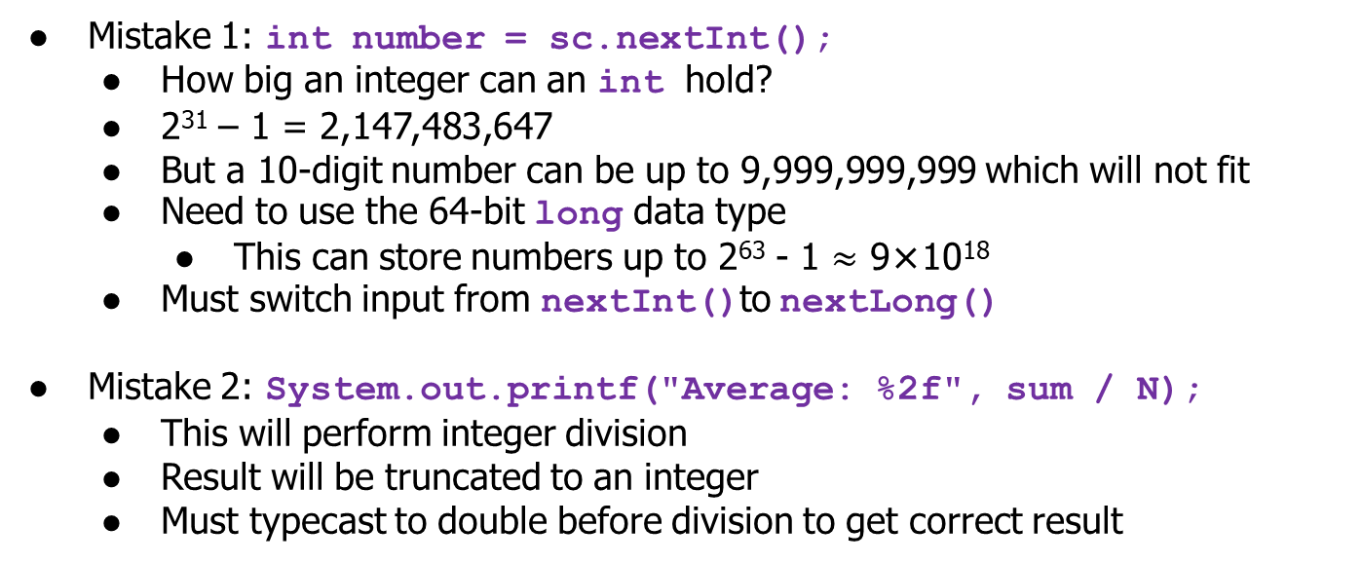
Statistics
Mistake 1: int number = sc.nextInt();
How big an integer can an int hold?
2³¹ – 1 = 2,147,483,647
But a 10-digit number can be up to 9,999,999,999 which will not fit
Need to use the 64-bit long data type
This can store numbers up to 2⁶³ - 1 $≈$ 9×10¹⁸
Must switch input from nextInt()to nextLong()
Mistake 2: System.out.printf("Average: %2f", sum / N);
This will perform integer division
Result will be truncated to an integer
Must typecast to double before division to get correct result

Slide 30
Statistics
Correct Solution
int N = sc.nextInt();
long sum = 0;
for (int i = 0; i < N; i++) {
long number = sc.nextLong();
sum += number;
}
System.out.println("Sum: " + sum);
System.out.printf("Average: %2f", (double)sum / N);

Slide 31
Statistics
Do be careful when casting to double.
System.out.printf("Average: %2f", (double)(sum / N));
This will still perform integer division.

Slide 32
Transpose
Transpose a grid of English letters
Solution: Store the rows as an array of Strings. Print the characters in the correct order.
int numRows = sc.nextInt();
int numCols = sc.nextInt();
String[] rows = new String[numRows];
for (int row = 0; row < numRows; row++) {
rows[row] = sc.next();
}

Slide 33
Transpose
Transpose Operation
// Take note of the order of the for loops
for (int col = 0; col < numCols; col++) {
for (int row = 0; row < numRows; row++) {
// Print a single character without newline
System.out.print(rows[row].charAt(col));
}
// Print a newline character
System.out.println();
}

Slide 34
Transpose
Alternatively, use toCharArray() to convert a String to a character array for easier processing
int numRows = sc.nextInt();
int numCols = sc.nextInt();
char[][] grid = new char[numRows][numCols];
for (int row = 0; row < numRows; row++) {
grid[row] = sc.next().toCharArray();
}

Slide 35
Transpose
Transpose Operation
// Take note of the order of the for loops
for (int col = 0; col < numCols; col++) {
for (int row = 0; row < numRows; row++) {
// Print a single character without newline
System.out.print(grid[row][col]);
}
// Print a newline character
System.out.println();
}

Slide 36
Take-Home Lab 1

Slide 37
Take-Home Lab 1
Released this week on IVLE and Codecrunch
3 questions following the exact same format as Sit-In Lab 1
Basic Java
String Processing
Linear Data Structures API
Due 15 February 2019, 2359hrs
Do not rush to do the questions yet as some of the topics have not been covered in lecture
Everything you need will be taught in next week’s lab session

Slide 38
Any Questions?

