Slide 1

CS2040 – Data Structures and Algorithms
Lecture 14 – Finding Shortest Way from Here to There, Part I
chongket@comp.nus.edu.sg
Notes:
Wednesday, 07 Oct 2015

Slide 2
Reminder
Continue training on http://visualgo.net/training.html !
Online quiz 2 is coming up on the 11th week (3 weeks later)

Slide 3
Annoucements
Amendment to PE scope
Will include slide 1 to 18 of this lecture (everything before Bellman Ford algorithm)

Slide 4
Outline
Single-Source Shortest Paths (SSSP) Problem
Motivating example
Some more definitions
Discussion of negative weight edges and cycles
Algorithms to Solve SSSP Problem (CP3 Section 4.4)
BFS algorithm (cannot be used for the general SSSP problem)
Bellman Ford’s algorithm
Precursor
Pseudo code, example animation, and later: Java implementation
Theorem, proof, and corollary about Bellman Ford’s algorithm
Notes:
General SSSP algorithm dropped, just go straight to Bellman Ford’s to save time…

Slide 5
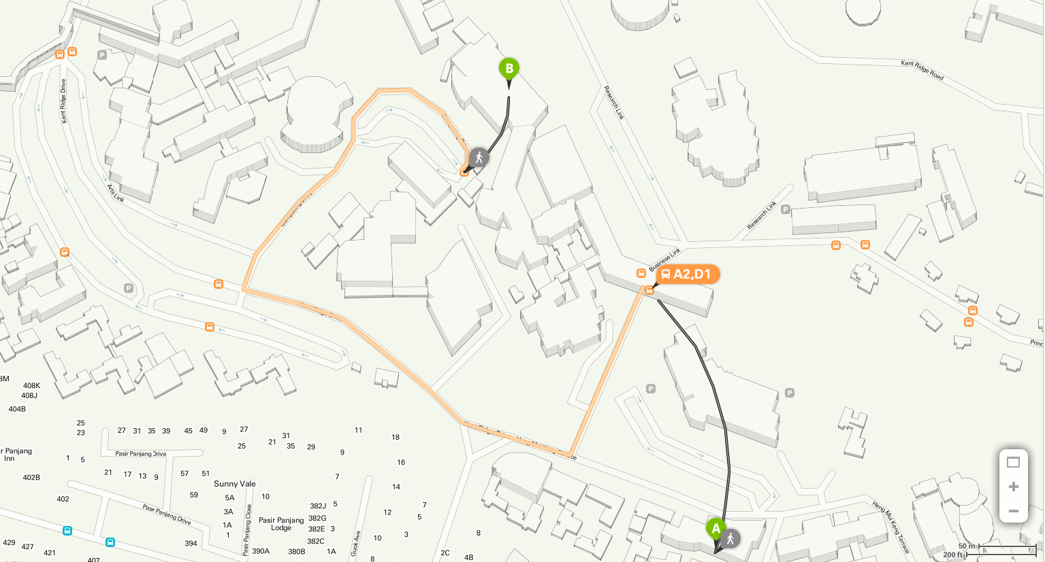
Motivating Example
SoC
Sheares Hall
Notes:
New slide for SH
Longer route – take A2 from SoC bus stop to Business school bus stop, get off and walk through i^3 to get to sheares hall
Shorter route – go through SoC exit from Hon Sui Sen library then walk out of business link and along heng mui keng terrace to reach sheares hall
Many real life applications which makes use of the shortest path between two points or some variant of it. For example
Route planning in GPS systems/Google map ~ Given starting point and destination point, will plot shortest route to drive from the start to the destination
Route planning for delivery trucks ~ Given a series of points that the delivery truck needs to make delivery to, plan the shortest path that will go through all of them
Sometimes we don’t want the shortest route in terms of distance rather the shortest route in terms of time (cheapest/min cost route)
Taking a cab, we may take a longer path if there are less stops (need to go through less traffic lights) so the travel time is actually lessened
Driving from one place to another by going through the fewest ERP gantries rather than the shortest path, so you pay less.
All these situation I mentioned uses the shortest path between two points or variants of it, so computing the shortest path between two points has a lot of real life
applications

Slide 6
Review: Definitions that you know
Vertex set V (e.g. street intersections, houses, etc)
Edge set E (e.g. streets, roads, avenues, etc)
Directed (e.g. one way road, etc)
Note that we can simply use 2 edges (bi-directional) to model 1 undirected edge (e.g. two ways road, etc)
Weighted (e.g. distance, time, toll, etc)
Weight function w(a, b): E→R, sets the weight of edge from a to b
Directed Weighted Graph: G(V, E), w(a, b): E→R
Notes:
The input for SSSP graph can be a disconnected graph

Slide 7
More Definitions (1)
(Simple) Path
Where
Simple = A path with no repeated vertex!
Shortcut notation: v₀ v_{k}
Means that p is a path from v₀ to v_{k}
Path weight:
p

Slide 8
More Definitions (2)
Shortest Path weight from vertex a to b: δ(a, b)
δ is pronounced as ‘delta’
Single-Source Shortest Paths (SSSP) Problem:
Given G(V, E), w(a, b): E->R, and a source vertex s
Find δ(s, b) (+best paths) from vertex s to each vertex b∈V
i.e. From one source to the rest
If there exists such path
p
a b
If b is unreachable from a
Notes:
^ single destination and single pair shortest paths can be reduced to single source shortest paths (sssp)!

Slide 9
More Definitions (3)
Additional Data Structures to solve the SSSP Problem:
An array/Vector D of size V (D stands for ‘distance’)
Initially, D[v] = 0 if v = s; otherwise D[v] = ∝ (a large number)
D[v] decreases as we find better paths
D[v] ≥ δ(s, v) throughout the execution of SSSP algorithm
D[v] = δ(s, v) at the end of SSSP algorithm
An array/Vector p of size V
p[v] = the predecessor on best path from source s to v
p[s] = -1 (not defined)
Recall: The usage of this array/Vector p is already discussed in BFS/DFS Spanning Tree
Notes:
Similar to BFS/DFS which generates a BFS/DFS spanning tree, a valid SSSP algorithm will generate a SSSP spanning tree out of the reachable vertices from the source vertex.

Slide 10
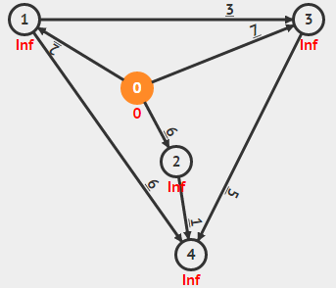
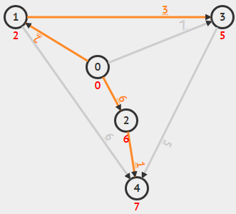
Example
s = 0
Initially:
D[s] = D[0] = 0
D[v]= ∝ for the rest
Denoted as values in red font/vertex
p[s] = -1 (to say ‘no predecessor’)
p[v] = -1 for the rest
Denoted as orange edges (none initially)
s = 0
At the end of algorithm:
D[s] = D[0] = 0 (unchanged)
D[v] = δ(s, v) for the rest
e.g. D[2] = 6, D[4] = 7
p[s] = -1 (source has no predecessor)
p[v] = the origin of orange edges for the rest
e.g. p[2] = 0, p[4] = 2
Notes:
The yellow edges represent the shortest path taken by the source vertex to reach each of the vertices and forms a SSSP spanning tree of this graph.

Slide 11
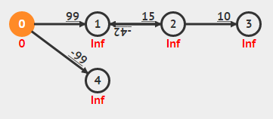
Negative Weight Edges and Cycles
They exist in some applications
Fictional application: Suppose you can travel back in time by passing through time tunnel (edges with negative weight)
Shortest paths from 0 to {1, 2, 3} are undefined
1→2→1 is a negative cycle as it has negative total path (cycle) weight
One can take 0→1→2→1→2→1→… indefinitely to get -∝
Shortest path from 0 to 4 is ok, with δ(0, 4) = -99
Notes:
Real life example with negative weights ->
Graph that represent the complex chemical reactions in a chemical plant. Vertices represent chemicals in some state and the edges represent the energy required to transit from one state to another. If energy is released
when transiting from one state to another then the edge will have a +ve weight and if energy is consumed to achieve the transition then the edge will have a -ve weight.
…
Now remember that we restrict ourselves to shortest paths which are simple paths, so why do we care about cycles in the path? Can we not only consider paths with no cycles when solving the SSSP problem? Indeed that is what we want, however finding shortest paths with no cycles on a graph with –ve cycles is a very hard problem …. still have no polynomial time solution.
So for our purposes if a graph has a –ve cycle we will just say the SSSP is not defined on the graph.

Slide 12
SSSP Algorithms
This SSSP problem is a(nother) well-known CS problem
We will discuss three algorithms in this lecture:
O(V+E) BFS which fails on general case of SSSP problem but useful for a special case
Introducing the “initSSSP” and “Relax” operations
General SSSP algorithm (pre-cursor to Bellman Ford)
O(VE) Bellman Ford’s SSSP algorithm
General idea of SSSP algorithm
Trick to ensure termination of the algorithm
Bonus: Detecting negative weight cycle
Notes:
Next week we will introduce another algorithm and its variant to solve the SSSP problem

Slide 13
Initialization Step
We will use this initialization step for all our SSSP algorithms
initSSSP(s)
for each v ∈ V // initialization phase
D[v] ← 1000000000 // use 1B to represent INF
p[v] ← -1 // use -1 to represent NULL
D[s] ← 0 // this is what we know so far

Slide 14
“Relaxation” Operation
relax(u, v, w(u,v))
if D[v] > D[u]+w(u,v) // if SP can be shortened
D[v] ← D[u]+w(u,v) // relax this edge
p[v] ← u // remember/update the predecessor
// if necessary, update some data structure
u
4
4
4
p[u] = s
v
s
9
9
0
p[v] = s
8
p[v] = u
Notes:
Elaborate more…
Why is it called a relaxation operation?
Ans: The shortest path cost from the source to any vertex v is an overestimate at the start as you consider better paths to reach v, the cost is “relaxed” closer and closer to the actual shortest path cost. At the end of
some valid algorithm for solving SSSP you must have the shortest path cost to each vertex v.
And whenever using an incoming edge to v reduces the shortest path cost to v, we say that we relax that incoming edge in order to get a better shortest path cost for v.
???
Change x to s

Slide 15
BFS for SSSP
When the graph is unweighted/edges have same weight*, the SSSP can be viewed as a problem of finding the least number of edges traversed from source s to other vertices
* We can view every edge as having weight 1
The O(V+E) Breadth First Search (BFS) traversal algorithm precisely measures this (BFS Spanning Tree = Shortest Paths Spanning Tree)
Run BFS from source vertex s
If want SP to v, reconstruct path using predecessor array starting from index v. (Path length)*(edge weight) is cost of the SP
Another way is to modify the BFS a little as shown in the next few slides (more in line with the way the other SP algorithms do it)
Notes:
Special Case 1: All edges have weight 1 (~unweighted)
This is much faster than the O(VE) Bellman Ford’s and the O((V + E) log V) Dijkstra’s algorithm (discussed today)
However we cannot use DFS unlike that for finding MST of unweighted connected graph.
For case study: State Search Graph

Slide 16
Modified BFS
Do these three simple modifications:
Replace visited to D ☺
At the start of BFS, set D[v] = INF (say, 1 Billion) for all v in G, except D[s] = 0 ☺
Change this part (in the BFS loop) from:
if visited[v] = 0 // if v is not visited before
visited[v] = 1; // set v as reachable from u
into:
if D[v] = INF // if v is not visited before
D[v] = D[u]+1; // v is 1 step away from u ☺

Slide 17
Modified BFS Pseudo Code (1)
for all v in V
D[v] ← INF
p[v] ← -1
Q ← {s} // start from s
D[s] ← 0
while Q is not empty
u ← Q.dequeue()
for all v adjacent to u // order of neighbor
if D[v] = INF // influences BFS
D[v] ← D[u]+1 // visitation sequence
p[v] ← u
Q.enqueue(v)
// we can then use information stored in D/p
Initialization phase
Main
loop

Slide 18
Modified BFS Pseudo Code (2) simpler form
initSSSP(s)
Q ← {s} // start from s
while Q is not empty
u ← Q.dequeue()
for all v adjacent to u // order of neighbor
relax(u, v, 1); // the weight is 1
and Q.enqueue(v) if the relaxation is successful
// we can then use information stored in D/p
Initialization phase
Main
loop

Slide 19
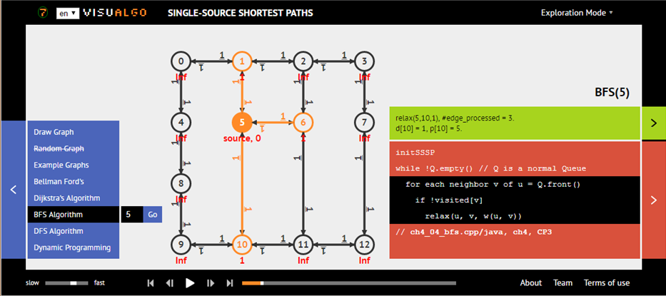
SSSP: BFS on Unweighted Graph
Ask VisuAlgo to perform BFS from various sources on the sample Graph (CP3 4.3)
In the screen shot below, we show the start of BFS from source vertex 5 (the same example as in Lecture 13)
Notes:
So what are the applications for BFS version of SSSP
1 possible application is to find the smallest number of hops in a network/let least number of routers in a network to send a packet of information from one computer to another.
Reducing the number of intermediate router the packet needs to pass through will reduce the time required to send the packet.

Slide 20
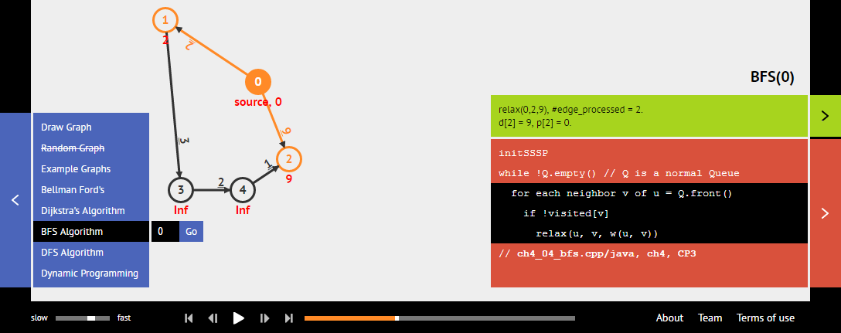
But BFS will not work on general cases
The shortest path from 0 to 2 is not path 0→2 with weight 9, but a “detour” path 0→1→3→4→2 with weight 2+3+2+1= 8
BFS cannot detect this and will only report path 0→2 (wrong answer)
You can draw this graph @ VisuAlgo and try it for yourself
Rule of Thumb:
If you know for sure that your graph is unweighted (all edges have weight 1 or all edges have the same constant weight), then solve the SSSP problem on it using the more efficient O(V+E) BFS algorithm
Notes:
http://visualgo.net/sssp.php?create={"vl":{"0":{"x":240,"y":160},"1":{"x":120,"y":80},"2":{"x":280,"y":260},"3":{"x":140,"y":300},"4":{"x":220,"y":300}},"el":{"0":{"u":0,"v":1,"w":2},"1":{"u":0,"v":2,"w":"9"},"2":{"u":1,"v":3,"w":3},"3":{"u":3,"v":4,"w":"2"},"4":{"v":2,"u":4,"w":1}}}
https://visualgo.net/sssp.php?create={"vl":{"0":{"x":360,"y":120},"1":{"x":240,"y":20},"2":{"x":360,"y":280},"3":{"x":180,"y":240},"4":{"x":260,"y":300}},"el":{"0":{"u":0,"v":1,"w":2},"1":{"u":0,"v":2,"w":"9"},"2":{"u":1,"v":3,"w":3},"3":{"u":3,"v":4,"w":2},"4":{"v":2,"u":4,"w":"1"}}}
Just run BFS once to get the SP from 0 to 2 based on BFS. Then show that this is wrong.

Slide 21
Bellman Ford’s SSSP Algorithm
Reference: CP3 Section 4.4 (especially Section 4.4.4)
visualgo.net/sssp

Slide 22
Precursor to Bellman Ford
How do we determine when an algorithm has solved the
SSSP?
when for all edges (u,v), D[v] <= D[u] + w(u,v)
(i.e no edge can be relaxed further)
Validate this condition
on the example in slide 8
Notes:
Change no vertex to no edge

Slide 23
Very simple algorithm to solve SSSP
initSSSP(s) // as defined in previous two slides
repeat // main loop
select edge(u, v) ∈ E in arbitrary manner
relax(u, v, w(u, v)) // as defined in previous slide
until all edges have D[v] <= D[u] + w(u, v)

Slide 24
Let’s Play a Simple Game (Demo on Whiteboard – cannot be done on VisuAlgo)
-1
-1
1
3
1
3
∞
2
7
∞
2
7
1
2
2
2
0
6
5
0
5
6
0
0
6
∞
6
6
1
1
s = 2
Initially:
D[s] = D[2] = 0
D[v]= ∝ for the rest
Denoted as values in yellow boxes
p[s] = -1 (to say ‘no predecessor’)
p[v] = -1 for the rest
Denoted as red arrows (none initially)
s = 2
At the end of algorithm:
D[s] = D[2] = 0 (unchanged)
D[v] = δ(s, v) for the rest
e.g. D[0] = 6, D[4] = 7
p[s] = -1 (source has no predecessor)
p[v] = the origin of red arrows for the rest
e.g. p[0] = 2, p[4] = 0
4
4
∞
7
Notes:
I will ask students to randomly choose any edge to implement the “select random edge” task
Challenge them to make me work more than 10 edges, but I scatter the choice to various students sitting in front (they lack the coordination part).
In 2013: They “failed”.

Slide 25
Let’s Play a Simple Game (Demo on Whiteboard – cannot be done on VisuAlgo)
s = 0
Initially:
D[s] = D[0] = 0
D[v]= ∝ for the rest
Denoted as values in red font/vertex
p[s] = -1 (to say ‘no predecessor’)
p[v] = -1 for the rest
Denoted as orange edges (none initially)
s = 0
At the end of algorithm:
D[s] = D[0] = 0 (unchanged)
D[v] = δ(s, v) for the rest
e.g. D[2] = 6, D[4] = 7
p[s] = -1 (source has no predecessor)
p[v] = the origin of orange edges for the rest
e.g. p[2] = 0, p[4] = 2
Notes:
0->1
0->2
0->3
1->3
1->4
2->4
3->4
1
6
6 6 5 7 2 3 2 6

Slide 26
Algorithm Analysis
If given a graph without negative weight cycle, when will this simple SSSP algorithm terminate?
A: Depends on your luck…
A: Can be very slow…
The main problem is in this line:
select edge(u, v) ∈ E in arbitrary manner
Next, we will study Bellman Ford’s algorithm that do these relaxations in a better order!

Slide 27
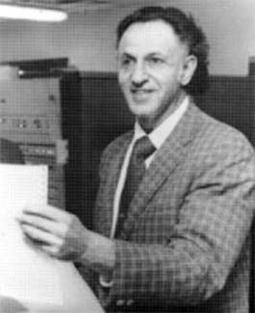

Bellman Ford’s Algorithm
initSSSP(s)
// Simple Bellman Ford's algorithm runs in O(VE)
for i = 1 to |V|-1 // O(V) here
for each edge(u, v) ∈ E // O(E) here
relax(u, v, w(u,v)) // O(1) here
// At the end of Bellman Ford's algorithm,
// D[v] = δ(s, v) if no negative weight cycle exist
// Q: Why "relaxing all edges V–1 times" works?

Slide 28
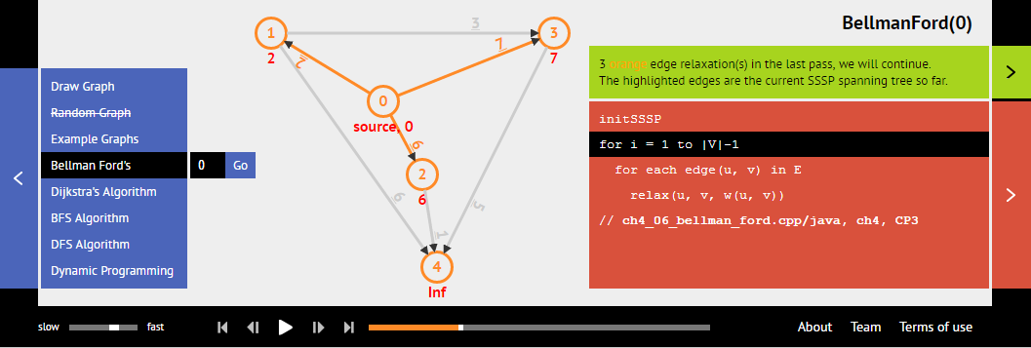
SSSP: Bellman Ford’s
Ask VisuAlgo to perform Bellman Ford’s algorithm from various sources on the sample Graph (CP3 4.17)
The screen shot below is the first pass of all E edges of BellmanFord(0)
Notes:
Edge list
1->4
1->3
0->1
2->4
0->2
3->4
0->3

Slide 29
Theorem 1 : If G = (V, E) contains no negative weight cycle, then the shortest path p from s to v is a simple path
4
Let’s do a Proof by Contradiction!
Suppose the shortest path p is not a simple path
Then p contains one (or more) cycle(s)
Suppose there is a cycle c in p with positive weight
If we remove c from p, then we have a shorter ‘shortest path’ than p
This contradicts the fact that p is a shortest path
1
2
3

Slide 30
Theorem 1 : If G = (V, E) contains no negative weight cycle, then the shortest path p from s to v is a simple path
0
Even if c is a cycle with zero total weight (it is possible!), we can still remove c from p without increasing the shortest path weight of p
So, p is a simple path (from point 5) or can always be made into a simple path (from point 6)
In other words, path p has at most |V|-1 edges from the source s to the “furthest possible” vertex v in G (in terms of number of edges in the shortest path)
1
0
3

Slide 31
Theorem 2 : If G = (V, E) contains no negative weight cycle, then after Bellman Ford’s terminates D[v] = δ(s, v), ∀v ∈ V
Let’s do a Proof by Induction!
Define v_{i} to be any vertex that has shortest path p requiring i hops (number of edges) from s
Initially D[v₀] = δ(s, v₀) = 0, as v₀ is just s
After 1 pass through E, we have D[v₁] = δ(s, v₁)
After 2 passes through E, we have D[v₂] = δ(s, v₂), ...
Notes:
It will not be changed as there is no negative cycle

Slide 32
Theorem 2 : If G = (V, E) contains no negative weight cycle, then after Bellman Ford’s terminates D[v] = δ(s, v), ∀v ∈ V
Let’s do a Proof by Induction!
Consider the shortest path p from s to v_{i} (p will have minimum number of edges)
v_{i} is defined as a vertex which has shortest path requiring i hops (number of edges) from s
Initially D[v₀] = δ(s, v₀) = 0, as v₀ is just s
After 1 pass through E, we have D[v₁] = δ(s, v₁)
Notes:
It will not be changed as there is no negative cycle

Slide 33
Theorem 2 : If G = (V, E) contains no negative weight cycle, then after Bellman Ford’s terminates D[v] = δ(s, v), ∀v ∈ V
After k passes through E, we have D[v_{k}] = δ(s, v_{k})
When there is no negative weight cycle, the shortest path p will be simple (see the previous proof)
Thus, after |V|-1 iterations, the “furthest” vertex v_{|V|-1} from s has D[v_{|V|-1}] = δ(s, v_{|V|-1})
Even if edges in E are processed in the worst possible order
3
1
2
3
2
1
Notes:
At most |V|-1 edges for the “longest” shortest path in terms of number of edges used
Show the bellman ford killer example on Visualgo

Slide 34
“Side Effect” of Bellman Ford’s
Corollary: If a value D[v] fails to converge after |V|-1 passes, then there exists a negative-weight cycle reachable from s
Additional check after running Bellman Ford’s:
for each edge(u, v) ∈ E
if (D[u] != INF && D[v] > D[u]+w(u, v))
report negative weight cycle exists in G

Slide 35
Java Implementation (2)
See BellmanFordDemo.java
Now implemented using AdjacencyList ☺
AdjacencyList or EdgeList can be used to have an O(VE) Bellman Ford’s
Show performance on:
Small graph without negative weight cycle → OK, in O(VE)
Small graph with negative weight cycle → terminate in O(VE)
Plus we can report that negative weight cycle exists
Small graph; some negative edges; no negative cycle → OK
Notes:
You have a flexibility on choosing which graph data structure to use!

Slide 36
Java Implementation
See BellmanFordDemo.java
Implemented using AdjacencyList ☺
AdjacencyList or EdgeList can be used to have an O(VE) Bellman Ford’s
Show performance on:
Small graph without negative weight cycle → OK, in O(VE)
Small graph with negative weight cycle → terminate in O(VE)
Plus we can report that negative weight cycle exists
Small graph; some negative edges; no negative cycle → OK
Notes:
You have a flexibility on choosing which graph data structure to use!
https://visualgo.net/en/sssp?create={"vl":{"0":{"x":120,"y":80},"1":{"x":180,"y":220},"2":{"x":320,"y":120}},"el":{"0":{"u":0,"v":1,"w":"-10"},"1":{"u":1,"v":2,"w":"-15"},"2":{"u":0,"v":2,"w":"-20"}}}

Slide 37
Summary
Introducing the SSSP problem
Revisiting BFS algorithm for unweighted SSSP problem
But it fails on general case
Introducing Bellman Ford’s algorithm
This one solves SSSP for general weighted graph in O(VE)
Can also be used to detect the presence of -ve weight cycle
Notes:
Introducing the ‘useless’ Generic SSSP algorithm
You can “forget” this algorithm after this lecture ☺

Slide 38
PS5* should now be doable ☺
* The first Subtask of PS5…
(but I will only open it on Saturday, 17 Oct 2015, 8am)
Subtask B (easy), Subtask C (medium-hard), and Subtask D (R-option, also medium-hard) require something else ☺
Train first to check basic understanding of the past two lectures on graph algorithms: http://visualgo.net/training.html?diff=Medium&n=5&tl=0&module=mst,sssp

Slide 39
Example
3
3
1
3
1
3
∞
2
7
∞
2
7
5
2
2
2
0
6
5
0
5
6
0
0
6
∞
6
6
1
1
s = 2
Initially:
D[s] = D[2] = 0
D[v]= ∝ for the rest
Denoted as values in yellow boxes
p[s] = -1 (to say ‘no predecessor’)
p[v] = -1 for the rest
Denoted as red arrows (none initially)
s = 2
At the end of algorithm:
D[s] = D[2] = 0 (unchanged)
D[v] = δ(s, v) for the rest
e.g. D[0] = 6, D[4] = 7
p[s] = -1 (source has no predecessor)
p[v] = the origin of red arrows for the rest
e.g. p[0] = 2, p[4] = 0
4
4
∞
7

Slide 40
Negative Weight Edges and Cycles
They exist in some applications
Fictional application: Suppose you can travel back in time by passing through time tunnel (edges with negative weight)
Shortest paths from 0 to {1, 2, 3} are undefined
1→2→1 is a negative cycle as it has negative total path (cycle) weight
One can take 0→1→2→1→2→1→… indefinitely to get -∝
Shortest path from 0 to 4 is ok, with δ(0, 4) = -99
15
0
99
1
2
10
3
0
∞
-42
∞
∞
-99
4
∞

Slide 41
End of Lecture Quiz ☺
Now practice (I don’t use test mode):
Go to: test.visualgo.net
Use your CS2010 account to try the 7 questions (easy difficulty, 5 minutes)
Meanwhile, train first: training.visualgo.net

Slide 42
General SSSP Algorithm

Slide 43
General SSSP Algorithm
initSSSP(s) // as defined in previous two slides
repeat // main loop
select edge(u, v) ∈ E in arbitrary manner
relax(u, v, w_u_v) // as defined in previous slide
until all edges have D[v] <= D[u] + w(u, v)

Slide 44
Let’s Play a Simple Game (Demo on Whiteboard – cannot be done on VisuAlgo)
3
3
1
3
1
3
∞
2
7
∞
2
7
5
2
2
2
0
6
5
0
5
6
0
0
6
∞
6
6
1
1
s = 2
Initially:
D[s] = D[2] = 0
D[v]= ∝ for the rest
Denoted as values in yellow boxes
p[s] = -1 (to say ‘no predecessor’)
p[v] = -1 for the rest
Denoted as red arrows (none initially)
s = 2
At the end of algorithm:
D[s] = D[2] = 0 (unchanged)
D[v] = δ(s, v) for the rest
e.g. D[0] = 6, D[4] = 7
p[s] = -1 (source has no predecessor)
p[v] = the origin of red arrows for the rest
e.g. p[0] = 2, p[4] = 0
4
4
∞
7
Notes:
I will ask students to randomly choose any edge to implement the “select random edge” task
Challenge them to make me work more than 10 edges, but I scatter the choice to various students sitting in front (they lack the coordination part).
In 2013: They “failed”.

Slide 45
Java Implementation (1)
See GenericSSSPDemo.java
Implemented using EdgeList for easier random-edge selection
This is the same as the one shown in Lecture 05
With path reconstruction subroutine (if terminate)
This is the same as the one shown in BFS/DFS lecture
Show performance on:
Small graph without negative weight cycle → OK
Small graph with negative weight cycle → ________ stop… ☹
Small graph; some negative edges; no negative cycle → OK

Slide 46
Algorithm Analysis
If given a graph without negative weight cycle, when will this Generic SSSP algorithm terminate?
A: Depends on your luck…
A: Can be very slow…
The main problem is in this line:
select edge(u, v) ∈ E in arbitrary manner
Next, we will study Bellman Ford’s algorithm that do these relaxations in a better order!

Slide 47
General SSSP Algorithm (Revisited)
What do we lack in the generic algorithm below?
A: An “order” of edge relaxation
initSSSP(s)
repeat
select edge(u, v) ∈ E in arbitrary manner
relax(u, v, w_u_v)
until all edges have D[v] <= D[u] + w(u, v)

Slide 48
Midterm Feedback about VisuAlgo (1)
Basically, reception of both sides of VisuAlgo (visualization and online quiz) are very good and much better than last year (when it does not have the online quiz system)
But these are the stuffs that can be better (now/soon):
Improve question bank for VisuAlgo → yes of course ☺, with your help, explanation in the next slide
Add link of CP3 sample source code to VisuAlgo so that we do not just stop at pseudo-code + visualization level
Mention analysis of algorithm briefly at the end of VisuAlgo animation, for example, we will see such thing at the end of Bellman Ford’s animation today ☺
Minor features: “Create empty” in bst.html, add “Pre and Postorder” traversal in bst.html, add the concept of “rank” in bst.html, display both Complete Binary Tree and Compact Array in heap.html, etc
Notes:
Question 1 overall impression: We managed to get what I want last year: Higher usage of Visu(alization) system. Coupling this with online assessment system is very very helpful. Force students to retry the visualization if they don't have 100% understanding of it. In the past, ppl "don't use the visualization" after trying it for a while as they "think they have mastered it".

Slide 49
Midterm Feedback about VisuAlgo (2)
But these are the stuffs that can be better in the future:
Training mode with greater control (# of questions, time trial :O)
Direct link between VisuAlgo visualization page and the corresponding training page for that topic, i.e. make “Exploration mode, Tutorial mode, and Training mode”
Provide option to “undo” last step… should be technically possible ☺
Click the source vertex instead of typing that vertex number?
Feature to change that “CS2010 account” password…, etc
About improving the question bank → new VisuAlgo feature to record input graph drawing (and who draw that to avoid spam issues) and the random graph rating system
I will show live demo on http://visualgo.net/mst.html

Slide 50
Quick Challenge (1)
Find the shortest paths from s = 2 to the rest
3
1
3
∞
2
∞
Suppose the edges are stored in this order:
(0, 4), w = 9
(4, 0), w = 1
(3, 4), w = 2
(1, 3), w = 3
(2, 1), w = 2
(2, 0), w = 9
2
0
9
2
0
∞
9
1
4
∞
Notes:
Ah, just use Online Quiz mode now ☺
Answer:
d[2] = 0 → d[0] = 9 → d[4] = 18 (both will be overwritten)
d[1] = 2 → d[3] = 5 → d[4] = 7 → d[0] = 8

Slide 51
Quick Challenge (2)
Find the shortest paths from s = 2 to the rest
This time, edge (2, 1) is removed
3
1
3
∞
2
∞
Suppose the edges are stored in this order:
(0, 4), w = 9
(4, 0), w = 1
(3, 4), w = 2
(1, 3), w = 3
(2, 1), w = 2
(2, 0), w = 9
0
9
2
0
∞
9
1
4
∞
Notes:
Answer:
d[2] = 0 → d[0] = 9 → d[4] = 18
d[1] and d[3] = INF as these two are unreachable from source 2

Slide 52
Quick Challenge (3)
Find the shortest paths from s = 2 to the rest
This time, some edges are negative, but no negative cycle
-3
1
3
∞
2
∞
Suppose the edges are stored in this order:
(0, 4), w = 9
(4, 0), w = 1
(3, 4), w = 2
(1, 3), w = 3
(2, 1), w = 2
(2, 0), w = 9
0
9
-2
0
∞
-8
8
4
∞
Notes:
Answer:
d[2] = 0 → d[0] = 9 → d[4] = 1
d[1] and d[3] = INF as these two are unreachable from source 2

Slide 53
Q: Will this Algorithm Terminate? (just use your feeling)
Yes, what is the problem?
No, because ______
Not always, because _______________
initSSSP(s) // as defined in previous two slides
repeat // main loop
select edge(u, v) ∈ E in arbitrary manner
relax(u, v, w_u_v) // as defined in previous slide
until all edges have D[v] <= D[u] + w(u, v)
15 of 120
Notes:
Drop this slide, just use personal challenge in the next slide
Not always,
Because if the given graph has negative cycle, it won’t terminate
If the graph has no negative cycle, it can stop but not sure when
7 say yes (wrong), 4 say no (also wrong), 11 say yes

Slide 54
One pass through all edges is now done. Is there any more edges that can be relaxed?
Yes, for example, edge(s) __________
No more, we are done
3
1
3
2
2
7
7
2
0
6
5
0
6
6
1
4
∞
0 of 120
Notes:
Everyone (12) can see that there are edges that can still be relaxed further

Slide 55
Now check. Does every D[v] = δ(s, v)?
Yes
No, because ______
3
1
3
2
2
7
5
2
0
6
5
0
6
6
1
4
7
0 of 120
Notes:
14 says yes, 2 say no (wrong)

Slide 56
During Lecture 5, only minority of you said that you know/have implement Bellman Ford’s algorithm before. Now…
Bellman Ford’s algorithm looks easy, I am now sure I can implement and use it to solve any SSSP problem
Bellman Ford’s algorithm may be easy, but I know you can set hard SSSP question??
I think I still need more time to revise this lecture material… Still not sure how Bellman Ford’s works
0 of 120
Notes:
2 say easy, 12 say question can be hard, 6 needs more revision

Slide 57
Quiz 1 Solution Discussion
Refer to Quiz1-sol.pdf
You can leave now if you do not want to hear all these data and statistics
You can review them on your own via webcast or by reading Quiz1-sol.pdf by yourself

Slide 58
Quiz 1: The True Picture
Quiz 1 average scores per section:
S1, 11.2/14 (80.0%) → for Quiz 2, this will be more or less the same
S2, 26.9/30 (89.8%) → for Quiz 2, weightage is reduced to 25
S3, 20.3/26 (78.2%) → for Quiz 2, this will be more or less the same
S4, 11.7/15 (78.1%) → for Quiz 2, this will be more or less the same
S5, 07.3/15 (48.5%) → for Quiz 2, weightage is increased to 20
------------------------------- +
Overall average (AVG): 77.5 (last year 76.03) marks
I am expecting average 70 for Quiz 2 (yeah, it will be a bit harder)
Standard deviation (STD): 12.5 (last year 10.66) marks

Slide 59
The Current Bell’s Curve (After Quiz 1)
Average: 77.5
< B- B- B B+ A- A A+

Slide 60
Which one is a valid partition of an array X = {8, 2, 7, 9, 10, 1, 5} around value 7? (you can select up to 5 choices)
X’ = {1, 2, 5, 7, 9, 10, 8}
X’ = {1, 2, 5, 7, 8, 9, 10}
X’ = {5, 2, 1, 7, 8, 9, 10}
X’ = {5, 2, 1, 8, 7, 9, 10}
X’ = {2, 1, 5, 8, 7, 9, 10}
0 of 120

Slide 61
Only for those who answer 3 or 4 in the previous survey: Do you think Dijkstra’s algorithm can be used if the graph has negative weight edges (no negative cycle)?
Obviously not
Obviously yes
Depends on how you implement it :O
0 of 120

Slide 62
Discussion About Cycle
And the problem with it…
Back edge disrupt the value of D[v]
See CLRS
Draw a cycle here with some D[v] values

Slide 63
Triangle Inequality
Theorem 2:
For all x, u, v ∈ V, we have δ(u, v) ≤ δ(u, x) + δ(x, v)
4
u
4
5
v
x
8
0
9
Notes:
Where is this property needed? In Relaxation? Think about it again…

Slide 64
Mid-SEMESTER REVIEW
This is what we have covered so far… (only discussed up to 10.30am only)

Slide 65
CS1020 Review – Stack/Queue DS
Stack
Last In First Out (LIFO)
Java Stack
Queue
First In First Out (FIFO)
Java Queue
Only an interface
Must be instantiated with Java LinkedList
See, we do not have to create our own Stack/Queue
Use Java Collections framework!
C
Top
B
A
Bottom
A
B
C
Front
Back

Slide 66
Review of the First One-Third
Trees
Binary Search Trees: Basic Concepts
Balanced BSTs: The importance of being Balanced, AVL
Priority Queues and Binary Heaps: Basic Concepts
Notable Examples:
Census Problem (“Dictionary Problem”)
PS1 Baby Names (also Dictionary Problem, involving range)
Air Traffic Controller
PS2 Scheduling Deliveries (a Priority Queue problem)
And the new concept that PQ is not always about Binary Heap…

Slide 67
What is the right child of the root of BST if the following sequence of items are inserted to an initially empty BST: {8, 7, 2, 10, 4}
2
7
8
10
4
0 of 120
Notes:
Too easy, majority of course got this correct (2,0,0,12,1)

Slide 68
Which Statement About Heap is False?
Heap must be a complete binary tree
Heap can be implemented with array
Heap can be used for sorting
Building a heap from an unsorted array can only be done in O(n log n)
Heap can be used in Prim’s algorithm
0 of 120
Notes:
Medium: 2,0,2,12,6

Slide 69
CS1020 + a bit of CS2010 Review Which sorting algorithm is the best?
Bubble Sort
Insertion Sort
Selection Sort
Merge Sort
Quick Sort
NEW: balanced BST Sort
NEW: Heap Sort
0 of 120
Notes:
No 4/5/6/7 are asymptotically good, Quick Sort is better for cache performance
But actually it depends on the question…
Insertion sort can be the best one if the input is nearly sorted…

Slide 70
Review: Tree (+ Additional Stuffs)
The Concepts of Tree
Connected; E = V - 1; Unique path between two vertices
Cannot have cycle
Types: Binary, n-ary, Complete, Full
Terminologies: Root, Internal Nodes, Leaves, Sub-trees
Tree Traversal Algorithms: Pre-order, In-order, Post-order, Level-order (essentially BFS)

Slide 71
Size of a Binary Tree
This is a naturally recursive algorithm
size(T)
if (T = NULL) return 0;
else return 1 + size(T.left) + size(T.right);
Time Complexity: O(V)
PS: change -> to .
7
5
3
8
Notes:
Can you make this iterative?
You can, with help of ________
You cannot

Slide 72
Height of a Binary Tree
height(T) if (T = NULL) // empty tree return 0; else if (T.left = NULL and T.right = NULL) // leaf return 1; else // internal node return 1 + max(height(T.left), height(T.right));
Time Complexity: also O(V)
7
5
3
8

Slide 73
Max (or Min) Item of a Binary Tree
maxV(T) // minor adjustment for finding min
if (T = NULL) return -INF;
else return max(T.value,
max(maxV(T.left), maxV(T.right));
Time Complexity: again O(V)
7
5
3
8

Slide 74
Can You Generalize It?
What if the tree is n-ary tree, not just binary tree?

Slide 75
Review: Second One-Third
Graphs
Graph Data Structures: AdjMat/List/EdgeList/Implicit Graph
Graph Traversal: DFS/BFS and its various applications
Minimum Spanning Trees: Prim’s/Kruskal’s
Single-Source Shortest Paths: Bellman Ford’s/Dijkstra’s (this and the next e-lecture)
Notable Examples:
Hospital Tour (Connected Components++)
Pancake Sorting (BFS+++)
Out for a Walk (ongoing)
The Onset of Labor (soon)

Slide 76
Select graph terminologies that you know now… (can select up to 8/clicker)
AdjMatrix/List/EdgeList
DFS/BFS
Topological Sort
MST/Prim’s
MST/Kruskal’s
SSSP/Bellman Ford’s
SSSP/Dijkstra’s
APSP/Floyd Warshall’s
0 of 120
Notes:
Mention that no 8 is soon ☺

Slide 77
Select DS/algorithms that you have already implement now… (can select up to 8/clicker)
AdjMatrix/List/EdgeList
DFS/BFS
Topological Sort
MST/Prim’s
MST/Kruskal’s
SSSP/Bellman Ford’s
SSSP/Dijkstra’s
APSP/Floyd Warshall’s
0 of 120

Slide 78
DFS and BFS always run in Θ(V²) on
Tree
Directed Acyclic Graph
Bipartite Graph
Complete Graph
Impossible, it is O(V+E)
0 of 120

Slide 79
DFS and BFS can run in O(V²) on
Tree
Directed Acyclic Graph
Bipartite Graph
Complete Graph
Impossible, it is O(V+E)
0 of 120

Slide 80
Hm… Can I use standard BFS (i.e. add one line like in modified DFS) to find toposort?
Yes, why not?
No, I think BFS will have a problem because _______
0 of 120
Notes:
No, try this graph:
A -> B -> C -> D
| ^ --------------------|
BFS: A, then B,D (second layer), then C
Toposort: A, B, C, then D
We have to modify much more than just one line of BFS to make it work
-. Enqueue only vertices with 0 incoming degrees
-. When processing neighbor V of vertex U, decrease incoming degrees of V by 1, see if it goes down to 0 If it is, enqueue, If it does not, leave it there for a while

Slide 81
Graph Modeling Find Real-Life Graphs Near You
Find several real-life graphs around you (in this room) or around your life!
State what are the vertices, the edges
Find simple and meaningful graph problems (if any)
Simple example:
Vertices: NUS modules
Edges: Module pre-requisites (it is a DAG!!)
Graph problem: I have taken a set of modules, can I take a certain future module given this pre-requisites DAG?
Notes:
Location of seats in the LT, what is the shortest way to get to my preferred seat from door?
Friendship connection in the room, who has the most friends?, which students are clique?
Birthday connection in the room, is there 2 person with same birthday, or birthweek?, etc

Slide 82
Review – Graph Properties
Elaborate the properties of these two graphs
How many V? E? Components? Is it connected? Is it weighted? Is it directed? Is it acyclic? Is it a tree? Is it bipartite? etc…
0
1
2
0
1
1
1
2
1
1
1
3
4
5
3
4
1
5
Notes:
Note: we skip “Strongly Connected Component” in this module

Slide 83
Review – Graph DS: Adjacency Matrix, Adjacency List, and Edge List
0
1
2
0
5
1
7
2
4
2
1
3
4
5
3
4
3
5
 | 0 | 1 | 2 | 3 | 4 | 5
0
1
2
3
4
5
id | u | v | w
0
1
2
3
4
5
0 | →
1 | →
2 | →
3 | →
4 | →
5 | →
http://www.comp.nus.edu.sg/~stevenha/visualization/representation.html

Slide 84
Which One To Use? (1) V = 10000, E = 10000
Adjacency Matrix
Adjacency List
Edge List
This is a trick question, the answer must be something else, which is _______________
0 of 120
Notes:
Adj List is the answer

Slide 85
Which One To Use? (2) V = 100, existence of edge(u, v) frequently asked
Adjacency Matrix
Adjacency List
Edge List
This is a trick question, the answer must be something else, which is _______________
0 of 120
Notes:
Matrix is the best

Slide 86
Which One To Use? (3) V = 200, E = 19900, neighbors frequently enumerated
Adjacency Matrix
Adjacency List
Edge List
This is a trick question, the answer must be something else, which is _______________
0 of 120
Notes:
No difference between Adj matrix and list, V = 200, E = 19900 is actually a complete graph
O(k) = O(V)

Slide 87
Which One To Use? (4) V = 200, E = 19900, sort the edges based on weight
Adjacency Matrix
Adjacency List
Edge List
This is a trick question, the answer must be something else, which is _______________
0 of 120

Slide 88
Review – Graph Traversal
Run BFS and then DFS from various source in the graph below
0
1
3
4
5
2
7
6
8
http://www.comp.nus.edu.sg/~stevenha/visualization/dfsbfs.html

Slide 89
Review: Path Reconstruction Algorithm (1)
// iterative version (will produce reversed output)
Output "(Reversed) Path:"
i ← t // start from end of path: suppose vertex t
while i != s
Output i
i ← p[i] // go back to predecessor of i
Output s
// try it on this array p, t = 4
// p = {-1, 0, 1, 2, 3, -1, -1, -1}
Notes:
The output is reversed

Slide 90
Review: Path Reconstruction Algorithm (2)
void backtrack(u)
if (u == -1) // recall: predecessor of s is -1
stop
backtrack(p[u]) // go back to predecessor of u
Output u // recursion will reverse the order
// in main method
// recursive version (normal path)
Output "Path:"
backtrack(t); // start from end of path (vertex t)
// try it on this array p, t = 4
// p = {-1, 0, 1, 2, 3, -1, -1, -1}

Slide 91
Hm… I prefer not to use recursion but I still want the correct path (from source to target), can I do that?
No, I have no choice but to use recursion to get the correct path
Possible, use this technique ______________
0 of 120
Notes:
You can use stack
Or you can simply store the reconstructed path and then use Collections.reverse
Or simply print the reconstructed path from back to front :O

Slide 92
Review: What happen if we run toposort algorithm and the given graph is not a DAG?
There will be no topological order and the modified DFS algorithm(topoVisit) will be able to tell
There will be no topological order and the modified DFS algorithm (topoVisit) will NOT be able to tell
0 of 120

Slide 93
Quick Challenge
Find MST of this connected weighted graph
Sort the edges and do the greedy strategy as shown earlier
1
5
2
0
4
2
7
7
6
3
7
1
4
http://www.comp.nus.edu.sg/~stevenha/visualization/mst.html
Notes:
Note: the MST may not be unique, but the MST cost is unique
There are 3 possible MSTs 4-1, 4-3, and 4-5 are all have weight 7

Slide 94
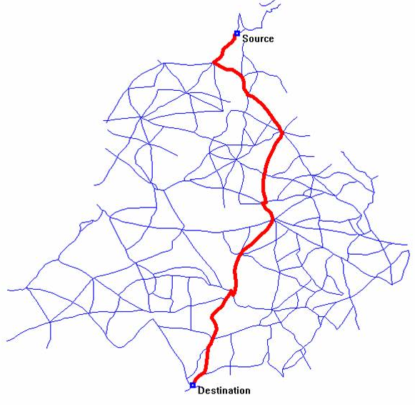
SINGLE SOURCE SHORTEST PATHS (ON WEIGHTED GRAPHS)
Notes:
CHANGE THIS FIGURE, this can be misleading… SSSP is not single-source single-destination!

Slide 95
Example (1)
0
1
2
3
4
5
6
7
8
Q = {5}
D[5] = 0
9
10
11
12
5

Slide 96
Example (2)
0
1
2
3
4
5
6
7
8
Q = {5}
Q = {1, 6, 10}
D[5] = 0
D[1] = D[5] + 1 = 1
D[6] = D[5] + 1 = 1
D[10] = D[5] + 1 = 1
9
10
11
12
1
5
6
10

Slide 97
Example (3)
0
1
2
3
4
5
6
7
8
Q = {5}
Q = {1, 6, 10}
Q = {6, 10, 0, 2}
Q = {10, 0, 2, 11}
Q = {0, 2, 11, 9}
D[5] = 0
D[1] = D[5] + 1 = 1
D[6] = D[5] + 1 = 1
D[10] = D[5] + 1 = 1
D[0] = D[1] + 1 = 2
D[2] = D[1] + 1 = 2
D[11] = D[6] + 1 = 2
D[9] = D[10] + 1 = 2
9
10
11
12
0
1
2
20
5
6
9
10
11

Slide 98
Example (4)
0
1
2
3
4
5
6
7
8
Q = {5}
Q = {1, 6, 10}
Q = {6, 10, 0, 2}
Q = {10, 0, 2, 11}
Q = {0, 2, 11, 9}
Q = {2, 11, 9, 4}
Q = {11, 9, 4, 3}
Q = {9, 4, 3, 12}
Q = {4, 3, 12, 8}
D[5] = 0
D[1] = D[5] + 1 = 1
D[6] = D[5] + 1 = 1
D[10] = D[5] + 1 = 1
D[0] = D[1] + 1 = 2
D[2] = D[1] + 1 = 2
D[11] = D[6] + 1 = 2
D[9] = D[10] + 1 = 2
D[4] = D[0] + 1 = 3
D[3] = D[2] + 1 = 3
D[12] = D[11] + 1 = 3
D[8] = D[9] + 1 = 3
9
10
11
12
0
1
2
3
20
4
5
6
8
9
10
11
12

Slide 99
Example (5)
0
1
2
3
4
5
6
7
8
Q = {5}
Q = {1, 6, 10}
Q = {6, 10, 0, 2}
Q = {10, 0, 2, 11}
Q = {0, 2, 11, 9}
Q = {2, 11, 9, 4}
Q = {11, 9, 4, 3}
Q = {9, 4, 3, 12}
Q = {4, 3, 12, 8}
Q = {3, 12, 8}
Q = {12, 8, 7}
Q = {8, 7}
Q = {7}
Q = {}
D[5] = 0
D[1] = D[5] + 1 = 1
D[6] = D[5] + 1 = 1
D[10] = D[5] + 1 = 1
D[0] = D[1] + 1 = 2
D[2] = D[1] + 1 = 2
D[11] = D[6] + 1 = 2
D[9] = D[10] + 1 = 2
D[4] = D[0] + 1 = 3
D[3] = D[2] + 1 = 3
D[12] = D[11] + 1 = 3
D[8] = D[9] + 1 = 3
D[7] = D[3] + 1 = 4
9
10
11
12
0
1
2
3
20
4
5
6
7
8
9
10
11
12
This is the BFS = SSSP ☺ spanning tree when BFS is started from vertex 5
Notes:
Highlight the BFS = SSSP Spanning Tree here

Slide 100
Bellman Ford’s Animation (0)
3
1
3
∞
2
7
∞
Suppose the edges are stored in this order:
(1, 4), w = 6
(1, 3), w = 3
(2, 1), w = 2
(0, 4), w = 1
(2, 0), w = 6
(3, 4), w = 5
(2, 3), w = 7
2
0
6
5
0
6
∞
1
4
∞

Slide 101
Bellman Ford’s Animation (1a)
3
1
3
2
2
7
∞
Suppose the edges are stored in this order:
(1, 4), w = 6
(1, 3), w = 3
→ (2, 1), w = 2
(0, 4), w = 1
(2, 0), w = 6
(3, 4), w = 5
(2, 3), w = 7
2
0
6
5
0
6
∞
1
4
∞

Slide 102
Bellman Ford’s Animation (1b)
3
1
3
2
2
7
∞
Suppose the edges are stored in this order:
(1, 4), w = 6
(1, 3), w = 3
(2, 1), w = 2
(0, 4), w = 1
→ (2, 0), w = 6
(3, 4), w = 5
(2, 3), w = 7
2
0
6
5
0
6
6
1
4
∞

Slide 103
Bellman Ford’s Animation (1c)
3
1
3
2
2
7
7
Suppose the edges are stored in this order:
(1, 4), w = 6
(1, 3), w = 3
(2, 1), w = 2
(0, 4), w = 1
(2, 0), w = 6
(3, 4), w = 5
→ (2, 3), w = 7
2
0
6
5
0
6
6
1
4
∞

Slide 104
Bellman Ford’s Animation (2a)
3
1
3
2
2
7
7
Suppose the edges are stored in this order:
→ (1, 4), w = 6
(1, 3), w = 3
(2, 1), w = 2
(0, 4), w = 1
(2, 0), w = 6
(3, 4), w = 5
(2, 3), w = 7
2
0
6
5
0
6
6
1
4
8

Slide 105
Bellman Ford’s Animation (2b)
3
1
3
2
2
7
5
Suppose the edges are stored in this order:
(1, 4), w = 6
→ (1, 3), w = 3
(2, 1), w = 2
(0, 4), w = 1
(2, 0), w = 6
(3, 4), w = 5
(2, 3), w = 7
2
0
6
5
0
6
6
1
4
8
Observe that when we relax(1,3),
D[3] drops from 7 to 5
p[3] changes from 2 to 1

Slide 106
Bellman Ford’s Animation (2c)
3
1
3
2
2
7
5
Suppose the edges are stored in this order:
(1, 4), w = 6
(1, 3), w = 3
(2, 1), w = 2
→ (0, 4), w = 1
(2, 0), w = 6
(3, 4), w = 5
(2, 3), w = 7
2
0
6
5
0
6
6
1
4
7
Observe that when we relax(0,4),
D[4] drops from 8 to 7 and
p[4] changes from 1 to 0

Slide 107
Bellman Ford’s Animation (2d)
3
1
3
2
2
7
5
Suppose the edges are stored in this order:
(1, 4), w = 6
(1, 3), w = 3
(2, 1), w = 2
(0, 4), w = 1
(2, 0), w = 6
(3, 4), w = 5
(2, 3), w = 7
2
0
6
5
0
6
6
1
4
7
Bellman Ford’s will still go through all set of edges 2 more times, but with no further changes
We call the set of edges in red as the Shortest Paths (Spanning) Tree of the graph from source s

Slide 108
What is your level of understanding of the other SSSP algorithm: Dijkstra’s?
I have never heard about this algorithm before
This is a popular algorithm, I have heard about it but not the details
I know the algorithm details but have never implemented it before
I have implemented Dijkstra’s to solve some SSSP problems before
11 of 120
Notes:
Only 6 has implemented it before, the rest have not
2011: 2 has implemented, 2 know details, 6 know name, 9 never heard
2012: 9, 6, 2, 2

