Slide 1
Week 12 (LAST LAB SESSION!!!)

Slide 2
Practical exam
Solutions

Slide 3
POP Middle

Slide 4
problem
Implement a Queue that can support 3 operations
  Push back
  Pop front
  Pop middle
Using default data structures is not fast enough
  Removing from the middle is O(N)!

Slide 5
Solution
Use TWO Queues!
  One stores front half of elements
  One stores back half of elements
  If odd number of elements, back half will store 1 more element
PUSH → Push back to back half
POP → Pop front from front half if not empty, otherwise pop front from back half
POP MIDDLE → Pop front from the back half
After each operation, balance the 2 halves if needed

Slide 6
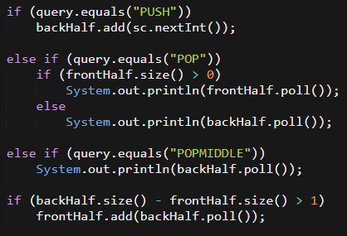
Solution
Notes:
int count = 0; //"global" counter on how many valid permutations
int D; //difficulty specificed, already read in using Scanner.
int[] heights; //heights of mountains, already read in using Scanner.
/* heights: actual heights of mountains,
hills: permutation of hills we're considering
used: array of [0, 1]. 0 means not used, 1 means used. */
private void permute(ArrayList<Integer> hills, boolean[] used) {
//Base case
if (hills.size() == heights.length) {
int difficulty = computeDifficulity(hills);
if (difficulty <= D) count += 1;
return;
}
//Recursive step
for (int i = 0; i < used.length; ++i) {
if (used[i]) continue;
used[i] = true; //Use position i
ArrayList<Integer> nxt = new ArrayList<>(hills);
nxt.add(heights[i]); //Create a copy of hills with the next hill
count += permute(nxt, used); //Recursively call
used[i] = false; //Remember to set "used[i]" back to un-used!
}
return;
}

Slide 7
Solution
Every operation is O(1)
At the end print all the numbers in the front half from front to back
Then print all the numbers in the back half from front to back
Notes:
private int computeDifficulity(ArrayList<Integer> hills) {
int diff = 0;
for (int i = 1; i < hills.size(); ++i) {
diff += (hills.get(i) - hills.get(i-1)) * (hills.get(i) - hills.get(i-1));
}
return diff;
}

Slide 8
Speakers

Slide 9
problem
Implement a Data Structure that can support 2 operations
  Insert a speech that starts at time S and ends at (S + L – 1)
    If overlap with another speech, ignore the operation
  Remove a speech that starts at time S and ends at (S + L – 1)
    If speech does not exist, ignore the operation
Notice: L is the same for ALL speakers

Slide 10
Solution
Two speeches will not overlap if and only if their starting times are at least L apart ➔ We do not need to care about the ending time!
Just use a TreeSet to store the set of starting times
For each insert, use floor() and ceiling() if the nearest speakers are at least time L apart from the new speech
For each remove, use contains() to check whether there exists such a speech
Remember to use long as already hinted
Notes:
class Student implements Comparable<Student> {
public String name;
public Integer score;
public Student(String name, ArrayList<Integer> scores) {
this.name = name;
Collections.sort(scores); //Sorts ascending by default, so we want last 3.
this.score = scores[1] + scores[2] + scores[3];
}
}

Slide 11
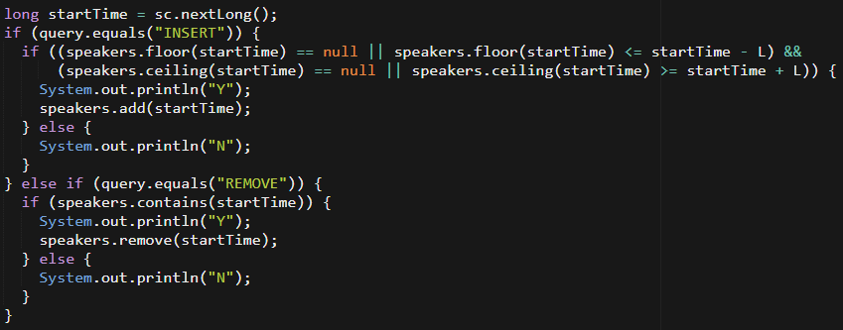
Solution
Notes:
class Student implements Comparable<Student> {
public String name;
public Integer score;
@Override
public int compareTo(Student other) {
if (this.score != other.score) {
return -(score.compareTo(other.score)); //Descending
}
return name.compareTo(other.name); //Lexicographical
}

Slide 12
Solution
Take note of the null case to avoid NullPointerException
Each operation can be done in O(log N)
Repeatedly call pollFirst() to get all the remaining values in ascending order to print
Notes:
private int computeDifficulity(ArrayList<Integer> hills) {
int diff = 0;
for (int i = 1; i < hills.size(); ++i) {
diff += (hills.get(i) - hills.get(i-1)) * (hills.get(i) - hills.get(i-1));
}
return diff;
}

Slide 13
MULTISOURCE

Slide 14
problem
Given an unweighted, directed graph, answer multiple shortest path queries from different sources to the same destination
Hint: Too slow to run BFS for every source vertex. What happens when you flip the graph?

Slide 15
Solution
The shortest path from vertex S to vertex T in a directed graph is the same as the shortest path from vertex T to vertex S in the flipped graph!
Hence, after flipping, problem becomes shortest path from vertex T to all other vertices in the graph, which can be solved using BFS from vertex T
BFS code is exactly the same as provided in lecture

Slide 16
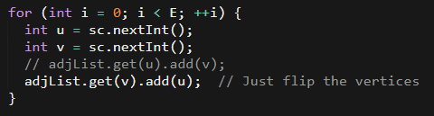
Solution
How to flip the graph?
Notes:
PriorityQueue<Long> pq = new PriorityQueue<>();
int totalHealing = 0; //This is the offset.

Slide 17
Computer game

Slide 18
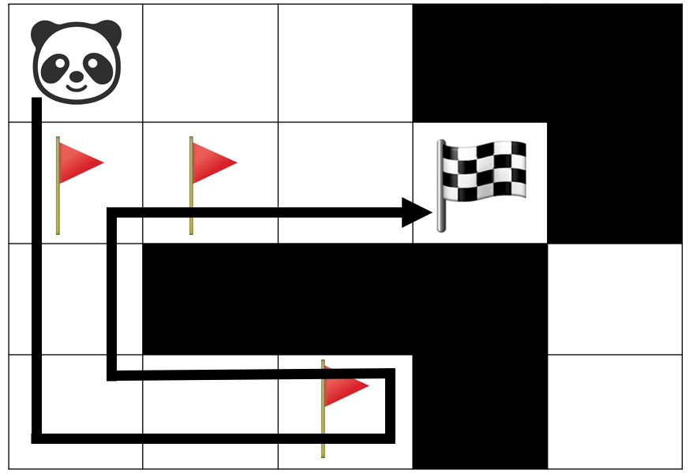
problem
Given a grid with a starting point, ending point and N checkpoints, find the minimum number of moves to collect all the checkpoints and reach the goal

Slide 19
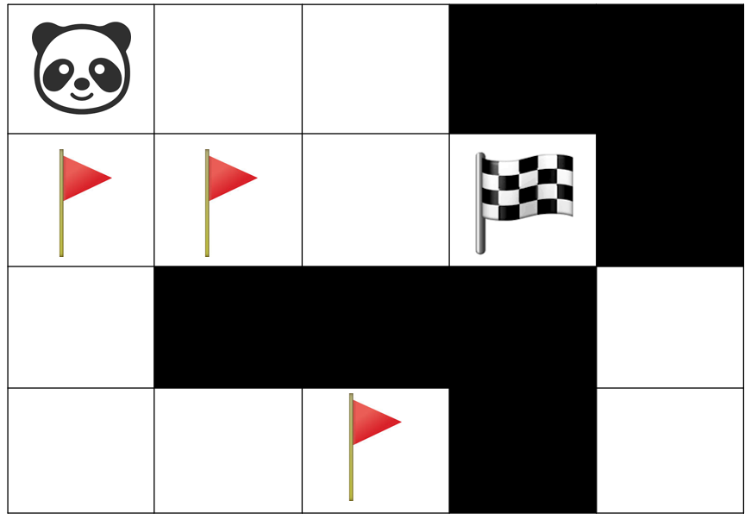
SOLUTION
We can model the grid as a graph where each cell is a vertex and between in pair of adjacent cells is an undirected, unweighted edge

Slide 20
SOLUTION
Run a BFS from the starting point to find the distance to each checkpoint
Run a BFS from the ending point to find the distance to each checkpoint
Run a BFS from each checkpoint to find the distance to all other checkpoints
Save all of these values in arrays

Slide 21
SOLUTION
Consider all possible permutations of checkpoints
Each permutation represents the order of visiting the checkpoints
E.g. S – 2 – 4 – 3 – 1 – E
You can calculate the total length of this path using all the values saved during the BFSes
Find the shortest length among all possible permutations

Slide 22
Any Questions?

Slide 23
Take Home Lab 4
Solutions

Slide 24
Take Home Lab 4
3 Questions to give you practice on Graph Algorithms
  Topological Ordering
  Applications of DFS/BFS
  Dijkstra Algorithm
Submit by 18th April 2019, 2359h

Slide 25
Pandachess

Slide 26
Problem Statement
N players
M matches between players
One winner and one loser for each match
Want to find a ranking such that:
Winner’s rank always higher than loser’s rank for all matches

Slide 27
Example
Match1: Player 1 beats Player 2
Player 1 should have higher rank than Player 2
Possible ranking: 1, 2
1
2

Slide 28
Example
Match1: Player 1 beats Player 2
Player 1 should have higher rank than Player 2
Match2: Player 2 beats Player 1
Player 2 should have higher rank than Player 1
Impossible!
1
2

Slide 29
Some Ideas
N players, M matches, each matches between two players
It’s a directed graph!
Players as vertices
Matches as directed edges
If player u beats player v, add an (u->v) edge
1
2
3
4

Slide 30
Some Ideas
What is the ‘ranking’ we want?
If we have edge (u->v), then u must have higher rank than v
It is the topological order!
1
2
3
4

Slide 31
Topological Ordering
1
2
Definition:
For every directed edge (u->v) in the directed graph, u comes before v in the ordering
Algorithm:
Keep removing vertices which have no incoming edge and update the graph.
3
4
Topological ordering: 3, 4, 1, 2

Slide 32
Implementation
BFS
Maintaining the number of incoming edges for each vertex
Start with the vertices has no incoming edges
For each vertex during BFS, remove all edges go out from the vertex and update the number of incoming edges for other vertices
After removing, find all vertices which have no incoming edges now and start BFS from them

Slide 33
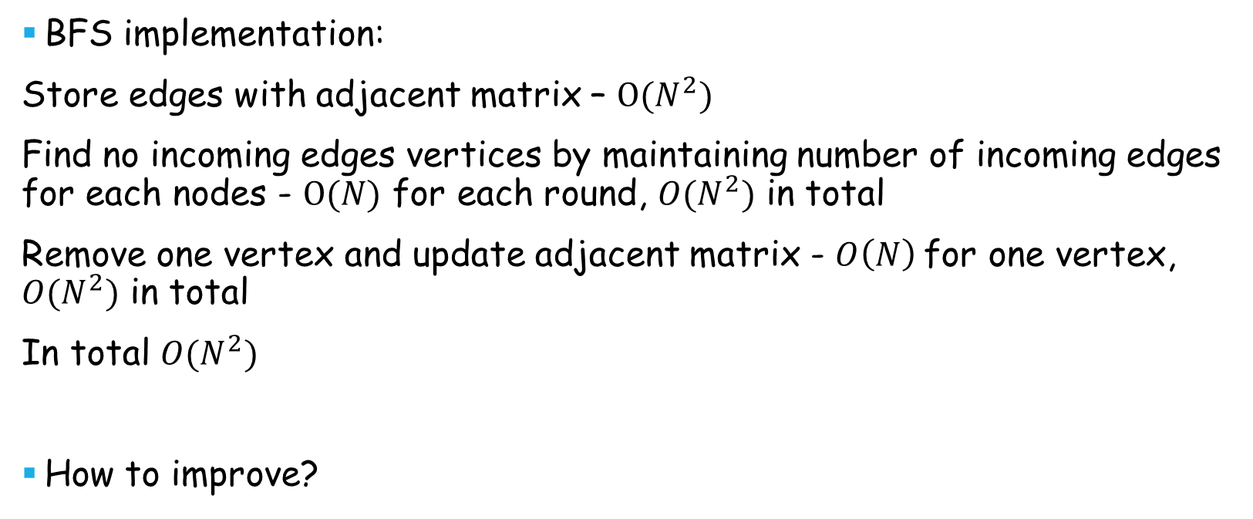
Time complexity
BFS implementation:
Store edges with adjacent matrix – $O(N^{2})$
Find no incoming edges vertices by maintaining number of incoming edges for each nodes - $O(N)$ for each round, $O(N^{2})$ in total
Remove one vertex and update adjacent matrix - $O\left(N\right)$for one vertex, $O(N^{2})$ in total
In total $O(N^{2})$
How to improve?

Slide 34
Better Implementation
Still using BFS
Using adjacent list instead of adjacent matrix
Maintaining the number of incoming edges for each vertex
Remove edges and records the vertices now has no incoming edges by the meantime

Slide 35
Topological Ordering
1
2
Number of incoming edges:
Vertices with no incoming edges:
{3}
Topological ordering:
{}
1 | 2 | 3 | 4
2 | 1 | 0 | 1
3
4

Slide 36
Removing vertex 3
Number of incoming edges:
Vertices with no incoming edges:
{3, 4}
Topological ordering:
{}
1
2
1 | 2 | 3 | 4
1 | 1 | 0 | 0
3
4
Using adjacent list to find all edges start from vertex 3
Update respective number of incoming edges
Find vertex 4 has no incoming edges now

Slide 37
Topological Ordering
1
2
Number of incoming edges:
Vertices with no incoming edges:
{4}
Topological ordering:
{3}
1 | 2 | 3 | 4
1 | 1 | 0 | 0
4

Slide 38
Topological Ordering
1
2
Number of incoming edges:
Vertices with no incoming edges:
{4, 1}
Topological ordering:
{3}
1 | 2 | 3 | 4
0 | 1 | 0 | 0
4
Using adjacent list to find all edges start from vertex 4
Update respective number of incoming edges
Find vertex 1 has no incoming edges now

Slide 39
Topological Ordering
1
2
Number of incoming edges:
Vertices with no incoming edges:
{1}
Topological ordering:
{3, 4}
1 | 2 | 3 | 4
0 | 1 | 0 | 0

Slide 40
Topological Ordering
1
2
Number of incoming edges:
Vertices with no incoming edges:
{1, 2}
Topological ordering:
{3, 4}
1 | 2 | 3 | 4
0 | 0 | 0 | 0
Using adjacent list to find all edges start from vertex 4
Update respective number of incoming edges
Find vertex 1 has no incoming edges now

Slide 41
Topological Ordering
2
Number of incoming edges:
Vertices with no incoming edges:
{2}
Topological ordering:
{3, 4, 1}
1 | 2 | 3 | 4
0 | 0 | 0 | 0

Slide 42
Topological Ordering
Number of incoming edges:
Vertices with no incoming edges:
{}
Topological ordering:
{3, 4, 1, 2}
1 | 2 | 3 | 4
0 | 0 | 0 | 0

Slide 43
Time complexity
BFS implementation:
Store edges with adjacent list – $O(N+M)$
Maintaining number of incoming edges for each nodes - $O(N)$
Remove one vertex, update adjacent list and number of incoming edges - $O(N+M)$ in total
Find the vertices with no incoming edges when updating adjacent list - $O(N+M)$ in total
In total $O(N+M)$

Slide 44
Issues
Topological sort only works for acyclic graph!
What happens if the graph has cycle?
There vertices in cycle will not be removed after BFS
When will the graph has a cycle?

Slide 45
Cycle
1
a1
2
a2
If we have a cycle with $l$vertices $a_{1}, a_{2}, a_{3},…, a_{l}$
Have to rank $a_{1}$ higher than $a_{2}$; $a_{2}$ higher than $a_{3}$;…; $a_{l−1}$ higher than $a_{l}$; $a_{l}$ higher than $a_{1}$
$$a_{1}>a_{2}>a_{3}>…>a_{l}>a_{1}$$
By contradiction, it’s impossible to rank them
3
a4
4
a3
?

Slide 46
Issues
How to determine whether the ranking is unique or not?

Slide 47
Unique Ranking
1
2
If we have choices of vertices to remove, the solution is not unique!
After removing vertex 4, we can choose vertex 1 or vertex 2
So both 3, 4, 1, 2 and 3, 4, 2, 1 are OK
3
4
1
2
4
1
2

Slide 48
Unique Ranking
1
2
If we don’t have choice, the solution is unique
There must be a edge between consecutive vertices in the ranking: (3->4), (4->1), (1->2) (otherwise we will have multiple choices)
These edges forms a chain go through all vertices and we have:
$$a_{1}>a_{2}>…>a_{n}$$
3
4
1
2
3
4

Slide 49
Unique Ranking
1
2
If we don’t have choice, the solution is unique
By contradiction, if we have another solution$b$. We can assume the first vertex $b_{i}$is not the same as $a_{i}$ is equal to $a_{j}(j>i)$. There must be a $b_{k}$ is the same as $a_{i}$ and $k>i$:
$$b_{1}=a_{1},b_{2}=a_{2}…,b_{i}=a_{j},…,b_{k}=a_{i}…$$
From the definition, we put $b_{i}=a_{j}$ before $b_{k}=a_{k}$.But we also have $a_{i}$ must be put before $a_{j}$($a_{i}>a_{j}$). Contradiction!
3
4
1
2
3
4

Slide 50
Summary
Topological sort with adjacent list
If there is circle (topological sort did not cover all vertices): no solution
During topological sort (BFS), if there are more than one vertices in queue waiting for process: solution not unique

Slide 51
Reading Material
https://en.wikipedia.org/wiki/Topological_sorting
https://en.wikipedia.org/wiki/Partially_ordered_set

Slide 52
Panda ISLANDS

Slide 53
Problem
N islands, 1 <= N <= 50,000
Each Island has an area X
E bridges, 1 <= E <= 300,000
Any two islands connected by a bridge must be a different color (Black or White)
Guaranteed that valid coloring exists
Islands are initially white, find area of Black Paint needed

Slide 54
Observations
If we pick a island to be black, the surrounding islands connected by a bridge must be white and vice versa
For this example, area of each island is equal to its index
Initially everything is white, but to be clear, lets make un-chosen islands red
1
3
2
4
5

Slide 55
Observations
If we pick a island to be black, the surrounding islands connected by a bridge must be white and vice versa
Pick 2 to be white
1
3
2
4
5

Slide 56
Observations
If we pick a island to be black, the surrounding islands connected by a bridge must be white and vice versa
Pick 2 to be white -> 1, 3, 4 must be black
1
3
2
4
5

Slide 57
Observations
If we pick a island to be black, the surrounding islands connected by a bridge must be white and vice versa
4 is black -> 5 is white
1
3
2
4
5

Slide 58
Observations
Having a valid way to paint the graph means that it is a bipartite graph
This just means that the nodes of the graph can be split into 2 sets where there only exists edges between the 2 sets.
Valid painting
Set 1
Set 2
1
3
1
2
2
3
4
5
5
4

Slide 59
Observations
Colors can be switched, so we should color the nodes in the smaller set to be black. Note that either coloring shown here is valid. *No need to actually color, just take the min
Set 1
Set 2
Set 1
Set 2
1
1
2
2
3
3
5
5
4
4
Black area: 8
Black area: 7

Slide 60
Observations
That only works when the graph is connected. What should we do?
  Treat each unconnected component as it’s own graph and add all the areas together. Total black area: 7 + 6 + 7 = 20
Set 1
Set 2
Set 1
Set 2
1
6
8
2
Black area: min(6, 8)
3
Set 1
Set 2
5
9
4
7
10
Black area: min(8, 7)
Black area: min(19, 7)

Slide 61
Algorithm
What is the algorithm to paint the graph?
  DFS/BFS (need to keep track of color and paint respectively)
How to keep track of area of each set?
  Store them in a class which keeps track of area of set 1 and area of set 2
Take note that the graph is unconnected
  Use a for loop around your initial DFS/BFS call (This will make it so that you go through every component once)
  Sum the min of the 2 areas you found after every iteration
The rest is your standard DFS/BFS!

Slide 62


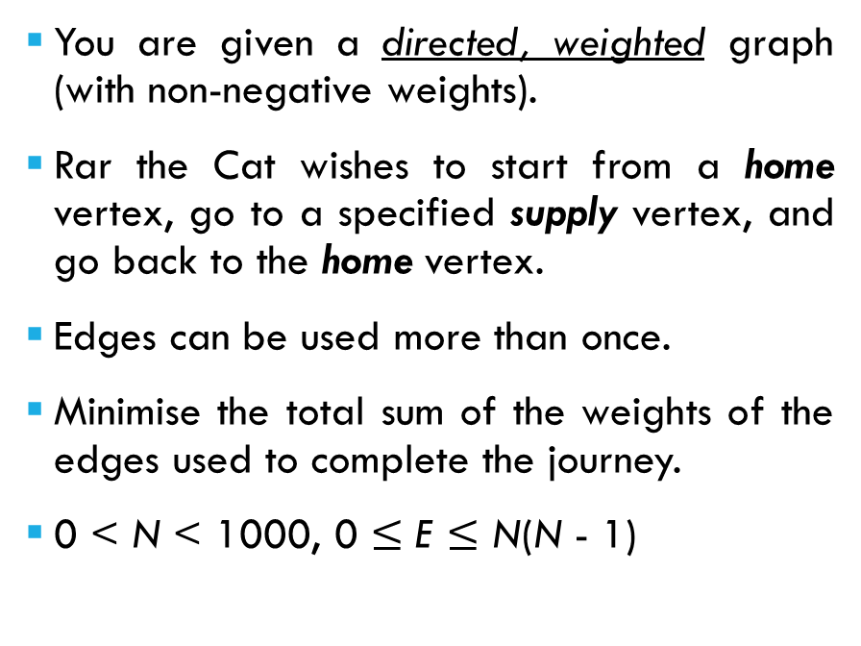
Problem Statement
Answer = 1 + 3 + 1 + 6 + 3 = 14
You are given a directed, weighted graph (with non-negative weights).
Rar the Cat wishes to start from a home vertex, go to a specified supply vertex, and go back to the home vertex.
Edges can be used more than once.
Minimise the total sum of the weights of the edges used to complete the journey.
0 < N < 1000, 0 $≤$ E $≤$ N(N - 1)
supply
5
1
3
8
1
4
3
1
6
0
2
3
home

Slide 63
Observation
The path from home → supply does not affect the path from supply → home.
The two paths can be calculated independently.
The answer to the problem is simply the sum of
  The weight of the shortest path from home → supply
  The weight of the shortest path from supply → home

Slide 64
Which algorithm to use?
Type | Name | Conditions | Time Complexity
APSP | Floyd-Warshall's | None | O(V ³)
SSSP | Bellman-Ford's | None | O(VE)
SSSP | Dijkstra's | Non-negative Edge Weights | O((V + E) log V)*
SSSP | Process in Topological Order | Directed Acyclic Graph (DAG) | O(V + E)
SSSP | BFS | Unweighted Graph (or all edge weights are equal) | O(V + E)
SSSP | BFS/DFS | Tree | O(V + E)
* (Outside scope of CS2040) The use of a Fibonacci Heap can speed this up to O(E + V log V)

Slide 65
Algorithm outline
1. Perform Dijkstra's Algorithm starting from the home vertex to find the shortest distance from home → supply.
1.1 If the distance estimate of the supply is still "Infinite" after the algorithm terminates, the answer is "Impossible". (Alternatively, check if the supply vertex was ever processed (for certain implementations).)
2. Perform Dijkstra's Algorithm starting from the supply vertex to find the shortest distance from supply → home.
2.1 The same check applies
3. Sum up the values to get the answer.

Slide 66
Time complexity analysis
Generation of the Adjacency List takes O(V + E) time.
We're performing 2 iterations of Dijkstra's Algorithm, each takes O((V + E) log V).
Total time complexity is O((V + E) log V)

Slide 67
Implementation details
Dijkstra's Algorithm requires you to support two operations:
  Decrease the distance estimate of a vertex.
  Retrieve and remove an unprocessed vertex with the lowest distance estimate.

Slide 68
Implementation Warning!
The elements in a Priority Queue (or Tree Set, or Tree Map, etc.) are not meant to be modified.
If you modify the elements stored in your Priority Queue such that the ordering of the elements may change, your data structure will have undefined behaviour.

Slide 69
Implementation Warning!
fooA
Consider the following example, where I have a Foo class that contains a single integer member called "value".
Foo objects are compared by "value" in ascending order.
The TreeSet on the right represents a possible structure for a TreeSet that contains two Foo objects, fooA and fooB with values 5 and 7 respectively.
If we were to change fooB's value to 0...
5
fooB
7

Slide 70
Implementation Warning!
fooA
Foo fooA = new Foo(5);
Foo fooB = new Foo(7);
TreeSet<Foo> fooSet = ...;
fooSet.add(fooA);
fooSet.add(fooB);
fooB.setValue(0);
return fooSet.contains(fooB);
Is this node equal to fooB? No.
5
fooB is less than this node, so search the left subtree.
Left subtree is empty. Return false.
fooB
0
7

Slide 71
Implementation details
Dijkstra's Algorithm requires you to support two operations:
  Decrease the distance estimate of a vertex.
  Retrieve and remove an unprocessed vertex with the lowest distance estimate.
There are three ways to go about this:
  Create your own Min Heap that can perform a decreaseKey(vertex, newKey) operation.
  Use a java.util.PriorityQueue with Lazy deletion (see Tutorial 8 Q1)
  Use a java.util.TreeSet.
We'll be using the second (because it's easy to code, and because TreeSet is slow)

Slide 72
Implementation details
Your Priority Queue will contain Nodes with the following details:
  The vertex to be processed.
  The distance estimate of the vertex.
We can create a helper class* called DijkNode because I couldn't think of a better name.
class DijkNode implements Comparable<DijkNode> {
private int vertex;
private int distEstimate;
public int compareTo(DijkNode other) {
return this.distEstimate - other.distEstimate;
}
}
* You can also use your Edge class since it's already there.

Slide 73
Implementation details
Since the vertices are labelled from 0 to N - 1, we'll store the most updated distance estimates in an array of size N.
final int INF = 1000000000;
int[] distance = new int[N];
for (int i = 0; i < N; ++i) {
distance[i] = INF;
}

Slide 74
Implementation details
During initialisation, set the distance of your source as 0 and push the node [source, 0] into your Priority Queue.
PriorityQueue<DijkNode> dijkstraPQ = new PriorityQueue<>();
distance[source] = 0;
dijkstraPQ.add(new DijkNode(source, 0));

Slide 75
Implementation details
While your Priority Queue is not empty, get the next DijkNode.
If the distance estimate of the DijkNode does not match the most updated value*, ignore it.
while (!dijkstraPQ.isEmpty()) {
DijkNode node = dijkstraPQ.poll();
int vertex = node.getVertex();
int distEst = node.getDistEstimate();
if (distance[vertex] != distEst) {
continue;
}
* You can also have a boolean array called isProcessed and ignore a DijkNode if the vertex has already been processed.

Slide 76
Implementation details
To process a vertex, relax all incident edges and push new DijkNodes into your Priority Queue if a distance estimate is updated.
for (Edge edge : adjList.get(vertex)) {
int nextVertex = edge.getTo();
int nextDistEst = distEst + edge.getWeight();
if (nextDistEst < distance[nextVertex]) {
distance[nextVertex] = nextDistEst;
dijkstraPQ.add(new DijkNode(nextVertex, nextDistEst));
}
}

Slide 77
Implementation details
Finally, return the distance between the source and your specified destination.
return distance[destination];

Slide 78
Quick question!
final int INF = 1000000000;
int[] distance = new int[N];
for (int i = 0; i < N; ++i) {
distance[i] = INF;
}
Why is INF set as 1,000,000,000 and not Integer.MAX_VALUE?
Randomly chosen using a 1,000,000,000-sided die.
Ooooooooooooooooooooo
Doesn't matter; both are big enough.
The zeroes soothe my pain.
oooooverflow

Slide 79
Quick question!
final int INF = 1000000000;
int[] distance = new int[N];
for (int i = 0; i < N; ++i) {
distance[i] = INF;
}
Why is INF set as 1,000,000,000 and not Integer.MAX_VALUE?
Randomly chosen using a 1,000,000,000-sided die.
Ooooooooooooooooooooo
Doesn't matter; both are big enough.
The zeroes soothe my pain.
for (Edge edge : adjList.get(vertex)) {
int nextVertex = edge.getTo();
int nextDistEst = distEst + edge.getWeight();
if (nextDistEst < distance[nextVertex]) {
oooooverflow
* Disclaimer: I know neither of those values can be INF, but you can see how things may crash and burn in other programs.

Slide 80
What if I want to use a TreeSet?
We'll have a TreeSet of DijkNodes, similar to the Priority Queue implementation.
However, remember that we cannot modify the DijkNodes directly while they're still in the TreeSet.
TreeSet<DijkNode> dijkstraTS = new TreeSet<>();

Slide 81
What if I want to use a TreeSet?
Updating the distance estimate of a vertex in the TreeSet consists of three steps:
  Remove the relevant DijkNode from the TreeSet.
  Update the distance estimate.
  Push the updated DijkNode back into the TreeSet.
DijkNode node = new DijkNode(vertex, distance[vertex]);
dijkstraTS.remove(node);
distance[vertex] = newDistEst;
node.setDistEstimate(newDistEst);
dijkstraTS.add(node);

Slide 82
What if I want to use decrease Key?
For the sake of completeness, I will also talk about a Dijkstra's implementation that uses DecreaseKey.
The idea is that you'll create your own Heap data structure, where you have complete control.
To decrease the distance estimate of a vertex, you can alter the actual node in the Heap and perform bubble-up to re-establish the Heap property.

Slide 83
decrease Key Implementation
You'll need to create your own Heap data structure. We'll be using an array as the internal container.
You'll also have to keep track of the index of each vertex in that array.
Because the vertices are labelled from 0 to N - 1, we'll use an int array.
class DijkHeap {
private DijkNode[] heapArray;
private int[] vertexIndex;
// Constructor
public DijkHeap(int numVertices) {
heapArray = new DijkNode[numVertices + 1];
vertexIndex = new int[numVertices];
for (int i = 0; i < numVertices; ++i) {
heapArray[i + 1] = new DijkNode(i, INF);
vertexIndex[i] = i + 1;
}
}

Slide 84
decrease Key Implementation
To decrease the key (distance estimate):
  Find the DijkNode in the Heap array
  Change the distance estimate
  Re-establish the Heap property using bubble-up.
public void decreaseKey(int vertex, int newDist) {
int index = vertexIndex[vertex];
DijkNode node = heapArray[index];
if (newDist < node.getDistEstimate()) {
node.setDistEstimate(newDist);
bubbleUp(index);
}
}

Slide 85
decrease Key Implementation
Ensure that your Heap methods also update the vertex indices as you move the DijkNodes around.
private void nodeSwap(int index1, int index2) {
DijkNode node1 = heapArray[index1];
DijkNode node2 = heapArray[index2];
// Update indices
vertexIndex[node1.getVertex()] = index2;
vertexIndex[node2.getVertex()] = index1;
heapArray[index1] = node2;
heapArray[index2] = node1;
}

Slide 86
decrease Key Implementation
Ensure that your Heap methods also update the vertex indices as you move the DijkNodes around.
For example, bubble up and bubble down.
private void bubbleUp(int index) {
while (index > 1) {
int parentIndex = index / 2;
DijkNode node = heapArray[index];
DijkNode parent = heapArray[parentIndex];
if (node.compareTo(parent) < 0) {
nodeSwap(index, parentIndex);
index /= 2;
} else {
break;
}
}
}

Slide 87
decrease Key Implementation
After creating your modified Heap, use it in your main code.
DijkHeap dijkHeap = new dijkHeap(numVertices);
dijkHeap.decreaseKey(source, 0);
while (!dijkHeap.isEmpty()) {
DijkNode node = dijkHeap.poll();
int vertex = node.getVertex();
int distEst = node.getDistEstimate();
if (distEst == INF) {
// No more reachable vertices
break;
}
for (Edge edge : adjList.get(vertex)) {
...

Slide 88
decrease Key Implementation
This implementation is quite specific for vertices labelled from 0 to N - 1.
For more general cases, you can use a HashMap to store the indices of the keys instead.
class MinHeap<K,V> {
ArrayList<Pair<K,V>> heapArray;
HashMap<K, Integer> keyIndex;
...

Slide 89

Pause - Any questions?

Slide 90
Extend the problem!
Answer = 1 + 3 + 1 + 6 + 3 = 14
Suppose there are now up to S scenarios.
In each scenario, there's a different supply vertex that Rar the Cat wants to go to.
  His home vertex stays the same.
Example:
  Scenario 1: Supply = 3, Answer = 14
supply 1
5
1
3
8
1
4
3
1
6
0
2
3
home

Slide 91

Extend the problem!
Answer = 1 + 3 + 3 = 7
Suppose there are now up to S scenarios.
In each scenario, there's a different supply vertex that Rar the Cat wants to go to.
  His home vertex stays the same.
Example:
  Scenario 1: Supply = 3, Answer = 14
  Scenario 2: Supply = 2, Answer = 7
5
1
3
8
1
4
3
1
6
0
2
3
home
supply 2

Slide 92
Extend the problem!
0 | 1 | 2 | 3
Distance from 0:
0 | 1 | 4 | 5
Distance from 3:
9 | 10 | 6 | 0
The previous solution requires you to run Dijkstra's from the home and supply vertices.
supply 1
5
1
3
8
1
4
3
1
6
0
2
3
home

Slide 93
Extend the problem!
0 | 1 | 2 | 3
Distance from 0:
0 | 1 | 4 | 5
9 | 10 | 6 | 0
9 | 10 | 6 | 0
Distance from 2:
3 | 4 | 0 | 1
Distance from 3:
The previous solution requires you to run Dijkstra's from the home and supply vertices.
Now that the supply vertex is different between scenarios, you'll need to run Dijkstra's at least once for each scenario.
  The distance from the home to the supply vertex can be known from previous scenarios.
  The distance from the supply to the home vertex needs to be recalculated.
The solution runs in O(S (V + E) log V).
Can we do better?
5
1
3
8
1
4
3
1
6
0
2
3
home
supply 2

Slide 94
Use a different algorithm?
Instead of using a single-source shortest path (SSSP) algorithm, maybe we'll have better luck with an all-pairs shortest path (APSP) algorithm.
Running Floyd-Warshall's algorithm gives you the shortest path between any pair of vertices in O(V³) time.
Now each scenario can be solved in O(1) time.
Total time complexity: O(V³ + S)
  It's not too much better than the previous solution.
  It's actually slower when the graph is sparse.
Can we do better?
 | 0 | 1 | 2 | 3
Distance from 0: | 0 | 1 | 4 | 5
Distance from 1: | 4 | 0 | 3 | 4
Distance from 2: | 3 | 4 | 0 | 1
Distance from 3: | 9 | 10 | 6 | 0

Slide 95
Observation
When you look at it, not all of the results from the APSP are used.
Specifically, the only values that are used are
  The distance from the home vertex to any vertex.
  The distance from any vertex to the home vertex.
The former can be calculated by running Dijkstra's from the home vertex.
The latter is the main issue.
 | 0 | 1 | 2 | 3
Distance from 0: | 0 | 1 | 4 | 5
Distance from 1: | 4 | 0 | 3 | 4
Distance from 2: | 3 | 4 | 0 | 1
Distance from 3: | 9 | 10 | 6 | 0
 | 0 | 1 | 2 | 3
Distance from 0: | 0 | 1 | 4 | 5
Distance from 1: | 4 | 0 | 3 | 4
Distance from 2: | 3 | 4 | 0 | 1
Distance from 3: | 9 | 10 | 6 | 0

Slide 96
Observation
Goal: Find the distance from any vertex to the home vertex.
Rather than a "Single-source shortest path", this is more of a
"Single-destination shortest path" problem.
It's almost like Dijkstra's, but backwards.
So let's try that.

Slide 97
Dijkstra's... Backwards?
4
5
9
1
2
3
4
1
When we perform Dijkstra's starting from 0, the edges selected are highlighted in green in the top graph.
When calculating the shortest paths from all vertices to 0, the edges selected are highlighted in blue in the bottom graph.
The algorithm appears to be the same as Dijkstra's, except you're considering only the incoming edges instead of the outgoing edges.
Another way to look at it is that all the edges in the graph are reversed, then Dijkstra's is run from 0 as per normal.
  A graph with all its edges reversed is known as its Transpose.
0
0
home
Normal Dijkstra's
What we want
6
5
1
1
2
3
4
1
0
0
home

Slide 98
Why would it work?
Suppose you have found the shortest path from 0 to 5 in the transpose graph.
Reversing all the edges in that path gives you the shortest path from 5 to 0 in the original graph.
3
5
3
5
3
3
3
3
9
9
2
8
2
8
1
4
1
4
2
6
2
6
1
1
3
1
3
1
9
9
7
7
0
0
Original
Transpose

Slide 99
Why would it work?
Running Dijkstra's on the transpose graph gives you the shortest paths from 0 to any vertex.
Reversing all the edges back to the original graph gives you the shortest paths from any vertex to 0.
9
9
6
3
5
6
3
5
3
3
3
3
9
3
9
3
2
8
2
8
1
4
1
4
4
2
6
4
2
6
1
1
1
1
3
1
4
3
1
4
9
9
7
7
0
0
Original
Transpose
0
0

Slide 100
Algorithm outline
Create two Adjacency Lists - one for the original and one for the transpose.
Run Dijkstra's from the home vertex on the original graph.
  This gets the distance from the home vertex to any vertex.
Run Dijkstra's from the home vertex on the transpose graph.
  This gets the distance from any vertex to the home vertex.
For each scenario, output the sum of the appropriate distance values from the previously executed Dijkstra's.

Slide 101
Time complexity analysis
Constructing the Adjacency Lists take O(V + E) time.
Dijkstra's is run twice, each on graphs with equal numbers of vertices and edges. This takes O((V + E) log V) time.
Each scenario is answered in O(1) time.
Total time complexity: O((V + E) log V + S)

Slide 102
Final notes
Dijkstra's Algorithm is a very useful and common algorithm.
Do take the time to learn how to code a working solution.

Slide 103
Any Questions?

Slide 104
VISUALGO Quiz 4

Slide 105
VisuAlgo Online Quiz 4
(10 Qns, 15mins, best out of 2 tries)
1.) Open Chrome and make sure it is fullscreened and no other window is opened except calculator if you need it
2.) In the browser, type the following link but don’t press enter → https://visualgo.net/training?diff=Hard&n=10&tl=15&module=bst,avl,graphds
(Now wait!)
3.) Later when you are done DO NOT press submit. Raise your hands to inform your lab TA who will submit for you.
4.) Wait for your lab TA to come and press submit and take down your score
Notes:
Lab TAs tell them not to press enter on the link yet on this slide. Just do step 1 to 2.
Lab TAs pls wait for 1-2 minutes then ask if everyone has done the above. If all yes then move to the next slide.

Slide 106
VisuAlgo Online Quiz 4
(10 Qns, 15mins, best out of 2 tries)
5.) Now press enter on the typed link, and proceed with the quiz
(Do not restart your quiz or set your difficulty to anything other than hard! Anyone caught doing this will get a zero !)

Slide 107
VisuAlgo Online Quiz 4
(10 Qns, 15mins, best out of 2 tries)
1.) Open Chrome and make sure it is fullscreened and no other window is opened except calculator if you need it
2.) In the browser, type the following link but don’t press enter → https://visualgo.net/training?diff=Hard&n=10&tl=15&module=bst,avl,graphds
3.) Later when you are done DO NOT press submit. Raise your hands to inform your lab TA who will submit for you
4.) Wait while your lab TA come and press submit and take down your score
5.) Now press enter on the typed link and proceed with the quiz
(Do not restart your quiz or set your difficulty to anything other than hard! Anyone caught doing this will get a zero !)
Notes:
Show this slide after the students start their quiz.
Lab TAs should now go and stand at the back/or move around to invigilate, to ensure no one restarts the quiz.

