Slide 1
Lab Session 02
CS2040 AY18/19 S2
Muhammad Irham Rasyidi
David Livingston

Slide 2
SCOPE FOR TODAY
Recap of Java OOP
Introduction to Algorithmic analysis
Run-through of Java classes
AAR for sit-in lab 0
Take Home lab 1 runthrough

Slide 3
Java OOP, Revisited
All of these are valid ways to initialize a list of integers. But how do they differ?
ArrayList<Integer> list1 = new ArrayList<>();
LinkedList<Integer> list2 = new LinkedList<>();
List<Integer> list3 = new ArrayList<>();
List<Integer> list4 = new LinkedList<>();

Slide 4
Java OOP, Revisited
ArrayList<Integer> list1 = new ArrayList<>();
List<Integer> list3 = new ArrayList<>();
Under the hood, both of these function in the exact same way.
The type of list1 is ArrayList<Integer>
  This gives you access to all methods in the List and ArrayList classes.
  E.g. You can call list1.removeRange(start, end), but not with list3.
However, by using List<Integer>, you can freely swap out ArrayList for LinkedList.
Ultimately, which one to use is up to you.

Slide 5
Java OOP, Revisited
ArrayList<Integer> list = new ArrayList<>();
<Type> is the type argument of the list. It's a compile-time feature that forces the list to only contain a certain type, known as Java Generics.
This ensures type safety.
Without it, Java can only guarantee that the contents are Objects.
ArrayList<Integer> list = new ArrayList<>();
list.add(5); // OK
// list.add("X"); // Not OK
int x = list.get(0); // OK
ArrayList list = new ArrayList();
list.add(5); // OK
// int x = list.get(0); // Not OK
int x = (Integer) list.get(0);

Slide 6
Algorithmic analysis
(a brief introduction)
What in the world does the Big O notation mean?

Slide 7

A case in point: pIGEON VS INTERNET
How does the running time scale with the input over time?

Slide 8
Algorithmic analysis in a nutshell
How long will my program take?
How much memory (space) will it consume?

Slide 9
tHE BIG OH NOTATION
The relationship between the running time and input size
Let’s look at some examples!

Slide 10
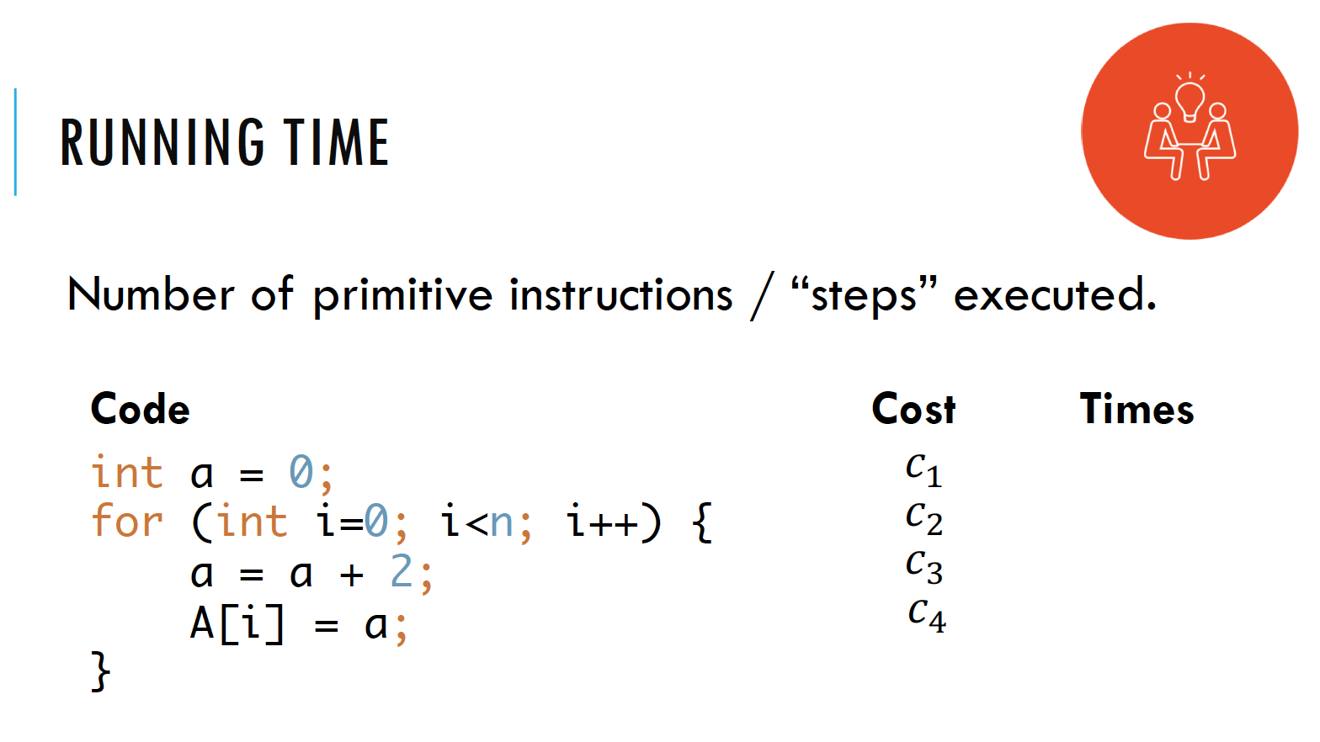

Slide 11
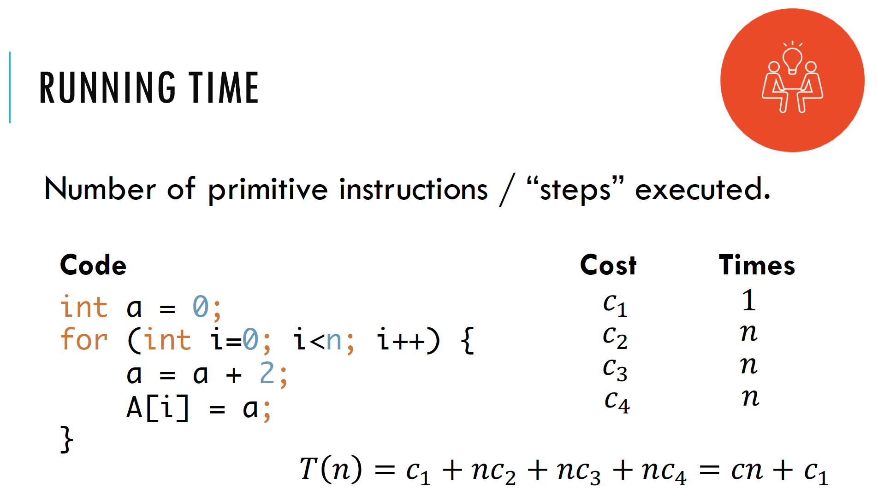
Time complexity In BIG-OH: O(N)

Slide 12
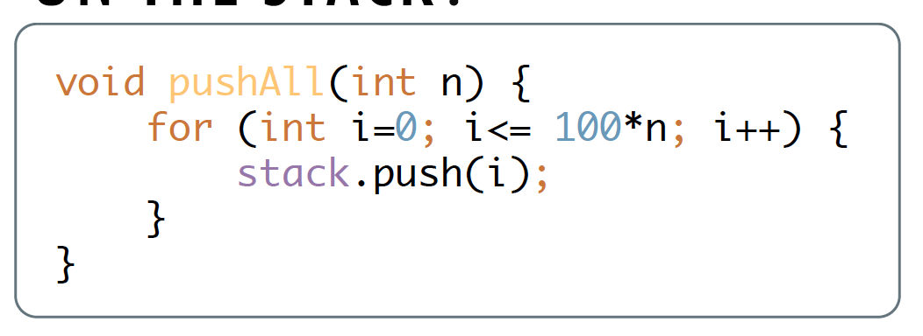
What is the time complexity?

Slide 13
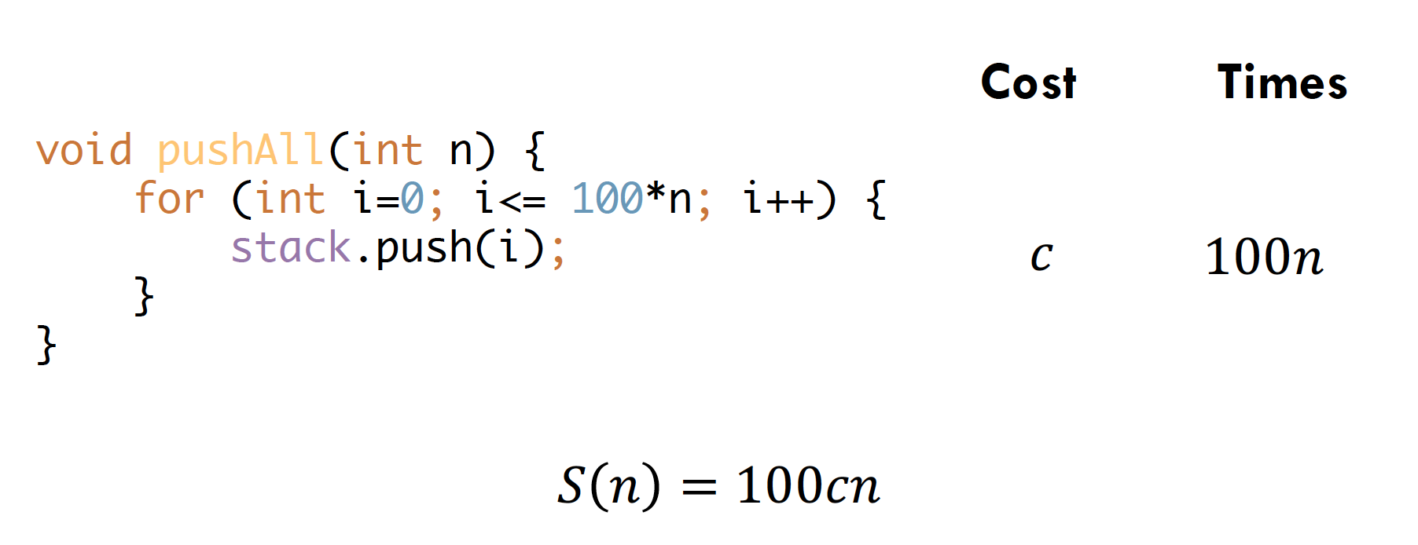
Time complexity In BIG-OH: O(N)

Slide 14
Some things to note
Different inputs mean Different variables
  E.g Finding all possible pairs in 2 arrays, A (of size m) and B (of size n)
  Complexity: O(mn)
Constants are dropped
  E.g O(100n) → O(n)
Discard non-dominant terms
  E.g O(n² + n) → O(n²)

Slide 15
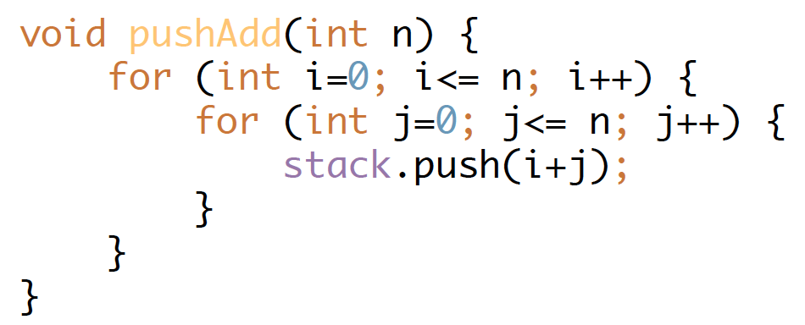
What is the time complexity?

Slide 16
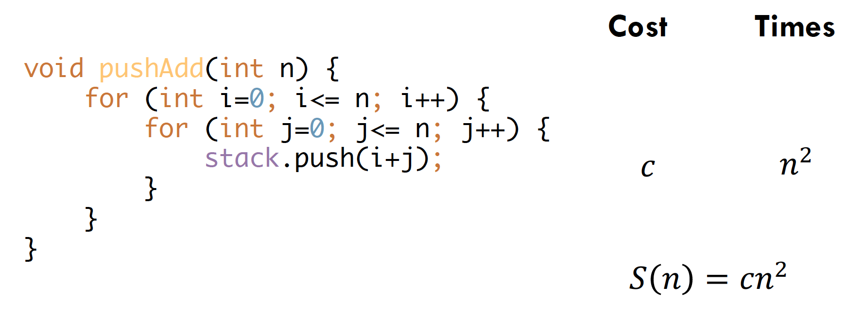
Time complexity: O(n²)
Note: Constants are dropped!

Slide 17
Java API ArrayList
ArrayList<Integer> l = new ArrayList<>();
https://docs.oracle.com/javase/8/docs/api/java/util/ArrayList.html
Methods | Description | Speed
isEmpty() size() | Self-explanatory. | O(1)

Slide 18
Java API ArrayList
Methods | Description | Speed
get(p) | Returns the element at position p. | O(1)
set(p, x) | Replaces the element at position p with x. | O(1)
indexOf(x) | Index of the first occurrence of object x. -1 if it does not exist in the ArrayList. | O(N)
contains(x) | Returns True/False depending whether object x is in the ArrayList. | O(N)
add(p, x) | Adds a new element x at position p. | O(N)
remove(p) | Returns and removes the element at position p. | O(N)
remove(x) | Returns and removes the first occurrence of object x from the ArrayList. | O(N)
clear() | Empties the ArrayList. | O(N)

Slide 19
Java API LinkedList
LinkedList<Integer> l = new LinkedList<>();
https://docs.oracle.com/javase/8/docs/api/java/util/LinkedList.html
Methods | Description | Speed
isEmpty() size() | Self-explanatory. | O(1)
addFirst(x) push(x) offerFirst(x) | Adds an element to the front of the Linked List. | O(1)
addLast(x) add(x) offerLast(x) offer(x) | Adds an element to the back of the Linked List. | O(1)

Slide 20
Java API LinkedList
Methods | Description | Speed
getFirst() peek() peekFirst() | Returns the element at the front of the Linked List. | O(1)
getLast() peekLast() | Returns the element at the back of the Linked List. | O(1)
pollFirst() poll() removeFirst() pop() | Returns and deletes the element at the front of the Linked List. | O(1)
pollLast() removeLast() | Returns and deletes the element at the back of the Linked List. | O(1)

Slide 21
Java API LinkedList
Methods | Description | Speed
get(p) | Returns the element at position p. | O(N)
set(p, x) | Replaces the element at position p with x. | O(N)
indexOf(x) | Index of the first occurrence of object x. -1 if it does not exist in the Linked List. | O(N)
contains(x) | Returns True/False depending whether object x is in the Linked List. | O(N)
add(p, x) | Adds a new element x at position p. | O(N)
remove(p) | Returns and removes the element at position p. | O(N)
remove(x) | Returns and removes the first occurrence of object x from the Linked List. | O(N)
clear() | Empties the Linked List. | O(N)

Slide 22
Java API ListIterator
LinkedList<Integer> l = new LinkedList<>();
ListIterator<Integer> it = l.listIterator();
Methods | Description | Speed
l.listIterator() | Returns a list iterator to the start of the Linked List. | O(1)
l.listIterator(i) | Returns a list iterator to the position between the (i-1)-th and i-th indexed elements in the Linked List. If i == 0, then the list iterator that is returned is before the first element. If i == N, then the list iterator that is returned is after the last element. | O(N)

Slide 23
Java API ListIterator
0
1
2
3
4
0
1
2
3
4
5
Iterators point to the area in-between two elements.
Elements have N positions/indexes: 0 to N-1.
Iterators have N+1 positions/indexes: 0 to N.

Slide 24
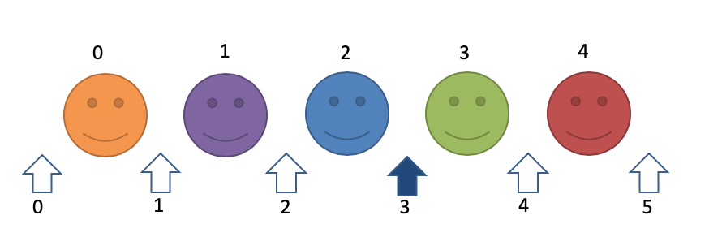
ConcurrentModificationException
Note: You cannot mutate the list directly (i.e using LinkedList API) while using an iterator.
  E.g If the iterator is at the shaded position above, you cannot do something like: myLinkedList.removeLast();

Slide 25
ConcurrentModificationException
Note: You can, however, mutate the list using the iterator.
  E.g If the iterator is at the shaded position above, you can do something like: myListIterator.remove();

Slide 26
Java API ListIterator
Methods | Description | Speed
hasNext() | Returns whether there is a next element. | O(1)
next() | Returns the next element. | O(1)
hasPrevious() | Returns whether there is a next element. | O(1)
previous() | Returns the previous element. | O(1)
set(x) | Replaces the element that was just returned by next() or previous() with x. | O(1)
remove() | Removes from the list the element that was just returned by next() or previous() | O(1)
add(x) | Adds x at the position of the ListIterator. The ListIterator will be updated to be after the inserted element. | O(1)

Slide 27
Java API Stack
Stack<Integer> s = new Stack<>();
https://docs.oracle.com/javase/8/docs/api/java/util/Stack.html
Methods | Description | Speed
isEmpty() size() | Self-explanatory | O(1)
push(x) add(x) | Adds an element to the top of the stack | O(1)
peek() | Returns the top element. | O(1)
pop() | Returns and removes the top element. | O(1)

Slide 28
Java API Queue
Queue<Integer> q = new LinkedList<>();
https://docs.oracle.com/javase/8/docs/api/java/util/Queue.html
Methods | Description | Speed
isEmpty() size() | Self-explanatory | O(1)
add(x) offer(x) | Adds an element to the back of the queue. | O(1)
peek() | Returns the front element. | O(1)
poll() | Returns and removes the front element. | O(1)

Slide 29
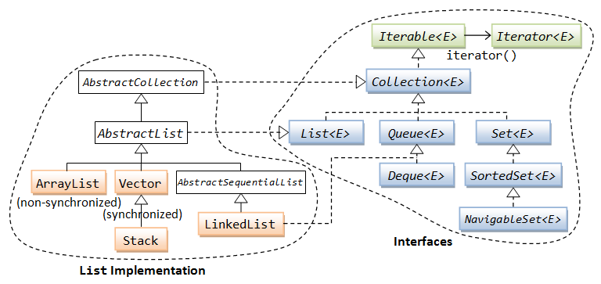
Java API
ArrayDeque
Image taken from: https://www.ntu.edu.sg/home/ehchua/programming/java/J5c_Collection.html

Slide 30
Java API Deque
Deque<Integer> dq = new LinkedList<>();
Deque<Integer> dq = new ArrayDeque<>();
https://docs.oracle.com/javase/8/docs/api/java/util/Deque.html
Methods | Description | Speed
isEmpty() size() | Self-explanatory. | O(1)
addFirst(x) push(x) offerFirst(x) | Adds an element to the front of the Deque. | O(1)
addLast(x) add(x) offerLast(x) offer(x) | Adds an element to the back of the Deque. | O(1)

Slide 31
Java API Deque
Methods | Description | Speed
getFirst() peek() peekFirst() | Returns the element at the front of the Deque. | O(1)
getLast() peekLast() | Returns the element at the back of the Deque. | O(1)
pollFirst() poll() removeFirst() pop() | Returns and deletes the element at the front of the Deque. | O(1)
pollLast() removeLast() | Returns and deletes the element at the back of the Deque. | O(1)

Slide 32
Java API Deque
Methods | Description | Speed
contains(x) | Returns True/False depending whether object x is in the Deque. | O(N)
remove(x) | Returns and removes the first occurrence of object x from the Deque. | O(N)
clear() | Empties the Deque. | O(N)

Slide 33
Questions?

Slide 34
Sit-in Lab 0 AAR
What do you mean I can't look at StackOverflow?

Slide 35
Sit-in Lab 0: AAR
Last week, you all had a taste of a Sit-in Lab.
Sit-in Lab 1 next week will be quite similar.
  Except it'll actually be 1h 40min.

Slide 36
Before the sit-in Lab
If nothing goes wrong, we will start the Sit-in Lab at exactly 8:05 A.M.
Reminder: You can bring in any hard-copy material you want.

Slide 37
First 15 minutes of the Sit-in Lab
Reminder: You are not allowed to touch the keyboard.
Instead you can:
  Read the question paper and scribble on it.
  Browse through the Java documentation (but only with the mouse)

Slide 38
Throughout the Sit-in Lab
Reminder: You are NOT allowed to surf the Internet.
  No StackOverflow or GeeksForGeeks to save you now :D
Disclaimer: I know it was cruel to require you to print a number correct to 2 d.p. last week; you were at a major disadvantage if you didn't already know how to do that. Let's hope there won't be anything like this next week.

Slide 39
Throughout the Sit-in Lab
If you need assistance with anything Unix-related (e.g. moving through the directories, etc.), do not hesitate to ask us.
  Your suffering should only be limited to Java.
Example Unix commands:
cd ex1
  Navigate to the folder "ex1".
cd ..
  Navigate to the parent folder.

Slide 40
Using the Check script
To use the check.sh script, run the following command:
For example, if your filename is YeahBoi.java, then you should run bash check.sh YeahBoi
bash check.sh ClassName

Slide 41
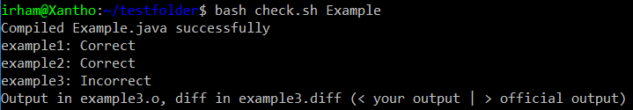
Using the Check script
If everything goes well, you'll see that all the test cases pass.
If not, you'll get an output that can look like this:
As the text mentions,
  Your program output is stored in example3.o
  The differences are stored in example3.diff

Slide 42
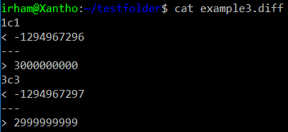
Using the Check script
To view the differences, you can use vim, or use the cat command.
Your output
Expected output

Slide 43
Throughout the Sit-in Lab
File name: Problem.java
Remember that you should only submit one Java file (i.e. the template that is provided).
You can have multiple classes, just make sure they're all in the same file.
class HelperClass1 {
...
}
class HelperClass2 {
...
}
public class Problem {
public static void main(String[] args) {
...
}
}

Slide 44
Throughout the Sit-in Lab
For all problems, do print a newline character at the end of the output.
E.g. Print out two numbers:
E.g. Print out contents of a list in a single line:
System.out.println(firstNum + " " + secondNum);
for (String word : wordList) {
System.out.print(word + " ");
}
System.out.println();

Slide 45
Throughout the Sit-in Lab
At the top of each file, you’ll see this comment.
Do remember to fill it in.
  (I think marks may be deducted if you fail to do so)
/**
* Name :
* Matric. No :
* Plab Acct. :
*/

Slide 46
End of the Sit-in Lab
The PLab sheets need to be collected in sorted order.
We'll try the following next week:
Person closest to the aisle, please collect the PLab sheets for your row and arrange them in sorted order.
  The smallest PLab account should be on top.
Please pass your Sit-in Lab Instruction Sheet and Question Paper to the person in front of you.
  Keep them in two nice stacks: One for the Instruction Sheet, one for the Question Paper.

Slide 47
Questions?

Slide 48
Take-HOME LAB 01
Slightly more interesting than Take-home Lab 0!

Slide 49
Sequences
Y'all got any more of them
diverging series?

Slide 50
Abridged Problem Statement
Print the first N terms of an Arithmetic or Geometric Sequence.
For an Arithmetic Sequence, given A and D, the sequence is
A, A+D, A+2D, A+3D, A+4D, ...
For a Geometric Sequence, given A and R, the sequence is
A, AR, AR², AR³, AR⁴, ...
DO NOT print a space after the last term in the sequence.

Slide 51
Generating the Terms
The terms to both sequences can be generated using a simple loop.
for (int i = 0; i < N; ++i) {
// ...
if (sequenceType == 1) {
// Arithmetic
currentTerm += value;
} else {
// Geometric
currentTerm *= value;
}
}

Slide 52
Pitfall: doubles are EVIL!
It might be tempting to generate the terms by calculating AR^{i-1} directly,
However, the return type of Math.pow() is a double, which may lead to precision errors when dealing with large numbers.
for (int i = 0; i < N; ++i) {
currentTerm = (long) (initialTerm * Math.pow(R, i - 1));
}
// Expected: 16677181699666569
// Actual: 16677181699666568
(long) Math.pow(3, 34);

Slide 53
No space after last term?
Printing the terms normally will result in a trailing space at the end.
How do we avoid this?
for (int i = 0; i < N; ++i) {
System.out.print(currentTerm + " ");
// ...
}
System.out.println();
Output:
2 5 8 11 14_

Slide 54
Option 1: Avoid space at last term
Simply avoid printing the space when printing the last term in the sequence.
Usually the simplest method.
for (int i = 0; i < N; ++i) {
System.out.print(currentTerm);
if (i != N - 1) {
System.out.print(" ");
}
// ...
}

Slide 55
Option 2: Avoid space at FIRST term
Print a space before the number, except at the first term.
Helpful for problems where you don't know the number of terms to print beforehand.
for (int i = 0; i < N; ++i) {
if (!isFirstTerm) {
System.out.print(" ");
} else {
isFirstTerm = false;
}
System.out.print(currentTerm);
// ...
}

Slide 56
Bad Option: MAKE a STRING
You could also put all the output into a String and print it at the end after trimming off the trailing spaces.
But this is slow and may result in you exceeding the time limit.
Remember the exercise from last week?
String output = "";
for (int i = 0; i < N; ++i) {
output = output + currentTerm + " ";
// ...
}
System.out.println(output.trim());

Slide 57
Okay Option: MAKE a STRING
But if you really want to do it this way, you can do so using the StringBuilder class.
StringBuilder output = new StringBuilder();
for (int i = 0; i < N; ++i) {
output.append(currentTerm).append(" ");
// ...
}
System.out.println(output.toString().trim());

Slide 58
Censorship
"Why is his mouth black?"
"We can't show Jotaro smoking; he's 17."

Slide 59
Abridged Problem Statement
You are given a list of N (N ≤ 10) bad words and a line of text.
Censor all appearances of bad words in the text by replacing them with asterisks. (i.e. ****)
Checking if a word is a bad word is case-insensitive.
Only entire words need to be censored.
  e.g. "slaughter" should not be censored just because "laughter" is a bad word.

Slide 60
Abridged Problem Statement
Bad words: {"code", "debug", "cat", "panda"}
Mr Panda and Rar the Cat hate debugging
Mr ***** and Rar the *** hate debugging

Slide 61
Basic Approach
Store the bad words in an Array.
Scan the text one word at a time.
  Compare the current word with each of the bad words.
  If any of them match the current word, print out the required number of asterisks.
  Otherwise, print out the original word.
  Terminate at end-of-file
Avoid trailing spaces at the end.

Slide 62
Case-insensitive String compare
When checking if the current word matches a bad word, the check needs to be case-insensitive.
This is quite similar to Compare from Take-home Lab 0, except we only need to check for equality.

Slide 63
Option 1: Standard String methods
There are a lot of methods in Java's String class.
It just so happens that one of them is called equalsIgnoreCase.
But if you didn't know about this...
if (currentWord.equalsIgnoreCase(badWord)) {
isBad = true;
}

Slide 64
Option 2: Convert to lower-case
If we want to ignore the case, then we can simply convert the strings into lower-case before comparing.
String lowerCurrentWord = currentWord.toLowerCase();
String lowerBadWord = badWord.toLowerCase();
if (lowerCurrentWord.equals(lowerBadWord)) {
isBad = true;
}

Slide 65
Avoid Trailing Spaces
Just like Sequences, we need to prevent trailing spaces.
Using this current approach, we don't know how many words there are until we reach the end-of-file.
We can use the second option of avoiding the space at the first word.
if (!isFirstTerm) {
System.out.print(" ");
} else {
isFirstTerm = false;
}

Slide 66
Alternative approach:
What if we simply read the entire text in one go?
Spot the mistake in the following code snippet:
  Assume N has already been scanned.
String[] badWords = new String[N];
for (int i = 0; i < N; ++i) {
badWords[i] = scanner.next();
}
String text = scanner.nextLine();
// ...

Slide 67
Why is The text empty...?
next() scans a token and stops before a whitespace character.
nextLine() scans until it reaches a newline character.
Suppose the 'cursor' is currently
over here after scanning 1.
1 \n
badword\n
The text is down here\n

Slide 68
Why is The text empty...?
next() scans a token and stops before a whitespace character.
nextLine() scans until it reaches a newline character.
What next() scans
1 \n
badword\n
The text is down here\n
What nextLine() scans
Where the 'cursor' ends up
after nextLine()

Slide 69
Remedy
Before using nextLine() to read an entire line of text, call nextLine() once to go to the next line.
String[] badWords = new String[N];
for (int i = 0; i < N; ++i) {
badWords[i] = scanner.next();
}
// Go to next line
scanner.nextLine();
String text = scanner.nextLine();

Slide 70
Remedy
Note that this only applies if you need to perform nextLine() after calling next() or nextInt(), or nextLong() etc.
Try and play around with it to see what does what.
// No need to call nextLine() in between
String firstLine = scanner.nextLine();
String secondLine = scanner.nextLine();

Slide 71
Nextline() solution
So, if you want a solution with the nextLine() method, it can possibly look like this.
The rest of the solution is the same as what we have discussed.
int N = scanner.nextInt();
scanner.nextLine(); // Go to next line
String[] badWords = scanner.nextLine().split(" ");
String[] text = scanner.nextLine().split(" ");
// ...

Slide 72
Ballpassing
"Do you want one of those balls?"
-Shield Hero

Slide 73
Abridged Problem Statement
Given N students sitting in a circle, one of whom is holding on to a ball, support the following events:
  NEXT: Pass the ball to the next student clockwise.
  LEAVE: The student holding the ball passes it to the next student clockwise before leaving the circle.
  JOIN: A new student joins the circle such that he will be the next to receive the ball. The ball then gets passed to this new student.
At the end of each event, output the name of the student holding the ball.

Slide 74

Abridged Problem Statement
NEXT: Print "B"
A
A
C
B
C
B

Slide 75
Abridged Problem Statement
JOIN D: Print "D"
A
A
C
B
C
B
D

Slide 76
Abridged Problem Statement
LEAVE: Print "C"
A
A
C
B
C
B
D

Slide 77
Abridged Problem Statement
The circle starts with N students.
There are a total of Q events.
3 ≤ N, Q ≤ 200,000

Slide 78
Initial approach
Store all the students' names in an ArrayList of Strings.
Let B the index of the student holding the ball.
For each event:
  NEXT: Increment B, or set B to 0 if at the end of the ArrayList.
  (i.e. B = (B + 1) % numStudents)
  LEAVE: Remove the B'th name from the ArrayList. Set B to 0 when necessary
  JOIN: Insert the new student after index B. Then increment B.
This should work... right?

Slide 79
Initial approach
Let's start by storing all the students' names in an ArrayList of Strings.
Let B be the index of the person currently holding the ball.
V | W | X | Y | Z
0 | 1 | 2 | 3 | 4
B = 3

Slide 80
Initial approach
NEXT
Increment B, or set B to 0 if it's at the end of the ArrayList.
In other words, B = (B + 1) % numStudents
V | W | X | Y | Z
0 | 1 | 2 | 3 | 4
B = 3

Slide 81
Initial approach
NEXT
Increment B, or set B to 0 if it's at the end of the ArrayList.
In other words, B = (B + 1) % numStudents
V | W | X | Y | Z
0 | 1 | 2 | 3 | 4
B = 4

Slide 82
Initial approach
NEXT
Increment B, or set B to 0 if it's at the end of the ArrayList.
In other words, B = (B + 1) % numStudents
V | W | X | Y | Z
0 | 1 | 2 | 3 | 4
B = 0

Slide 83
Initial approach
JOIN
Insert the new student after index B in the ArrayList.
Then increment B.
V | W | X | Y | Z
0 | 1 | 2 | 3 | 4
B = 3

Slide 84
Initial approach
JOIN
Insert the new student after index B in the ArrayList.
Then increment B.
V | W | X | Y | A | Z
0 | 1 | 2 | 3 | 4 | 5
B = 3

Slide 85
Initial approach
JOIN
Insert the new student after index B in the ArrayList.
Then increment B.
V | W | X | Y | A | Z
0 | 1 | 2 | 3 | 4 | 5
B = 4

Slide 86
Initial approach
LEAVE
Remove the student at index B in the ArrayList.
Set B to 0 when necessary.
V | W | X | Y | Z
0 | 1 | 2 | 3 | 4
B = 3

Slide 87
Initial approach
LEAVE
Remove the student at index B in the ArrayList.
Set B to 0 when necessary.
V | W | X | Z
0 | 1 | 2 | 3
B = 3

Slide 88
Initial approach
LEAVE
Remove the student at index B in the ArrayList.
Set B to 0 when necessary.
V | W | X
0 | 1 | 2
B = 0

Slide 89
Initial approach
Store all the students' names in an ArrayList of Strings.
Let B the index of the student holding the ball.
For each event:
  NEXT: Set B = (B + 1) % numStudents)
  LEAVE: Remove the B'th name from the ArrayList. Set B to 0 when necessary
  JOIN: Insert the new student after index B. Then increment B.
This should work... right?

Slide 90
Well, sort of...
It sort of works, but doesn't pass all test cases.
If you were to try this, you might be able to pass about 72% of the test cases.
For the last few, this solution exceeds the time limit.
Is this solution really that slow?

Slide 91
Initial approach: Time complexity
For simplicity, let's assume that N is the number of students at any point in the algorithm.
NEXT:
  Set B to (B + 1) % N O(1)
LEAVE:
  Remove the name at index B from the ArrayList. O(N)
JOIN:
  Insert the new name after index B in the ArrayList. O(N)
Printing the element at index B in the ArrayList O(1)

Slide 92
Initial approach: Time complexity
Each event takes, in the worst case, takes O(N) time.
In the worst case, the algorithm takes O(QN) time.
Q×N ≤ 40 Billion
That is way too slow.
  In general, if your calculations exceed 1 Million, it's likely that it's too slow, and will exceed the time limit.
Can we do better?

Slide 93
What now?
Well, an ArrayList didn't work.
Maybe try a LinkedList and see what happens?

Slide 94
Algo #2: Linked List
Exactly the same as the initial approach, except using a LinkedList instead of an ArrayList to store the students' names.
Inerstion and Deletion will be done using the following methods:
  linkedList.add(name, B)
  linkedList.remove(B)
...Will this run in time?

Slide 95
Algo #2: Time complexity
NEXT:
  Set B to (B + 1) % N O(1)
LEAVE:
  Remove the name at index B from the LinkedList. O(N)
JOIN:
  Insert the new name after index B in the LinkedList. O(N)
Printing the element at index B in the LinkedList O(N)

Slide 96
Algo #2: Time complexity
Each event takes, in the worst case, takes O(N) time.
In the worst case, the algorithm takes O(QN) time.
That's exactly the same as Algorithm #1.
We'll need something else...

Slide 97
Question!
A
B
C
D
Why does insertion/deletion from a LinkedList take O(N) time?
It takes O(N) time to actually insert/delete the element.
It takes O(N) time to get to the insertion/deletion point.
LinkedLists are baaad.
linkedList.add(3, "X");
A
B
C
X
D

Slide 98
Question!
A
B
C
D
Why does insertion/deletion from a LinkedList take O(N) time?
It takes O(N) time to actually insert/delete the element.
It takes O(N) time to get to the insertion/deletion point.
LinkedLists are baaad.
linkedList.add(3, "X");
A
B
C
X
D

Slide 99
What does this mean...?
If we can avoid the time it takes to get to the insertion/deletion point, the algorithm can run faster.
What other options do we have?

Slide 100
What does this mean...?
Another way to insert/delete is to use ListIterator.
By having the ListIterator where we want it, we can perform insertions and deletions in O(1) time.
The insertion/deletion point will always move by at most 1 index after every event (NEXT, LEAVE or JOIN). All we need to do is make sure the ListIterator is where we need it.
Let's give it a try!

Slide 101
List iterators
Currently holding ball
A
E
B
A
B
C
D
E
D
C
iterator
Let's have a ListIterator that will always be directly after the student currently holding the ball.

Slide 102
NEXT: Middle of list
Currently holding ball
Next to hold ball
A
E
B
A
B
C
D
E
D
C
iterator
Simply call iterator.next() to get the next ball-holder.

Slide 103
NEXT: Middle of list
Currently holding ball
Next to hold ball
A
E
B
A
B
C
D
E
D
C
iterator
Simply call iterator.next() to get the next ball-holder.

Slide 104
NEXT: End of list
Currently holding ball
Next to hold ball
A
E
B
A
B
C
D
E
D
C
iterator
First you'll need to bring the iterator back to the start using iterator = linkedList.listIterator();

Slide 105
NEXT: End of list
Currently holding ball
Next to hold ball
A
E
B
A
B
C
D
E
D
C
iterator
First you'll need to bring the iterator back to the start using iterator = linkedList.listIterator();
Then call iterator.next();

Slide 106
NEXT: End of list
Currently holding ball
Next to hold ball
A
E
B
A
B
C
D
E
D
C
iterator
First you'll need to bring the iterator back to the start using iterator = linkedList.listIterator();
Then call iterator.next();

Slide 107
JOIN: Middle of list
Currently holding ball
Next to hold ball
A
E
B
A
B
C
D
E
D
C
iterator
Simply call iterator.add(name) to insert the new student.

Slide 108
JOIN: Middle of list
Currently holding ball
Next to hold ball
A
E
B
A
B
X
C
D
E
D
X
C
iterator
Simply call iterator.add(name) to insert the new student.
Then print name.

Slide 109
join: End of list
Currently holding ball
Next to hold ball
A
E
B
A
B
C
D
E
D
C
iterator
No different from the middle of the list.
Simply call iterator.add(name)

Slide 110
join: End of list
Currently holding ball
Next to hold ball
A
X
B
A
B
C
D
E
X
E
C
D
iterator
No different from the middle of the list.
Simply call iterator.add(name)

Slide 111
leave: Middle of list
Currently holding ball
Next to hold ball
A
E
B
A
B
C
D
E
D
C
iterator
Simply call iterator.remove() to remove the current ball-holder.
Or do we...?

Slide 112
Question!
What will happen when we call
iterator.remove()?
It will remove B.
It will remove C.
The program will crash and burn.
One of the above; no one knows which.
void remove()
Removes from the list the last element that was returned by next() or previous()
A
B
C
D
E
iterator

Slide 113
Question!
What will happen when we call
iterator.remove()?
It will remove B.
It will remove C.
The program will crash and burn.
One of the above; no one knows which.
void remove()
Removes from the list the last element that was returned by next() or previous()
A
B
C
D
E
iterator

Slide 114
leave: Middle of list
Currently holding ball
Next to hold ball
A
E
B
A
B
C
D
E
D
C
iterator
To ensure iterator.remove() will remove the student we want, we'll need to ensure it was last returned by a next() or previous() call.

Slide 115
leave: Middle of list
Currently holding ball
Next to hold ball
A
E
B
A
B
C
D
E
D
C
iterator
One way to do this is to call iterator.previous().

Slide 116
leave: Middle of list
Currently holding ball
Next to hold ball
Last returned by next() or previous()
A
E
B
A
B
C
D
E
D
C
iterator
One way to do this is to call iterator.previous().
Then call iterator.remove().

Slide 117
leave: Middle of list
Currently holding ball
Next to hold ball
Last returned by next() or previous()
A
E
C
A
C
D
E
D
iterator
One way to do this is to call iterator.previous().
Then call iterator.remove().

Slide 118
leave: Middle of list
Currently holding ball
Next to hold ball
Last returned by next() or previous()
A
E
C
A
C
D
E
D
iterator
What comes next is exactly the same as a NEXT event.
If we're in the middle of the list, call iterator.next().

Slide 119
leave: Middle of list
Currently holding ball
Next to hold ball
Last returned by next() or previous()
A
E
C
A
C
D
E
D
iterator
What comes next is exactly the same as a NEXT event.
If we're in the middle of the list, call iterator.next().

Slide 120
leave: End of list
Currently holding ball
Next to hold ball
Last returned by next() or previous()
A
E
C
A
B
C
D
D
iterator
What comes next is exactly the same as a NEXT event.
If we're at the end of the list, reset iterator first.
iterator = linkedList.listIterator().

Slide 121
leave: END of list
Currently holding ball
Next to hold ball
Last returned by next() or previous()
A
E
C
A
B
C
D
D
iterator
What comes next is exactly the same as a NEXT event.
Then call iterator.next().

Slide 122
leave: End of list
Currently holding ball
Next to hold ball
Last returned by next() or previous()
A
E
C
A
B
C
D
D
iterator
What comes next is exactly the same as a NEXT event.
Then call iterator.next().

Slide 123
Algo #3: List iterator
Initially, place the N names in a LinkedList. Initialize a list iterator after the first name.
For each event:
NEXT
  If iterator is at the end of the list, reset it to the start.
  Print iterator.next()
LEAVE
  Call iterator.previous() followed by iterator.remove().
  Perform a NEXT event.
JOIN
  Call iterator.add(name).
  Print the newly inserted name.

Slide 124
Algo #3: Time complexity
Initially, place the N names in a LinkedList. O(N)
Initialize a list iterator after the first name.
For each event:
NEXT
  If iterator is at the end of the list, reset it to the start. O(1)
  Print iterator.next() O(1)
LEAVE
  Call iterator.previous() followed by iterator.remove(). O(1)
  Perform a NEXT event. O(1)
JOIN
  Call iterator.add(name). O(1)
  Print the newly inserted name. O(1)

Slide 125
Algo #3: Time complexity
Each event can be performed in O(1) time.
Therefore, the overall time complexity is O(N+Q).
N+Q ≤ 400,000
This will be fast enough to pass all test cases.
Let's not stop here. Is there another way to do this?

Slide 126
Another look
Previously, we mentioned that insertion and deletion from an ArrayList or a LinkedList takes O(N) time, where N is the size of the list.
However, that's not true for all cases.
  Insertion and deletion from the back of an ArrayList takes O(1) time.
  Insertion and deletion from the front or the back of a LinkedList takes O(1) time.
Can we take advantage of this?

Slide 127
Another look
In our initial algorithm, we needed to perform insertion/deletion when processing a JOIN/LEAVE event.
In both cases, the insertion/deletion occurred at B, the index of the person holding the ball.
Can we somehow manipulate the ArrayList/LinkedList such that B is always at the front, or always at the end of the list?
Let's try and keep B at the front.

Slide 128
The front?
If the student holding the ball is always at the front, the list might look like this:
How would it change after each of the events?
A
E
B
B | C | D | E | A
D
C

Slide 129
next
The first name moves to the end.
A
A
E
B
E
B
D
C
D
C
B | C | D | E | A
C | D | E | A | B

Slide 130
LEAVE
The first name is removed from the list
A
A
E
B
E
C
D
C
D
B | C | D | E | A
C | D | E | A

Slide 131
JOIN
The first name moves to the end of the list.
The new name is inserted to the front of the list.
A
A
E
B
E
B
D
F
D
C
C
B | C | D | E | A
F | C | D | E | A | B

Slide 132
This seems good...
Now, all three events can be processed using the following operations:
  Remove the name at the start of the List.
  Insert a name to the end of the List.
  Insert a name to the front of the List.
  Get the name at the front of the List. (The Ball holder)
What data structure supports these operations?

Slide 133
A Double-ended Queue!
We can perform each of those operations in O(1) time using a double-ended queue (i.e. a Deque).
Possible options include an ArrayDeque, or a LinkedList.
  Both will work for this problem.

Slide 134
Algo #4: Double-ended Queue
Initially, place the N names in a Deque.
For each event:
NEXT
  Remove the name at the front, then insert it to the back.
LEAVE
  Remove the name at the front.
JOIN
  Remove the name at the front, then insert it to the back.
  Insert the new name to the front.
Print the name at the front of the Deque.

Slide 135
Algo #4: Time complexity
Initially, place the N names in a Deque. O(N)
For each event:
NEXT
  Remove the name at the front, then insert it to the back. O(1)
LEAVE
  Remove the name at the front. O(1)
JOIN
  Remove the name at the front, then insert it to the back. O(1)
  Insert the new name to the front. O(1)
Print the name at the front of the Deque. O(1)

Slide 136
Algo #3: Time complexity
Each event can be performed in O(1) time.
Therefore, the overall time complexity is O(N+Q).
N+Q ≤ 400,000

Slide 137
Questions?

