Slide 1

Project Presentation

Slide 2
Contents
Overview
Gameplay
Character & Enemies
Model Making
Map Generation
CSV Processing
AI
UI
BGM & SE
Future work

Slide 3
Overview
95% complete
Finished features:
Gameplay for a single-player Bomberman
Map generation
Basic AI
Reasonable UI
Unfinished features:
Save/Load
Seeking AI
Network features

Slide 4
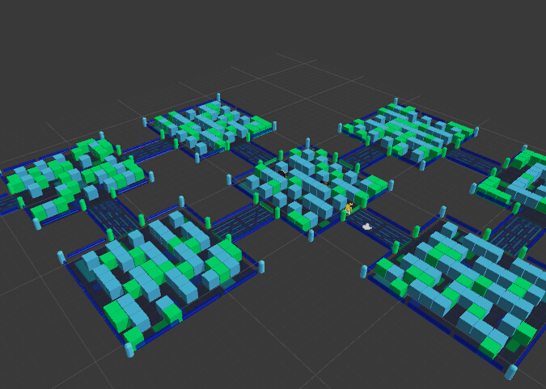
Gameplay
Each stage is divided into multiple rooms
Map and rooms is generated upon entering level
Clear current room to proceed to next one

Slide 5
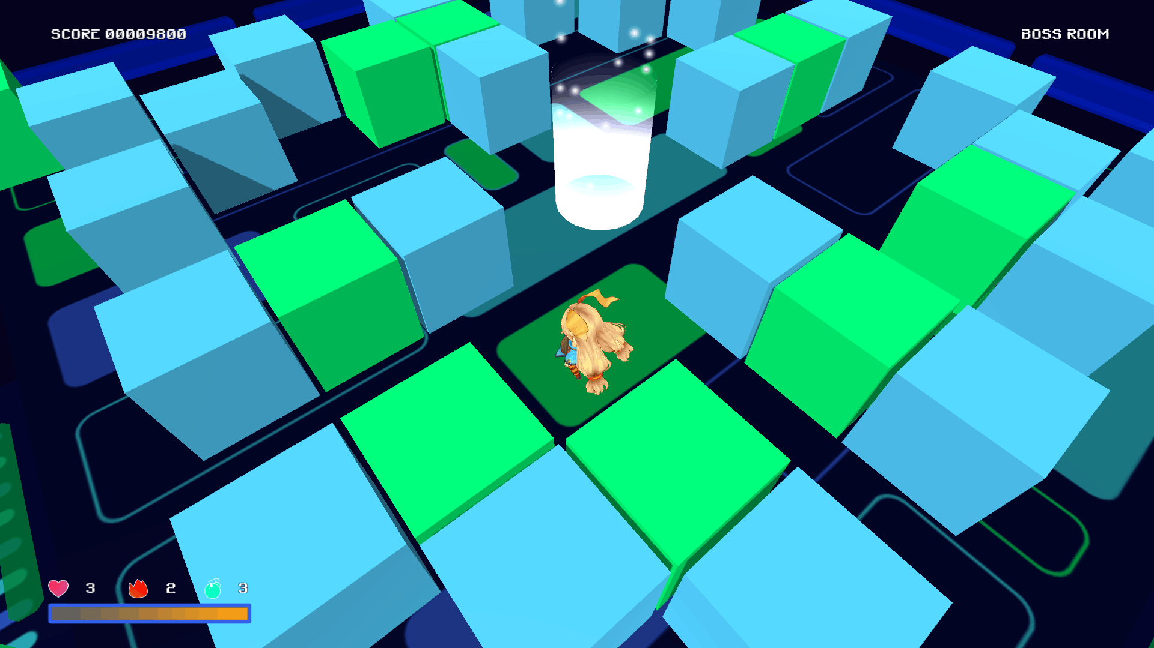
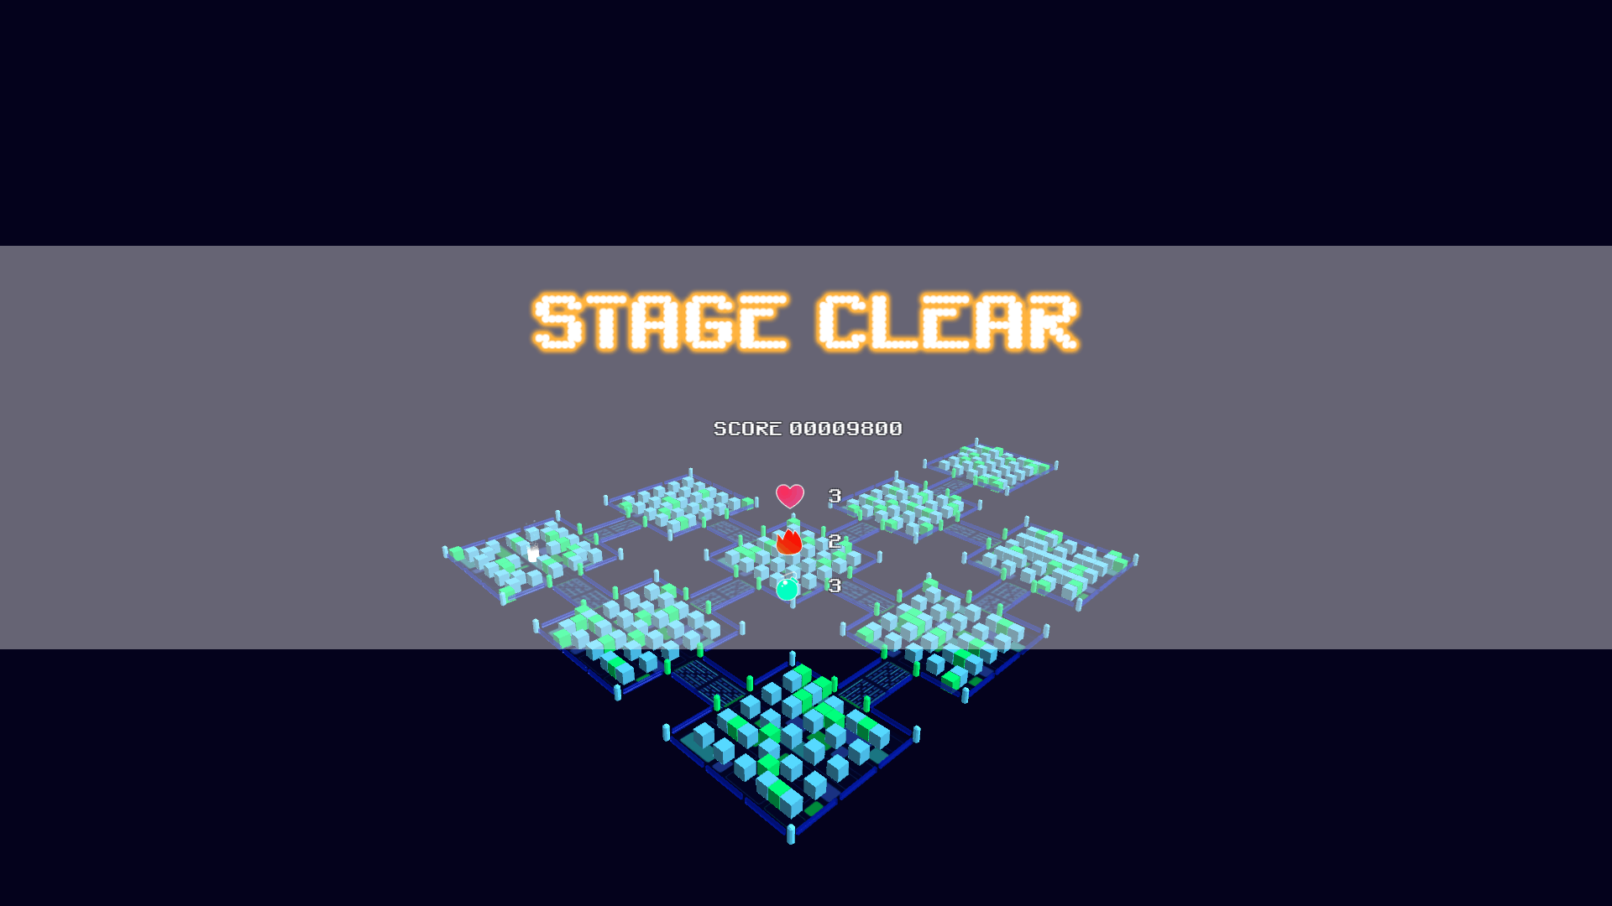
Gameplay
One room is marked as “boss room”
Stage exit will appear after boss room is clear
Step into the exit to go to next stage
Inspired by The Binding of Isaac

Slide 6
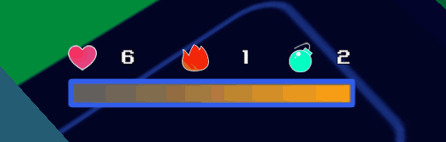
Gameplay
4 attribute – HP(max 15), Fire power, Bomb count, Stamina
Stamina used for dashing
4 items respectively

Slide 7
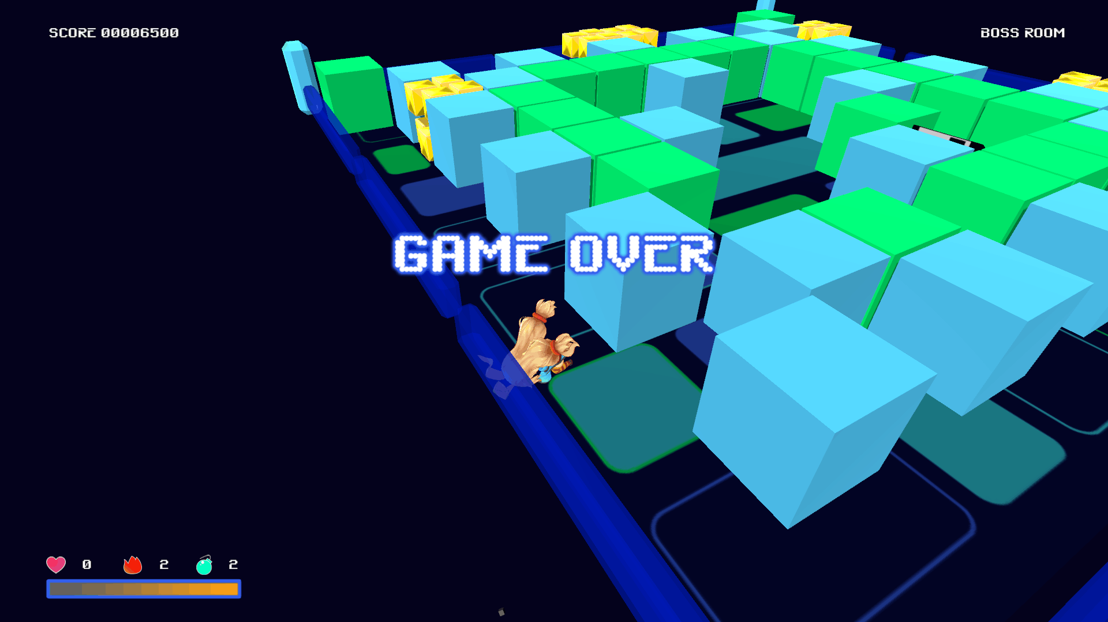
Gameplay
HP decrease when hit by enemy/bomb flare
Player dies when HP goes 0
Only 1 life

Slide 8

Character & Enemies
Main Character – Unity-Chan
Unity Japan “Official Figure”
I’m glad to talk a lot about her, but well, let’s skip this…
Provide a full set of model data, including meshes, textures, animation, and even voice
unity-chan.com

Slide 9
Character
Main Character – Unity-Chan
Unity Japan “Official Figure”
I’m glad to talk a lot about her, but well, let’s skip this…
Provide a full set of model data, including meshes, textures, animation, and even voice
unity-chan.com

Slide 10
Enemies
BlockBlock
Fast, dumb and unstable
Reference: An enemy from Hyperdimension Neptunia
Coin
Fast, unstable but route-identifying
Reference: The most powerful enemy in the first Bomberman on FC

