Slide 1

Analysis of the impact of B-chromosomes in Zea Mays
Josh Halprin, Princeton Joseph, Larry Mason, Lucas Pereira
December 5th, 2022 Group 13

Slide 2
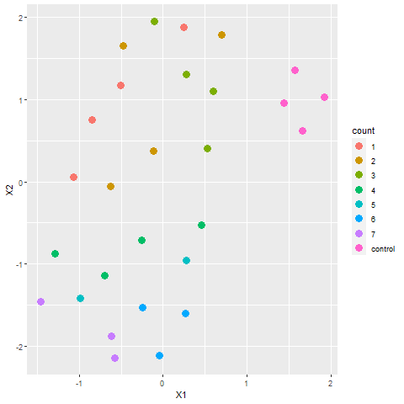
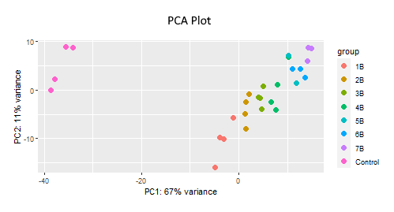
Introduction
Data was in the form of samples containing 0-7 B-chromosomes
Counts were either tested based on sample, or based on testing group (# of B-chromosomes)
UMAP Plot

Slide 3
Hypothesis
We predicted that if 1 or more B chromosomes are present, then the gene expression of Zea mays will be affected.
In order to test this, we examined clusters between samples and highly differentially expressed genes.
Motivation
The B chromosome is non essential and irregular in that it develops from fragments of the A chromosome during meiosis and its inheritance is non-mendelian.
Many of the effects of the chromosome are unknown due to these factors, leaving this area of study open-ended.

Slide 4
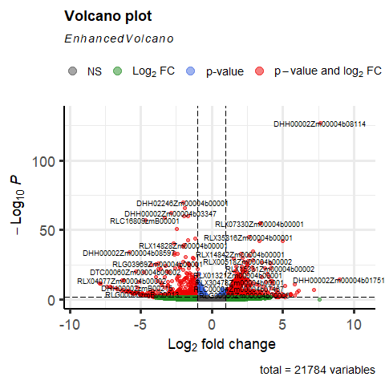
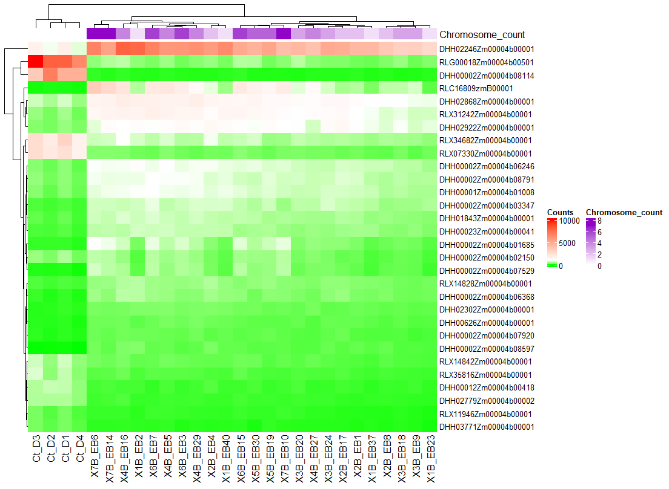
Differential Expression and Enrichment Analysis
Volcano Plot
Volcano plot of DE shows number of significantly differentially expressed genes
DHH00002Zm00004b08114
DHH02246Zm00004b00001
Heatmap shows distinct “cuts” between control & other samples, as well as other areas
Both suggest an impact of B-chromosomes
Heatmap

Slide 6
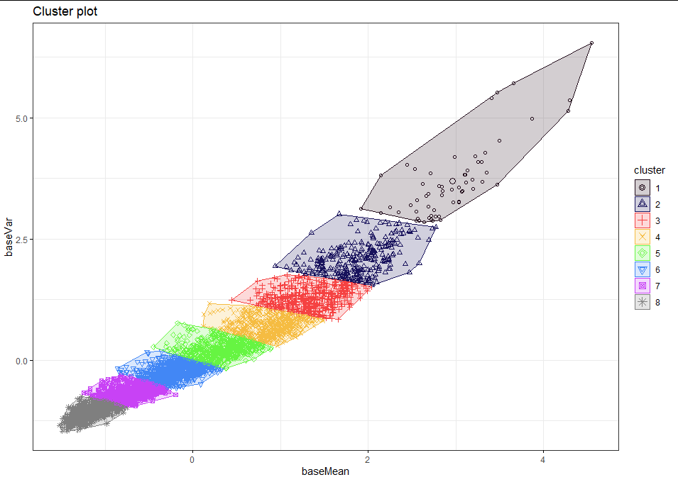
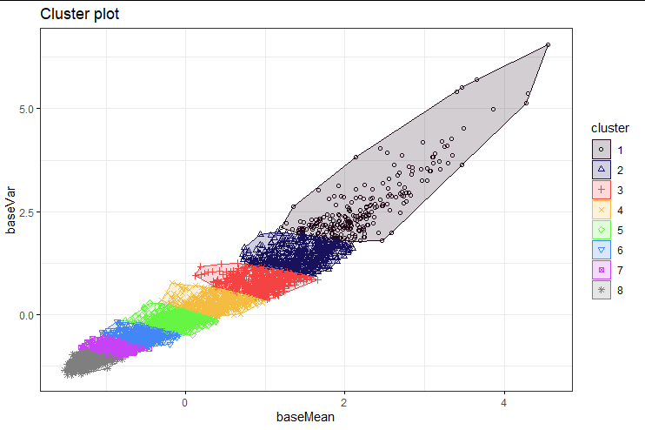
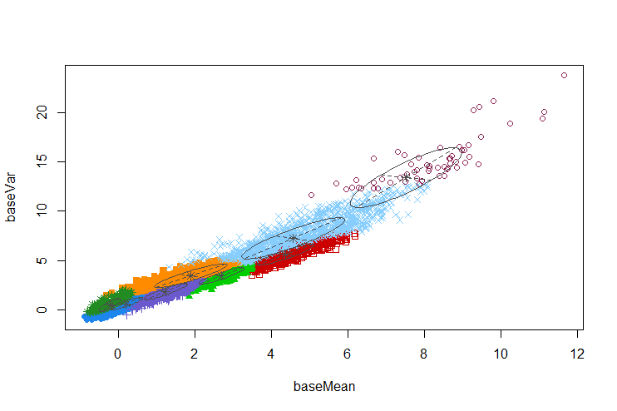
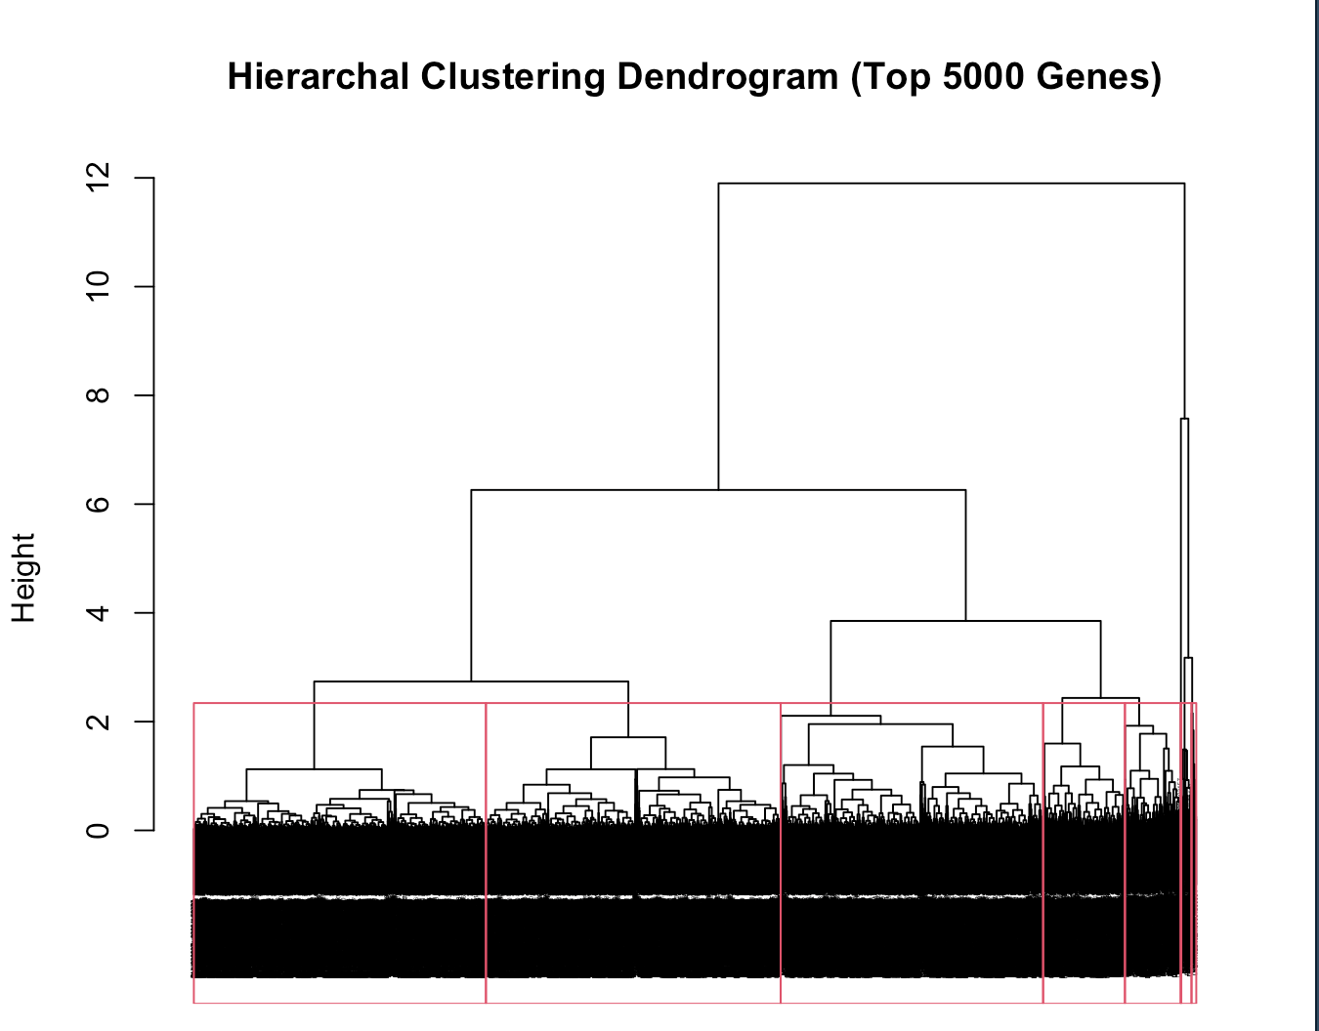
Clustering & Enrichment Analysis
K-means
PAM
Fairly consistent clustering results based on mean and variance of gene counts data, although distributions of genes were slightly different
Indicative of relationship between B-chromosome count and sample gene counts
GMM
Hierarchical

Slide 7
Conclusions & Future Work
Differential Analysis found significantly differentially expressed genes
Suggests impact of B-chromosomes on certain genes
Clustering found clear groupings of genes based on B-chromosome count
Clusters were relatively consistent between methods
Clusters were more clear with smaller selection of genes
Chi-sq testing inconclusive
Can be improved with alternate method of quantitatively determining similarity of clustering.

