Slide 1


BioChain:
Using Lexical Chaining Approaches for Biomedical Text Summarization
Lawrence Reeve
INFO780 - Mid-term Report – Summer 2005

Slide 2
Discussions
BioChain
  Goal
  Approach
  Implementation Status
  Text Summarization
  Evaluation Methods

Slide 3
BioChain Goal
Take biomedical abstract (or full text) …
… and generate summary of key points:
Adjuvant Chemotherapy for Adult Soft Tissue Sarcomas of the Extremities and Girdles: Results of the Italian Randomized Cooperative Trial.
Adjuvant chemotherapy for soft tissue sarcoma is controversial because previous trials reported conflicting results. The present study was designed with restricted selection criteria and high dose-intensities of the two most active chemotherapeutic agents.
Patients and Methods: Patients between 18 and 65 years of age with grade 3 to 4 spindle-cell sarcomas (primary diameter >= 5 cm or any size recurrent tumor) in extremities or girdles were eligible. Stratification was by primary versus recurrent tumors and by tumor diameter greater than or equal to 10 cm versus less than 10 cm. One hundred four patients were randomized, 51 to the control group and 53 to the treatment group (five cycles of 4'-epidoxorubicin 60 mg/m2 days 1 and 2 and ifosfamide 1.8 g/m2 days 1 through 5, with hydration, mesna, and granulocyte colony-stimulating factor).
Results: After a median follow-up of 59 months, 60 patients had relapsed and 48 died (28 and 20 in the treatment arm and 32 and 28 in the control arm, respectively). The median disease-free survival (DFS) was 48 months in the treatment group and 16 months in the control group (P = .04); and the median overall survival (OS) was 75 months for treated and 46 months for untreated patients (P = .03). For OS, the absolute benefit deriving from chemotherapy was 13% at 2 years and increased to 19% at 4 years (P = .04).
Conclusion: Intensified adjuvant chemotherapy had a positive impact on the DFS and OS of patients with high risk extremity soft tissue sarcomas at a median follow-up of 59 months. Therefore, our data favor an intensified treatment in similar cases. Although cure is still difficult to achieve, a significant delay in death is worthwhile, also considering the short duration of treatment and the absence of toxic deaths.
The median disease-free survival (DFS) was 48 months in the treatment group and 16 months in the control group (P = .04); and the median overall survival (OS) was 75 months for treated and 46 months for untreated patients (P = .03).

Slide 4
BioChain Goal
Work done in conjunction DUCOM
  Dr. Ari Brooks
What’s the latest, best information on cancer treatment?
  Current focus is on clinical trial papers
    Database of 1,200 manually processed papers
Current goal: Summarize a single clinical trial paper
Ultimate goal: Summarize multiple clinical trial documents

Slide 5
BioChain Approach
Apply methods/concepts from lexical chaining:
  Cluster (chain) words together based on semantic-relatedness
    Words are chained together based on word ‘senses’ (concepts)
Lexical Chaining…
  identifies lexical cohesion (causes sentences to ‘hang together’)
  captures core themes of a text (‘aboutness’)
  is an intermediate format
Example:
  “The house contains an attic. The home is a cabin.”
  Lexical Chain: dwelling → {house, attic, home, cabin}

Slide 6
Implemented Using UMLS
Key parts of UMLS used:
  Thesaurus
    Incorporates multiple source vocabularies
      (SNOMEDCT, CPT, others)
  Semantic Network
    organizes related concepts
  MetaMap Transfer
    text-to-concept mapping tool

Slide 7
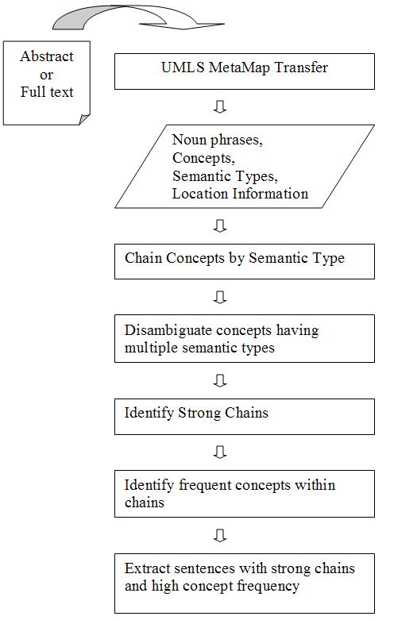
BioChain Process

Slide 8
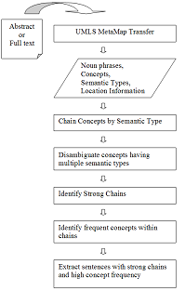
Input
Abstract or full text from PubMed
  Need to identify sentences noun phrases (concepts) occur in
  PDF conversion issues
    Columns
    Captions
    Bibliography

Slide 9
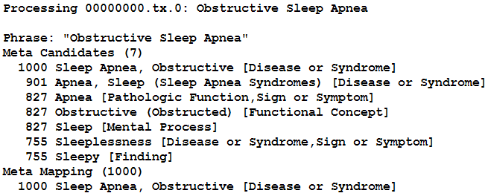
MetaMap Transfer
  Maps noun phrases
    to UMLS Metathesaurus concepts
    to UMLS Semantic Types
Sentence / Phrase
Scores
Candidate Concepts
Final Mapping
Concept
Semantic Type

Slide 10
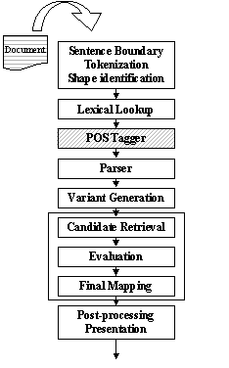
MetaMap Transfer Processing
Source: http://mmtx.nlm.nih.gov/design/sld006.htm

Slide 11
UMLS Metathesaurus
Vocabulary database
  Contains concepts, names and relationships
  links alternative names and views of the same concept together
  identifies relationships between different concepts
    co-occurrence
    parent, child, sibling
    synonymy

Slide 12
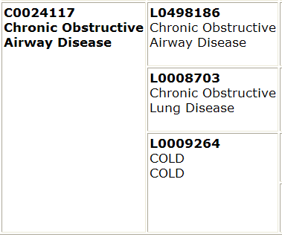
UMLS Metathesaurus
Terms
Concept
Source: http://www.nlm.nih.gov/research/umls/meta2.html

Slide 13
UMLS Semantic
Network
Provides:
  categorization of all concepts in the UMLS Metathesaurus
  relationships between concepts
Consists of:
  135 semantic types
  54 relationships

Slide 14
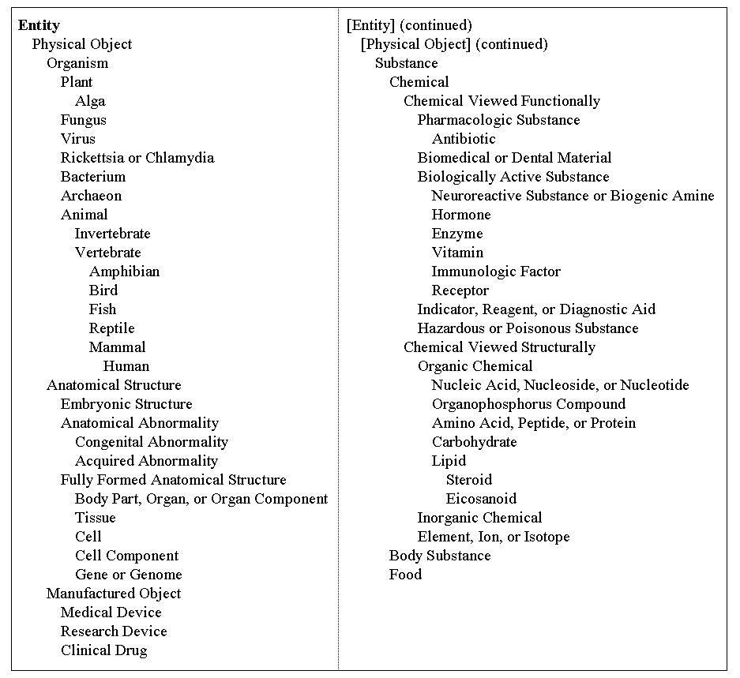
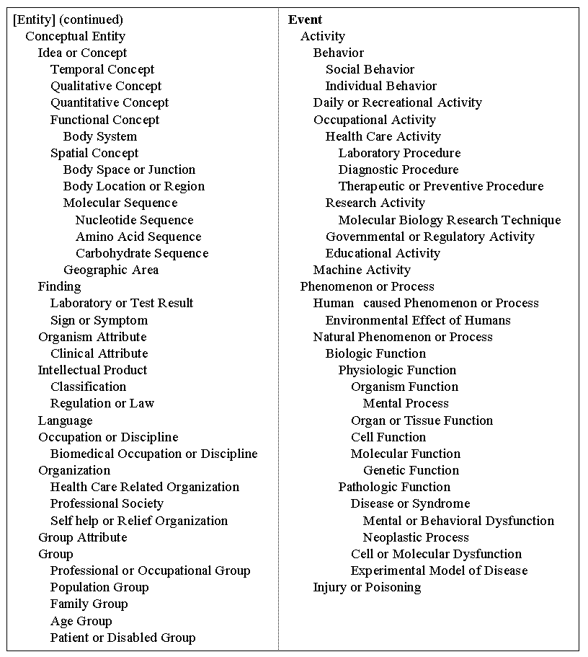
UMLS Semantic
Network
Source: http://www.nlm.nih.gov/research/umls/META3_current_semantic_types.html

Slide 15
Concept Chaining
Use semantic network to link together related concepts:
  Quantitative (semantic type)
    High dose (concept)
    cm (concept)
    Size (concept)
    Median Statistical Measurement (concept)
MetaMap:
  Noun phrase → concept → semantic type
BioChain:
  Semantic type→ concept, concept, concept

Slide 16
Concept Chaining
Internal storage:
  135 semantic types, each has a type id
    T061 - Therapeutic or Preventive Procedure
  Array of semantic types formed
    135 entries indexed by semantic id
    Each semantic type entry holds a list of concepts found in the text
  Each concept in semantic type entry contains:
    Original noun phrase
    Sentence number
    Section (paragraph) number

Slide 17
Sample Abstract
Adjuvant Chemotherapy for Adult Soft Tissue Sarcomas of the Extremities and Girdles: Results of the Italian Randomized Cooperative Trial.
Adjuvant chemotherapy for soft tissue sarcoma is controversial because previous trials reported conflicting results. The present study was designed with restricted selection criteria and high dose-intensities of the two most active chemotherapeutic agents.
Patients and Methods: Patients between 18 and 65 years of age with grade 3 to 4 spindle-cell sarcomas (primary diameter >= 5 cm or any size recurrent tumor) in extremities or girdles were eligible. Stratification was by primary versus recurrent tumors and by tumor diameter greater than or equal to 10 cm versus less than 10 cm. One hundred four patients were randomized, 51 to the control group and 53 to the treatment group (five cycles of 4'-epidoxorubicin 60 mg/m2 days 1 and 2 and ifosfamide 1.8 g/m2 days 1 through 5, with hydration, mesna, and granulocyte colony-stimulating factor).
Results: After a median follow-up of 59 months, 60 patients had relapsed and 48 died (28 and 20 in the treatment arm and 32 and 28 in the control arm, respectively). The median disease-free survival (DFS) was 48 months in the treatment group and 16 months in the control group (P = .04); and the median overall survival (OS) was 75 months for treated and 46 months for untreated patients (P = .03). For OS, the absolute benefit deriving from chemotherapy was 13% at 2 years and increased to 19% at 4 years (P = .04).
Conclusion: Intensified adjuvant chemotherapy had a positive impact on the DFS and OS of patients with high risk extremity soft tissue sarcomas at a median follow-up of 59 months. Therefore, our data favor an intensified treatment in similar cases. Although cure is still difficult to achieve, a significant delay in death is worthwhile, also considering the short duration of treatment and the absence of toxic deaths.

Slide 18
Concept Chaining
T061 - Therapeutic or Preventive Procedure: 6.0
phrase: Adjuvant Chemotherapy
concept: Chemotherapy, Adjuvant
sentence#0
section#0
phrase: Adjuvant chemotherapy
concept: Chemotherapy, Adjuvant
sentence#2
section#1
phrase: primary diameter cm
concept: Primary operation (qualifier value)
sentence#5
section#2
phrase: Intensified adjuvant chemotherapy
concept: Chemotherapy, Adjuvant
sentence#13
section#4
phrase: intensified treatment
concept: Therapeutic procedure
sentence#14
section#4

Slide 19
Chain Disambiguation
Some concepts have multiple semantic types:
  Concept Ifosfamide belongs to semantic types:
    Organophosphorus Compound
    Pharmacologic Substance
    Gene or Genome
Which semantic type is best in context?
Use additional UMLS information to judge concept-concept strength
  Concept co-occurrence
  Parent, child, sibling relationships

Slide 20
Chain Scoring
  Each chain has a score
    Indicates degree a semantic type is discussed in text
  Lexical chaining research identified 3 factors for strength: (Morris & Hirst, 1991)
    Reiteration: more repetion is better
    Density: shorter distance between concepts is better
    Length: longer chain length is better
  Using method from University College Dublin (Doran, Stokes, Dunnion, McCarthy, 2004)
    Frequency of most frequent concept (reiteraton)*
    number of unique concept occurences

Slide 21
Strong Chains
  Strong chains identify ‘best’ semantic types in text
  Lexical chaining research generally uses:
    two standard deviations above the mean of the scores computed for every chain in the document (Barzilay, Elhadad, 1997)

Slide 22
Strong Chains
Top chains:
  T081-Quantitative Concept, score: 14.0
  T061-Therapeutic or Preventive Procedure, score: 6.0
  T169-Functional Concept, score: 6.0
  T079-Temporal Concept, score: 4.0
  T080-Qualitative Concept, score: 4.0
  T082-Spatial Concept, score: 4.0
  T073-Manufactured Object, score: 2.0
  T109-Organic Chemical, score: 2.0
  T170-Intellectual Product, score: 2.0
  T121-Pharmacologic Substance, score: 1.0
Strong chains: (2 StdDev)
Avg score: 1.6666666666666667
  Std Dev: 3.0671497204093914
  Strong Score: 7.80096610748545
  T081-Quantitative Concept: 14.0
Strong chains: (1 StdDev)
  Avg score: 1.6666666666666667
  Std Dev: 3.0671497204093914
  Strong Score: 4.733816387076058
  T081-Quantitative Concept: 14.0
  T061-Therapeutic or Preventive Procedure: 6.0
  T169-Functional Concept: 6.0

Slide 23
Top Concepts
  Identifying top concepts
    Get top chains (top semantic types)
      based on chain strength
    Perform frequency count on concepts with chains
      concept(s) with highest frequency is top concept
    Another approach:
      Identify concept relationship types
        assign weight to each relationship type
        synonymy, siblings, parent, child
      Score each concept based on contribution to chain
      Choose highest scoring concept

Slide 24
Top Concepts
T061 - Therapeutic or Preventive Procedure: 6.0
  concept: Chemotherapy, Adjuvant
  concept: Chemotherapy, Adjuvant
  concept: Primary operation (qualifier value)
  concept: Chemotherapy, Adjuvant
  concept: Therapeutic procedure
Frequency:
  Chemotherapy, Adjuvant = 3
  Primary operation (qualifier value) = 1
  Therapeutic procedure = 1
Top Concept in this chain: Chemotherapy, Adjuvant

Slide 25
Sentence Extraction
Extractive
  Extract sentences or parts of sentences verbatim from text (most common)
    Ordering
    Anaphora resolution
- versus –
Abstractive
  Generate summary text using NLP techniques

Slide 26
Sentence Extraction
Extractive approach
  Identify main concepts in text using semantic types
    May be multiple semantic types for each concept
  Identify which sentences discusses the main concepts the most
    Using chain strength and concept frequency

Slide 27
Sentence Extraction
Top Concepts – 2 standard deviations
T081-Quantitative Concept
--------------
Concept: Median Statistical Measurement, sentence#9
Sentence: The median disease-free survival (DFS) was 48 months in the treatment group and 16 months in the control group (P = .04);
Concept: Median Statistical Measurement, sentence#10
Sentence: and the median overall survival (OS) was 75 months for treated and 46 months for untreated patients (P = .03).

Slide 28
Top Concepts – 1 standard deviation
T081-Quantitative Concept: (Same as previous slide)
T061-Therapeutic or Preventive Procedure
--------------
Concept: Chemotherapy, Adjuvant, sentence#0
Sentence: Adjuvant Chemotherapy for Adult Soft Tissue Sarcomas of the Extremities and Girdles:
Concept: Chemotherapy, Adjuvant, sentence#2
Sentence: Adjuvant chemotherapy for soft tissue sarcoma is controversial because previous trials reported conflicting results.
Concept: Chemotherapy, Adjuvant, sentence#13
Sentence: Intensified adjuvant chemotherapy had a positive impact on the DFS and OS of patients with highrisk extremity soft tissue sarcomas at a median follow-up of 59 months.
T169-Functional Concept
--------------
Concept: Result (navigational concept), sentence#1
Sentence: Results of the Italian Randomized Cooperative Trial.
Concept: Result (navigational concept), sentence#2
Sentence: Adjuvant chemotherapy for soft tissue sarcoma is controversial because previous trials reported conflicting results.
Concept: Result (navigational concept), sentence#7
Sentence: Results:

Slide 29
Implementation Status

Slide 30
Evaluation
Subjective
Quantitative

Slide 31
Summary
  Want to summarize biomedical texts (specifically oncology)
  Use lexical chaining approaches with existing UMLS resources to identify the ‘aboutness’ of a text
  Extract sentences containing strongest concepts within a semantic type
  Result is an indicative summary of what text is about
  Base implementation completed; evaluation and additional improvements underway

Slide 32
References
  x

