Slide 1
Evidence-Based Medicine in Clinical Oncology
First Year Class (F1-01)
Fellowship in Surgical Oncology
June 19, 2000

Slide 2
The F1-01 project
Is our current management of solid organ malignancies based on the best evidence available?
What is the best evidence available?
What are the areas that require more work?

Slide 3
Outline
I. History of Clinical Trials
II. NCI clinical trials database
III. MEDLINE
IV. F1 Project, methods
V. Review of Level I evidence
A. Statistics
B. Modality
VI. Access to the data

Slide 4
History of Clinical Trials
Evidence-Based Oncology
Court of King Nebuchadnezzar: Daniel and his companions wished to avoid rich food
Secretly provided with vegetables and water
After 10 days declared by the King to be healthier than any other men in the court
Daniel 1:6-16

Slide 5
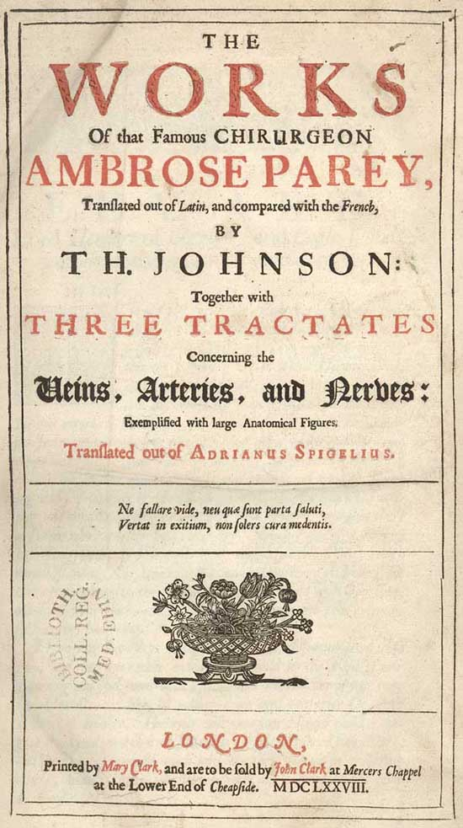
History of Clinical Trials
Evidence-Based Oncology
1545: Ambroise Pare
Parts of wounds and burns dressed with crushed onions, and parts left untouched or traditional dressings.
Crushed onions found to be more effective

Slide 6
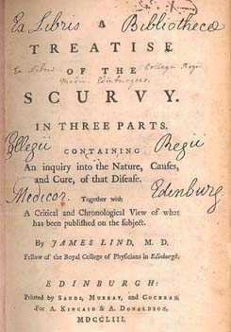
History of Clinical Trials
Evidence-Based Oncology
James Lind, RN
Twelve sailors with scurvy “as similar as (he) could have them”

Slide 7
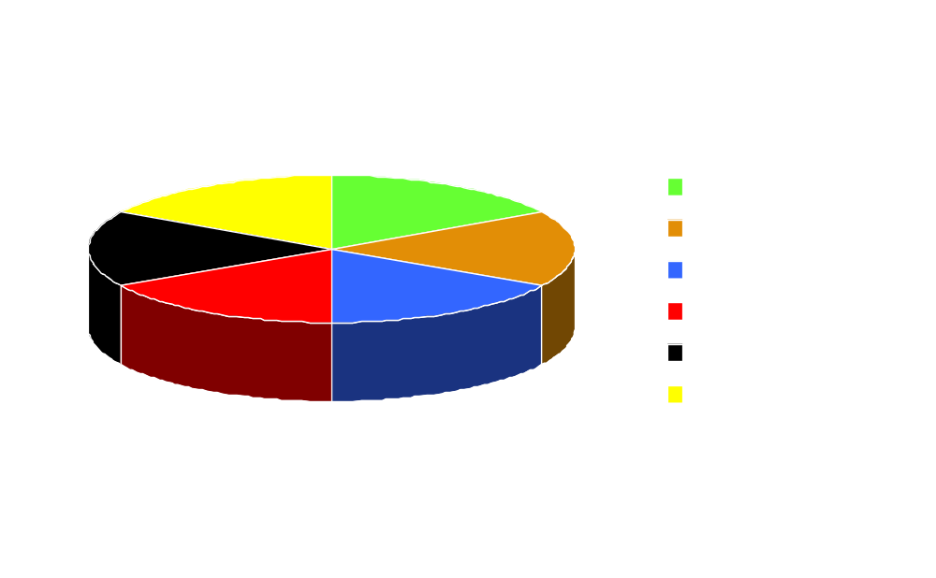
History of Clinical Trials
Evidence-Based Oncology
James Lind MD
Aboard HMS Salisbury 1747

Slide 8
History of Clinical Trials
Evidence-Based Oncology
Treatment of pulmonary tuberculosis c. 1940
Unilateral Collapse therapy (therapeutic pneumothorax)
Bilateral Bed rest

Slide 9
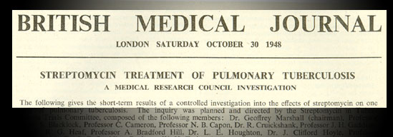
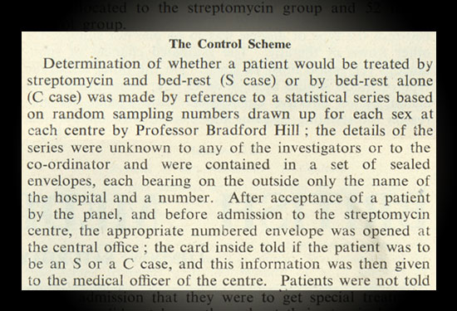
Evidence-Based Oncology
History of Clinical Trials

Slide 10
History of Clinical Trials
Evidence-Based Oncology
Marshal et al. Br Med J 1948;2:769-782

Slide 11
History of Clinical Trials
Evidence-Based Oncology
Operative treatment of angina c. 1950’s
Ligation of the internal mammary arteries
Supposed diversion of blood into the coronary circulation through collaterals
Reader’s Digest

Slide 12
RCT of internal mammary ligation versus sham procedure
Evidence-Based Oncology
Patients with severe angina (n=17)
Exposure of internal mammaries under local anaesthesia
Randomization
Ligation No Ligation

Slide 13
RCT of internal mammary ligation versus sham procedure
Evidence-Based Oncology
Results
Use of nitroglycerin reduced by 42% in sham groups and 34% in those ligated
5 patients in each group reported improved symptoms
1 patient in the sham group claimed complete relief
Cobb et al., N Engl J Med 1959; 260:1115-18

Slide 14
Levels of Evidence
1. Randomized controlled trial or
Meta-analysis
2. Nonrandomized controlled clinical trial, subset analysis of RCT
3. Case series, population based, consecutive or not
4. Opinions of respected authorities based upon clinical experience or reports of expert committees

Slide 15
Surgery and the RCT
Evidence-Based Oncology
Surgical Research or Comic Opera?
Random survey of 9 surgical journals
215 articles
175 contained original research
12/175 (7%) contained data from RCT’s
80/175 (46%) case series
Horton R. The Lancet 1996;347:984

Slide 16
Outline
I. History of Clinical Trials
II. NCI clinical trials database
III. MEDLINE
IV. F1 Project, methods
V. Review of Level I evidence
A. Statistics
B. Modality
VI. Access to the data

Slide 17
Goals
1. To determine the current status of evidence-based medicine in the treatment of solid tumors.
2. To collect and catalog all available level I evidence for each organ system.
3. To review all level I evidence for its contribution to clinical management and statistical strength.
4. To make this information easily available.

Slide 18
Methods: PDQ
NCI cancer database
  Peer reviewed summaries of cancer care
  Registry of cancer trials from around the world
  1,800 open trials
  10,300 closed trials
http://cancernet.nci.nih.gov/

Slide 19
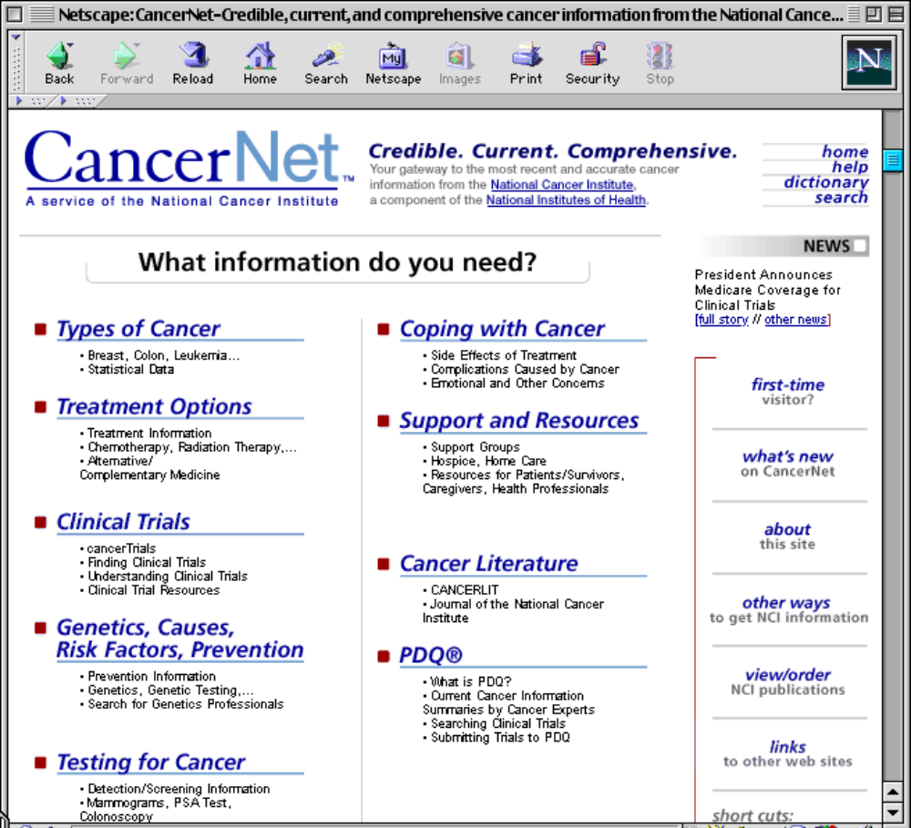

Slide 20
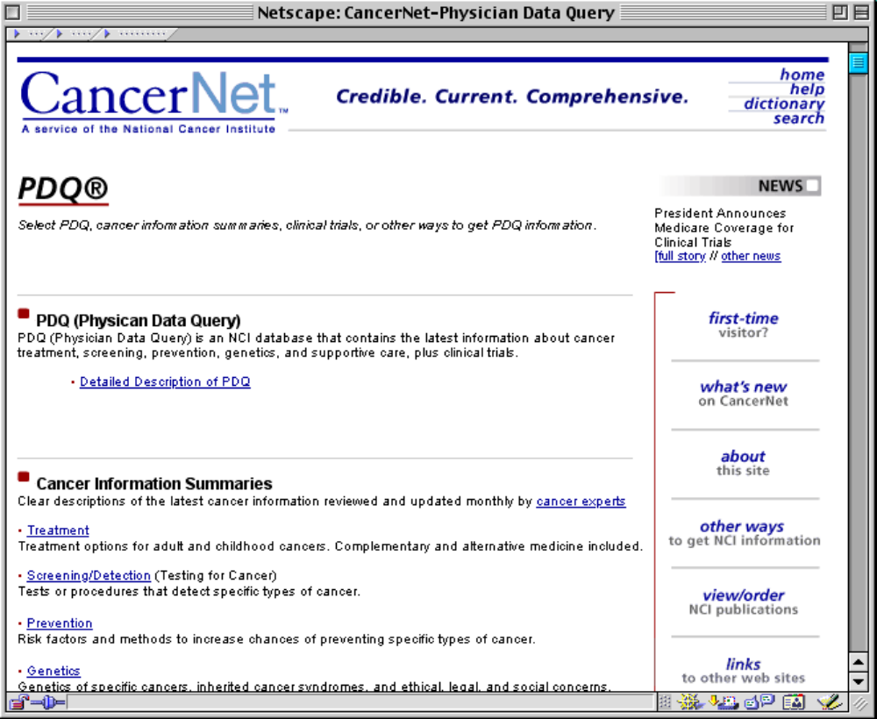

Slide 21
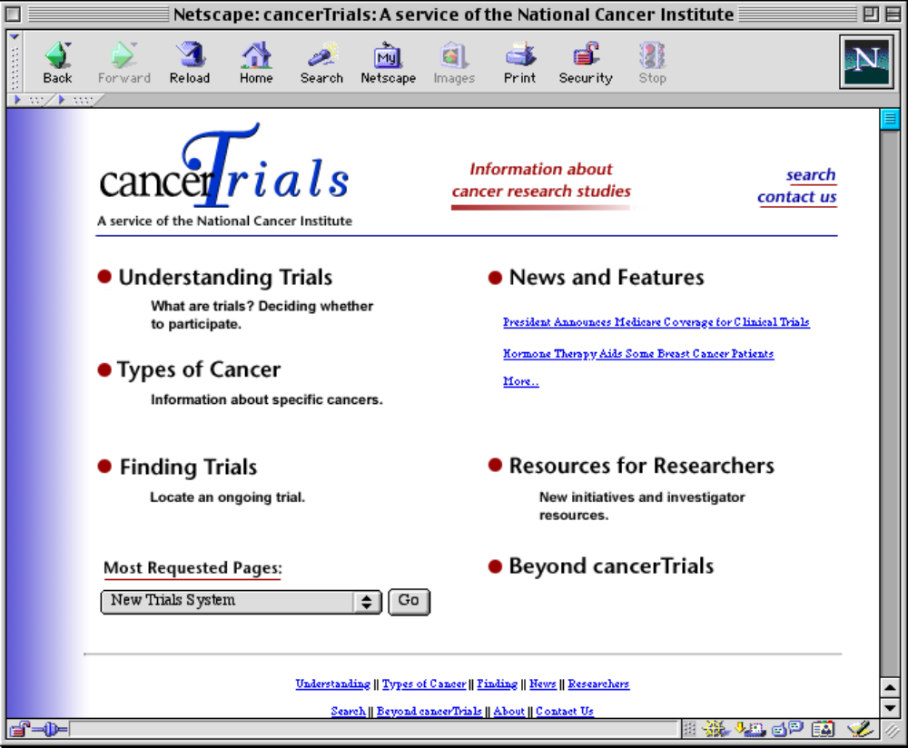

Slide 22
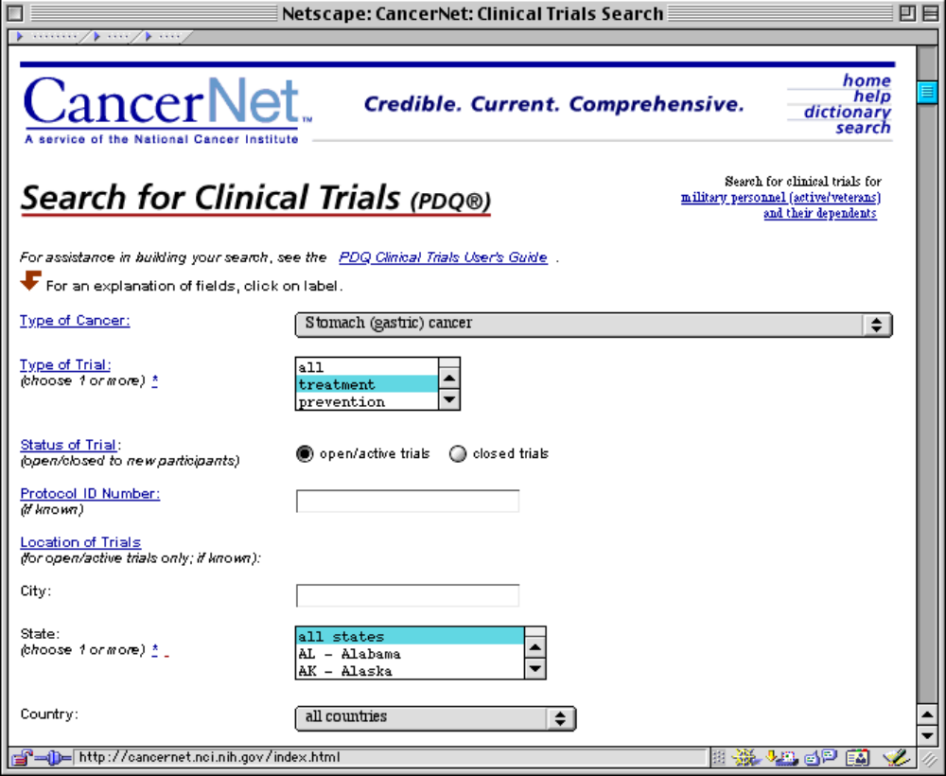

Slide 23
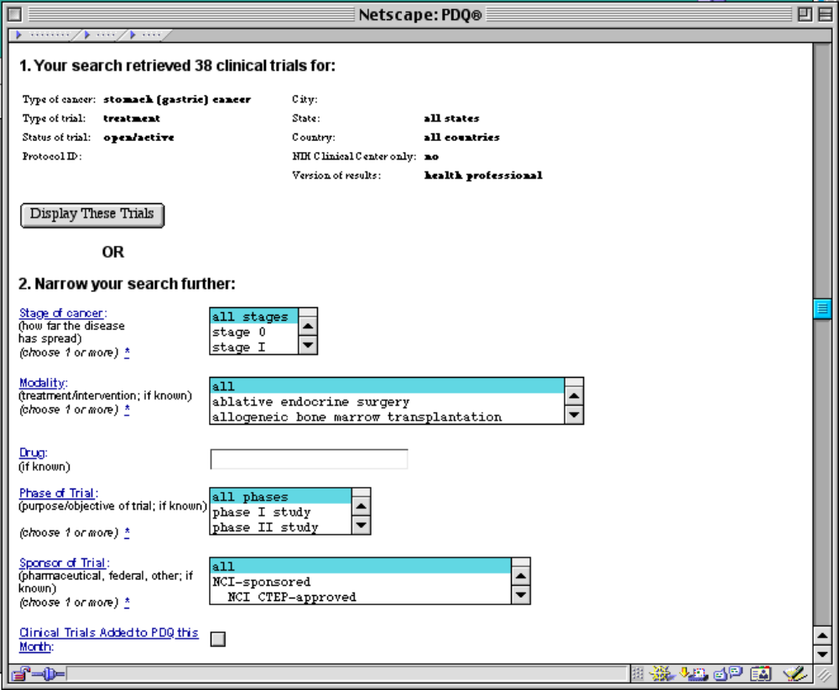

Slide 24

PDQ Trials
Esophagus, Stomach, Breast, Colorectal, Melanoma, Sarcoma, Liver, Gallbladder, Endometrial, Pancreas

Slide 25
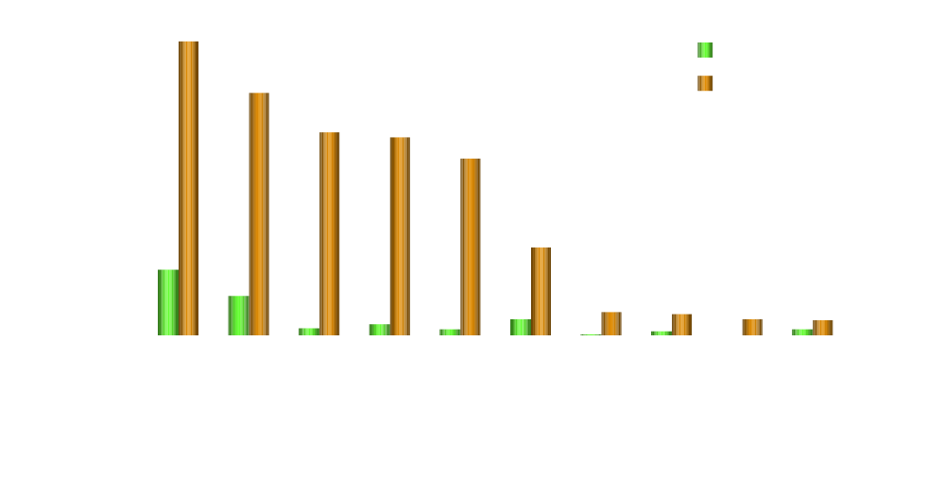
PDQ Trials By Organ

Slide 26
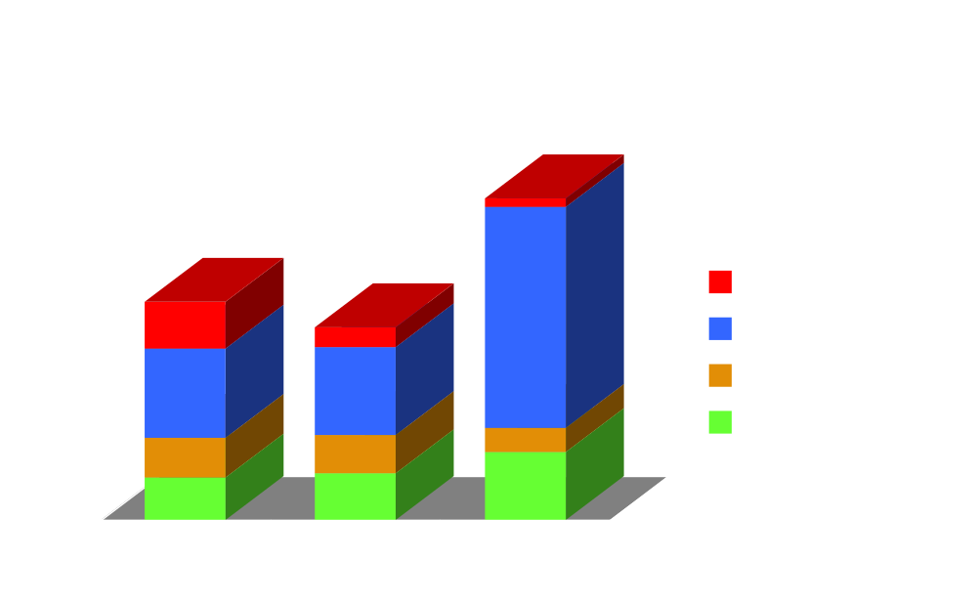
PDQ

Slide 27
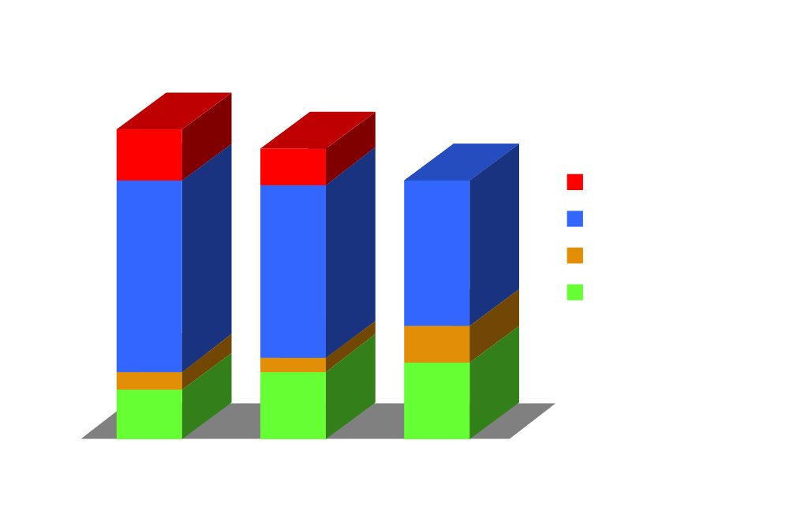
PDQ

Slide 28
Outline
I. History of Clinical Trials
II. NCI clinical trials database
III. MEDLINE
IV. F1 Project, methods
V. Review of Level I evidence
A. Statistics
B. Modality
VI. Access to the data

Slide 29
MEDLINE
Over 9 million articles, dating to 1966
31,000 added each month
  754,383 (8.4%) - human cancer
  131,760 (1.5%) - clinical trials
  68,301 (0.75%) - prospective randomized
    5,811 (0.06%) human cancer prospective randomized clinical trials

Slide 30
Methods
Identify All Level I Evidence
MEDLINE Search:
  Term: Neoplasm
  Subheadings: /Prevention control, /drug, /rt, /surgery, /therapy
  Publication Type: Randomized Control Trial.pt. (post 1991)
  Text word: Randomi$.tw (1966-1991)
  Limit: Human & English

Slide 31
MEDLINE Data Disclaimers
Articles are selected based on uniform MEDLINE search, those without appropriate MeSH terms may be missed
Not all tumor types have been evaluated yet
Percentages based on total number of studies identified

Slide 32
Neurology Homunculus

Slide 33

The Onculus
U.S. Cancer Incidence

Slide 34
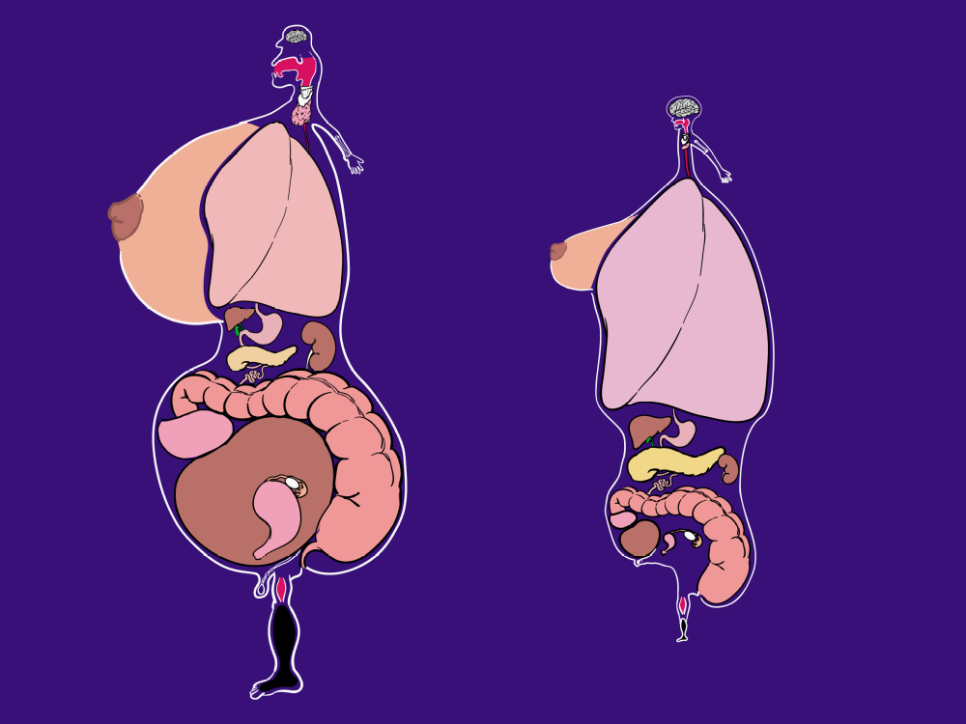
U.S. Cancer
Incidence
U.S. Cancer
Mortality

Slide 35
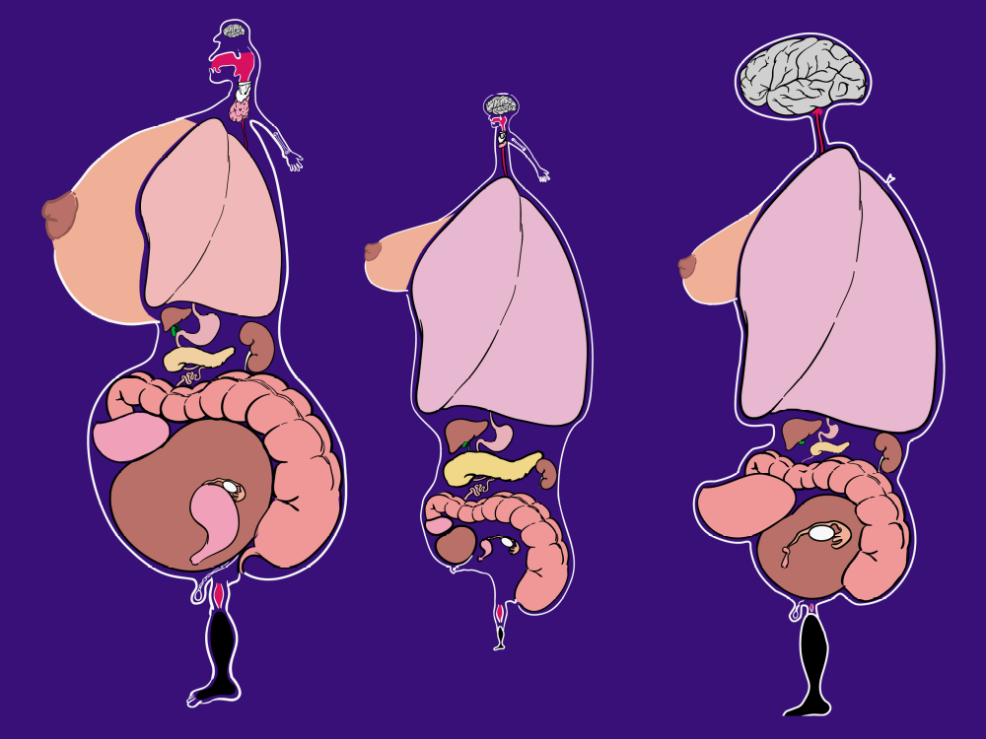
Cancer
Level I
Evidence
U.S. Cancer
Incidence
U.S. Cancer
Mortality

Slide 36

Level I evidence by Publication Date
Excluding lung, melanoma, GU tumors, brain and bone

Slide 37
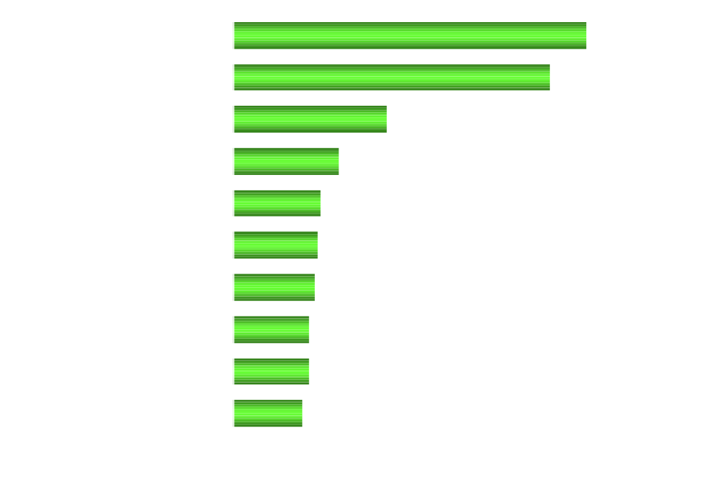
Journal Distribution
Excluding lung, melanoma, GU tumors, brain and bone
Percent of publications (n=1128 in 176 journals)
Mean number of pages 4.2 (range 1-17)

Slide 38
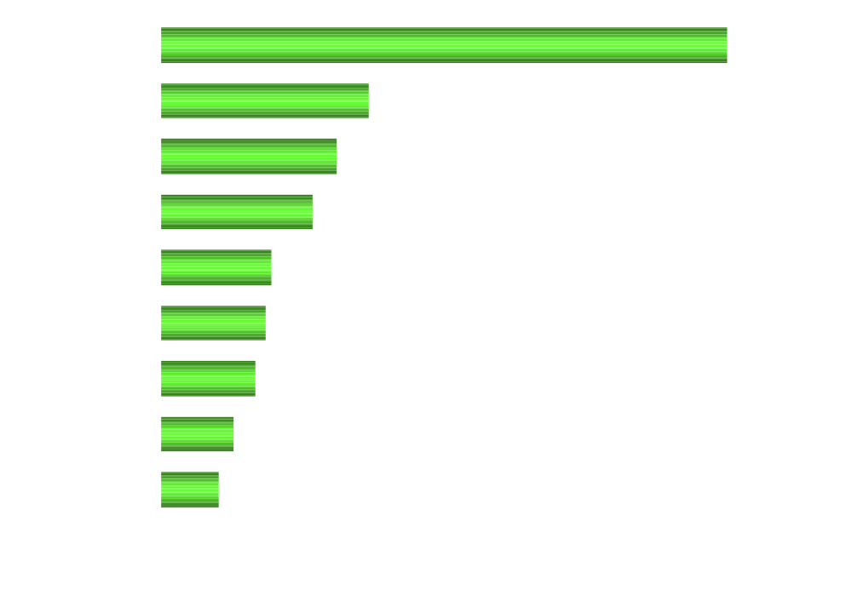
Geographic Distribution
Excluding lung, melanoma, GU tumors, brain and bone
Percent of publications (n=1128)
42 Countries

Slide 39
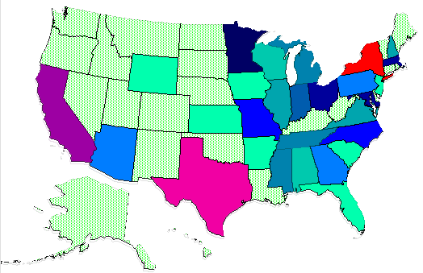
Distribution by State
184 Institutional Studies
1
5
8
13
16
19
40

Slide 40
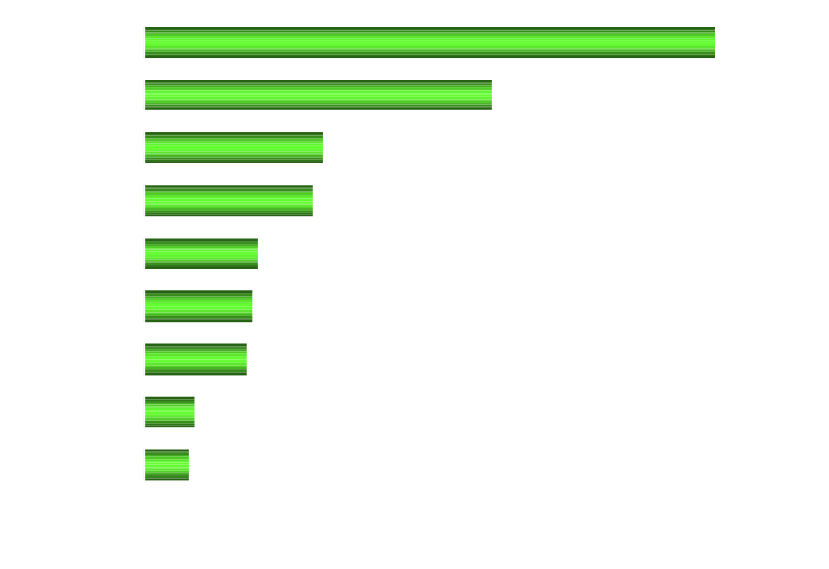
Prevention Studies

Slide 41
Outline
I. History of Clinical Trials
II. NCI clinical trials database
III. MEDLINE
IV. F1 Project, methods
V. Review of Level I evidence
A. Statistics
B. Modality
VI. Access to the data

Slide 42
F1 Project Methods
Review abstracts from initial MEDLINE search
  select prospective randomized trials with therapeutic endpoints
  Average 62% of initial search is kept
Place complete reference in Reference Manager™ software
Export to “F1 Project” FileMaker™ database
Request copied references from the library
  store articles in fellows office
Enter reviews in “F1 Project” database

Slide 43
F1 Project FileMaker Database

Slide 44

F1 Project Time Commitment

Slide 45
Outline
I. History of Clinical Trials
II. NCI clinical trials database
III. MEDLINE
IV. F1 Project, methods
V. Review of Level I evidence
A. Statistics
B. Modality
VI. Access to the data

Slide 46
F1 Project Disclaimer
Data reported are based on articles reviewed
Not all tumor types have been evaluated yet
Percentages based on number of studies reviewed

Slide 47
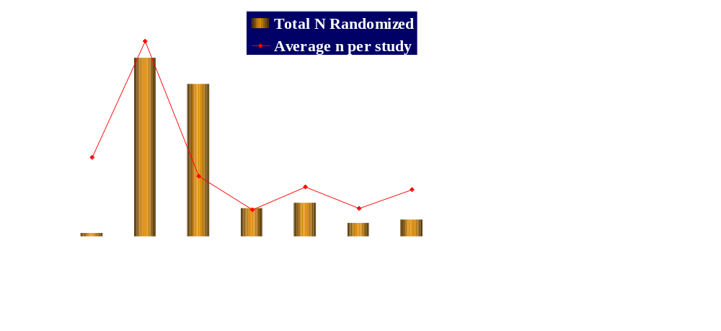
Level I Evidence
Sample Size
Sum of all patients randomized
Average patients per study
Mean length of study: 3.7 years (range 1-13)

Slide 48
Randomization and Blinding
Computer 151
Central office 5
Envelope method 5
Phone 4
Not reported 25
MRN 4
Date of Birth/Entry 2
Alternating entry 1
“biased coin approach” 2
11% of trials blinded to patients and/or clinicians
199 articles reviewed for this data

Slide 49
Stratification
Anatomic Site 59 (16%)
Age 35 (9.5%)
Histology 31 (8%)
Performance Status 28 (7.5%)
Gender 28 (7.5%)
Institution 25 (7%)
Stage 23 (6.5%)
Extent of Resection 19 (5%)
Tumor size 16 (4.5%)
Nodal Status 14 (4%)
368 articles reviewed for this data

Slide 50
Endpoints
Endpoint Primary Secondary
  Mortality/Survival 43% 23%
  Complications 17% 13%
  Disease Free Survival 12% 25%
  Toxicity/QOL 10% 8%
  Response 8% 20%
  159 articles reviewed for this information

Slide 51
Study Characteristics
Curative 34%
Adjuvant 34%
Palliative 22%
Neoadjuvant 9.5%
231 articles reviewed for this information

Slide 52
Significance
51% of studies showed no significant difference between groups
In those studies reporting significant differences the mean difference was 4.3% (range 0-50%)

Slide 53
Outline
I. History of Clinical Trials
II. NCI clinical trials database
III. MEDLINE
IV. F1 Project, methods
V. Review of Level I evidence
A. Statistics
B. Modality
VI. Access to the data

Slide 54

Discipline of First Author for articles reviewed
Percent of publications (n=433)

Slide 55
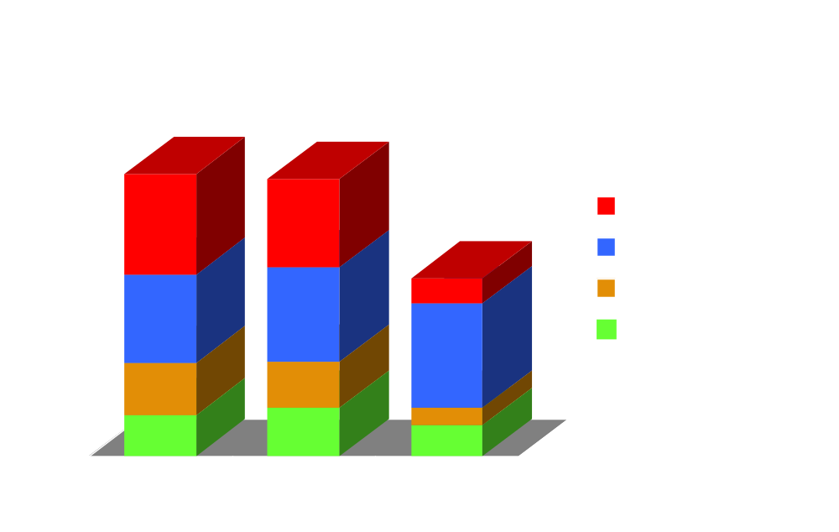
Overall

Slide 56

Breast
# trials

Slide 57
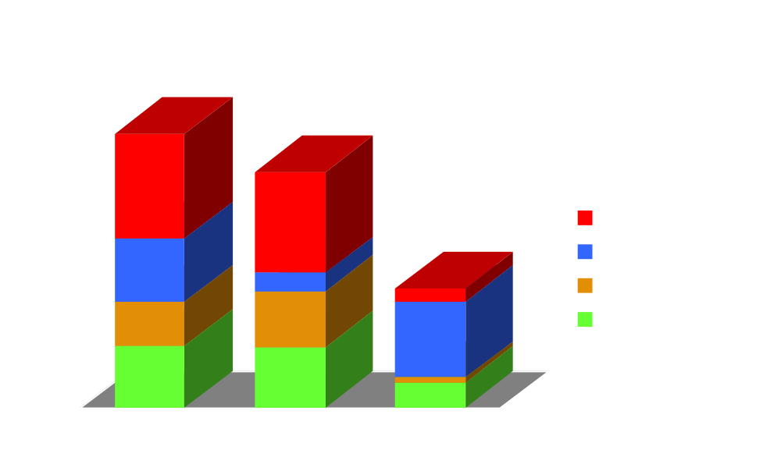
Colorectal
# trials

Slide 58
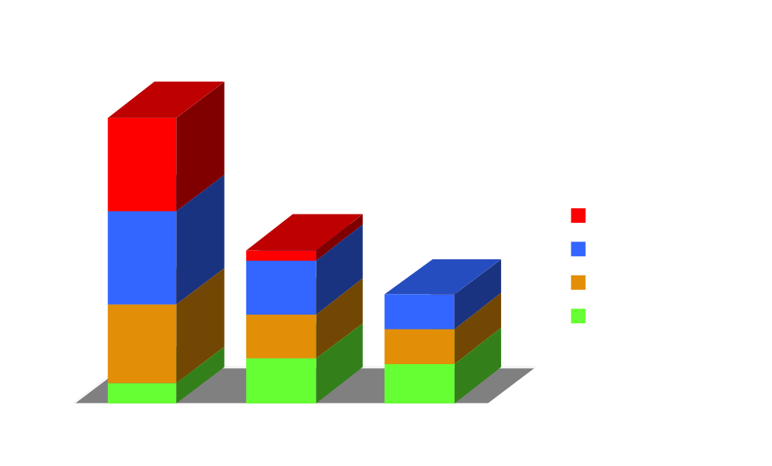
Esophagus
# trials

Slide 59
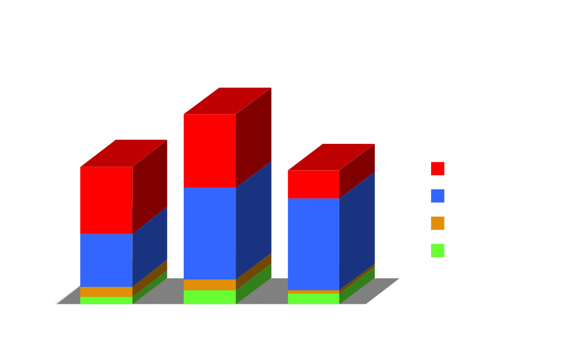
Gastric
# trials

Slide 60

Pancreatic

Slide 61
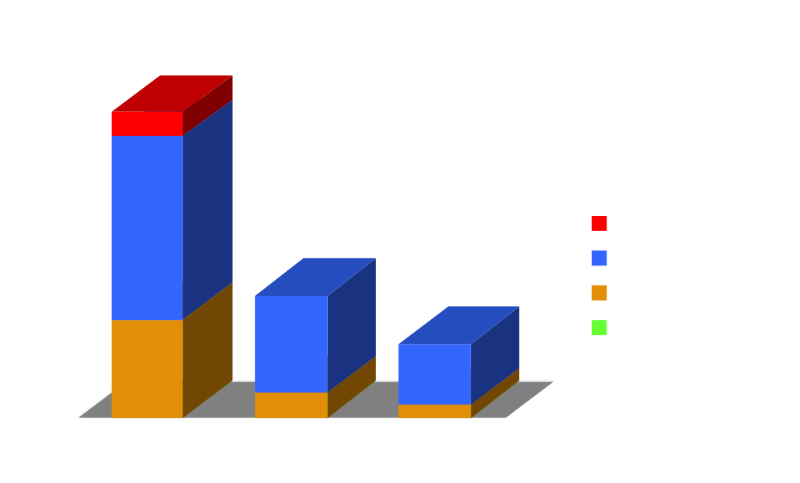
Sarcoma
# trials

Slide 62
Outline
I. History of Clinical Trials
II. NCI clinical trials database
III. MEDLINE
IV. F1 Project, methods
V. Review of Level I evidence
A. Statistics
B. Modality
VI. Access to the data

Slide 63
Access to the Data
Reference Manager Modules
Hard copy file cabinet in fellow’s office
Web based access on the Intranet
Portable modules

Slide 65
Future Directions
Real time updates
Printed format
Other Modules
  Diagnosis
  Prevention
  Historical
  Meta-analysis

