Slide 1

Adapting the TileBar Interface for Visualizing Resource Usage
Session 602
Larry Reeve
CIMS Lab, Inc.
www.cimslab.com

Slide 2
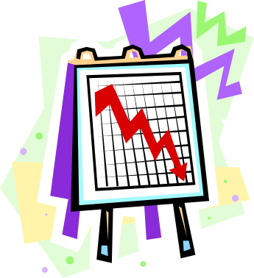
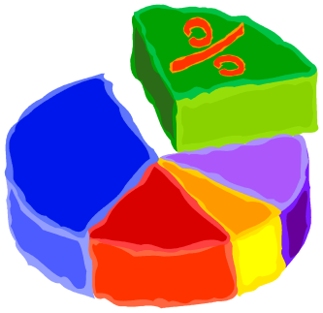
Goal
Are there new ways to visualize resource usage?
  Move from showing to discovering
  Look to field of Information Visualization for new ideas

Slide 3
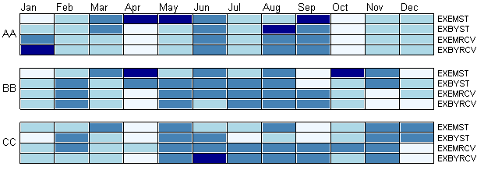
Example: TileBar

Slide 4

Agenda
Motivating Example
Information Visualization Overview
Original TileBar Design for Information Retrieval
Adapted TileBar for Resource Usage

Slide 5
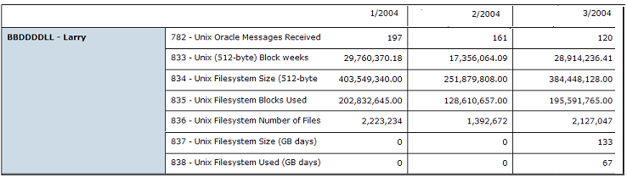
Motivating Example
Standard text-based report

Slide 6
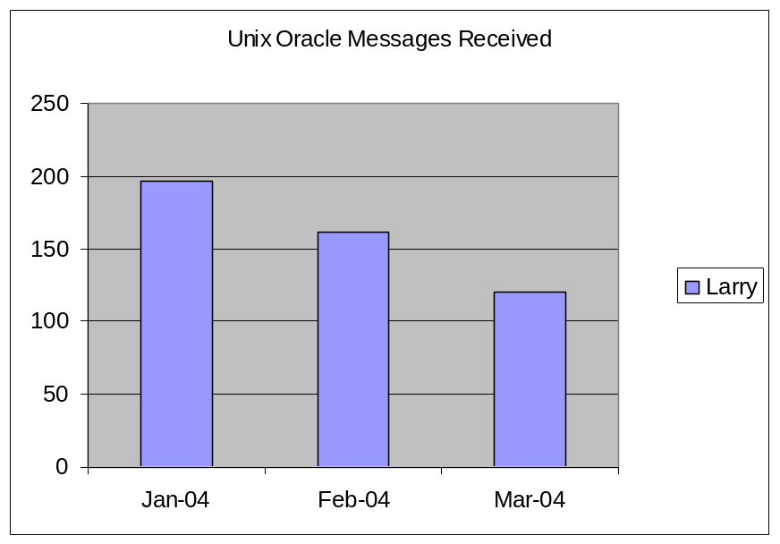
Motivating Example
Report charted
(Single user, single resource)

Slide 7
Motivating Example
  Chart shows 3 dimensions:
      Resource User
      Time period
      Resource Value
      ResourceType - using title
  How to also show both:
      Multiple resources types
      Multiple users

Slide 8
Motivating Example
How to rapidly answer questions such as:
    What are the most used resources and what are their peak periods? And also by user?
    How does resource group usage compare across users?
    Is there anything interesting in resource groups for a user? (e.g., sends vs receives) Across a set of users?

Slide 9
Information Visualization
Two definitions:
  “Process of transforming information into a visual form enabling the viewer to observe, browse, make sense, and understand the information” – (www.infovis.org)
  “The use of computer-supported, interactive, visual representations of abstract data to amplify cognition" - (Card, Mackinlay, & Shneiderman, 1999)

Slide 10
Information Visualization
Enable users to make discoveries about patterns in data
Reduces search process by grouping information together in a small, dense space - (Card, Mackinlay, & Shneiderman, 1999)

Slide 11
Information Visualization
Human visual system handles cognitive processing
  Perceives and processes information
  High bandwidth
  Expands working memory
    emphasizes recognition over recall

Slide 12
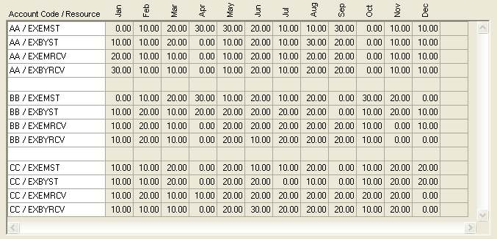
Human Visual System Example:
Spreadsheet

Slide 13
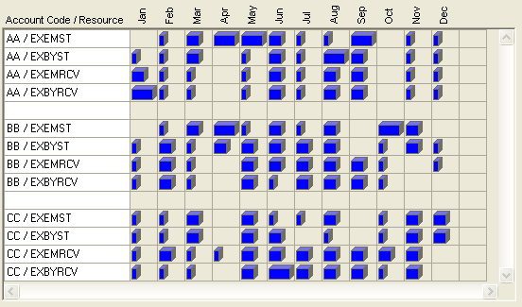
Human Visual System Example:
Piano Roll

Slide 14
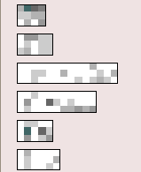
TileBar
From information retrieval field
Marti Hearst, 1995
  UC Berkeley,
  Digital Libraries project
Used in keyword searches
  Aid to user in determining ‘relevance’ of document

Slide 15
TileBar
Designed to simultaneously and compactly show:
  relative length of a document,
  frequency of terms in document,
  distribution of terms with respect to the document and to each other

Slide 16

TileBar
Varying-length bars indicate document length
Color intensity indicates term frequency
(darker =higher)
Distribution of 2 terms

Slide 17
TileBar
Bars are composed of linked tiles
Each tile indicates a document segment
Darker tiles indicate higher frequency counts
Lengths of bars correspond to relative lengths of documents
Bars can be stacked to show multiple terms

Slide 18
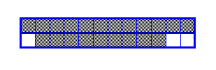
TileBar: Anatomy
Search Term #1
Document length
Search Term #2
Document segments using color intensity

Slide 19
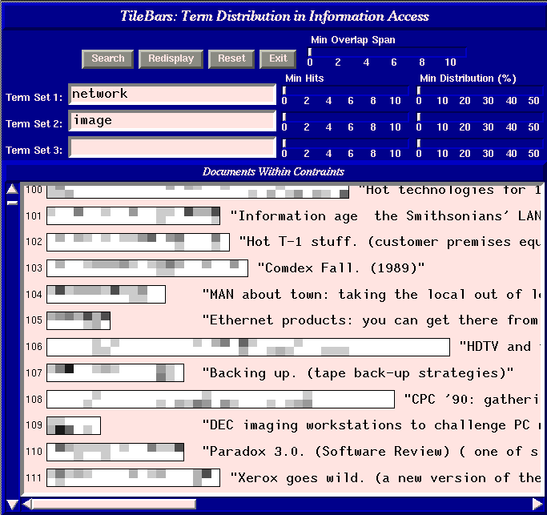
TileBar: Example UI

Slide 20
Adapting TileBar
TileBar interesting for resource usage
  it can show 4 attributes simultaneously:
    Time periods
    Categorized resource usage amounts
    Resource User(s)
    Resource Type(s)

Slide 21

Adapting TileBar
Resources
Resource
User
Time Periods
Resource Values

Slide 22
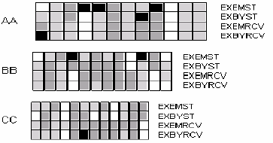
Adapting TileBar
First pass: follow Information Retrieval work
User
(value=document)
Varying-length bars
(avg usage=doc length)
Stacked bars
(resources = mult terms)
Grayscale shading
(resource value=term freq)
(no, low, medium, high)

Slide 23
Adapting TileBar
Initial feedback
  Varying-length bars make comparisons hard
    Fixed-length: lose average use information
  Make tile widths (time) consistent across all users
  Complete labels

Slide 24
Adapting TileBar
Adapted TileBar:

Slide 25
Adapting TileBar
Advantages over Original
  1) Consistent bar- and tile-widths
    Allow comparison within a user
    Allow comparisons between user
    Pattern analysis vs document navigation
  2) Complete labels make clear the meaning of each part of graphic

Slide 26
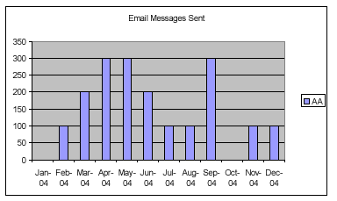
Bar Chart Comparison
Resource Type
Resource Value
Resource User
Time Period

Slide 27
Bar Chart Comparison
Can add additional users
  Use multiple vertical bars
Can show multiple resources
  If bars represent resources and not users (single user only)
How to show multiple users and multiple resources simultaneously?

Slide 28
Bar Chart Comparison
Time Period
Multiple
Resources
Multiple
Users
Resource Values

Slide 29
Navigation
Information seeking mantra
  Overview first,
  zoom and filter,
  then details-on-demand
  (Ben Shneiderman, University of Maryland)

Slide 30
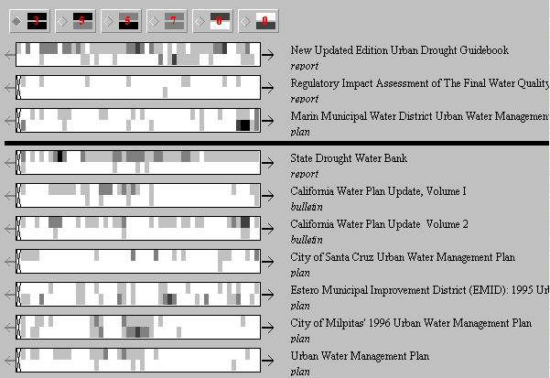
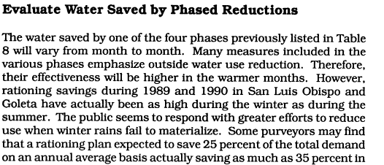
Navigation
IR TileBar:
(http://elib.cs.berkeley.edu/cgi-bin/tilebars.ch.tcl)

Slide 31
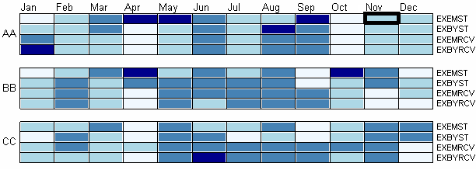

Navigation

Slide 32
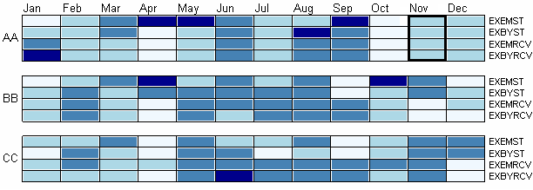
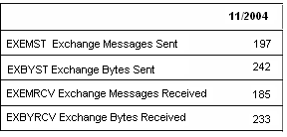
Navigation

Slide 33
Future Work
Quantitative user evaluation
Explore more abstract resource utilization visualization applications
  Example: Activity Based Costing
Other visualization methods that can be applied to resource visualization
  Example: MSR Data Visualization Components

Slide 34
Summary
Data and Information Visualization provide methods for using the human visual system to amplify cognition
TileBar is one method
Adaptation of methods can be required for resource utilization domain
Many visualization methods exist

Slide 35
Thank you!
Session 602
Larry Reeve
CIMS Lab, Inc.
www.cimslab.com

