Slide 1
Course Theme: Abstraction Is Good But Don’t Forget Reality
Carnegie Mellon
CIS courses often emphasize abstraction
Abstract data types
Asymptotic analysis
These abstractions have limits
Need to understand details of underlying implementations
Useful outcomes
Become effective programmers
Able to write code that’s easy to reason about
Able to understand and tune for program performance
Able to find and eliminate bugs efficiently
Prepare for later “systems” classes in CIS
Compilers, Operating Systems, Networks, Computer Architecture, Graphics, Game Programming

Slide 2
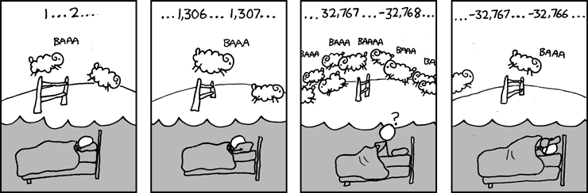
Great Reality #1: Ints are not Integers, Floats are not Reals
Carnegie Mellon
Example 1: Is x² ≥ 0?
Float’s: Yes!
Int’s:
40000 * 40000 ➙ 1600000000
50000 * 50000 ➙ ??
Example 2: Is (x + y) + z = x + (y + z)?
Unsigned & Signed Int’s: Yes!
Float’s:
(1e20 + -1e20) + 3.14 --> 3.14
1e20 + (-1e20 + 3.14) --> ??
Source: xkcd.com/571

Slide 3
Great Reality #2: You’ve Got to Know Assembly
Carnegie Mellon
Understanding assembly is key to machine-level execution model
Behavior of programs in presence of bugs
High-level language models break down
Tuning program performance
Understand optimizations done / not done by the compiler
Understanding sources of program inefficiency
Implementing system software
Compiler has machine code as target
Operating systems must manage process state
Google says so

Slide 4
Great Reality #3: Memory Matters Random Access Memory Is an Unphysical Abstraction
Carnegie Mellon
Memory is not unbounded
It must be allocated and managed
Many applications are memory dominated
Memory referencing bugs especially pernicious
Effects are distant in both time and space
Memory performance is not uniform
Cache and virtual memory effects can greatly affect program performance
Adapting program to characteristics of memory system can lead to major speed improvements

Slide 5
Memory Referencing Bug Example
Carnegie Mellon
typedef struct {
int a[2];
double d;
} struct_t;
double fun(int i) {
struct_t s;
s.d = 3.14;
s.a[i] = 1073741824; /* Possibly out of bounds */
return s.d;
}
fun(0) ➙ 3.140000
fun(1) ➙ 3.140000
fun(2) ➙ 3.140000
fun(3) ➙ 2.000001
fun(4) ➙ 3.140000
fun(6) ➙ Segmentation fault: 11
Result is system specific

Slide 6
Memory System Performance Example
Carnegie Mellon
void copyij(int src[2048][2048],
int dst[2048][2048])
{
int i,j;
for (i = 0; i < 2048; i++)
for (j = 0; j < 2048; j++)
dst[i][j] = src[i][j];
}
void copyji(int src[2048][2048],
int dst[2048][2048])
{
int i,j;
for (j = 0; j < 2048; j++)
for (i = 0; i < 2048; i++)
dst[i][j] = src[i][j];
}
4.3ms
81.8ms
2.0 GHz Intel Core i7 Haswell
Hierarchical memory organization
Performance depends on access patterns
Including how step through multi-dimensional array

Slide 7
Example Memory Hierarchy
L0:
Regs
CPU registers hold words retrieved from the L1 cache.
Smaller,
faster,
and
costlier
(per byte)
storage
devices
L1:
L1 cache
(SRAM)
L1 cache holds cache lines retrieved from the L2 cache.
L2:
L2 cache
(SRAM)
L2 cache holds cache lines
retrieved from L3 cache
L3:
L3 cache
(SRAM)
L3 cache holds cache lines
retrieved from main memory.
Larger,
slower,
and
cheaper
(per byte)
storage
devices
L4:
Main memory
(DRAM)
Main memory holds disk blocks retrieved from local disks.
L5:
Local secondary storage
(local disks)
Local disks hold files retrieved from disks
on remote servers
L6:
Remote secondary storage
(e.g., Web servers)

Slide 8
Why The Performance Differs
copyij
copyji

Slide 9
Great Reality #4: There’s more to performance than asymptotic complexity
Carnegie Mellon
Constant factors matter too!
And even exact op count does not predict performance
Easily see 10:1 performance range depending on how code written
Must optimize at multiple levels: algorithm, data representations, procedures, and loops
Must understand system to optimize performance
How programs compiled and executed
How to measure program performance and identify bottlenecks
How to improve performance without destroying code modularity and generality

Slide 10
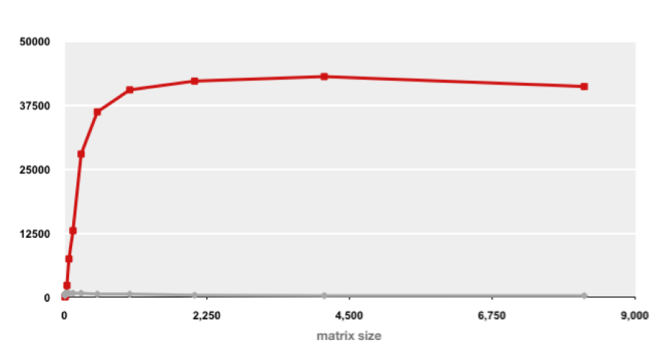
Example Matrix Multiplication
Carnegie Mellon
Matrix-Matrix Multiplication (MMM) on 2 x Core 2 Duo 3 GHz (double precision)
Gflop/s
Best code
320x
Triple loop
Standard desktop computer, vendor compiler, using optimization flags
Both implementations have exactly the same operations count (2n³)
What is going on?

Slide 11
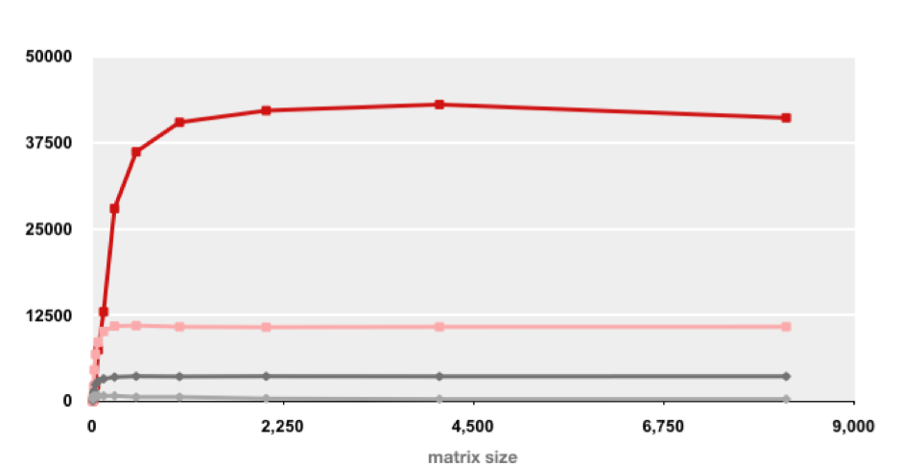
MMM Plot: Analysis
Carnegie Mellon
Matrix-Matrix Multiplication (MMM) on 2 x Core 2 Duo 3 GHz
Gflop/s
Multiple threads: 4x
Vector instructions: 4x
Memory hierarchy and other optimizations: 20x
Reason for 20x: Blocking or tiling, loop unrolling, instruction scheduling
Effect: fewer register spills and L1/L2 cache misses

Slide 12
Great Reality #5: Performance ALWAYS Matters (IMHO)
Carnegie Mellon
Apps
Games
Servers
Web pages
OS
Libs
Can anyone think of a case where performance DOESN’T matter? ☺

