Slide 1
SEQ Stages
newPC
PC
valE
,
valM
Write back
valM
Fetch
Read instruction from instruction memory
Decode
Read program registers
Execute
Compute value or address
Memory
Read or write data
Write Back
Write program registers
PC
Update program counter
Data
Memory
Data
memory
memory
Addr
, Data
valE
CC
CC
ALU
Execute
Cnd
ALU
aluA
,
aluB
valA
,
valB
Decode
srcA
,
srcB
A
A
B
dstA
,
dstB
B
M
Register
M
Register
Register
Register
file
file
file
file
E
E
icode
rA
,
ifun
valP
,
rB
valC
Instruction
PC
Instruction
PC
Fetch
memory
increment
memory
increment
PC

Slide 2
Instruction Decoding
Optional
Optional
5
0
rA
rB
D
icode
ifun
rA
rB
valC
Instruction Format
Instruction byte icode:ifun
Optional register byte rA:rB
Optional constant word valC

Slide 3
Y86-64 Instruction Set #1
Byte
0
1
2
3
4
5
6
7
8
9
halt
0
0
nop
1
0
cmovXX rA, rB
2
fn
rA
rB
irmovq V, rB
3
0
F
rB
V
rmmovq rA, D(rB)
4
0
rA
rB
D
mrmovq D(rB), rA
5
0
rA
rB
D
OPq rA, rB
6
fn
rA
rB
jXX Dest
7
fn
Dest
call Dest
8
0
Dest
ret
9
0
pushq rA
A
0
rA
F
popq rA
B
0
rA
F

Slide 4
Computed Values
Fetch
icode Instruction code
ifun Instruction function
rA Instr. Register A
rB Instr. Register B
valC Instruction constant
valP Incremented PC
Decode
srcA Register ID A
srcB Register ID B
dstE Destination Register E
dstM Destination Register M
valA Register value A
valB Register value B
Execute
valE ALU result
Cnd Branch/move flag
Memory
valM Value from memory

Slide 5
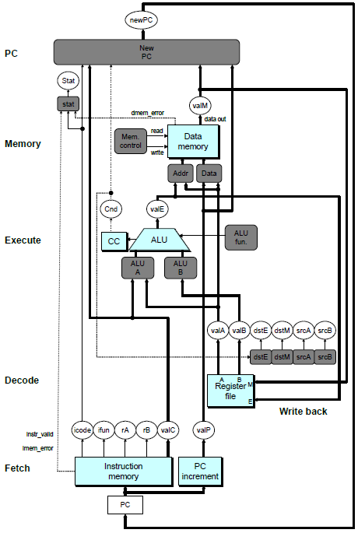
SEQ Hardware
Key
Blue boxes: predesigned hardware blocks
E.g., memories, ALU
Gray boxes: control logic
Describe in HCL
White ovals: labels for signals
Thick lines: 64-bit word values
Thin lines: 4-8 bit values
Dotted lines: 1-bit values

Slide 6
Fetch Logic
icode
ifun
rA
rB
valC
valP
Need
valC
Predefined Blocks
PC: Register containing PC
Instruction memory: Read 10 bytes (PC to PC+9)
Split: Divide instruction byte into icode and ifun
Align: Get fields for rA, rB, and valC
PC
increment
Instr
valid
Need
regids
icode
ifun
Split
Align
Byte 0
Bytes 1-9
Instruction
memory
imem_error
PC
Control Logic
Need regids: Does this instruction have a register byte?
Need valC: Does this instruction have a constant word?

Slide 7
Decode Logic
Register File
Read ports A, B
Write ports E, M
Addresses are register IDs or 15 (0xF) (no access)
Cnd
valA
valB
valM
valE
A
B
Register
file
M
dstE
dstM
srcA
E
srcB
Control Logic
srcA, srcB: read port addresses
dstE, dstM: write port addresses
dstE
dstM
srcA
srcB
icode
rA
rB
Signals
Cnd: Indicate whether or not to perform conditional move
Computed in Execute stage

Slide 8
Execute Logic
Units
ALU
Implements 4 required functions
Generates condition code values
CC
Register with 3 condition code bits
cond
Computes conditional jump/move flag
Control Logic
Set CC: Should condition code register be loaded?
ALU A: Input A to ALU
ALU B: Input B to ALU
ALU fun: What function should ALU compute?
Cnd
valE
cond
ALU
ALU
fun.
CC
Set
CC
ALU
A
ALU
B
icode
ifun
valC
valA
valB

Slide 9
Memory Logic
Stat
Memory
Reads or writes memory word
Control Logic
stat: What is instruction status?
Mem. read: should word be read?
Mem. write: should word be written?
Mem. addr.: Select address
Mem. data.: Select data
stat
valM
dmem_error
data out
instr_valid
Mem.
read
read
Data
memory
imem_error
Mem.
write
write
data in
Mem.
addr
Mem.
data
icode
valE
valA
valP

Slide 10
Writeback
Register File
Write ports E, M
Addresses are register IDs or 15 (0xF) (no access)
Cnd
valA
valB
valM
valE
A
B
Register
file
M
dstE
dstM
srcA
E
srcB
Control Logic
dstE, dstM: write port addresses
dstE
dstM
srcA
srcB
icode
rA
rB
Signals
Cnd: Indicate whether or not to perform conditional move
Computed in Execute stage

Slide 11
PC Update Logic
PC
New PC
Select next value of PC
New
PC
icode
Cnd
valC
valM
valP

Slide 12
Computed Values
Fetch
icode Instruction code
ifun Instruction function
rA Instr. Register A
rB Instr. Register B
valC Instruction constant
valP Incremented PC
Decode
srcA Register ID A
srcB Register ID B
dstE Destination Register E
dstM Destination Register M
valA Register value A
valB Register value B
Execute
valE ALU result
Cnd Branch/move flag
Memory
valM Value from memory

Slide 13
Stage Computation: Arith/Log. Ops
OPq rA, rB
Fetch
icode:ifun ← M₁[PC]
Read instruction byte
rA:rB ← M₁[PC+1]
Read register byte
valP ← PC+2
Compute next PC
Decode
valA ← R[rA]
Read operand A
valB ← R[rB]
Read operand B
Execute
valE ← valB OP valA
Perform ALU operation
Set CC
Set condition code register
Memory
Write
back
R[rB] ← valE
Write back result
PC update
PC ← valP
Update PC
Formulate instruction execution as sequence of simple steps
Use same general form for all instructions

Slide 14
Stage Computation: rmmovq
rmmovq rA, D(rB)
Fetch
icode:ifun ← M₁[PC]
Read instruction byte
rA:rB ← M₁[PC+1]
Read register byte
valC ← M₈[PC+2]
Read displacement D
valP ← PC+10
Compute next PC
Decode
valA ← R[rA]
Read operand A
valB ← R[rB]
Read operand B
Execute
valE ← valB + valC
Compute effective address
Memory
M₈[valE] ← valA
Write value to memory
Write
back
PC update
PC ← valP
Update PC
Use ALU for address computation

Slide 15
Stage Computation: Jumps
jXX Dest
Fetch
icode:ifun ← M₁[PC]
Read instruction byte
valC ← M₈[PC+1]
Read destination address
valP ← PC+9
Fall through address
Decode
Execute
Cnd ← Cond(CC,ifun)
Take branch?
Memory
Write
back
PC update
PC ← Cnd ? valC : valP
Update PC
Compute both addresses
Choose based on setting of condition codes and branch condition

Slide 16
Stage Computation: call
call Dest
Fetch
icode:ifun ← M₁[PC]
Read instruction byte
valC ← M₈[PC+1]
Read destination address
valP ← PC+9
Compute return point
Decode
valB ← R[%rsp]
Read stack pointer
Execute
valE ← valB + –8
Decrement stack pointer
Memory
M₈[valE] ← valP
Write return value on stack
Write
back
R[%rsp] ← valE
Update stack pointer
PC update
PC ← valC
Set PC to destination
Use ALU to decrement stack pointer
Store incremented PC

Slide 17
Stage Computation: ret
ret
Fetch
icode:ifun ← M₁[PC]
Read instruction byte
Decode
valA ← R[%rsp]
Read operand stack pointer
valB ← R[%rsp]
Read operand stack pointer
Execute
valE ← valB + 8
Increment stack pointer
Memory
valM ← M₈[valA]
Read return address
Write
back
R[%rsp] ← valE
Update stack pointer
PC update
PC ← valM
Set PC to return address
Use ALU to increment stack pointer
Read return address from memory

Slide 18
SEQ Operation
State
PC register
Cond. Code register
Data memory
Register file
All updated as clock rises
Combinational Logic
ALU
Control logic
Memory reads
Instruction memory
Register file
Data memory
Combinational
logic
Read
Write
Data
memory
CC
100
Read
ports
Write
ports
Register
file
%rbx = 0x100
PC
0x014

Slide 19
SEQ Operation
Cycle 1
Cycle 2
Cycle 3
Cycle 4
Clock
j
k
l
m
Cycle 1:
0x000: irmovq $0x100,%rbx # %rbx <-- 0x100
Cycle 2:
0x00a: irmovq $0x200,%rdx # %rdx <-- 0x200
Cycle 3:
0x014: addq %rdx,%rbx # %rbx <-- 0x300 CC <-- 000
Cycle 4:
0x016: je dest # Not taken
Cycle 5:
0x01f: rmmovq %rbx,0(%rdx) # M[0x200] <-- 0x300
Combinational
logic
Read
Write
Data
memory
state set according to second irmovq instruction
combinational logic starting to react to state changes
CC
100
Read
ports
Write
ports
Register
file
%rbx = 0x100
PC
0x014

Slide 20
SEQ Operation
Cycle 1
Cycle 2
Cycle 3
Cycle 4
Clock
j
k
l
m
Cycle 1:
0x000: irmovq $0x100,%rbx # %rbx <-- 0x100
Cycle 2:
0x00a: irmovq $0x200,%rdx # %rdx <-- 0x200
Cycle 3:
0x014: addq %rdx,%rbx # %rbx <-- 0x300 CC <-- 000
Cycle 4:
0x016: je dest # Not taken
Cycle 5:
0x01f: rmmovq %rbx,0(%rdx) # M[0x200] <-- 0x300
Combinational
logic
Read
Write
Data
memory
state set according to second irmovq instruction
combinational logic generates results for addq instruction
CC
100
000
Read
ports
Write
ports
Register
file
%rbx = 0x100
%rbx
<--
0x300
0x016
PC
0x014
Combinational
logic
Combinational
logic
Combinational
logic
Read
Write
Combinational
logic
Read
Write
Combinational
logic
Data
memory
Read
Write
Combinational
logic
Data
memory
Read
Write
Combinational
logic
Data
memory
Read
Write
Combinational
logic
Data
memory
Read
Write
Combinational
logic
Data
memory
CC
000
Read
Write
Data
memory
CC
000
Read
Write
Data
memory
CC
000
Read
ports
Read
Write
Write
ports
Data
memory
CC
000
Read
ports
Write
ports
Data
memory
CC
000
Read
ports
Write
ports
CC
000
Register
file
%rbx = 0x300
Read
ports
Write
ports
CC
000
Register
file
%rbx = 0x300
Read
ports
Write
ports
CC
000
Register
file
%rbx = 0x300
Read
ports
Write
ports
CC
000
Register
file
%rbx = 0x300
Read
ports
Write
ports
Register
file
%rbx = 0x300
Read
ports
Write
ports
Register
file
%rbx = 0x300
Read
ports
Write
ports
Register
file
%rbx = 0x300
Register
file
%rbx = 0x300
PC
0x016
Register
file
%rbx = 0x300
PC
0x016
PC
0x016
PC
0x016
PC
0x016
PC
0x016
PC
0x016
PC
0x016
PC
0x016

Slide 21
SEQ Operation
Cycle 1
Cycle 2
Cycle 3
Cycle 4
Clock
j
k
l
m
Cycle 1:
0x000: irmovq $0x100,%rbx # %rbx <-- 0x100
Cycle 2:
0x00a: irmovq $0x200,%rdx # %rdx <-- 0x200
Cycle 3:
0x014: addq %rdx,%rbx # %rbx <-- 0x300 CC <-- 000
Cycle 4:
0x016: je dest # Not taken
Cycle 5:
0x01f: rmmovq %rbx,0(%rdx) # M[0x200] <-- 0x300
Combinational
logic
Read
Write
Data
memory
state set according to addq instruction
combinational logic starting to react to state changes
CC
000
Read
ports
Write
ports
Register
file
%rbx = 0x300
PC
0x016
Combinational
logic
Combinational
logic
Combinational
logic
Read
Write
Combinational
logic
Read
Write
Data
memory
Read
Write
Data
memory
Read
Write
Data
memory
Data
memory
CC
000
CC
000
CC
000
Read
ports
Write
ports
CC
000
Read
ports
Write
ports
Read
ports
Write
ports
Register
file
%rbx = 0x300
Read
ports
Write
ports
Register
file
%rbx = 0x300
Register
file
%rbx = 0x300
Register
file
%rbx = 0x300
PC
0x016
PC
0x016
PC
0x016
PC
0x016

Slide 22
SEQ Operation
Cycle 1
Cycle 2
Cycle 3
Cycle 4
Clock
j
k
l
m
Cycle 1:
0x000: irmovq $0x100,%rbx # %rbx <-- 0x100
Cycle 2:
0x00a: irmovq $0x200,%rdx # %rdx <-- 0x200
Cycle 3:
0x014: addq %rdx,%rbx # %rbx <-- 0x300 CC <-- 000
Cycle 4:
0x016: je dest # Not taken
Cycle 5:
0x01f: rmmovq %rbx,0(%rdx) # M[0x200] <-- 0x300
Combinational
logic
Read
Write
Data
memory
state set according to addq instruction
combinational logic generates results for je instruction
CC
000
Read
ports
Write
ports
Register
file
%rbx = 0x300
0x01f
PC
0x016
Combinational
logic
Combinational
logic
Combinational
logic
Read
Write
Read
Write
Data
memory
Read
Write
Data
memory
Data
memory
CC
000
CC
000
CC
000
Read
ports
Write
ports
Read
ports
Write
ports
Read
ports
Write
ports
Register
file
%rbx = 0x300
Register
file
%rbx = 0x300
Register
file
%rbx = 0x300
0x01f
PC
0x016
0x01f
PC
0x016
0x01f
PC
0x016

Slide 23
SEQ Summary
Implementation
Express every instruction as series of simple steps
Follow same general flow for each instruction type
Assemble registers, memories, predesigned combinational blocks
Connect with control logic
Limitations
Too slow to be practical
In one cycle, must propagate through instruction memory, register file, ALU, and data memory
Would need to run clock very slowly
Hardware units only active for fraction of clock cycle

Slide 24


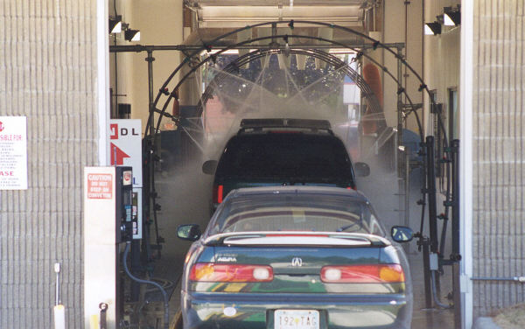
Real-World Pipelines: Car Washes
Sequential
Parallel
Pipelined
Idea
Divide process into independent stages
Move objects through stages in sequence
At any given times, multiple objects being processed

Slide 25
Computational Example
300 ps
20 ps
Combinational
logic
R
e
g
Delay = 320 ps
Throughput = 3.12 GIPS
Clock
System
Computation requires total of 300 picoseconds
Additional 20 picoseconds to save result in register
Must have clock cycle of at least 320 ps

Slide 26
3-Way Pipelined Version
100 ps
20 ps
100 ps
20 ps
100 ps
20 ps
Comb.
logic
A
R
e
g
Comb.
logic
B
R
e
g
Comb.
logic
C
R
e
g
Delay = 360 ps
Throughput = 8.33 GIPS
Clock
System
Divide combinational logic into 3 blocks of 100 ps each
Can begin new operation as soon as previous one passes through stage A.
Begin new operation every 120 ps
Overall latency increases
360 ps from start to finish

Slide 27
Pipeline Diagrams
Unpipelined
Cannot start new operation until previous one completes
3-Way Pipelined
Up to 3 operations in process simultaneously
OP1
OP2
OP3
Time
OP1
A
B
C
OP2
A
B
C
OP3
A
B
C
Time

