Slide 1

Local Sharing

Slide 2
Why choose localShare
Gain experience and knowledge by volunteering - wherever in the world you are
01
Tools available to people in need
02
Join carpools to save money and reduce your carbon footprint
03

Slide 3
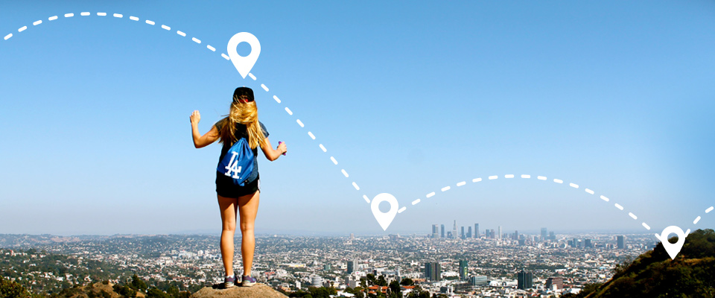
Uses geolocation to find services close to you.

Slide 4
So, what is Local ?
Network for finding volunteering jobs.
Marketplace for giveaway products
Donate money to organisations in need
To build stronger local communitites and a shared economy by putting the items we already know to better use

Slide 5
Team RALF-IT
Thank you !

