Slide 1

BAMBANK
EMILIANO JOSSIE
LOUIS JULIANO
CHERRY KOSASIH
LARS TAN

Slide 2
BACKGROUND
Why did we choose this track?
Because mass vaccination for covid is taking place soon
We believe this is very helpful to make schedule when each person get vaccinated

Slide 3
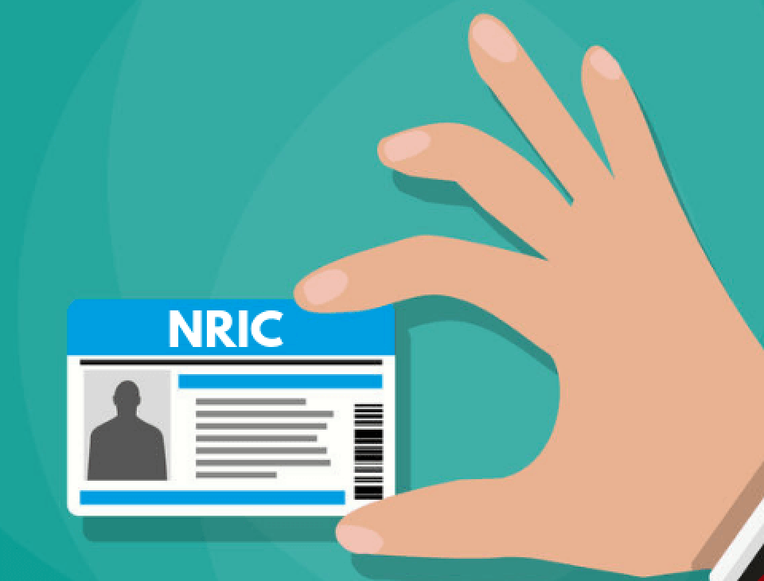
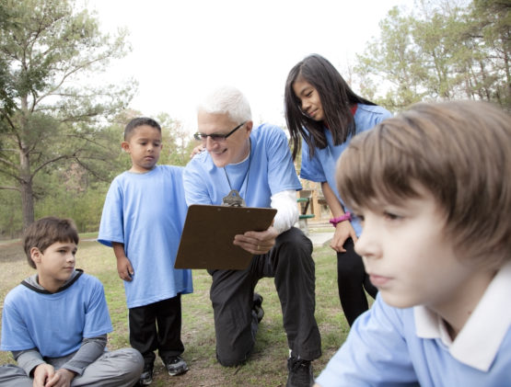
How it works
1. Set priority level based on residency(local/foreigner) and age group

Slide 4
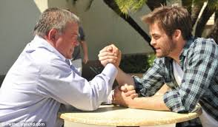
2. Sort the people based on descending priority level and based on the productivity of their age group

Slide 5
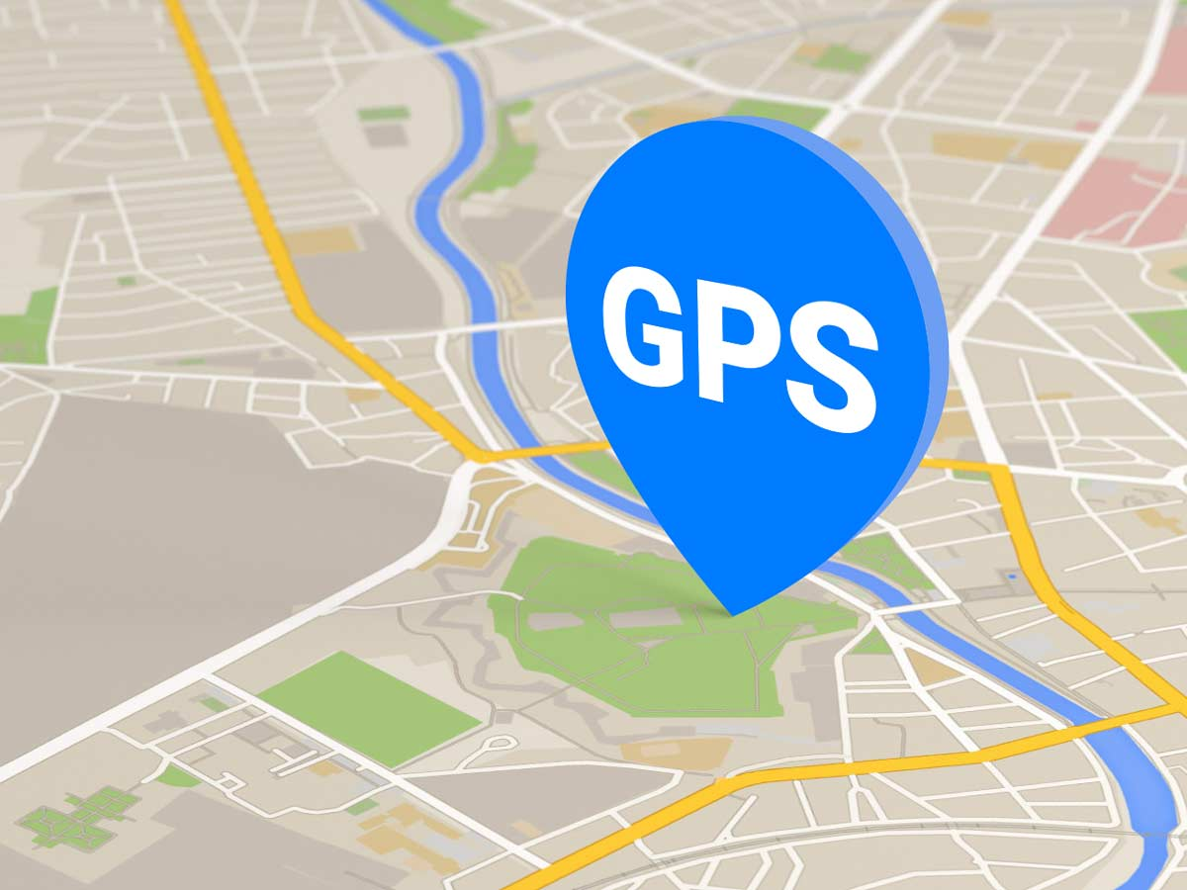
3. Calculate distance between the person and hospital from the coordinates in the data

Slide 6
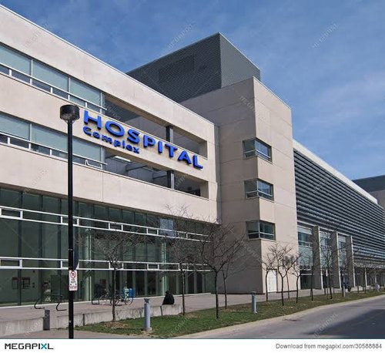
4. Assign people to hospital based on the closest location

Slide 7

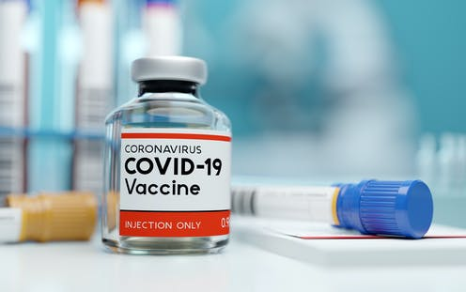
5. When user click set my schedule, they are scheduled for vaccination based on location , the availability of vaccine stock in that location.

Slide 8
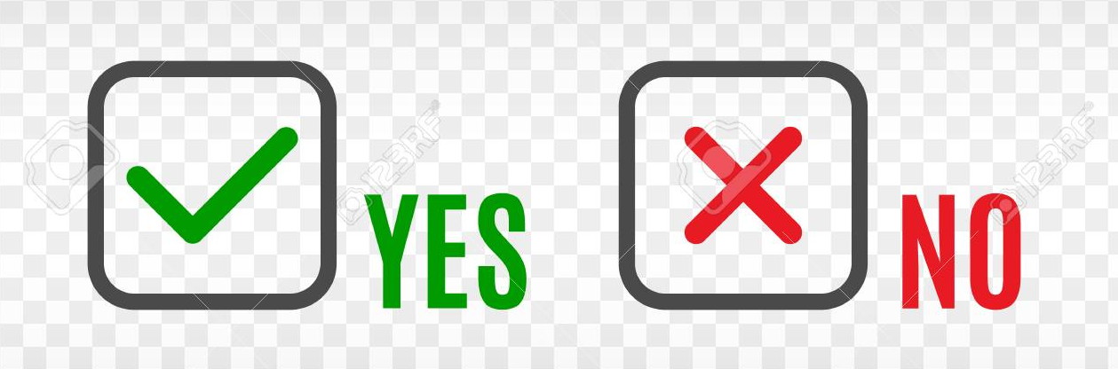
6. User may choose to accept or reject that schedule

Slide 9
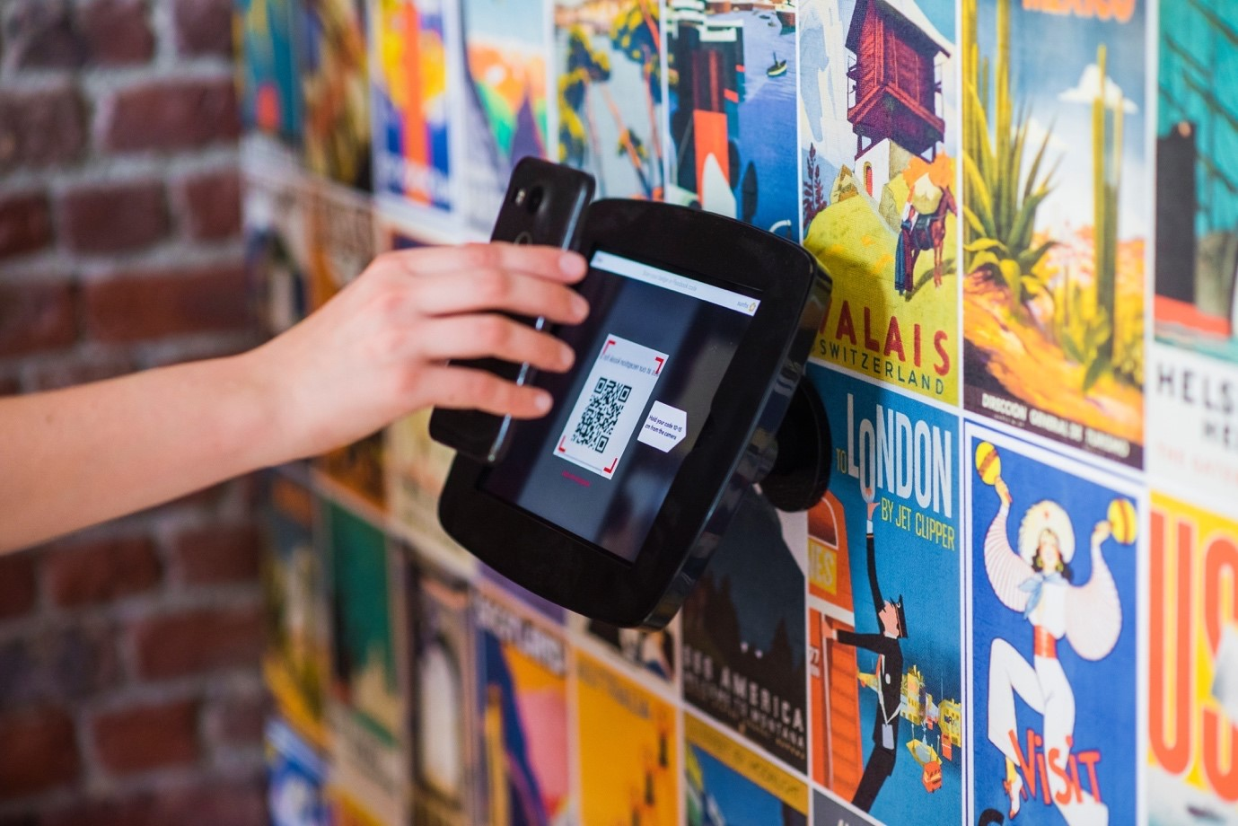
7. When user arrive to hospital for their vaccination , they will scan the given QR Code to check in , and hospital will remove their profile from the queue

Slide 10
THANK YOU

