Slide 1
PROJECT DEVELOPMENT TRACKER
Škoda Storyboard → Edge Delivery Services
Project development tracker — weekly progress
One slide per week · headline = progress · notes = talk track

Slide 2
WEEK 1 · 1–7 Sep 2026
Discovery & analysis
Measured the whole site and proved the migration is feasible.
Detailed talk track in speaker notes ▸
Škoda Storyboard → AEM Edge Delivery · internal progress tracker
Notes:
Week 1 — 1–7 Sep 2026 — Discovery & analysis
• Enumerated the full editorial corpus via the WordPress REST API: ~13,100 pages (5,282 stories · 6,558 press releases · 551 pages · 725 Škodapedia) across 6 languages.
• Parsed all 55 attachment sitemaps → ~28,300 logical media items / ~200k physical files; confirmed images sit on S3 + CloudFront with no Dynamic Media (EDS pipeline will be an upgrade).
• Scanned 100% of stories (2,773 EN+CS, 0 fetch errors): 98.7% covered by a small, consistent component set that is identical in EN and CS — so Czech adds volume, not complexity.
• Mapped the dynamic back-ends read-only (media-cart, banners, newsletter, search) to size the rebuild; only the media-cart zip needs a small serverless function.
• Produced the leadership exec briefing (source-of-truth) and the DA/EDS target architecture; every headline number LIVE-reconfirmed before send.
• Verdict: technical complexity moderate and well-understood; the real risk is the fixed 15 Oct date, not the build.

Slide 3
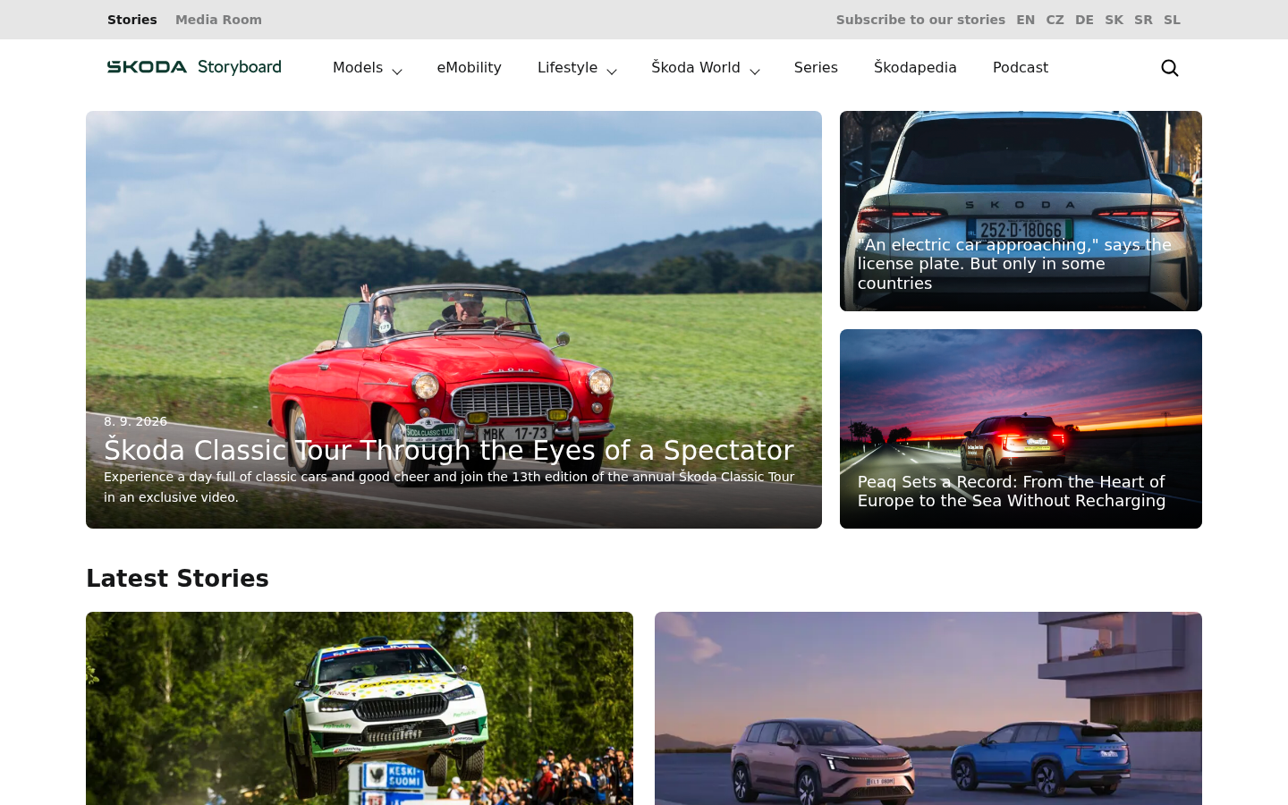
WEEK 2 · 8–11 Sep 2026
Capability pilot — /en landing page
Migrated the English landing page end-to-end and pixel-matched it to the original.
Detailed talk track in speaker notes ▸
Škoda Storyboard → AEM Edge Delivery · internal progress tracker
Notes:
Week 2 — 8–11 Sep 2026 — Capability pilot — /en landing page
• Stood up the reusable capability on one page: scraped & analysed /en, then built the block set (hero, cards overlay/media/toolbar, carousel, social, newsletter stub).
• Built content-driven import infrastructure (parsers + transformers + orchestrator) and ran it via the bulk importer; pushed the page + nav + footer fragments to Document Authoring.
• Content completeness ~97%, 0 source teaser titles missing; live at main--skoda-storyboard--larsauffarth.aem.page/en/.
• Extracted the design system from the live site into brand.css (SKODA Next stack, brand green #0e3a2f, type scale, spacing, radii, shadows, 1248px container) and applied it globally.
• Pixel-matched at 1440px: rebuilt the promo-box as the source's 1-large + 2-stacked featured grid, matched Latest Stories' 2+3 grid, dark Social/Series sections, header wordmark + topbar, and the dark-green footer with submenus.
• Fixed real defects found in-browser: restored section-metadata handling the vendored aem.js omitted; kept sized derivatives (not 20–34MB masters) so preview stops 409-ing; added a query-index-driven Latest Stories block and tag-filtered rails.
• Shipped as a series of reviewed PRs (#2–#25), all merged to main.
• Intentionally deferred/stubbed: media-cart, banners, live newsletter/social feed, search, the other 5 locales, RSS feed.

