Slide 1

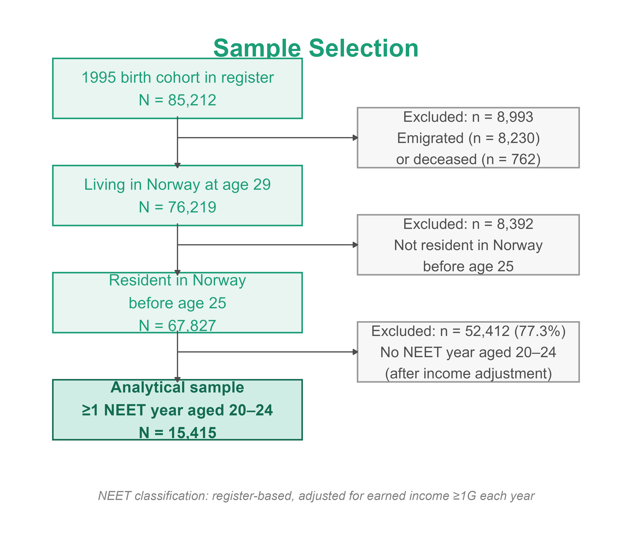
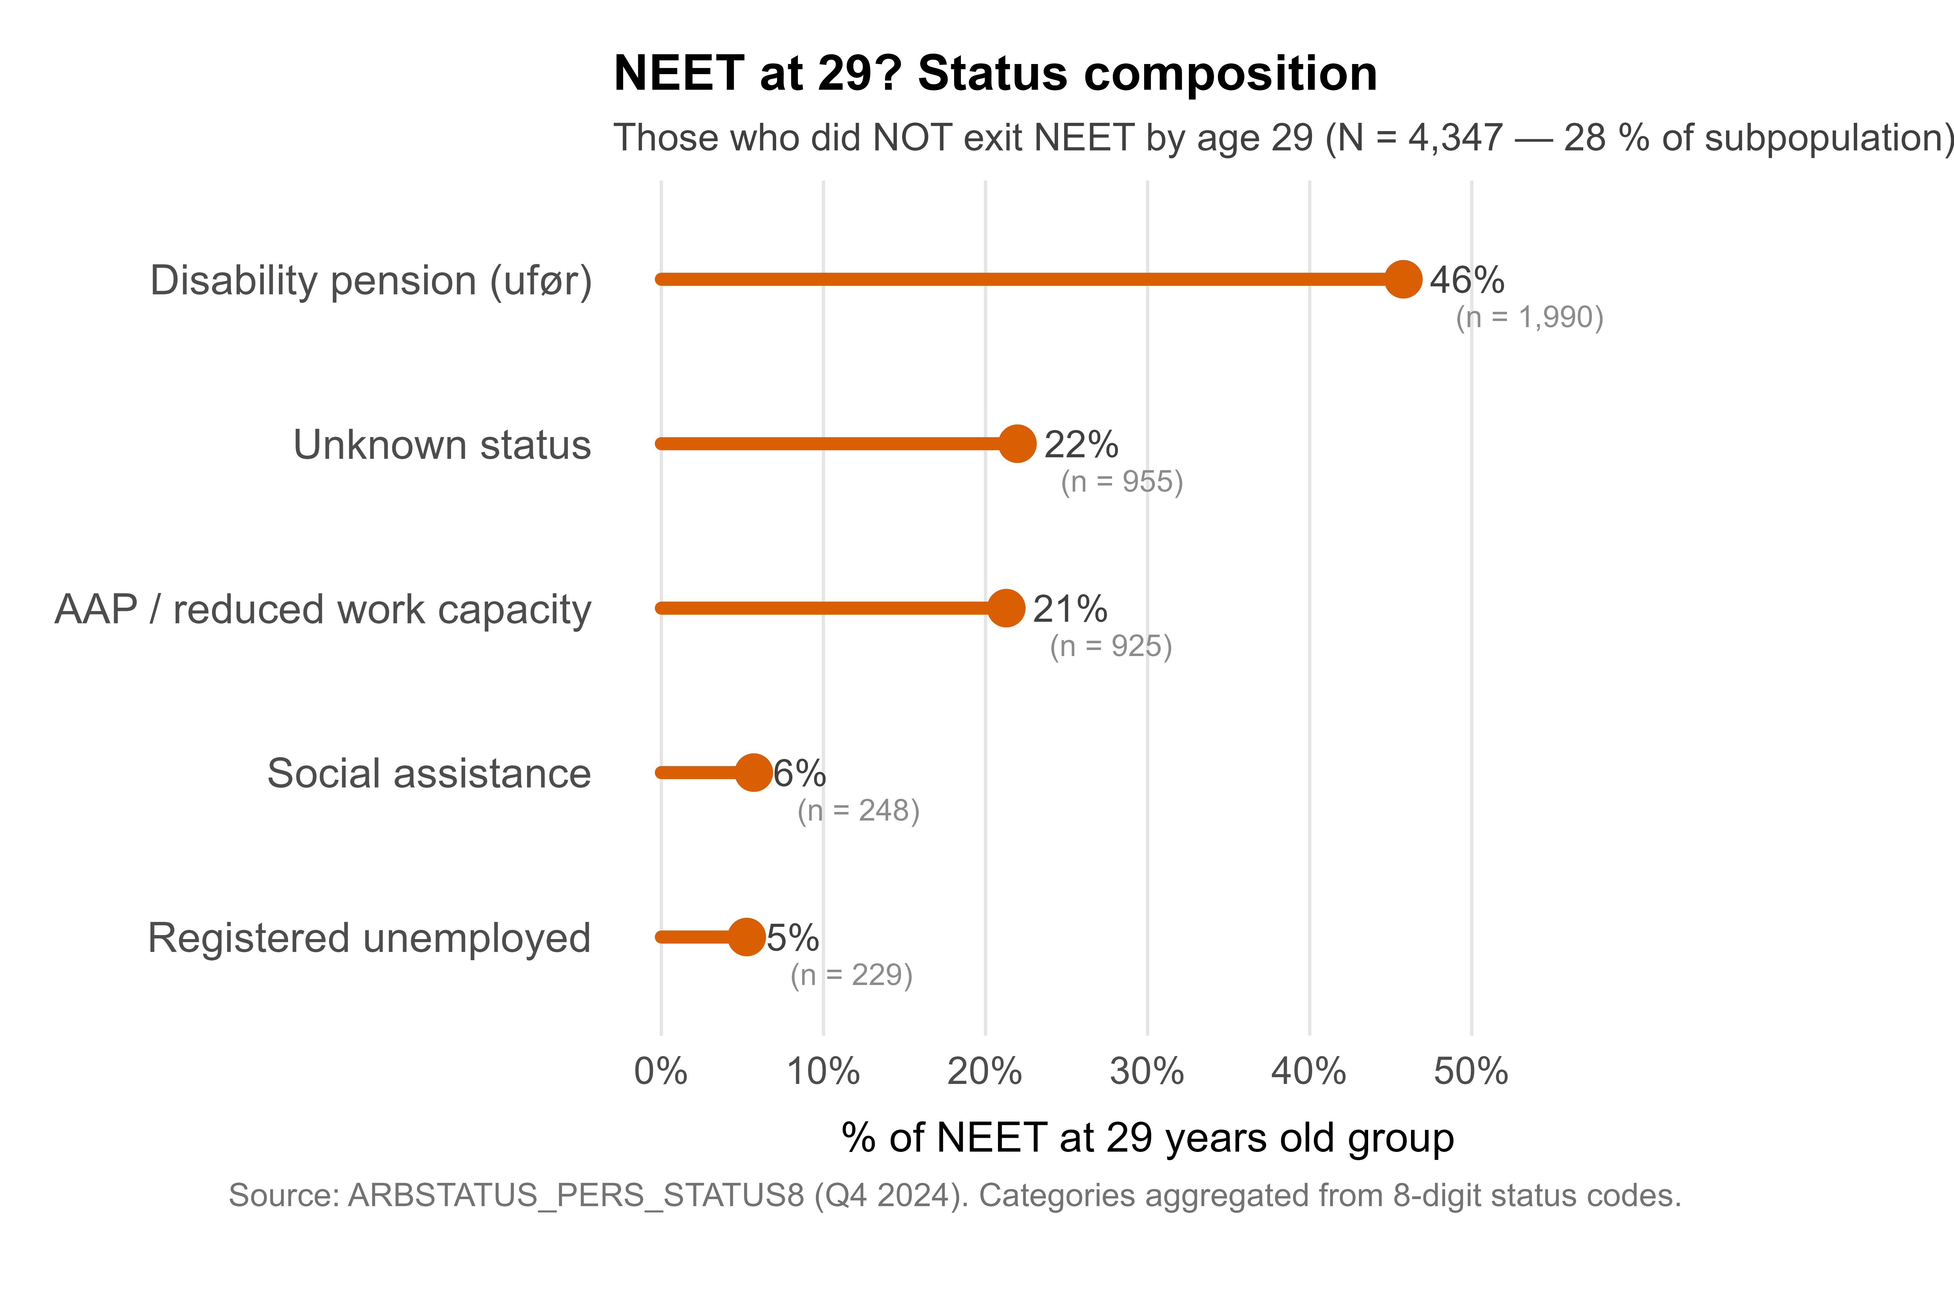
Pathways Out of NEET: Profiling Young Adults Using Registry Data
Lars Bauger^{1,3}, Karianne Nyheim Stray ^{1,2} & Susanne Hagen^{1,2}
¹ Research Group for Health Promotion in Settings, Department of Health, Social and Welfare Studies, University of South-Eastern Norway, Norway
² The Settings and Workplace Health Promotion Working Group, Nordic Health Promotion Research Network (https://nhprn.com/settings/)
³ Children and Young People in Health Promoting Settings, Nordic Health Promotion Research Network (https://nhprn.com/children-and-young-people /)
Image generated with DALL·E (OpenAI, 2024) via ChatGPT
Background & objective
Method
Descriptive results
Young adults not in education, employment, or training (NEET) represent a growing social and health concern, reflecting exclusion from key arenas that support participation, belonging, and wellbeing during the transition to adulthood. While previous research has focused on NEET prevalence and associated risk and protective factors, less is known about individuals who exit NEET status and successfully reintegrate into education or work.
We used Norwegian administrative registry data (microdata.no) covering all individuals born in 1995 (N = 85,212 with valid residency records). The analytical sample comprised 15,415 young adults who were NEET in at least one year before age 25 (ages 20-24). NEET status was defined using register-based labor market and educational status, adjusted for earned income. Individuals were reclassified as non-NEET in years where annual earnings reached or exceeded 1G (ranging from NOK 99,000 - 119,000). The outcome was NEET status at age 29 (2024). Logistic regression with average marginal effects (AME) was used to estimate adjusted associations with exit.
Objectives:
This study examines who exits NEET status and who remains NEET into their late 20s. We aim to:
estimate the proportion of young adults with prior NEET experience who successfully exit by age 29, and
identify demographic and socioeconomic predictors of NEET exit using logistic regression with average marginal effects
Regression results
Logistic regression with average marginal effects (N = 11,339 complete cases; Pseudo R² = 0.15) identified the following predictors of exit:
NEET duration was the strongest predictor of remaining NEET: two NEET years reduced exit probability by 13.5 percentage points (pp) (p<0.001), and three or more years by 29.9 pp (p<0.001), compared to one NEET year.
Child welfare experience reduced exit probability by 6.0 pp (p<0.001), the strongest single demographic predictor.
Socioeconomic background also mattered: growing up in the highest childhood income quartile increased exit probability by 4.1 pp (p<0.001), and higher school grades were independently associated with exit (2.6 pp per standard deviation, p<0.001).
Being male was associated with a 5.3 pp higher exit probability (p<0.001). Immigration background and parental education level were not significantly associated with NEET exit
Conclusion
Three in four young adults with a NEET period before age 25 had successfully transitioned out of NEET by age 29, indicating that early NEET experience does not inevitably lead to long-term exclusion. However, NEET duration, child welfare involvement, and lower socioeconomic background substantially reduce the likelihood of exit. Health promotion interventions should prioritize young people in their first year of NEET, when exit probability is still high and ensure targeted support for those with child welfare histories, who face markedly greater barriers to reintegration.
QR kode til poster og supplerende info bør være her?
Funding: This work was supported by Sparebankstiftelsene: Sparebankstiftelsen Sparebank 1 Buskerud Vestfold, Sparebankstiftelsen Nøtterøy-Tønsberg, Sparebankstiftelsen Telemark and Sparebankstiftelsen Nome

