Slide 1
Building on Solr Search
John Fiala
Vintage Digital
jcfiala@gmail.com
@jcfiala on twitter, irc, etc, etc

Slide 2
Who is John Fiala?
10 years web programming
3 years drupal
Several modules: Link, DME, BackReference, Own Term, etc.
...we also walk dogs.

Slide 3
Solr in Brief
According to Wikipedia, “Solr is an open source enterprise search server based on the Lucene Java search library, with XML/HTTP and JSON APIs, hit highlighting, faceted search, caching, replication, and a web administration interface”
If you're curious, Lucene is what does the work inside of the server, and Solr is the server bits providing the web server functionality, something like the caramel filling inside of a chocolate shell.

Slide 4
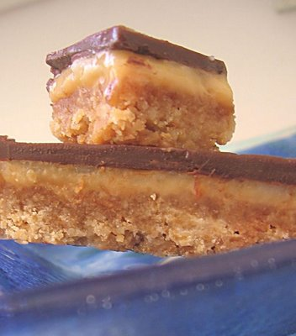
Mmm... Caramel

Slide 5
Extending Solr
You Can:
Change how the search is returned/performed. (Presentation changes)
Change how it indexes/searches it's data. (Logical changes in the search)

Slide 6
Example Modules
Apache Solr Autocomplete
Apache Solr AJAX

Slide 7
Stop!!
Demo Time

Slide 8
Customizing Search
search-result.tpl.php
search-results.tpl.php
hook_search_preprocess
hook_search_page
hook_apachesolr_search_result
  Instead of hook_nodeapi('search result')

Slide 9
Getting into how Solr Works
When you're trying to change how Solr indexes and searches, it's a good idea to see how Solr's been customized for Drupal. (schema.xml)
And what's really great is testing out Solr's web interface, to separate the module's search from what Solr does.
http://localhost:8983/solr/admin/form.jsp

Slide 10
Task: Creating a new field, and filtering off of it.
1) identify the fields, types, etc.
2) hook_apachesolr_update_index
(A digression into naming fields and what they mean.)
3) hook_apachesolr_facets()
4) hook_block
6) Making the facets pretty
In case of problems – kill cache_apachesolr

Slide 11
So, let's sort that field
To sort on a field, you need to tell apachesolr that it's a sortable field – which means we get to subclass Solr_Base_Query.
Demo

Slide 12
Overriding Solr_Base_Query
variable_set(
  'apachesolr_query_class',
  array('my_module_name',
    'my_child_class_name));
Normally you're going to define this in the .install of your module, of course.
You also want to do this in the hook_enable()/hook_disable() as well.

Slide 13
Sorting on more than one field is tricky
In the apachesolr module, the code that's trying to set the parameter for sorting is fixed on one field – a #name and a #direction!
And we can't modify that, because hook_apachesolr_modify_query is called before this is done.
So – We cheat, without accidentally harming any nearby kittens.

Slide 14

These are Safe

Slide 15
The problem code
foreach (module_implements('apachesolr_modify_query') as $module) {
$function_name = $module . '_apachesolr_modify_query';
$function_name($query, $params, $caller);
}
// TODO: The query object should hold all the params.
// Add array of fq parameters.
if ($query && ($fq = $query->get_fq())) {
$params['fq'] = $fq;
}
// Add sort if present.
if ($query) {
$sort = $query->get_solrsort();
$sortstring = $sort['#name'] .' '. $sort['#direction'];
// We don't bother telling Solr to do its default sort.
if ($sortstring != 'score asc') {
$params['sort'] = $sortstring;
}
}

Slide 16
Another Demo

Slide 17
Inclusive vs. Exclusive Filters
The basic filters as defined by the apachesolr module are exclusive – if you choose tid 5 and tid 7 as filters, you only see nodes which have both 5 and 7.
Sometimes you want to be inclusive – Such as when you're searching for something in Maryland OR Delaware.
This is tricky. We want to send tid:(823 OR 1009) to solr, but apachesolr isn't built to do that.

Slide 18
Questions?
(Or, y'know, we could go get a drink before closing ceremonies.)

