Slide 1
Ttt4110 - project
By
Kristoffer K. Larsen
Magnus Skeide
Martin Ervik
Spring 2014

Slide 2
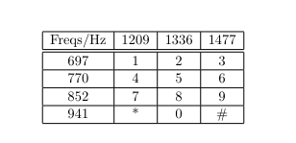
Part 1 - theory
Generating the DTMF-signals from the given table
Play the generated numbers from an arbitrary number

Slide 3
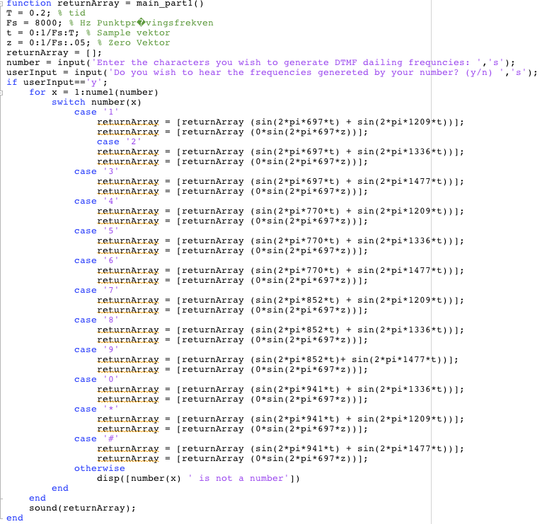
Part 1 - code

Slide 4
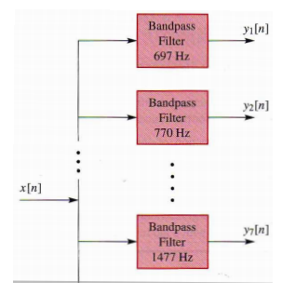
Part 2 – Theory
Decoding the DTMF-signals
The input is now a signal
We want the output to be the numbers
To do so we must:
Create filters
Split up signal
Recognize the numbers in an iterative manner

Slide 5
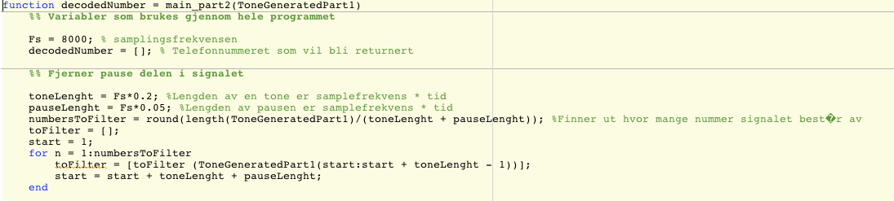
part 2 - code
Variables for use throughout the code
Checking length of signal

Slide 6
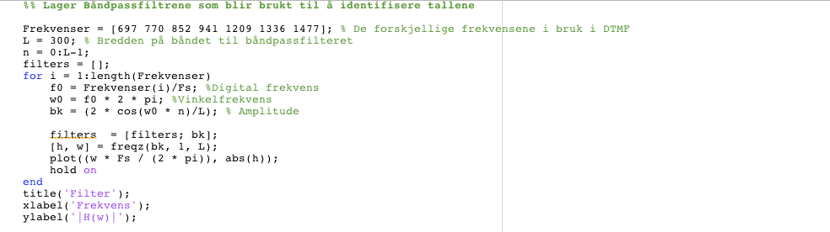
Code continues
Creating the filters

Slide 7
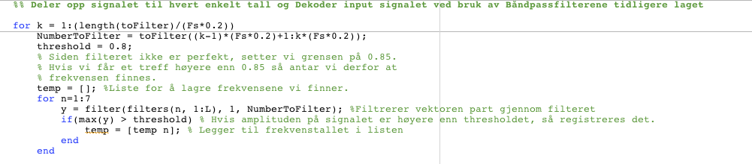
Code continues
Separating and decoding each “piece” of the input signal

Slide 8
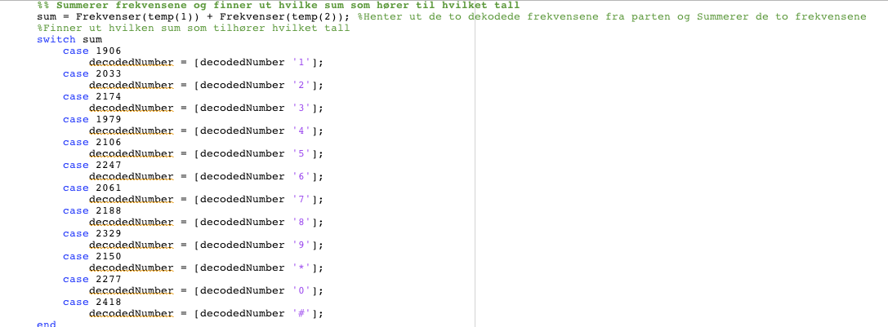
Summing the frequencies for the final result

Slide 9
Takk for oss!

