Slide 1
TTT4110 - PROJECT
By
Kristoffer K. Larsen
Magnus Skeide
Martin Ervik
Spring 2014

Slide 2
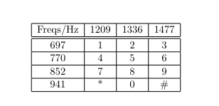
PART 1 - THEORY
Generating the DTMF-signals from the given table
Play the generated numbers from an arbitrary number

Slide 3
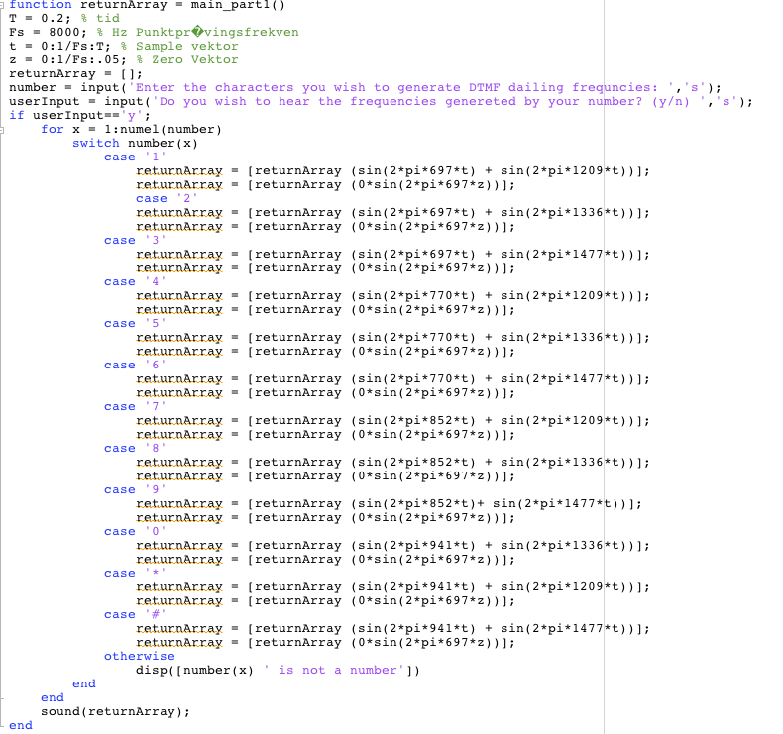
PART 1 - CODE

Slide 4
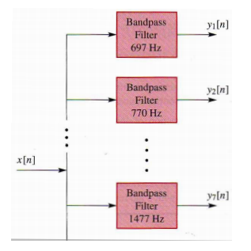
PART 2 – THEORY
Decoding the DTMF-signals
The input is now a signal
We want the output to be the numbers
To do so we must:
  Create filters
  Split up signal
  Recognize the numbers in an iterative manner

Slide 5
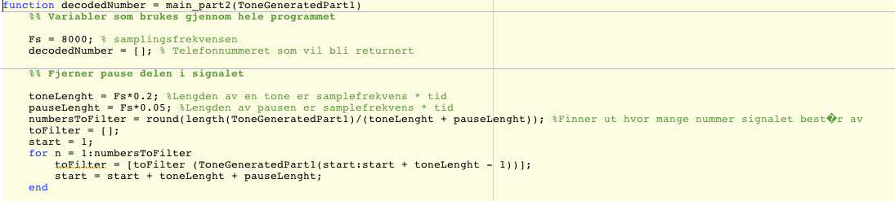
PART 2 - CODE
Variables for use throughout the code
Checking length of signal

Slide 6
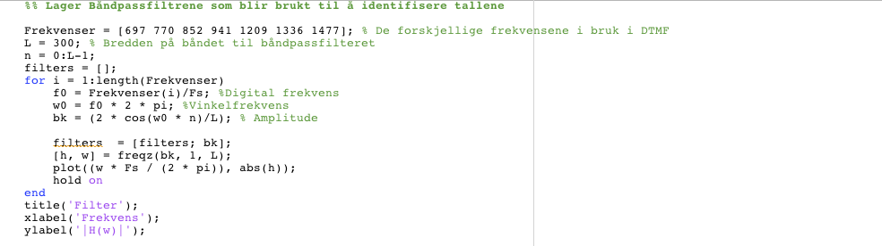
CODE CONTINUES
Creating the filters

Slide 7
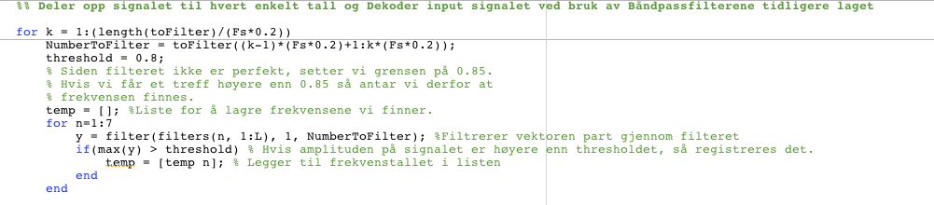
CODE CONTINUES
Separating and decoding each “piece” of the input signal

Slide 8
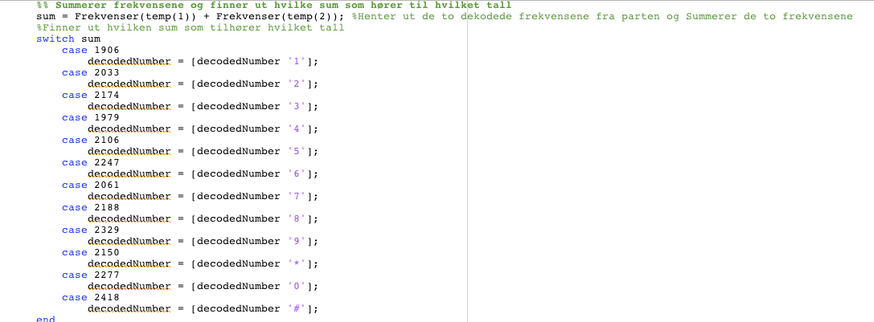
Summing the frequencies for the final result

Slide 9
Takk for oss!

