Slide 1
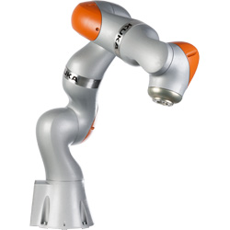


Modbus/TCP
ReadMultipleRegistersRequest(register, length);
TCP Packages
Modbus/TCP Client
Modbus/TCP Server
[CameraIP]:502

