Slide 1
power to sensors and radio
use high efficiency PNP
zetex?
maybe use internal PU,
would need to disable PU
when changing pin to output?
3.3v
3.3v_out
Vout
Vbat
ldo
R1
R2
R2 > 100K; < 33uA
possible?
gnd
t84
Vcc
nrf24
Vcc
Vbat
ldo
Vrf
t84
gnd
better to use an low Iq LDO.
the NRF24 Vcc MUST be < 3.6V.
This means that can’t run lofi directly
from 18650 or LIR2450
Run t84 from Vbat so that can report
battery voltage to receiver. (i.e. can use
ADC to read Vbat).
Vcc
enb

Slide 2
power to sensors and radio
Vout
Vbat
ldo
gnd
t84
Vcc
nrf24
Vcc

Slide 3
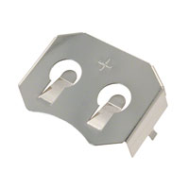
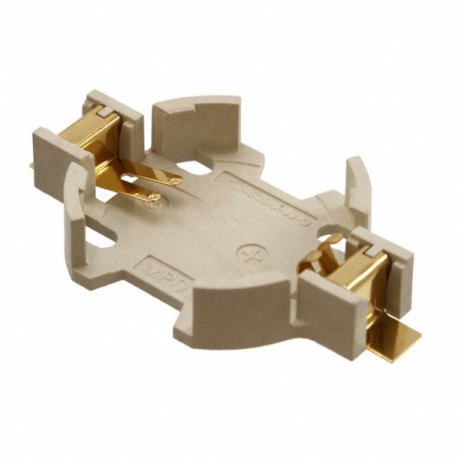
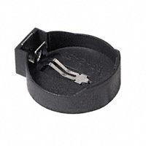
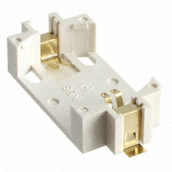
2450 battery holders
BK-5033-ND
BU2450SM-JJ-GCT-ND
BS-2450-ND
36-1052-ND

Slide 4
questions

Slide 5
Mission Time and 1pps Flow
received Mission TIme
Update Command
cmd
processing
Update Mission Time
TimeBase_now
update flag
last Mission Time
TimeBase_mt
tbAvgTicksPerSec
1pps
tbIsr
Current
Mission Time
1pps
ISR
1pps Analysis
Task
Now( )
PPC
TimeBase

