Slide 1
Washington wildfire
recovery map
A Washington incident map for infrastructure
recovery coordinators
Seattle Kiro Buildathon
Notes:
0:00–0:30. This demo is for an infrastructure recovery coordinator. The question is how to move from thousands of wildfire records to a specific incident worth checking. We use a real Washington data extract and an interactive map.

Slide 2
The recovery coordinator's question
Which incidents warrant a closer
infrastructure check?
A county recovery coordinator needs to locate fires in a service area, review nearby power lines and roads, and share an incident record.
Proposed user persona for this demo; no agency deployment is claimed.
Notes:
0:30–1:20. Our proposed user is a county infrastructure recovery coordinator. They need to find fires in their service area and check whether nearby power lines or roads warrant follow-up. We do not claim an agency has deployed this tool. The app supports a focused screening decision, not a final damage assessment.

Slide 3
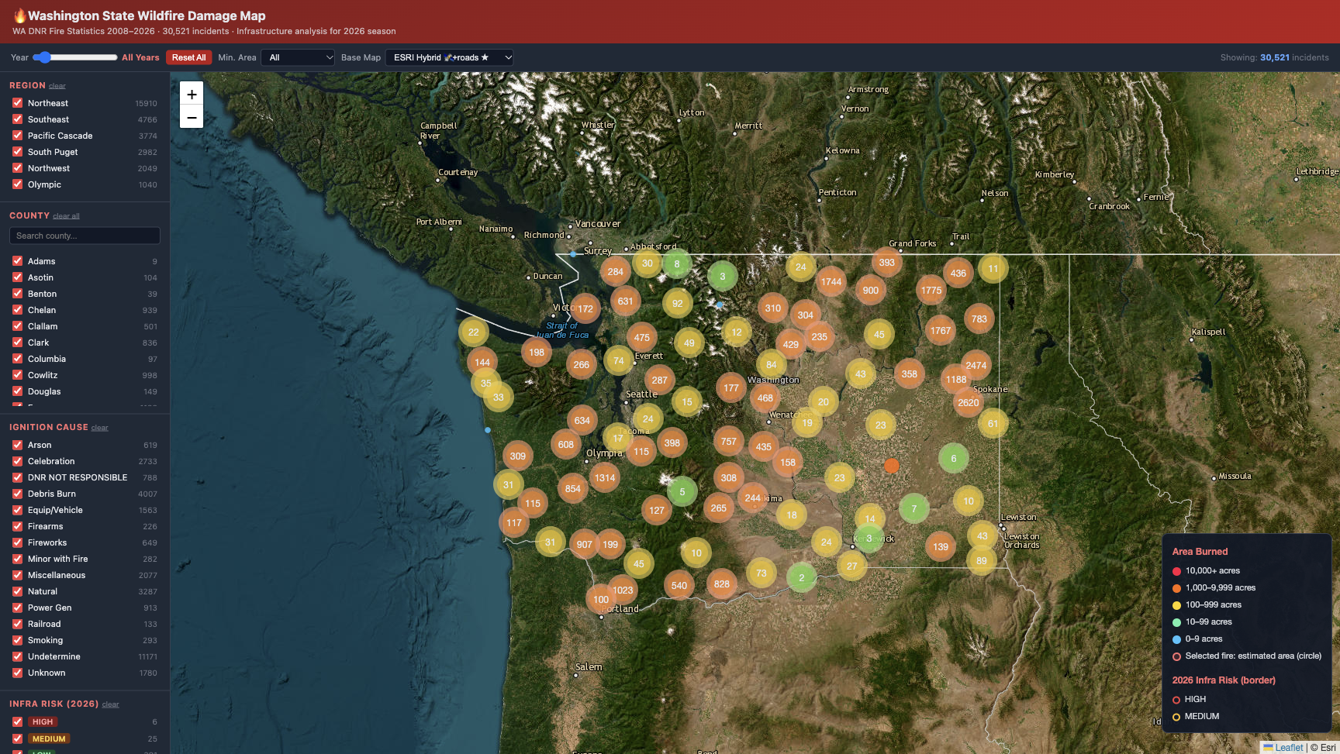
A working map built on real records
30,521
WA DNR incidents
Filter by year, county, cause and burned acres. Open a fire to see its record, estimated area and report.
AI assisted the build. Runtime filters, counts and area math are deterministic.
Source: WA DNR Fire Statistics local extract. Image: working map captured for this deck.
Notes:
1:20–2:50. The map loads 30,521 WA DNR incident records from a local extract, so the demo works without a live data API. Show a county or year filter, then click an incident. The map shows its record, a same-area circle based on burned acres, and a downloadable report. AI helped build the app. Filtering, counts and the circle calculation run as deterministic code.

Slide 4
Two incidents show the data boundary
STONE · 2026
LEDBETTER · 2017
0.7 acres
0.3 acres
Stevens County
1 km scan: no nearby power-line segments or major roads
Infrastructure risk: LOW
Pend Oreille County
Recorded cause: Power Gen
Infrastructure analysis unavailable for this incident
Power Gen is an ignition-cause label, not proof of infrastructure damage. Sources: supplied incident reports.
Notes:
2:50–4:10. Compare two supplied reports. STONE, a 2026 incident in Stevens County, burned 0.7 acres. The 1 km scan found no nearby power-line segments or major roads, so the report labels infrastructure risk LOW. LEDBETTER, a 2017 incident in Pend Oreille County, burned 0.3 acres and has a Power Gen ignition-cause label. Infrastructure analysis is unavailable for that record. The cause label alone does not establish damage.

Slide 5
What this tool can and cannot show
Useful now
Known limits
Narrow thousands of records to a relevant region. Compare individual incidents. Use 2026 proximity analysis to decide what merits follow-up.
The area circle is a same-area estimate, not the observed fire perimeter. Proximity does not verify asset damage.
Next: add official fire perimeters and verified asset damage records.
Notes:
4:10–5:00. The value is triage: narrow a large record set, inspect a specific incident, and share its report. We keep the limits visible. The circle is an area estimate, not a true fire boundary. Nearby infrastructure is not confirmed damage. The next useful addition is official fire perimeter geometry and verified asset damage records.

