Slide 1

Infrastructure as Code (IaC)
Solving real problems
Lars-Jo Røsberg – Senior Cloud Developer

Slide 2
Agenda
What does it all mean - definitions
Why do we need it - benefits
How does it work – demonstration
Bonus material?

Slide 3
Introduction to IaC
Infrastructure as Code.. what is “code”
Declarative definition files
Multiple standards, such as JSON, XML, YAML -> IaC
Cloud agnostic?
Tools
ARM Templates
Bicep templates
Terraform

Slide 4
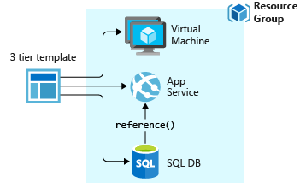
Azure Resource Manager templates (ARM templates)
“The template is a JavaScript Object Notation (JSON) file that defines the infrastructure and configuration for your project. The template uses declarative syntax, which lets you state what you intend to deploy without having to write the sequence of programming commands to create it. In the template, you specify the resources to deploy and the properties for those resources.”

Slide 5
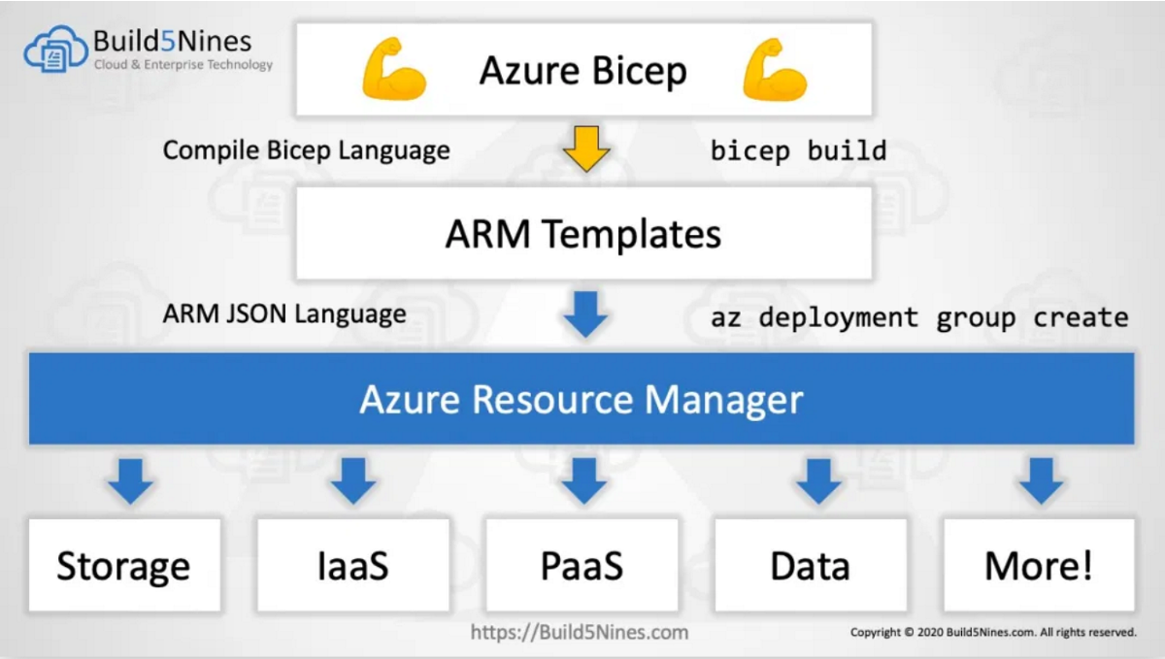
Bicep
“Bicep is a domain-specific language (DSL) that uses declarative syntax to deploy Azure resources. It provides concise syntax, reliable type safety, and support for code reuse. We believe Bicep offers the best authoring experience for your infrastructure-as-code solutions in Azure.”

Slide 6
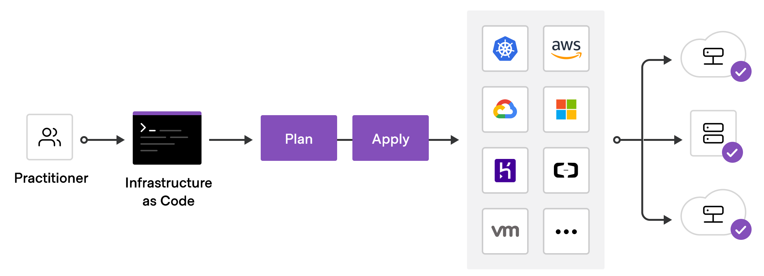
Terraform
“Terraform is an open-source infrastructure as code software tool that provides a consistent CLI workflow to manage hundreds of cloud services. Terraform codifies cloud APIs into declarative configuration files.”

Slide 7
Questions

Slide 8

Demonstration

Slide 9

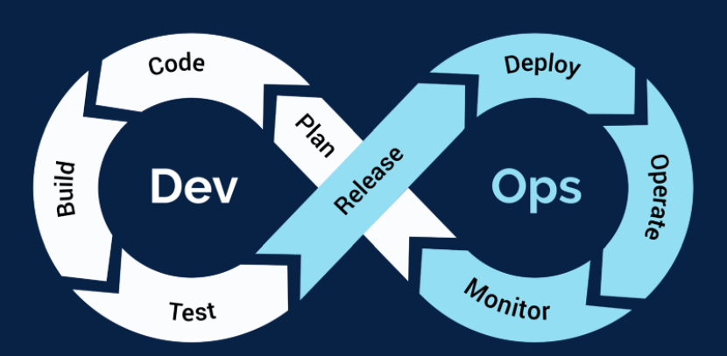
Bonus material
Continuous Integration and Deployment (CI/CD)
Process of automating development and delivery phases
Version control systems such as Git, BitBucket, Suversion, etc.
Modern DevOps platforms can be leveraged to create build and release pipelines
Azure DevOps
GitHub Actions
Jenkins
Avoid environment drift by ensuring latest committed changes are applied to live environments by a simple check-in

Slide 10
Bonus Demo

Slide 11
Q&A

Slide 12
Thank you
Lars-Jo Røsberg
Senior Cloud Developer
Public Cloud - TietoEvry Bergen

