Slide 1
Review Ledger
From a code finding to an approved,
verified change
Lars Klander | Track 5 capstone | 5 November 2026
Notes:
Opening, about 10 seconds. Review Ledger links agent proposals to exact human decisions and test evidence. Slides 1–5 form the short introduction before code; 6–8 are appendix material. Keep the combined presentation and demo below ten minutes. The existing rehearsal timer remains stopped until Lars explicitly starts. Source: CAPSTONE-REQUIREMENTS.md and DEMO-RUNBOOK.md.

Slide 2
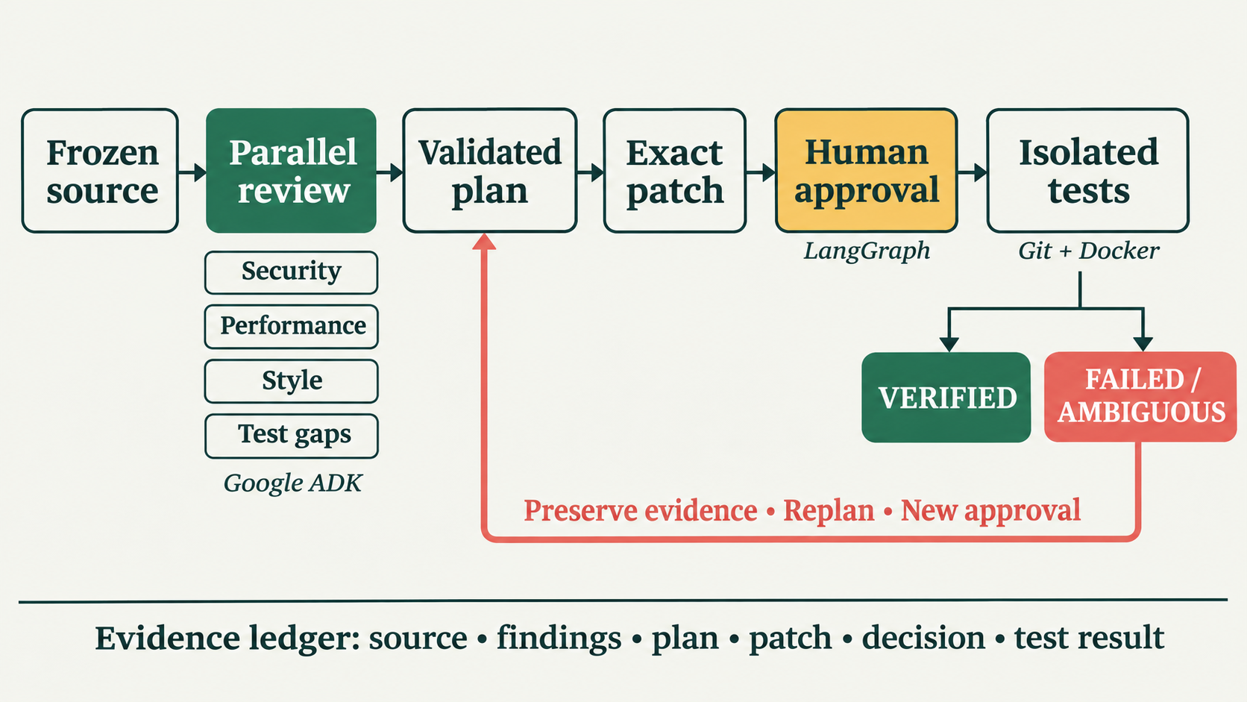
How a proposed change becomes evidence
Review Ledger · project flow
2
Notes:
About 25 seconds. Google ADK performs the parallel reviews; LangGraph persists the gate and lifecycle. Git pins source and isolates revisions; Docker isolates execution. The image is an explanatory diagram, not execution evidence. Ambiguous operations stop for inspection; the recovery loop does not authorize automatic replay. Source: ARCHITECTURE.md, approval_executor.py, action_planning.py.

Slide 3
Permission and correctness need different evidence
Personal approval
Behavioral verification
Binds one exact patch to its parent,
plan, policy and decision-maker.
Tests the proposed behavior.
A passing result has a bounded scope.
What the failures taught us
Long paths → ambiguous execution and quarantine
Wrong generated assertion → repair the test oracle
Failed patch → preserve logs, replan, obtain a new approval
Review Ledger · project flow
3
Notes:
About 20 seconds. Keep the distinction between real unplanned failures and the intentional demonstration fault. The original historical recovery passed seven tests and thirteen extra checks. A generated expected result was wrong; we fixed the test rather than changing correct production behavior. Raw planner output was missing from an early rejected response; later outputs are retained before validation. Source: TECHNICAL-REFLECTION.md, TEST-EXPECTATION-CORRECTION.md, FRESH-REHEARSAL-RESULT.md.

Slide 4
Original scope and additional work stay visible
Primary rubric path
Additional development
Four specialist reviews
Dependency-aware planning
Personal approval before each step
Failure, replanning and recovery
Read-only evidence dashboard
Bounded Python / public PR intake
Fifth reviewer: logic correctness
Broader repair-outcome evaluation
Preserve original runs and scores. Label every new result by its scope.
Review Ledger · project flow
4
Notes:
About 20 seconds. The primary recording follows the established rubric. General PR intake is additional: the rubric allows codebase OR PR diff. Historical Assignment 5 PR intake and personally approved local repository repair are different capabilities. The dashboard labels scores, evidence and limitations separately. Source: CAPSTONE-REQUIREMENTS.md, dashboard-scope.json, REPOSITORY-HARDENING-RESULTS.md.

Slide 5
Now follow one change through the code
01 Review
spike_live.py
Parallel roles and cited source evidence
02 Plan
action_planning.py
Dependencies, readiness and validation
03 Execute
approval_executor.py
Exact patch binding, persistent gate, Docker
04 Recover
failure_demo.py
Actual failure log, new plan and fresh approval
Dashboard → evidence → code → terminal decision → verified outcome
Review Ledger · project flow
5
Notes:
About 15 seconds, then transition to the code/demo. Keep the original fault approval cue at approximately 2:20; the opening must fit inside existing introductory time, not add ten more minutes. The displayed original run is thursday-dress-20261103-01. Characterization is already personally approved and VERIFIED; do not ask for that approval again. Next approval is the deliberate fault, followed by separately approved repair. Source: REHEARSAL-SESSION-2026-11-03.md and DEMO-RUNBOOK.md.

Slide 6
More reviewers did not improve the original precision
Original frozen comparison | Four specialists | Single reviewer
Held-out macro precision | 0.411 | 0.510
Held-out macro recall | 1.000 | 1.000
Provider-reported tokens | 101,708 | 34,945
Neither met the 0.80 precision target on this evaluation.
Role coverage is inspectable. Agreement and extra model calls are not proof of accuracy.
Appendix · additional detail
6
Notes:
Appendix; use for evaluation discussion, not all during the opening. This is the original frozen finding evaluation. Held-out automatic macro precision is reported, not micro precision or repair success. Both variants had 48 completed reviews. Sparse labels can omit valid extras, but original scores remain unchanged. Source: results/comparison.json and results/COMPARISON.md.

Slide 7
Later evaluations answer two different questions
Review accuracy · 12-case Luna holdout
Same frozen outputs | Original key | Adjudicated
Overall precision | 72.7% | 100%
Macro precision | 85.0% | 100%
Recall (overall / macro) | 100% / 100% | 100% / 100%
Repair outcomes · known development cases
2/8 → 8/8 complete case-runs after adding correctness review
6/6 repairs · 2/2 clean controls · 2/2 injected-failure recoveries
Different corpora and methods; these results do not replace the original scores.
Appendix · additional detail
7
Notes:
Appendix. Luna authored twelve synthetic cases after Gemini was frozen; same locked outputs, different labels after project-author adjudication. Three accepted extras were test-coverage findings. One repeat; no external blinded adjudication or general accuracy claim. The repair corpus is four related known synthetic cases run twice; the correctness reviewer was added after v1 misses. Two recovery failures were harness-injected, all benchmark approvals simulated. Sources: HOLDOUT-LUNA-RESULTS.md; results/holdout-luna-20261104/adjudicated-comparison.json; results/repository-hardening-20261104/v1-summary.json and v2-summary.json.

Slide 8
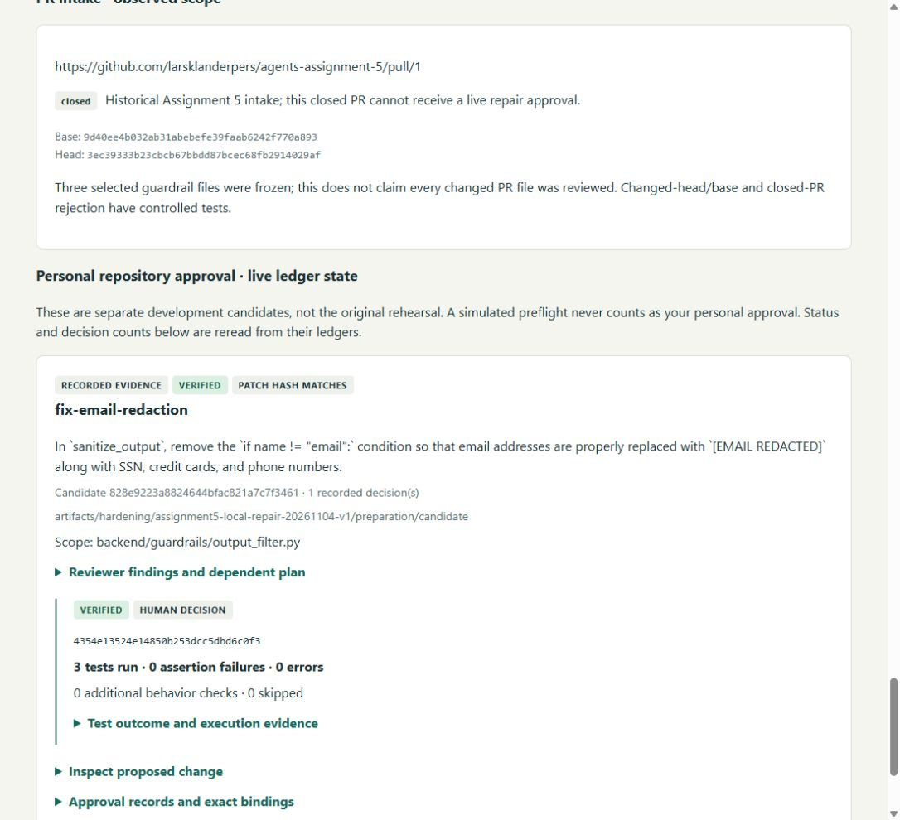
The Assignment 5 local repair has a real human result
VERIFIED
Personal approval recorded
3/3 visible tests passed
Exact patch and log hashes checked
Separate simulation: 12/12 tests
Original checkout unchanged
Seeded development copy;
no live PR repair claim.
Appendix · additional detail
8
Notes:
Appendix. This is a deliberately seeded disposable Assignment 5 copy, not a newly discovered bug in the original assignment. Lars personally approved patch 10f7dab6d466. Operation 4354e13524e14850b253dcc5dbd6c0f3 is VERIFIED with three visible tests. A separate simulated preflight passed twelve acceptance tests, including email assertions. Source checkout unchanged. This demonstrates bounded local repository repair; the existing closed PR is historical intake evidence, not a personally approved live PR repair. Screenshot is actual saved Review Ledger evidence from 4 November. Source: artifacts/hardening/assignment5-local-repair-20261104-v1/preparation/candidate/ledger.sqlite and separate-simulated-preflight/outcome.json.

