Slide 1
Washington

Slide 2
Content
General facts
Climate
Famous persons
Geographic
Nature

Slide 3
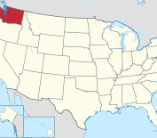
General facts
President George Washington
18th largest state
13th most popolus
Capital is Olympia
Boarders to Idaho, Oregon, Canada and the pacific
Famous companies: Microsoft, Starbucks and Boeing
Called Washington territory
State in 1889

Slide 4
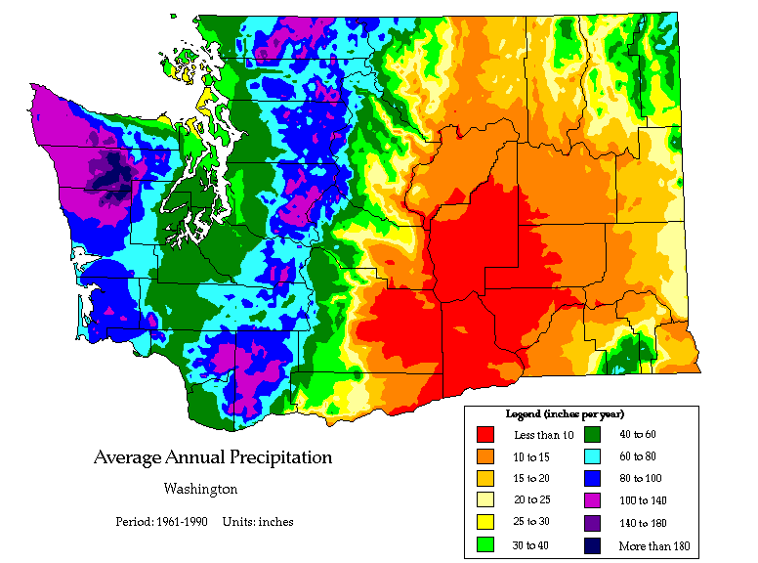
Climate
Varies alot from east to west
Oceanic climate in the west
Dry climate in east
The difference in rainfall is huge

Slide 5
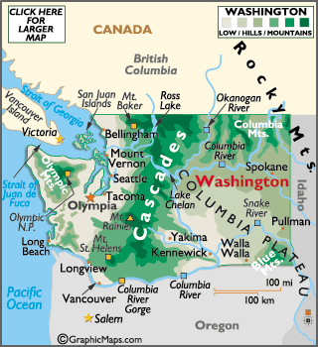
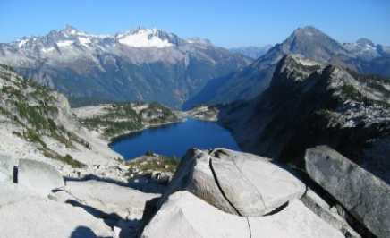
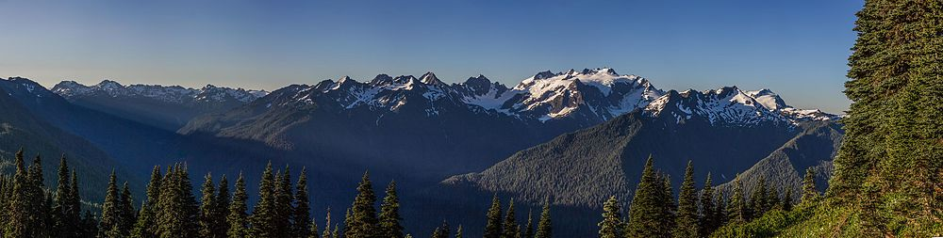
Mountains
Cascade Mountains
1100
130
Volcanos
Mount St. Helens
Mount Rainer
4392
Olympic Mountains

Slide 6
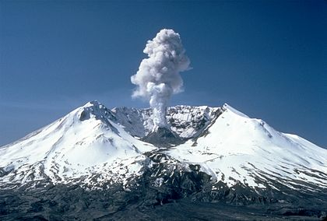
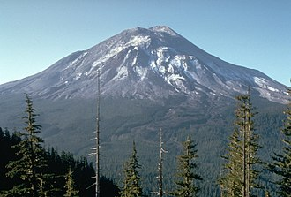
Mount St Helens
Active vulcano
1980
75
Earthquake
Carter
1,6 km

Slide 7
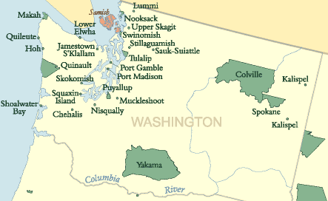
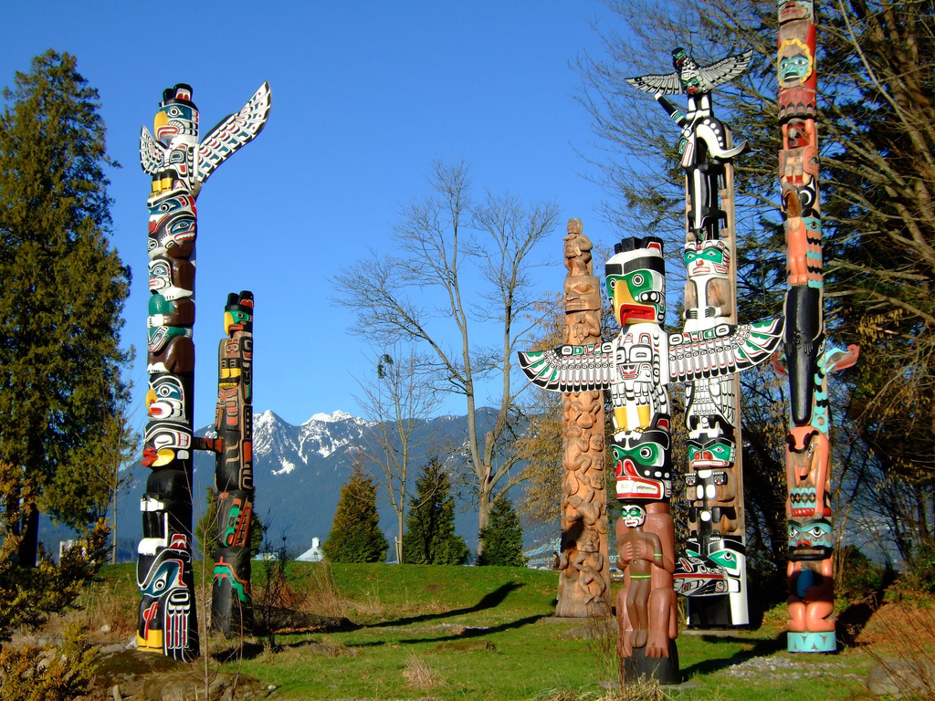
Native Americans
Alone
Totem poles
Late 1700s
Epidemic
29 tribes
50 000
3 big reservations

Slide 8
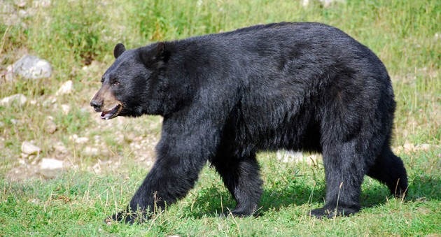
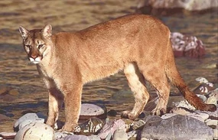
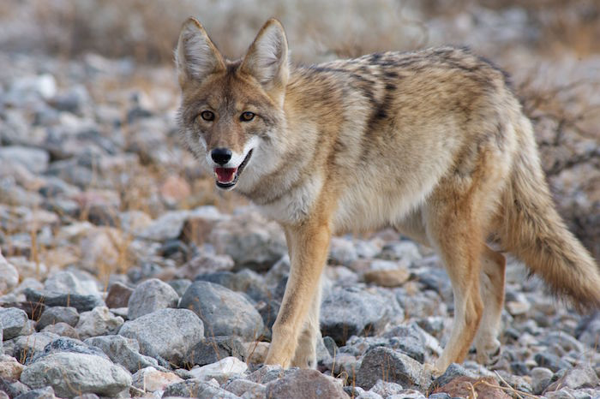
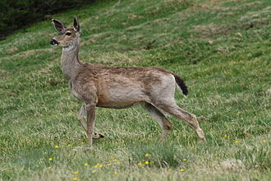
Flora and Fauna
50 %
Mammels
Snakes
Anphibians
Varities
Bird spiceis

Slide 9
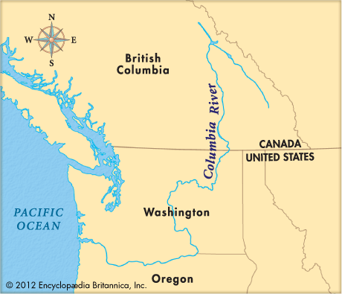
Columbia River
Longest river
2000 km
Canada-British Columbia
Pacific

Slide 10

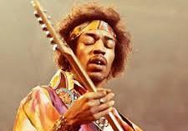


Famous persons
Bill Gates
Kurt Cobain
Jimi Hendrix
Macklemore

Slide 11
The End

