Slide 1



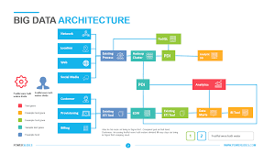
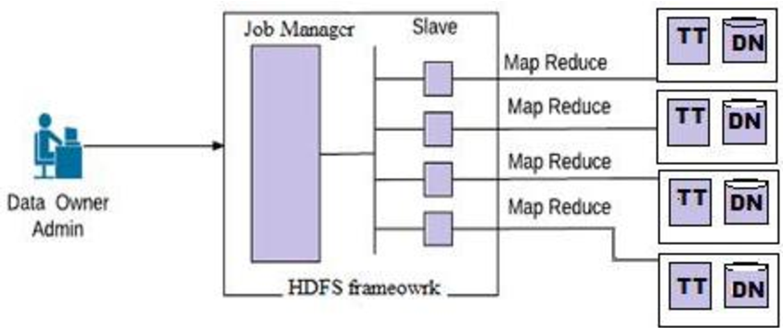


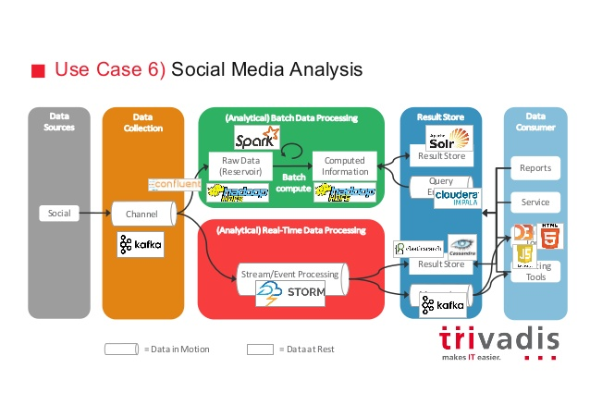
FiDoop DP Data Partitioning in Frequent Items set mining on Hadoop​ COMPARISON BETWEEN HADOOP vs FIDOOP DP​ IN BIG DATA ANALYTICS
BIG DATA ARCHITECTURE
BIG DATA:
In the face of huge data collections, we have now created new needs to help us make better management choices.
Such specifications are automated data analysis, retrieval of the "essence" of stored information, and pattern discovery in raw data.
HADOOP:
Apache Hadoop is a collection of open-source software utilities that facilitate using a network of many computers to solve problems involving massive amounts of data and computation.
FIDOOP-DP
Fidoop incorporates the frequent items ultra metric tree, rather than conventional FP trees. In Fidoop, three MapReduce jobs are implemented to complete the mining task. In the crucial third MapReduce job, the mappers independently decompose item sets, the reducers perform combination operations by constructing small ultra metric trees, and the actual mining of these trees separately
ADVANTAGES:
H - Excellent open source platform.
H - Best data management provisions
F – Conductive to reduce the network and computing load
F- Improves the performance of parallel frequent pattern scheme
DISADVANTAGES:
It is possible for the collected data to be manipulated which causes security issues
RESULT:
In order to solve the scalability, flexibility of existing systems for commonly used element configurations, MapReduce has been implemented as the coding framework in Hadoop for concurrent periodic entity array mining called FiDoop.
HaDooP combines three MapReduce workers smoothly. The 3rd MapReduce project plays an important role for parallel mining; its models separately break down item sets, while its reduction system it produces smaller and larger trees for separate mining. In fact, this statistic is used as a FiDoop to analyse specialized load balancing Techniques to calculate the load balance with additional research.
The conclude, the large amount of data mining can be retrieved from the warehouse with the help of HaDooP which includes the Tree MapReduce process and Voronoi based data partitioning process. It can eliminate the latency issues and load balancing during the process.

