Slide 1

Assistance Finder
Accuracy • Efficiency • Simplicity
Notes:
The problem we want to solve for Best Buy is when people want help deciding what to buy and can’t find a Blue Shirt to help them seal the deal. We are proposing tracking users are they move through the store, now most people would propose GeoTagging or GPS. But those don’t work indoors so we propose using BLE Beacons.
Imagine Cherry’s shopping at Best Buy for a laptop but doesn’t know much about them. She can’t find a Blue Shirt to help her so she pulls out her handy smart phone. She uses the wifi and best buy app to press the ‘help’ button and receives a notification that help is on the way.
At the same time, the Best Buy manager Daniel gets a notification on his own phone that someone’s requesting help over in the laptop section. He sees Cindy, one of the computer specialists, is free and notifies her to head over. Cherry’s able to get all the help she wanted from Cindy thanks to Best Buy’s fast response time.

Slide 2
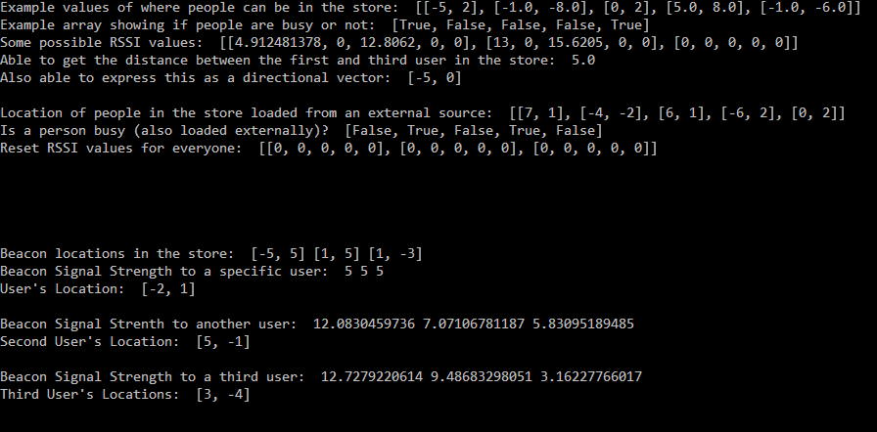
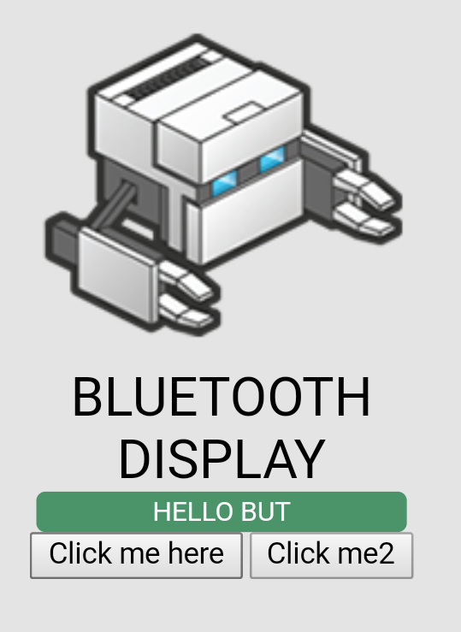
What We’ve Built
Notes:
This past 24 hours we’ve build the framework required for our application. Our smartphone app connects to our laptop over wifi and signals us that they need assistance. From there we figure out where they are in store, identify the closest Blue Shirt and are able to tell if they’re free to help or not.
Our app provides a super simple interface for Best Buy customers, and is even easy for management to use. It’s also unique in the market because nobody is tracking users as they walk through the store which we’re able to do. It also provides some interesting opportunities for future developments in Data-Analytics in researching consumer trends as they shop.

Slide 3
How it Works
Walk in Store
In Store
Press Help
Request to Manager
Employee Dispatched
Customer Knows Help is Coming
Employee Approaches
Employee in General Area of Customer
Customer’s Phone Makes a Noise
Help is Found
Notes:
The application we’re proposing is going to take customers who would’ve had a neutral experience at Best Buy to have a great experience where they leave the store with exactly what they need.
From the customer walking into the store and connecting to the wifi, to needing help making a decision. They pushes the help button on her smart phone and requests help to which the manager on shift dispatches an employee while letting the customer know help is on the way.
As the employee approaches the general are of the customer they’re able to have the customer’s phone play a sound so they can locate the specific individual who request help.

Slide 4
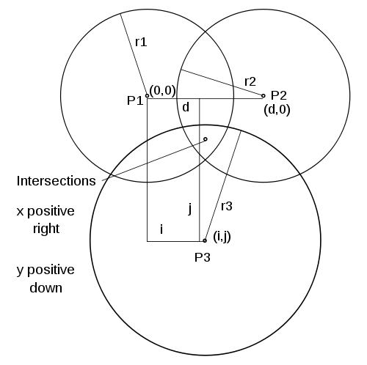
Technical Info
Integrable web-deployed ‘help’ button to ping a Blue-Shirt
Find Exactly where the Blue Shirt needs to go to find the Customer
Manager gets overview of the full store and where people are at any given time
Notes:
This application lets the managers on duty leverage their team in a super efficient way. They can know where everyone in their store is at any moment when they’re using the app and can direct employees to assist customers as soon as they need help, meaning customers don’t need to spend time looking around for help any more.

