Slide 1


The material in this presentation belongs to St. Francis Institute of Technology and is solely for educational purposes. Distribution and modifications of the content is prohibited.
Database Management System (DBMS)
CSC403
Subject Incharge
Dr. Kavita Sonawane
Professor
email: kavitasonawane@sfit.ac.in
St. Francis Institute of Technology
Department of Computer Engineering
Database Management System
1

Slide 2
Unit 1
The material in this presentation belongs to St. Francis Institute of Technology and is solely for educational purposes. Distribution and modifications of the content is prohibited.
St. Francis Institute of Technology
Department of Computer Engineering
Database Management System
2

Slide 3
Unit 1
The material in this presentation belongs to St. Francis Institute of Technology and is solely for educational purposes. Distribution and modifications of the content is prohibited.
St. Francis Institute of Technology
Department of Computer Engineering
Database Management System
3

Slide 4
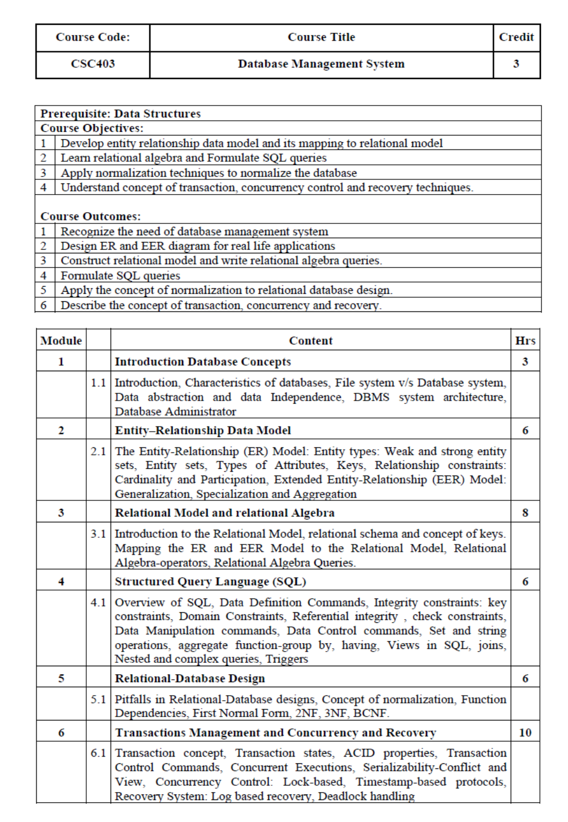
Unit 1
The material in this presentation belongs to St. Francis Institute of Technology and is solely for educational purposes. Distribution and modifications of the content is prohibited.
St. Francis Institute of Technology
Department of Computer Engineering
Database Management System
4

Slide 5
Unit 1
The material in this presentation belongs to St. Francis Institute of Technology and is solely for educational purposes. Distribution and modifications of the content is prohibited.
Introduction Database Concepts
St. Francis Institute of Technology
Department of Computer Engineering
Database Management System
5

Slide 6
The material in this presentation belongs to St. Francis Institute of Technology and is solely for educational purposes. Distribution and modifications of the content is prohibited.
What is Data?
Data can be facts related to any object in consideration.
For example,
Name of person, age, height, weight, etc. are some data related to person.
A picture, image, file, pdf, etc. can also be considered data.
St. Francis Institute of Technology
Department of Computer Engineering
Database Management System
6

Slide 7
The material in this presentation belongs to St. Francis Institute of Technology and is solely for educational purposes. Distribution and modifications of the content is prohibited.
What is Database?
A database is an systematic collection of data, so that it can be easily accessed and managed.
The main purpose of the database is to operate a large amount of information by storing, retrieving, and managing data.
Example:
An online telephone directory uses a database to store data of people, phone numbers, and other contact details.
2. Electricity service provider uses a database to manage billing, client-related issues, handle fault data, etc.
St. Francis Institute of Technology
Department of Information Technology
Database Management System
7

Slide 8
Facebook- It needs to store, manipulate, and present data related to members, their friends, member activities, messages, advertisements, and a lot more.
There are many databases available like MySQL, Sybase, Oracle, MongoDB, Informix, PostgreSQL, SQL Server, etc.
Modern databases are managed by the database management system (DBMS).
St. Francis Institute of Technology
Department of Computer Engineering
Database Management System
8

Slide 9
The material in this presentation belongs to St. Francis Institute of Technology and is solely for educational purposes. Distribution and modifications of the content is prohibited.
Types of Databases
Centralized database:
A centralized database is stored at a single location such as a mainframe computer.
It is maintained and modified from that location only and usually accessed using an internet connection such as a LAN or WAN.
The centralized database is used by organizations such as colleges, companies, banks etc.
St. Francis Institute of Technology
Department of Cmputer Engineering
Database Management System
9

Slide 10
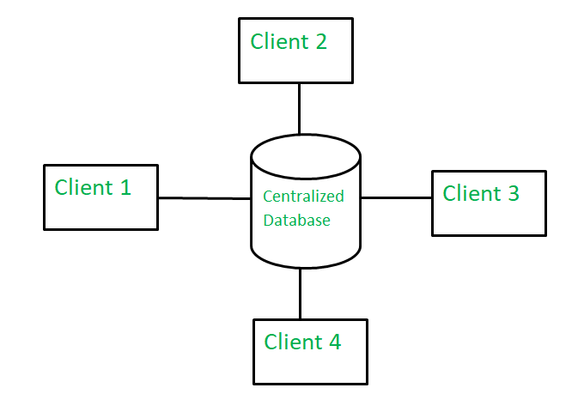
The material in this presentation belongs to St. Francis Institute of Technology and is solely for educational purposes. Distribution and modifications of the content is prohibited.
St. Francis Institute of Technology
Department of Computer Engineering
Database Management System
10

Slide 11
The material in this presentation belongs to St. Francis Institute of Technology and is solely for educational purposes. Distribution and modifications of the content is prohibited.
2. Distributed databases:
A distributed database is basically a database that is not limited to one system, it is spread over different sites, i.e, on multiple computers or over a network of computers.
A distributed database is a collection of multiple interconnected databases, which are spread physically across various locations that communicate via a computer network.
In this type of database system, the data is not in one place and is distributed at various organizations.
St. Francis Institute of Technology
Department of Cmputer Engineering
Database Management System
11

Slide 12
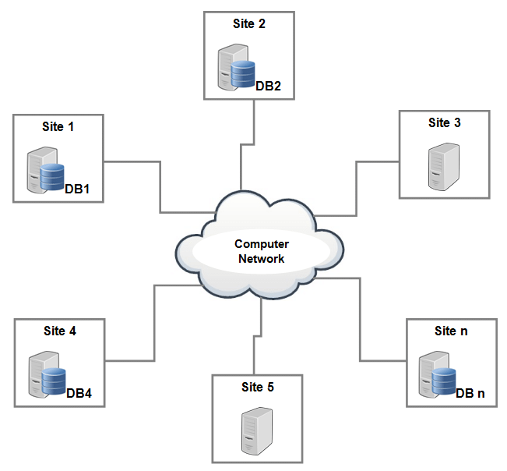

Slide 13
The material in this presentation belongs to St. Francis Institute of Technology and is solely for educational purposes. Distribution and modifications of the content is prohibited.
What is a Database Management System (DBMS)?
Database Management System (DBMS) is a collection of programs that enable its users to access databases, manipulate data and represent data.
It also helps to control access to the database.
Database Management Systems had been first implemented in the 1960s.
Charles Bachman’s Integrated Data Store (IDS) is said to be the first DBMS in history.
St. Francis Institute of Technology
Department of Computer Engineering
Database Management System
13

Slide 14
The material in this presentation belongs to St. Francis Institute of Technology and is solely for educational purposes. Distribution and modifications of the content is prohibited.
Characteristics of databases
1. Relation-based tables − DBMS allows entities and among them to form tables. A user can understand the architecture of a database just by looking at the table names.
St. Francis Institute of Technology
Department of Computer Engineering
Database Management System
14

Slide 15
The material in this presentation belongs to St. Francis Institute of Technology and is solely for educational purposes. Distribution and modifications of the content is prohibited.
2. Less redundancy − DBMS follows the rules of normalization, which splits a relation when any of its attributes is having redundancy in values.
3. Consistency − Consistency is a state where every relation in a database remains consistent. A DBMS can provide greater consistency as compared to earlier forms of data storing applications.
St. Francis Institute of Technology
Department of Computer Engineering
Database Management System
15

Slide 16
The material in this presentation belongs to St. Francis Institute of Technology and is solely for educational purposes. Distribution and modifications of the content is prohibited.
4. Query Language − DBMS is equipped with query language, which makes it more efficient to retrieve and manipulate data. A user can apply as many and as different filtering options as required to retrieve a set of data.
5. ACID Properties − DBMS follows the concepts of Atomicity, Consistency, Isolation, and Durability .These concepts are applied on transactions, which manipulate data in a database. ACID properties help the database stay healthy in multi-transactional environments and in case of failure.
St. Francis Institute of Technology
Department of Computer Engineering
Database Management System
16

Slide 17
The material in this presentation belongs to St. Francis Institute of Technology and is solely for educational purposes. Distribution and modifications of the content is prohibited.
6. Multiuser and Concurrent Access − DBMS supports multi-user environment and allows them to access and manipulate data in parallel.
7. Security − DBMS offers methods to impose constraints while entering data into the database and retrieving the same at a later stage. DBMS offers many different levels of security features, which enables multiple users to have different views with different features. For example, a user in the Sales department cannot see the data that belongs to the Purchase department. Additionally, it can also be managed how much data of the Sales department should be displayed to the user.
St. Francis Institute of Technology
Department of Computer Engineering
Database Management System
17

Slide 18
File system vs DBMS

Slide 19
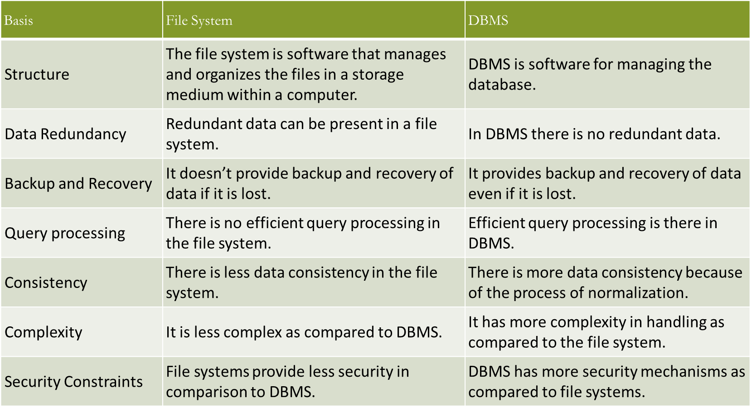
The material in this presentation belongs to St. Francis Institute of Technology and is solely for educational purposes. Distribution and modifications of the content is prohibited.
St. Francis Institute of Technology
Department of Computer Engineering
Database Management System
19

Slide 20
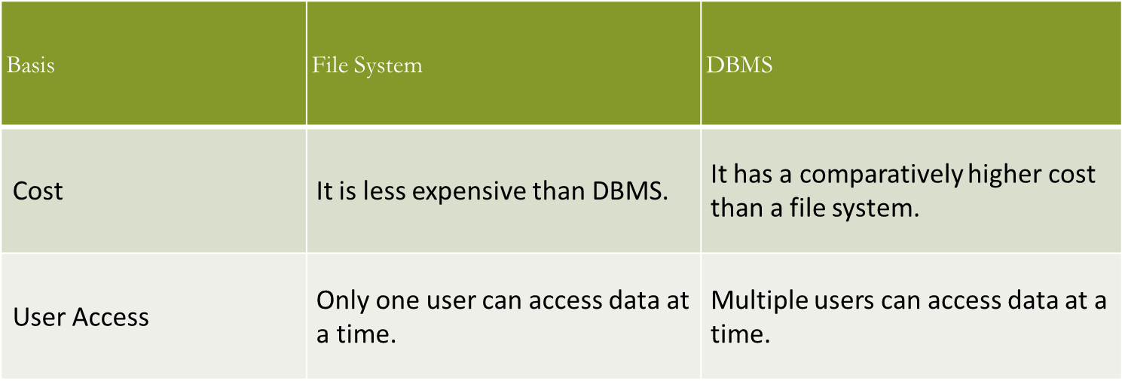
The material in this presentation belongs to St. Francis Institute of Technology and is solely for educational purposes. Distribution and modifications of the content is prohibited.
St. Francis Institute of Technology
Department of Computer Engineering
Database Management System
20

Slide 21
Application of DBMS
  Banking: all transactions
  Airlines: reservations, schedules
  Universities: registration, grades
  Sales: customers, products, purchases
  Online retailers: order tracking, customized recommendations
  Manufacturing: production, inventory, orders, supply chain
  Human resources: employee records, salaries, tax deductions

Slide 22
Overall system structure

Slide 23
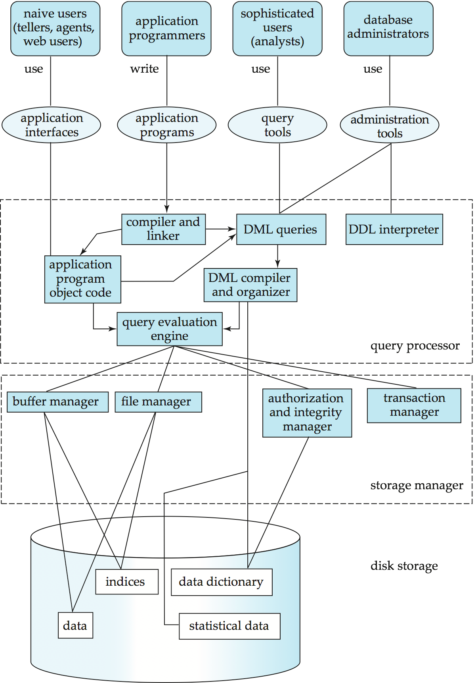

Slide 24
Database Management System Internals
Database Users
Storage management
Query processing

Slide 25
The design of Database System must include the considerations of the interface between the database system and the operating system.
Functional Components of a database system are:
1. Query Processor Components
DML compiler: Translates DML statements into low level instructions that query evaluation engine can understand.
DDL interpreter : interprets DDL statements and records them in a set of tables containing metadata.
Query Evaluation Engine: Executes low-level instructions generated by DML compiler

Slide 26
2.Storage Manger Components
Authorization & Integrity Manager: Test satisfaction of integrity constraints and checks authority of users to access data.
Transaction Manager: Ensures that the database remains in a consistent state despite the system failures, and concurrent transaction execution without confliction.
File Manager: Manages the allocation of space on disk storage and data structures used to represent information.
Buffer Manager: Responsible for fetching data from disk storage into main memory and decide what data to cache in memory.

Slide 27
In addition , several data structures are required as part of physical system implementation
Data Files : which stores the database itself
Data Dictionary : which stores metadata about the structure of the database.
Indices : which provide fast access to data items that hold particular values.
Statistical Data: which stores statistical information about the data in the database. This info is used by query processor to select efficient ways to execute a query.

Slide 28
Database Users
  Database administrators
  Naïve users
  Application programmers
  Sophisticated users
  Specialized users
  Casual/temporary users

Slide 29
The material in this presentation belongs to St. Francis Institute of Technology and is solely for educational purposes. Distribution and modifications of the content is prohibited.
Data Abstraction
Data Abstraction is a process of hiding unwanted or irrelevant details from the end user.
The database systems consist of complicated data structures and relations. For users to access the data easily, these complications are kept hidden, and only the relevant part of the database is made accessible to the users through data abstraction.
St. Francis Institute of Technology
Department of Computer Engineering
Database Management System
29

Slide 30
The material in this presentation belongs to St. Francis Institute of Technology and is solely for educational purposes. Distribution and modifications of the content is prohibited.
Levels of abstraction for DBMS
Mainly there are three levels of abstraction for DBMS, which are as follows −
Physical or Internal Level
Logical or Conceptual Level
View or External Level
St. Francis Institute of Technology
Department of Computer Engineering
Database Management System
30

Slide 31
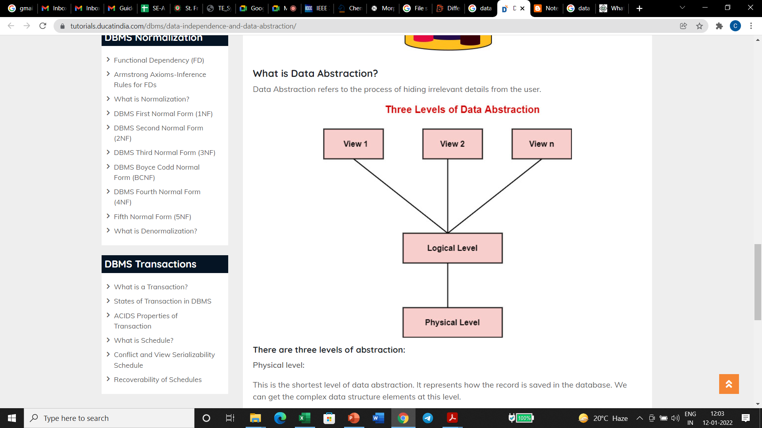
The material in this presentation belongs to St. Francis Institute of Technology and is solely for educational purposes. Distribution and modifications of the content is prohibited.
St. Francis Institute of Technology
Department of Computer Engineering
Database Management System
31

Slide 32
The material in this presentation belongs to St. Francis Institute of Technology and is solely for educational purposes. Distribution and modifications of the content is prohibited.
1.Physical or Internal Level
It is the lowest level of abstraction for DBMS which defines how the data is actually stored, it defines data-structures to store data and access methods used by the database. Actually, it is decided by developers or database application programmers how to store the data in the database.
So, overall, the entire database is described in this level that is physical or internal level. It is a very complex level to understand.
For example, customer's information is stored in tables and data is stored in the form of blocks of storage such as bytes, gigabytes etc.
St. Francis Institute of Technology
Department of Computer Engineering
Database Management System
32

Slide 33
The material in this presentation belongs to St. Francis Institute of Technology and is solely for educational purposes. Distribution and modifications of the content is prohibited.
2. Logical or Conceptual Level
Logical level is the intermediate level or next higher level. It describes what data is stored in the database and what relationship exists among those data. It tries to describe the entire or whole data because it describes what tables to be created and what are the links among those tables that are created.
It is less complex than the physical level. Logical level is used by developers or database administrators (DBA). So, overall, the logical level contains tables (fields and attributes) and relationships among table attributes.
St. Francis Institute of Technology
Department of Computer Engineering
Database Management System
33

Slide 34
The material in this presentation belongs to St. Francis Institute of Technology and is solely for educational purposes. Distribution and modifications of the content is prohibited.
3.View or External Level
It is the highest level. In view level, there are different levels of views and every view only defines a part of the entire data. It also simplifies interaction with the user and it provides many views or multiple views of the same database.
View level can be used by all users (all levels' users). This level is the least complex and easy to understand.
For example, a user can interact with a system using GUI that is view level and can enter details at GUI or screen and the user does not know how data is stored and what data is stored, this detail is hidden from the user.
St. Francis Institute of Technology
Department of Computer Engineering
Database Management System
34

Slide 35
The material in this presentation belongs to St. Francis Institute of Technology and is solely for educational purposes. Distribution and modifications of the content is prohibited.
Data Independence
Data Independence is defined as a property of DBMS that helps you to change the Database schema at one level of a database system without requiring to change the schema at the next higher level.
Types of Data Independence
In DBMS there are two types of data independence
Physical data independence
Logical data independence.
St. Francis Institute of Technology
Department of Computer Engineering
Database Management System
35

Slide 36
The material in this presentation belongs to St. Francis Institute of Technology and is solely for educational purposes. Distribution and modifications of the content is prohibited.
Physical Data Independence
Physical data independence refers to the ability to change the data’s physical structure without affecting the conceptual level.
Physical changes include using a new storage device or moving the database’s location, changing the data structure, or altering indexes to speed up data retrieval.
Example: The patient database could be moved from drive C to drive D, but the conceptual schema and external views remain unchanged because of physical data independence.
St. Francis Institute of Technology
Department of Computer Engineering
Database Management System
36

Slide 37
The material in this presentation belongs to St. Francis Institute of Technology and is solely for educational purposes. Distribution and modifications of the content is prohibited.
Logical Data Independence
Logical data independence, on the other hand, allows users to change the conceptual schema without changing the external views.
For example, the hospital billing department could add a column to the database table for each patient’s insurance policy number. Having logical data independence means that the view of the food services department and other users are not changed even though modifications were made to the conceptual level.
St. Francis Institute of Technology
Department of Computer Engineering
Database Management System
37

Slide 38
The material in this presentation belongs to St. Francis Institute of Technology and is solely for educational purposes. Distribution and modifications of the content is prohibited.
Due to Logical independence, any of the below change will not affect the external layer.
Add/Modify/Delete a new attribute, entity or relationship is possible without a rewrite of existing application programs
Merging two records into one
Breaking an existing record into two or more records
St. Francis Institute of Technology
Department of Computer Engineering
Database Management System
38

Slide 39
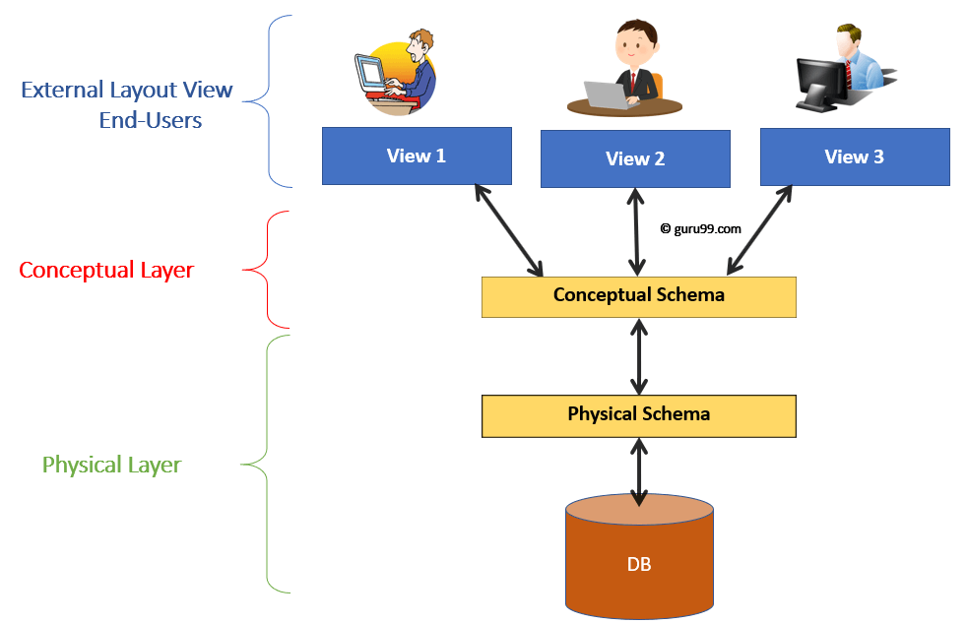
The material in this presentation belongs to St. Francis Institute of Technology and is solely for educational purposes. Distribution and modifications of the content is prohibited.
Levels of Database
Physical/Internal
Conceptual
External
St. Francis Institute of Technology
Department of Computer Engineering
Database Management System
39

Slide 40
The material in this presentation belongs to St. Francis Institute of Technology and is solely for educational purposes. Distribution and modifications of the content is prohibited.
Consider an Example of a University Database. At the different levels this is how the implementation will look like:
Type of Schema | Implementation
External Schema | View 1: Course info(cid:int,cname:string) View 2: studeninfo(id:int. name:string)
Conceptual Shema | Students(id: int, name: string, login: string, age: integer) Courses(id: int, cname:string, credits:integer) Enrolled(id: int, grade:string)
Physical Schema | Relations stored as unordered files. Index on the first column of Students.
St. Francis Institute of Technology
Department of Computer Engineering
Database Management System
40

Slide 41
The material in this presentation belongs to St. Francis Institute of Technology and is solely for educational purposes. Distribution and modifications of the content is prohibited.
Database Administrator (DBA)
A Database Administrator (DBA) is individual or person responsible for controlling, maintenance, coordinating, and operation of database management system.
St. Francis Institute of Technology
Department of Computer Engineering
Database Management System
41

Slide 42
The material in this presentation belongs to St. Francis Institute of Technology and is solely for educational purposes. Distribution and modifications of the content is prohibited.
Types of Database Administrator (DBA) :
Administrative DBA –
Their job is to maintain server and keep it functional. They are concerned with data backups, security, trouble shooting, replication, migration etc.
Data Warehouse DBA –
-Accountable for merging data from various sources into data warehouse. They also design warehouse, with cleaning and scrubs data prior to loading.
Development DBA –
They build and develop queries that meets firm or organization needs.
St. Francis Institute of Technology
Department of Computer Engineering
Database Management System
42

Slide 43
The material in this presentation belongs to St. Francis Institute of Technology and is solely for educational purposes. Distribution and modifications of the content is prohibited.
Application DBA –
They particularly manages all requirements of application components that interact with database and accomplish activities such as application installation and coordinating, application upgrades, database cloning, data load process management, etc.
Architect –
They are held responsible for designing schemas like building tables. They work to build structure that meets organization needs. The design is further used by developers and development DBAs to design and implement real application.
St. Francis Institute of Technology
Department of Computer Engineering
Database Management System
43

Slide 44
The material in this presentation belongs to St. Francis Institute of Technology and is solely for educational purposes. Distribution and modifications of the content is prohibited.
Role and Duties of Database Administrator (DBA) :
Decides hardware –
They decides economical hardware, based upon cost, performance and efficiency of hardware, and best suits organization. It is hardware which is interface between end users and database.
Manages data integrity and security –
Data integrity need to be checked and managed accurately as it protects and restricts data from unauthorized use. DBA eyes on relationship within data to maintain data integrity.
Database design –
DBA is held responsible and accountable for database design ,integrity and security control.
St. Francis Institute of Technology
Department of Computer Engineering
Database Management System
44

Slide 45
The material in this presentation belongs to St. Francis Institute of Technology and is solely for educational purposes. Distribution and modifications of the content is prohibited.
Database implementation –
DBA implements DBMS and checks database loading at time of its implementation.
Query processing performance –
DBA enhances query processing
St. Francis Institute of Technology
Department of Computer Engineering
Database Management System
45

