Slide 1

The Impact of House Prices on Small Business Creation in Switzerland
By Abächerli, S. and Sgarbi, C. (2019)
Research Seminar in Financial Economics - Discussion
Discussants: Lars Stauffenegger and Julian Wössner

Slide 2
Agenda
Paper summary
Comment 1 – Methodological approach
Comment 2 – The conclusions
Comment 3 – The contribution
Conclusion

Slide 3
Overview
The paper investigates the effect of house price increases in Switzerland on economic development.
Thereby they follow closely the approach of Adelino et al. (2015)
House price increases, through the collateral lending channel, should lead to an increase in small firms in Switzerland
Two stage regression with an instrumental variable approach
No significant impact of house price increases on small business creation
The difference might be due to:
Collateralized lending not used predominantly in Switzerland
The ratio of secured to unsecured loans for small businesses stayed constant

Slide 4
The collateral lending channel
Under the asymmetric information between lenders and borrowers, lending capacity is constrained
Lender
Information asymmetry
Borrower
Increase of house price
Increase of collateral value
House price
Increased loan volume, easier access
Collateral
Lower credit constraint
Loan
Decrease in house price
Decrease of collateral value
Decreased loan volume, decreased access
Higher credit constraint

Slide 5
Agenda
Paper summary
Comment 1 – Methodological approach
Comment 2 – The conclusions
Comment 3 – The contribution
Conclusion

Slide 6
Methodology
House price elasticity as instrumental variable
Rental prices and rental housing units as proxy for house prices
The correlation between rental prices and house prices might be conspicuous:
Theoretical example:
House and rental prices are correlated but the intensity might vary
If house prices become very high compared to rental prices in a city, the demand for rentals will increase
Some existing landlords will sell their rentals to look for better investment opportunities
Rental supply shrinks and house supply increases
Rental prices increase while house prices decrease
The same might be true for the other direction

Slide 7
Methodology
The focus of the paper is limited to cantonal areas
Swiss cantons show different profile
Cities like Zurich or Geneva might be highly unelastic
More rural areas in the same canton might be more elastic
The gap between elastic and unelastic areas might distort the elasticity index
This can lead to underestimation of house price changes
Suggestion
Critically evaluate the correlation and dependency between house prices and rental prices
Narrow down the area of investigation to avoid distorted instruments

Slide 8
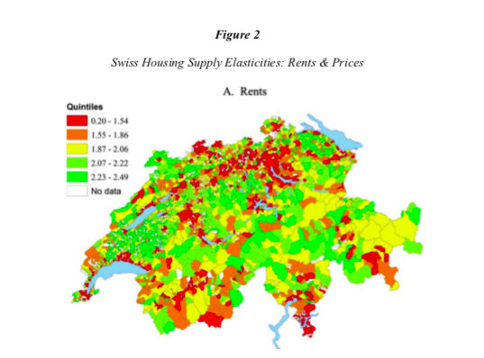
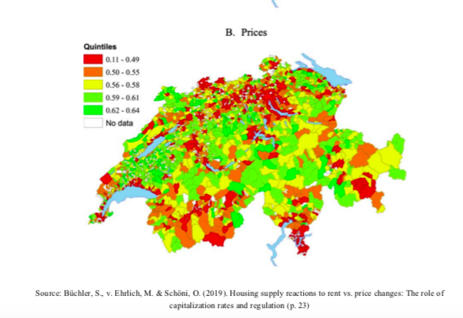
Methodology

Slide 9
Agenda
Paper summary
Comment 1 – Methodological approach
Comment 2 – The conclusions
Comment 3 – The contribution
Conclusion

Slide 10
Conclusions
The paper makes a good effort in explaining why the outcome for Switzerland differs from the US
Low importance of collateralized loans
Shift of entrepreneurs from unsecured to secured loans without increase of small firms
Further reason:
Mortgage market is significantly different in Switzerland
Distinguish between houses with mortgages and fully owned houses
Difficulty to pledge house as collateral when already used for another mortgage
Schmalz, Sraer and Thesmar (2017) show that for France, the constraints in levering houses are severe

Slide 11
Agenda
Paper summary
Comment 1 – The methodological approach
Comment 2 – The conclusions
Comment 3 – The contribution
Conclusion

Slide 12
Contribution
The authors contribute to research practice by applying research practice in different settings - generalizability
Implications of booming asset markets on the wider economy are important
On the suggestions of the paper:
“… unexploited potential for Swiss banks to include more home equity collateralized consumer loans in their product portfolio…”
Increasing collateralized debt obligations can lead to negative consequences for the economy
Financial accelerator gets even strengthened
Small businesses are specifically exposed to high default risk
Positive effects on the economy on the first sight might can lead to adverse longer term outcomes

Slide 13
Agenda
Paper summary
Comment 1 – The methodological approach
Comment 2 – The conclusions
Comment 3 – The contribution
Conclusion

Slide 14
Conclusion
Overall paper shows that
House price increases can have different effects in different settings
Evidence suggests that collateral lending channel is not predominantly affecting small business creation in Switzerland
Suggestions / Comments
The instrumental variable used should be further tested for relevance
Try to narrow down the basis of investigation (cantonal vs. cities, communities, etc.)
More carefully weigh the implications of the research results

Slide 15
References
Schmalz, M. C., Sraer, D. A., & Thesmar, D. (2017). Housing collateral and entrepreneurship. The Journal of Finance, 72(1), 99-132.

