Slide 1

The Impact of House Prices on Small Business Creation in Switzerland
By Abächerli, S. and Sgarbi, C. (2019)
Research Seminar in Financial Economics - Discussion
Discussants: Lars Stauffenegger and Julian Wössner

Slide 2
Agenda
Paper summary
Evaluation of the approach
Contribution
Suggestions

Slide 3
The impact of house prices on small business creation
Summary
Theory
Hypothesis
Methodology
Results
Limitations
Collateral lending channel
House value as collateral for credit
Increase in loans constitutes growth of businesses and employment
More creation of small firms due to increased house prices in Switzerland
Exclude demand effects
Focus on low capital requirement firms
Effect is strongest in sole proprietorships
Rent prices and change of renting units (elasticity) as proxy for house price increase
Two stage least squares instrumental variable regression
Dependent variable: Change in number of companies
Several controls
No significant relationship between increased house prices and increase of small business creation
Increase in small business creation was not driven by increased local demand
Companies with lower capital requirements are not affected more than others
Data limitations
Construction of the instrumental variable
Instrumental variable seems to work only in one direction → up movement of housing prices.

Slide 4
Agenda
Paper summary
Evaluation of the approach
Contribution
Suggestions

Slide 5
Instrumental variable approach
Evaluation
The paper sticks to well approved and beforehand used methodology
Instrumental variable approach as accepted approach to mitigate endogeneity
Selection bias and simultaneity can be mitigated fairly well
But:
Is the way the instrument is created (expansion of housing units/increase of rental price
Is the instrumental variable relevant enough? – Low variation in the explanatory variable might compromise results
Is the increase of rental prices a strong enough proxy for house prices
Is multicollinearity an issue?
A high R² might not be an indication of very good model fit…
Check if the variables have the same distribution
Check assumptions regarding standardized residuals

Slide 6
Agenda
Paper summary
Evaluation of the approach
Contribution
Suggestions

Slide 7
The paper investigates a relevant topic
Contribution
House prices have seen a dramatic increase in some areas of Switzerland in the past… This effect is also visible in other countries.
The paper contributes to understanding the implications of increases in house prices.
Evaluation:
Might also be relevant for the identification of bubbles in the housing markets, if increased value of houses is not used for investment but consumption.
Raises awareness of the context of application of general theories

Slide 8
Agenda
Paper summary
Evaluation of the approach
Contribution
Suggestions

Slide 9
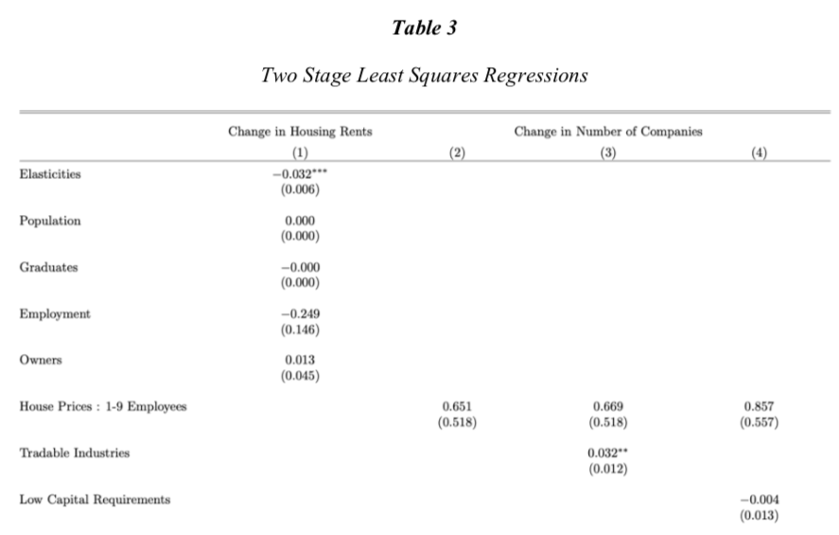
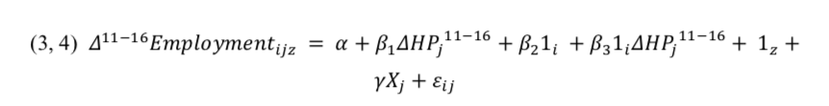
Make clear what is used as dependent variable
The regression approach

Slide 10
Further suggestions
Further suggestions regarding robustness
Motivate a second instrument or a different proxy for house prices to confirm the results, e.g. Graham (2018)
Investigate multicollinearity in the regression equation
Investigate the relationship between change in house price and change in collateralized loans in Switzerland
Does narrowing the frame from cantonal to e.g. communities or cities change the results
Suggestion for future research:
Assess whether the limitation with regards to the data set change the outcome of the study, e.g. trying to use new data sources

Slide 11
References
Graham, J. (2018). House Prices and Consumption: A New Instrumental Variables Approach. Available at SSRN: https://dx.doi.org/10.2139/ssrn.3285263

Slide 12
Appendix

