Slide 1

How the Swiss National Bank influenced the Swiss Stock Market
A decision tree analysis
Research Seminar in Financial Economics
Seminar presentation by Stauffenegger, Lars and Wössner, Julian. 03.05.2019 - 04.05.2019
Source: Financial Times. Retrieved from: https://www.ft.com/content/0a766658-8cb9-11e7-a352-e46f43c5825d

Slide 2

Agenda
Introduction
Theory and Data
Methodology
Results
Conclusion

Slide 3






10 years of global Quantitative Easing
CHF
Federal Reserve
European Central Bank
Swiss National Bank
Burst of housing bubble in 2008
In first QE round, FED bought MBS worth $1.1 trillion.
Over ten years, 3 QE rounds implemented.
Govt Debt crisis in 2010 in Europe.
European countries faced rising debt burden with struggling economy.
ECB stepped in with € 2.5 trillion government bond purchase program
Strong appreciation of the CHF compared to EURO.
Strong exposure of Swiss economy to euro area.
SNB created CHF liquidity by increasing sight deposits from CHF 5bn to almost CHF 500bn over ten years.
Notes:
QE has become increasingly popular as a policy tool in zero interest environments
European financial crisis led to strong appreciation of the CHF compared to EURO.

Slide 4
Sight Deposits of Domestic Banks, SMI and Exchange rate

Slide 5
Agenda
Introduction
Theory and Data
Methodology
Results
Conclusion

Slide 6


Transmission Channels
Transmission channels of unconventional monetary policy
SIGNALLING
PORTFOLIO REBALANCING
The central bank sends a credible signal regarding a specified target.
Credible signals change market participants expectations.
The changed expectations lead to a change of asset prices.
The central bank buys from foreign investors and creates fiat money.
Domestic banks portfolios become skewed towards sight deposits.
Banks optimize their portfolio by buying other assets → Price of the assets is affected
Information about Sight Deposit as our Signal to be priced into the Stock Market.
No conclusion about directions of patterns
Notes:
Unconventional MP and spill over to other asset classes
New liquidity rests as sight deposits on the central banks balance sheet and is allocated to domestic banks.

Slide 7
The interventions of the SNB affected the Swiss Stock market
Hypothesis
Several studies have already found that QE affects other asset markets.
A previous decision tree analysis performed for the US market established a relationship between the increase of the central bank balance sheet and the stock market.
It stays relatively controversial which transmission channels play a role for different asset markets.
H1: The SNB interventions proxied by the domestic banks’ sight deposits are classified as important inputs for the development of the SMI.
H2: As during the Cap period there is an official signal about the SNB’s strategy, the importance of the SNB interventions proxied by the domestic bank’s sight deposits differs compared to the other periods.
Notes:
Do we find Spillover effects of SNB interventions to the Swiss Stock Market through the Signalling Channel?
Is confirmed, if the classification Algorithm

Slide 8
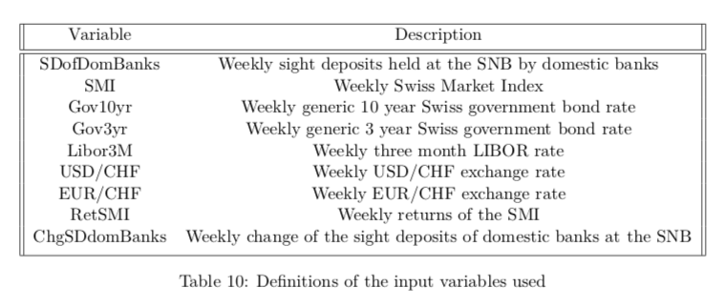
We use an extensive data set to investigate the hypothesis
Data set
Time period from 15.02.2008 – 28.12.2019
Time series from Thomson Reuters Datastream and Bloomberg
Handcollected data for the sight deposits from 2008 – 2011.

Slide 9
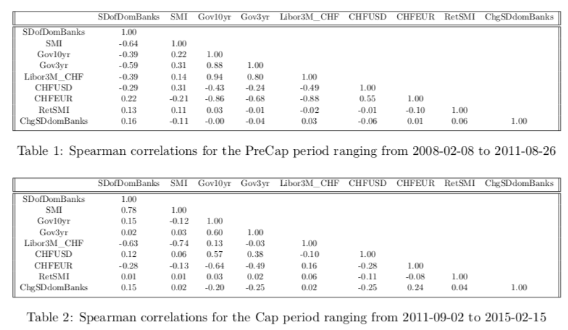
Correlations change in the different data sets
Correlations
In the PreCap period, correlations are negative.
In the Cap period, correlations switch signs.
→ Change of the dependencies is due to change in dependencies between stock market and the sight deposits.

Slide 10
Agenda
Introduction
Theory and Data
Methodology
Results
Conclusion

Slide 11
Decision Tree (C5.0)
Decision tree with classification
Data set
illustrative
CHF/EUR < 1.20
Importance | usage | splits
CHF/EUR | 100% | 14%
SDdir | 48% | 29%
SD < 3200
SMIret > 0.01
Gov10yr < 0.001
SDdir = up
SDdir = down
LIBOR < 0.001
9/10
“up”
18/2
“up”
7/3
“up”
4/10
“up”
“down”
“down”
“down”
“down”

Slide 12
The approach in a nutshell
We use a six step approach
We apply the decision tree algorithm on our data set
Model is built on randomly sampled 70% of the data of every period
The model is used to forecast the remaining 30% of outcomes in the respective data set
We perform this procedure for 2000 times to reduce noise
Average variable importance and forecast accuracy for every period are parsed from the model outputs
Common statistical testing to ensure significance of results

Slide 13

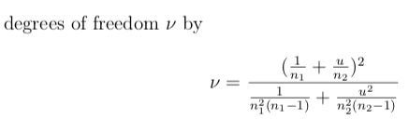
Ensuring statistical significance
We use two ways to assess our model
Assessing the model fit via t-test if out of sample accuracy is significantly different from 50%
Change in variable importance via Welch t-test to investigate if difference is significant

Slide 14
Agenda
Introduction
Theory and Data
Methodology
Results
Conclusion

Slide 15
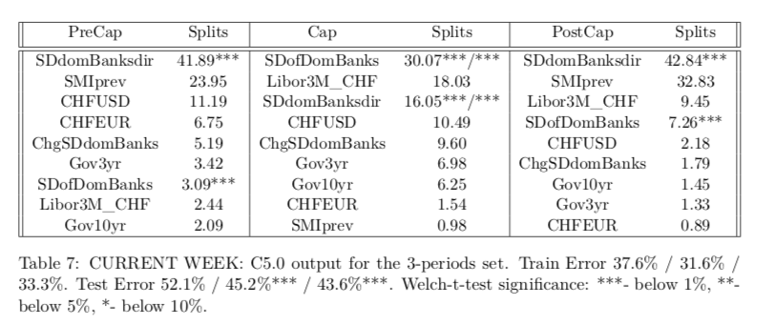
We find a change in variable importance!
Current week results
PreCap: SDdomBanksdir is most important
Cap: SDofDomBanks is most important
PostCap: SDdomBanksdir is most important
→The switch in importance indicates that different signals sent by the SNB influenced the development of the SMI

Slide 16
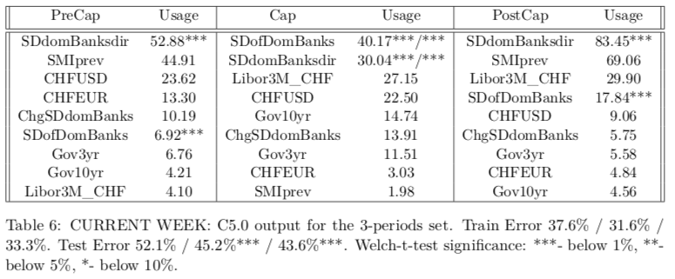
The same picture appears with respect to variable usage
Current week results
In the PreCap and PostCap period, market participants used the weekly announcements and especially the direction of SD changes as indication for SNB sentiment.
In the Cap period, the sentiment of SNB was clear, therefore the direction of SD movements did not play a great role.
→ This represents evidence for signaling effects playing a role in the transmission of monetary policy actions to the stock market.

Slide 17
Robustness
Run algorithm against different Target Variables
Next week’s SMI: no evidence for lagged effect on stock market
CHF/EUR: confirms importance of Sight Deposits
Splitting data differently
75%-Quantile of Sight Deposit Changes:

Slide 18
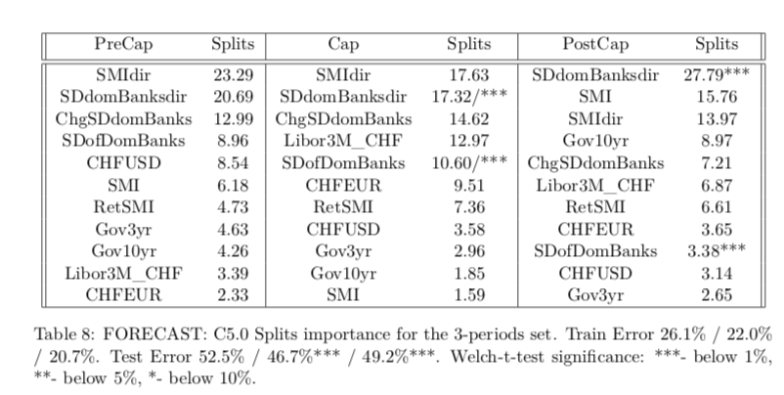
When looking at next weeks variables, no clear statement is possible
Next week results
No significant difference between PreCap and Cap period importance for SDdomBanksdir.
The effects in the current week data set are much more mild and mixed.
→ As one week passes between the communicated interventions of the SNB and the stock market observation, there might be several other external effects influencing the stock market.

Slide 19
Agenda
Introduction
Theory and Data
Methodology
Results
Conclusion

Slide 20
Conclusion
On a glance
We find strong evidence that the signaling channel played a role in the transmission
Market participants use communications by the SNB to infer its state of mind and adapt!
QE has side effects, some of which might not be intended in the first place
Portfolio balance effects might also be present in our case… We leave it to further research!
Contribution / Implications
We are one of very few paper that are able to establish a direct connection between QE and stock markets
Our results provide important insights for regulators and market participants
The methodology used opens field for further research in areas where common statistical methods might fail
Notes:
Do we find Spillover effects of SNB interventions to the Swiss Stock Market through the Signalling Channel?
Is confirmed, if the classification Algorithm

Slide 21
References

Slide 22
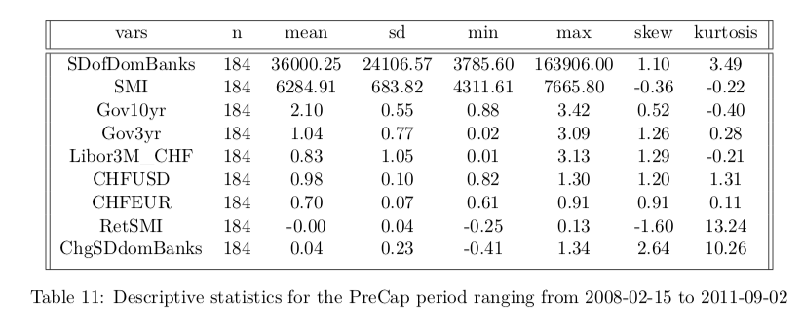
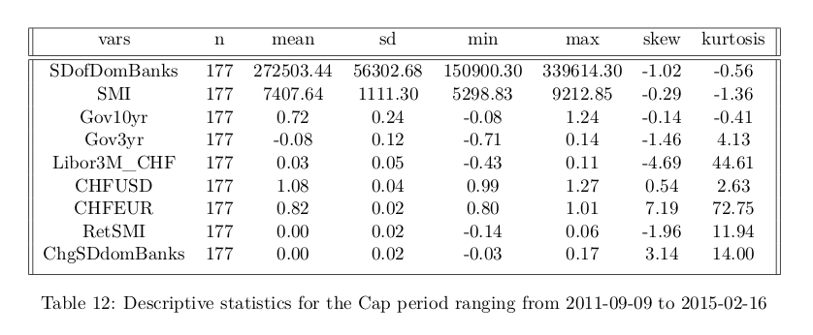
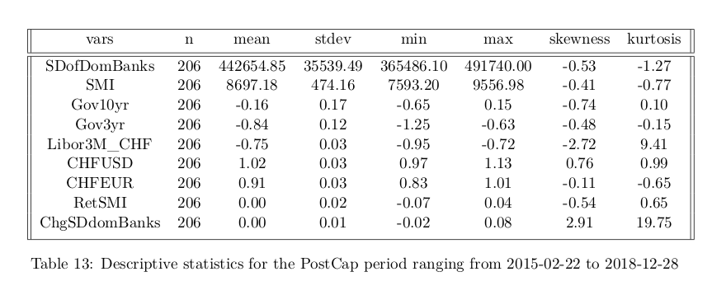
Appendix A
Descriptive statistics

Slide 23
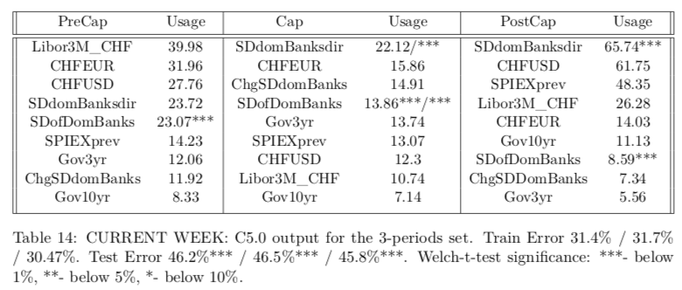
Appendix B.1
Model Results for the SPIEX

Slide 24
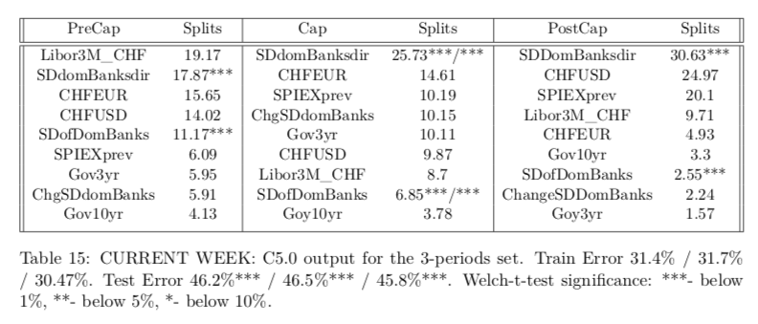
Appendix B.2
Model Results for the SPIEX

Slide 25
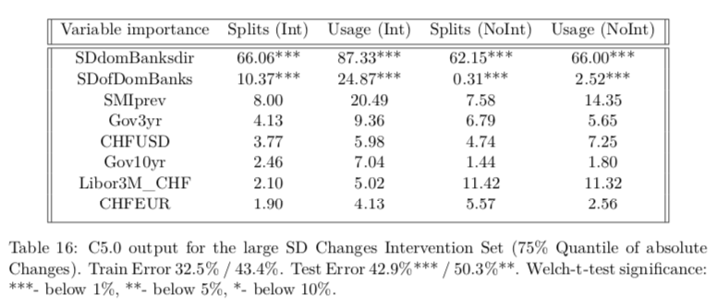
Appendix C
Model Results for Int/No Int (large SD interventions)

Slide 26
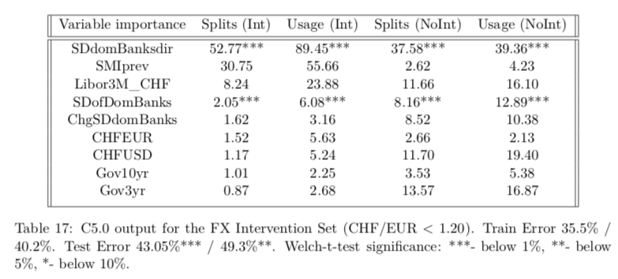
Appendix D
Model results for the FX interventions set

Slide 27
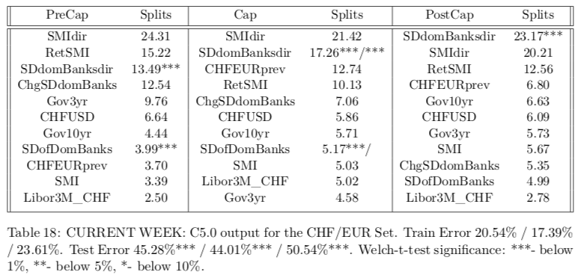
Appendix E.1
Model results for the CHF/EUR set

Slide 28
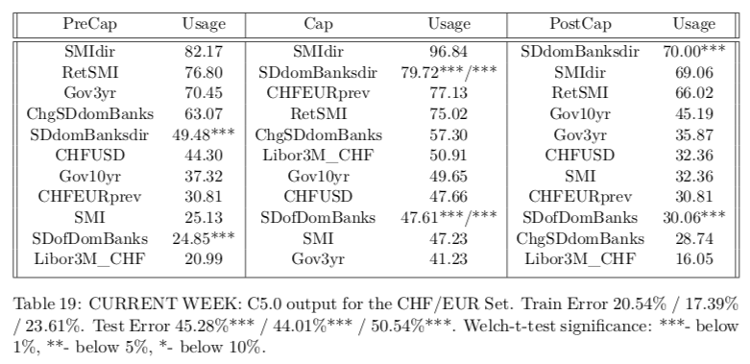
Appendix E.2
Model results for the CHF/EUR set

