Slide 1

UI - React Component
@observer
@action
@observable
@computed
Todo Store
People Store

Slide 2
@observer
UI - React Components
@observable
@computed
@action
Store-1
Store-n

Slide 3
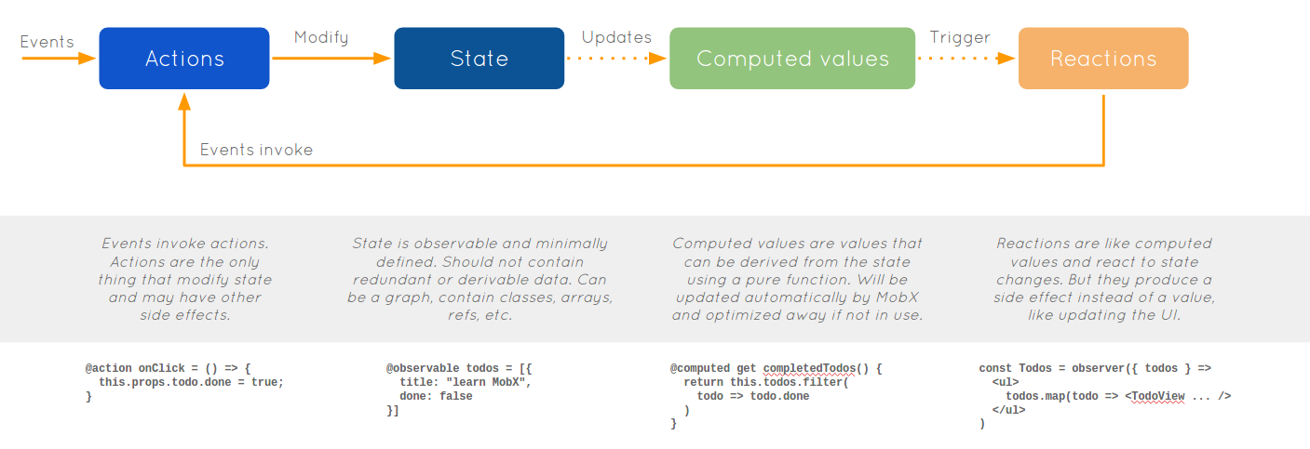
@action onClick =() => {
this.props.todo.done = true;
}

Slide 4
useStrict(true);
class TodoStore { @observable todos = [];
@computed get completedTodos() { return
this.todos.filter(todo => {
return todo.completed === true;
}); } @action addTodo(task) { this.todos.push({ task: task, completed: false, assignee: null }); } }
Use Strict Mode to prevent any state changes outside an action
Use @observable to let MobX track all changes being made, and update code using @observer accordingly.
Use @computed to mark all derived values and let MobX track changes, and update code using @observer accordingly.
Use @action to mark all code that changes state for better debugging, and necessary when using Strict Mode

Slide 5
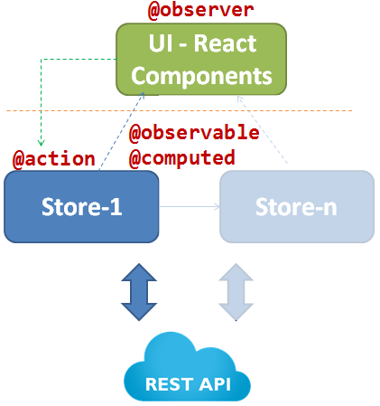
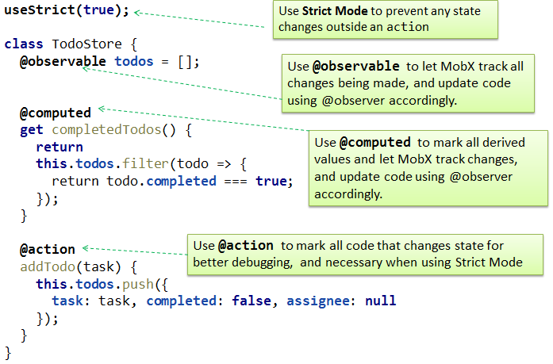
Overall Architecture
Individual Stores/Facades

Slide 6




Paradigms
OO
Functional
MobX
Redux

Slide 7
import { observer } from "mobx-react";
@observer
class TodoList extends React.Component {
...
}
TodoList = observer ((props) => {
})
Mark a class component as an observer
Mark a functional component as an observer

Slide 8

