Slide 1
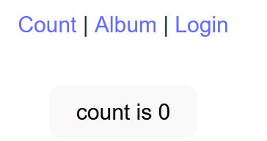
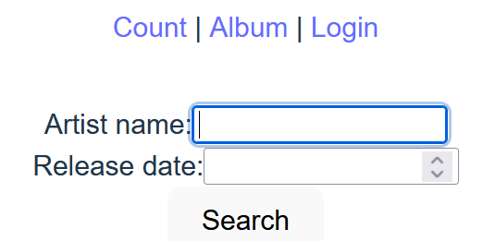
2
/
/?page=album
navigate('?page=album')
onClick()
1
5
switch(page)
0
history.pushState()
dispatchEvent(popState)
addEventListener(“popState”,popStateHandler)
<App />
effect
useEffect()
popStateHandler()
initial state
“count”
[page, setPage] = useState()
setPage()
popStateHandler(...)
new state
3
“album”
window.location.search
4
browser history
URL: ?page=album

