Slide 1
Disclosure limitation and confidentiality protection in linked data
Lars Vilhuber
Based on joint work with John M. Abowd and Ian M. Schmutte

Slide 2
administrative data in the infrastructure of official statistics
Back to the 1960s – frames, if not surveys
Motivation behind Fellegi’s original work
Today not just frame but data source
European censuses based on administrative data
US business registers used for Business Dynamics Statistics (BDS), County Business Patterns
New sources emerging (health, education, law)

Slide 3
rich new analysis and publications
held back by concerns of citizens and businesses about privacy

Slide 4
privacy concerns
1960s in the US: proposal for “National Data Bank” with the goal of combining survey and administrative data to make available to researchers
Instead, and partially as a consequence, privacy laws were formalized in the 1970s (“Privacy Act 1974” (Public Law 93-579, 5 U.S.C. § 552a)) specifically prohibited “matching” programs, linking data from different agencies.
More recently: 2016 Australian Census elicited substantial controversy
Identifiable data with explicit goal of enabling linkages between the census and administrative data, as well as linkages across historical censuses

Slide 5
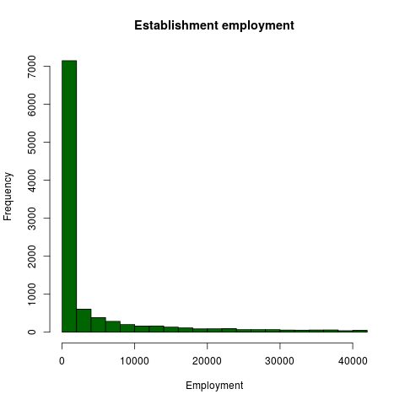
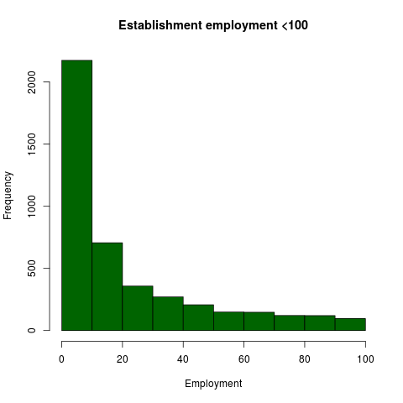
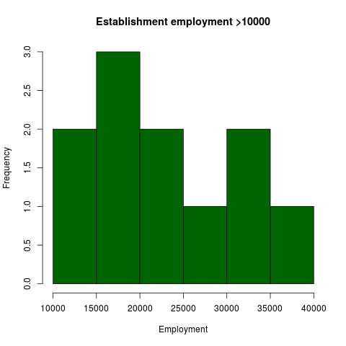
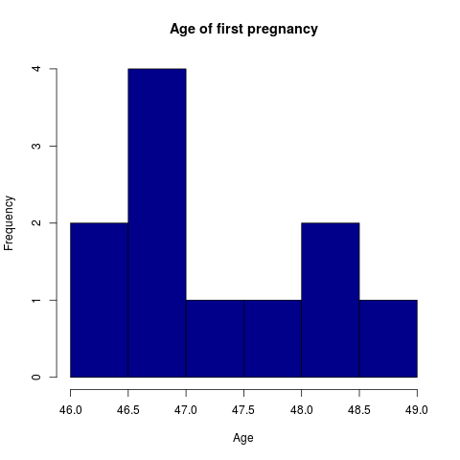
current state of protection mechanisms
Public-use files and tabulations, created using techniques developed for survey files
Suppression
Coarsening
swapping
noisy queries (input and output)
Limited utility for “thin tails” (or thin distributions)
Business data
But more generally “rare data”

Slide 6
access methods
Tabulations
Tabulations
Public-use microdata
Raw microdata
Ease of access
Privacy loss →
← Loss of detail

Slide 7

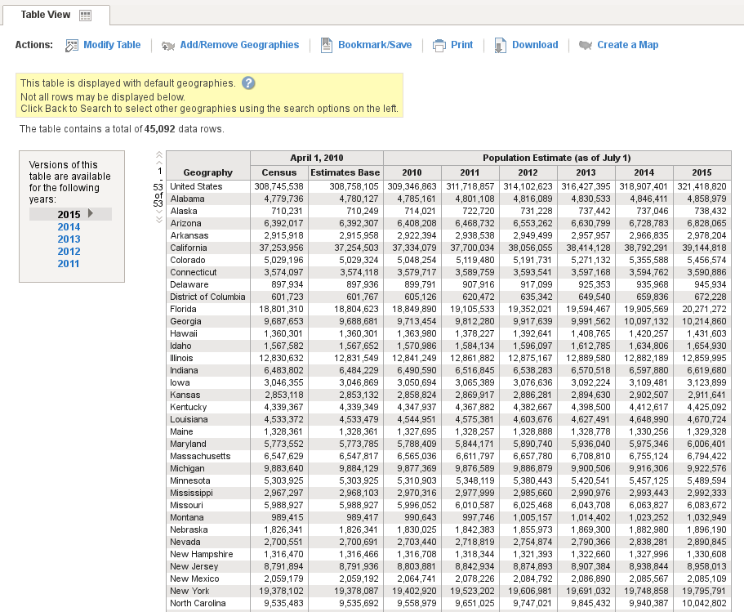
focus
I will focus on access mechanisms for researchers
Source: (Fox News/REUTERS/Kacper Pempel/Files/https://goo.gl/ZHMkog)
I will exclude
Newer mechanisms to create tabular data (synthetic data, differentially-private data)

Slide 8
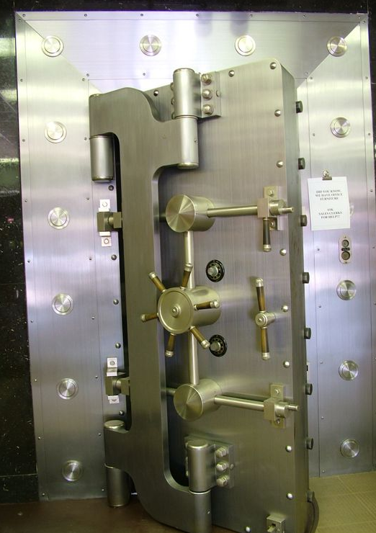
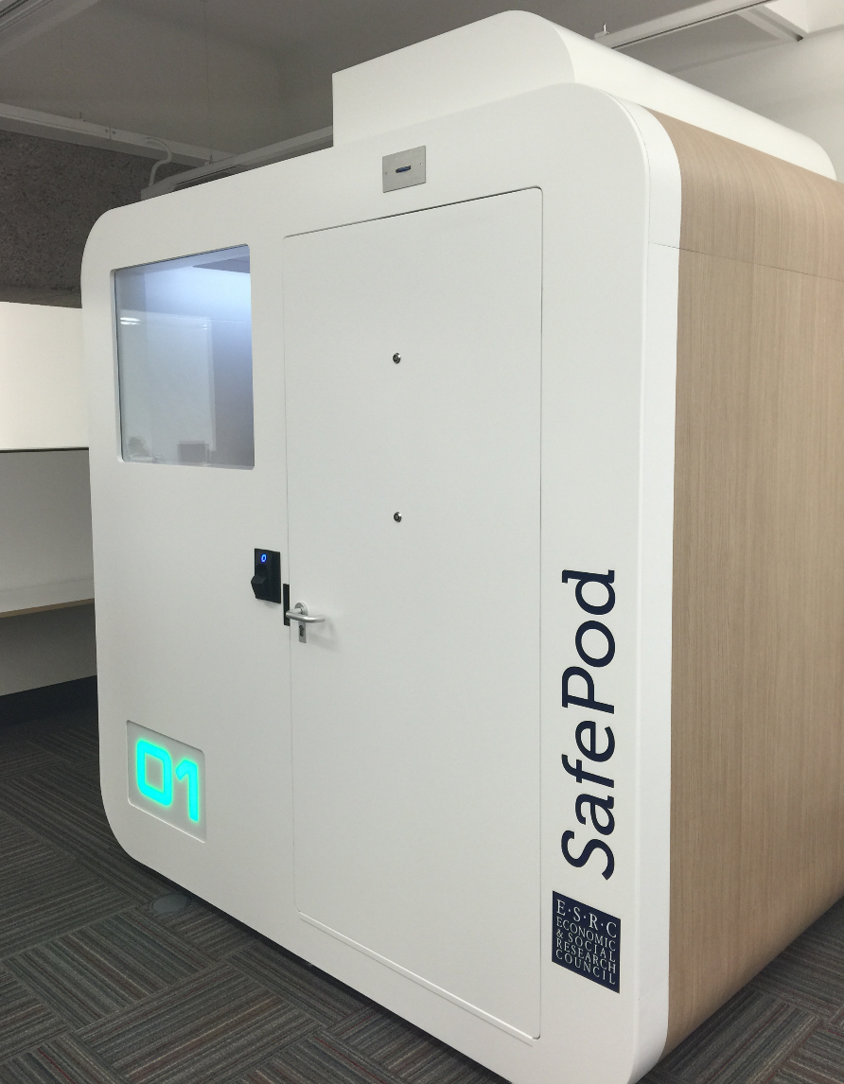
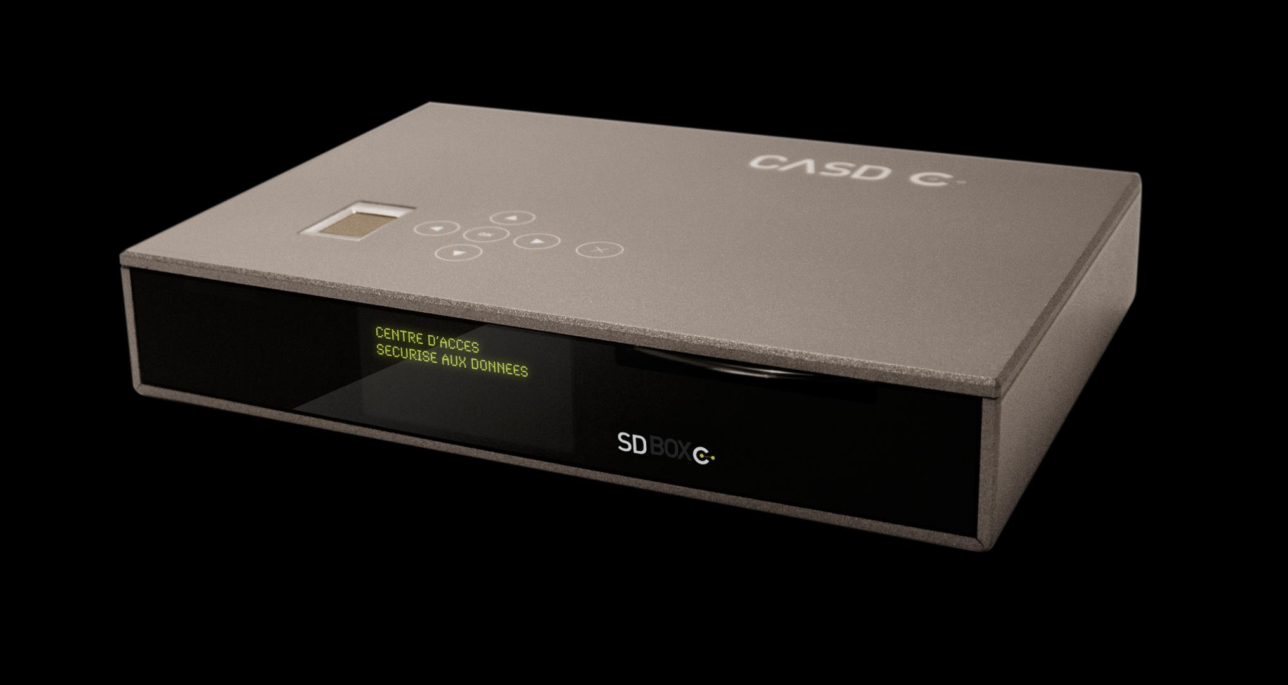
newer methods: Data Enclaves
custom tabulations (by staff) became too onerous
tabulation and analysis work offloaded onto researchers by providing them with access to protected microdata

Slide 9
access methods
Tabulations
Tabulations
Public-use microdata
Raw microdata
Ease of access
Privacy loss
Privacy loss →
← Loss of detail

Slide 10
access methods: enclaves
Tabulations
Tabulations
Public-use microdata
Software on your own PC giving a view onto secure data environment, with manual DA
Remote desktop
Ease of use
Thin client
Secondary secure PC giving a view onto secure data environment, with manual DA
Remote execution
Privacy loss
Submitting analysis programs by email or through website, with manual disclosure avoidance (DA) (possibly combined with synthetic microdata)
RDC
← Loss of detail

Slide 11
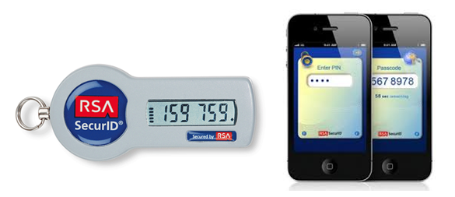


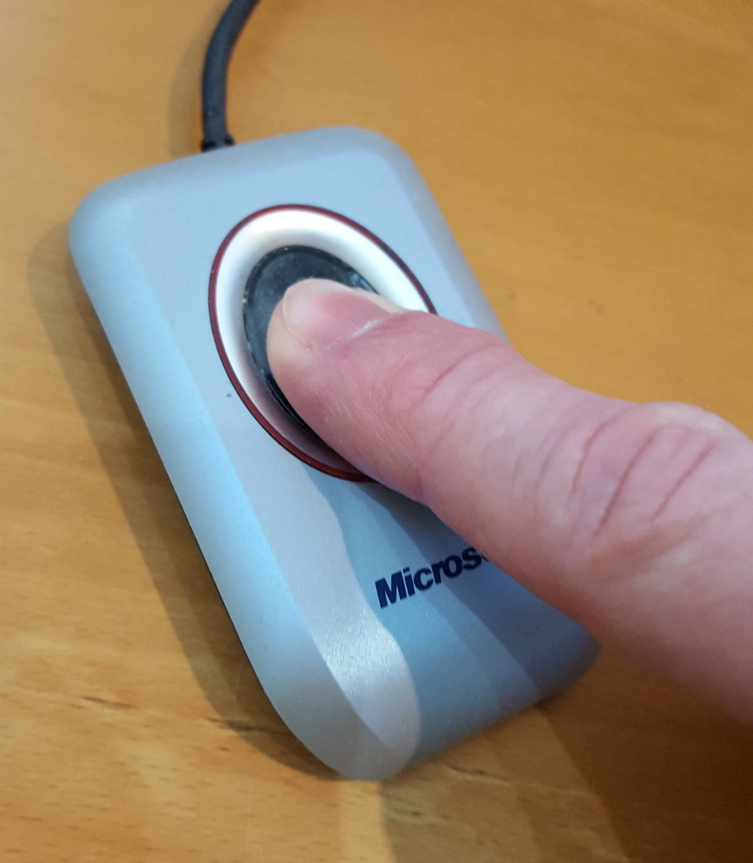
thin clients
With the notable exception of the Canadian RDCs (for now), thin clients are the preferred method of access
Surrounded by walls = RDC [FSRDC in US, Germany, others]
Embedded in a managed device = “thin client” [above, plus France]
Software with a managed access token = “remote desktop” or “VDI” [some US agencies; DK, Finland]
Additional controls may be
IP address control [many]
Biometric authentication [France]
Smart card [France, US]
70.48.127.42

Slide 12
access methods: enclaves with researcher-controlled release
Tabulations
Tabulations
Public-use microdata
Self-controlled release
Raw microdata
Remote desktop
Ease of use
Thin client
Remote execution
RDC
← Loss of detail

Slide 13
trust and access
Frequent discussion
Security measures are for (malevolent) intruders/opponents
Researchers are trusted collaborators…
… who know what they are doing
A corollary:
Protect against the bad guys
But let the “good” guys do their thing
Examples:
Network-moderated access
Contracts with disclosure avoidance rules
Danish remote access with researcher-controlled release of results and authorized establishments
How do you know who the good guys are?
Also known as the “old boys’ network”

Slide 14
access methods: enclaves with researcher-controlled release
Tabulations
Tabulations
Public-use microdata
Self-controlled release
Raw microdata
Remote desktop
Ease of use
Self-controlled release
Thin client
Remote execution
RDC
← Loss of detail

Slide 15
access methods: remote tabulation
Tabulations
Tabulations
Remote tabulation
Self-disclosure
Public-use microdata
Raw microdata
Remote desktop
Ease of use
Self-disclosure
Thin client
Remote execution
RDC
← Loss of detail

Slide 16
hidden element: how is Disclosure Avoidance done?
Most access methods:
Enforcing minimum count of entities in a statistic (coefficient, mean, stddev)
Prohibiting creation of tabular data (or making it very expensive)
(Vain) attempt at tracking overlapping releases
Automated systems
Tracking of cells, implementation of (randomized) rounding, suppression, (output) noise infusion (StatCan, ABS)
Similar in CB’s Microdata Analysis System/Automated Query System
Newer mechanisms
Noise infusion upon computation
Differentially-private output perturbation (of model-based statistics, incl. coefficients and expected counts)

Slide 17
hidden cost: managing the network
Categorizing access requests
What is an authorized institution? [Eurostat: recognized research entity]
Framework contracts with each institution
Managing access requests
Ideally, that’s a problem you would like to have
Training [France: 3h enrollment sessions], managing access tokens, [physical thin clients]
Cost? [France: itemized price list]
Disclosure avoidance
Bottleneck – ideally primary function of designated staff
Training of users important [Based on our survey of 100 US FSRDC users]
Provision of tools important
Enforcement (in particular for self-disclosure)

Slide 18
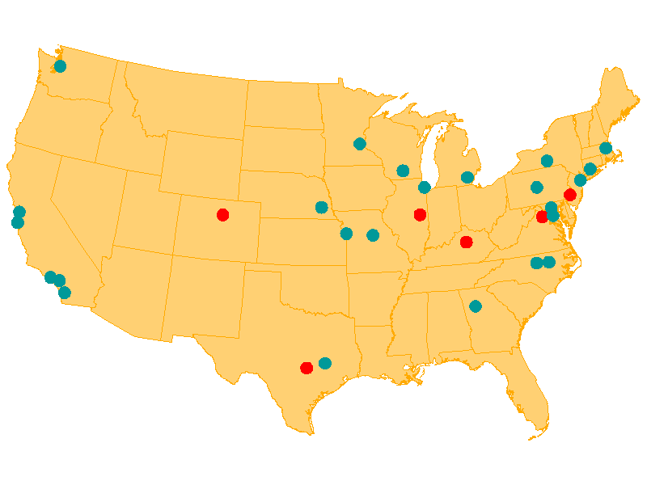
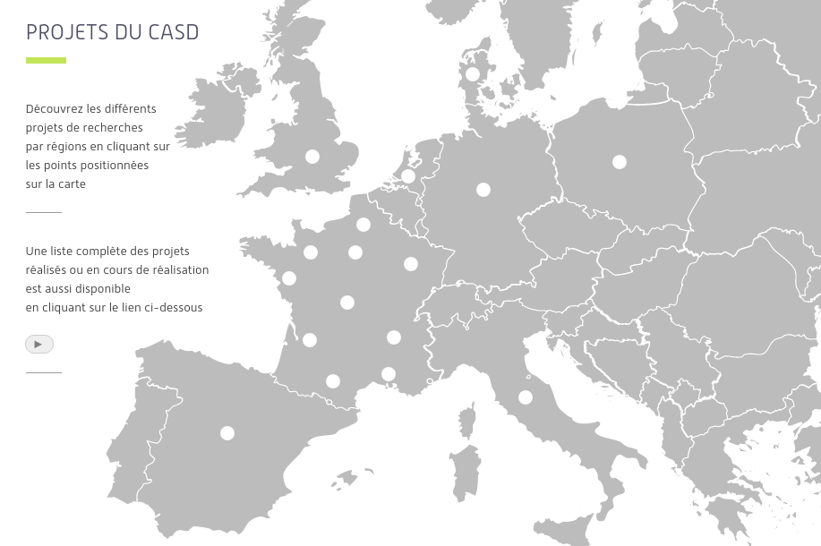
natural economies of scale
Increasing emphasis on consolidation of (national) networks
US Census Bureau’s Research Data Centers (since 1990s) now Federal Statistical Research Data Centers (FSRDC) with 8 new federal partners
France Centre d’accès sécurisé aux données (CASD) provides access to data from more than 15 national entities, including health-admin data
Some Canadian RDCs also providing access to provincial data
Secondary research benefit
Ability to break out of data silos

Slide 19
summary
Many more tools today than in the past
Remote access of some type is the standard practice around the world
Disclosure avoidance is still quite pedestrian in almost all cases
Newer methods are being developed, but few access mechanisms (proposed or implemented) successfully combine ability to estimate arbitrary models with robust (provable) protection mechanisms

Slide 20

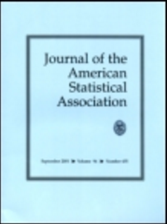
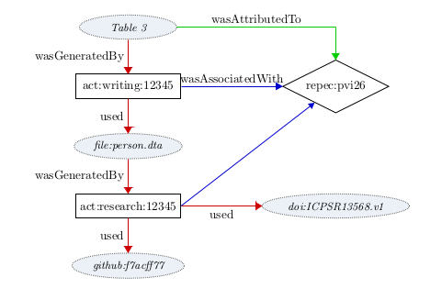
p.s. one last thing
Replicability is a nascent problem
More and more journals require provable replicability
Cannot be satisfied with idiosyncratic access mechanisms
Some research with confidential files will lose (reputable) publication outlets
Transparency critical
Need capability to be able to archive research files within secure enclaves
Need ability to publically identify such files (documentation) [DDI, DOI]

Slide 21

thank you
lars.vilhuber@cornell.edu

