Slide 1
Confidentiality protection and physical safeguards
Lars Vilhuber
Cornell University
Funding acknowledged under NSF-#1131848 (NCRN) and a grant from the Alfred P. Sloan Foundation

Slide 2
Disclaimer
The opinions and observations expressed here are mine, and do not reflect any of the institutions I am affiliated or associated with, or funded by (U.S. Census Bureau, NSF, CASD, IZA, CIQSS).
Some of the information used in this presentation was collected and gathered with funding from the Sloan Foundation and NSF (#1131848 (NCRN) and #1012593 (TC-Large))

Slide 3
context of my talk today
Focus on researcher access to authorized microdata collections of federal statistical data
But private collections face similar issues and use similar mechanisms
Focus on the mechanisms for providing access
Mostly physical access controls
Role of disclosure avoidance mechanisms
Highlight the roles of “community”
Training
Legal framework
Role of institutions
Notes:
While the focus is not on building new data collections, the ability to protect existing data obviously has an impact on new data collections (see IMI,

Slide 4
publication trade-offs
Tabulations
Tabulations
Public-use microdata
Raw microdata
Ease of access
Privacy loss
← Loss of detail
Notes:
What will frame the analysis is the tension between undesirable (possibly illegal) publication of raw microdata, and the accessibility to a broader public of information on the contents of that raw microdata. The by now traditional solution was the publication of public-use microdata, using a variety of methods I won’t be discussing here.

Slide 5
The goal of data access
How to provide easy and convenient access to data with more detail than public-use microdata, less privacy loss than direct publication of raw data?

Slide 6
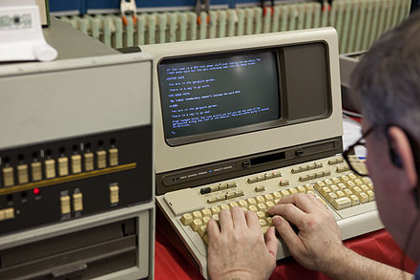


public use data
Data provider/ custodian
Data user/ researcher
Notes:
Back in the old days, convenience for public-use data meant that the data provider provided the data directly to the researcher.

Slide 7


confidential data
What type of access device?
What type of person?
?
Where is the data?
What type of room?
How do results leave the room?
Notes:
When facing the need to provide access to confidential data, the approach has been to put the researcher into a closed room. Questions then arising, and which I will talk about, involve defining the type of room, the type of computer used to access the data, the location of the data itself, who has the rights to access the data, and how results leave the room.

Slide 8
basic paradigm
“Data Enclave” or “Secure Room”
Where is the data?
What type of room?
Notes:
For instance, if the data provider ships the data directly to the secure room, we call it a “data enclave” or a “secure room”

Slide 9
the ideal
“My laptop”
“Data Enclave” or “Secure Room”
What type of access device?
Where is the data?
What type of room?
Notes:
From a physical point of view, not the best way to distribute data (loss of laptop…)

Slide 10
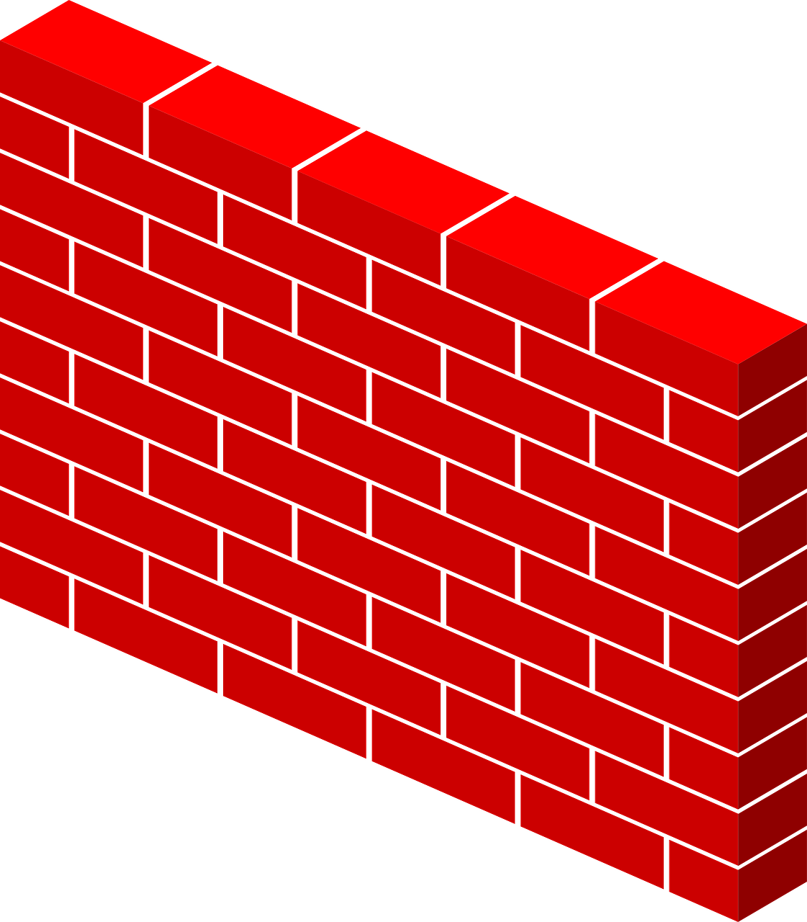
making things virtual
“Virtual Data Enclave”
What type of access device?
Where is the data?
What type of room?
Notes:
If on the other hand, the data provider retains custody of the data, and provides a remote access to the data through a firewall, we have virtualized the data enclave: the data enclave no longer physically houses the data. We may still walk into a well-defined space – a RDC – but as we will see, that is not always the case.

Slide 11
virtual data enclaves
Synonyms:
VDI
(virtual desktop infrastructure)
Thin clients
Remote desktop

Slide 12
Examples in 1990s
Physical data enclaves
Virtual data enclaves
(data remains in secure data center)
BLS HQ
BJS data access
Department of Education data
Census Bureau RDCs
Canadian RDCs
HRS restricted-access data
and many more
Notes:
Physical data enclaves were widely used in the 1990s, when direct provision of the data to end users was not feasible, including at the pioneering Census and Canadian RDCs

Slide 13
Examples in 2017
Physical data enclaves
Virtual data enclaves
(data remains in secure data center)
BLS HQ ?
BJS data access
Department of Education data
Census Bureau RDCs
Canadian RDCs
HRS restricted-access data
and many more
Census Bureau/Federal Statistical RDCs (since early 2000s)
German IAB RDCs (since mid 2000s)
French CASD (since late 2000s)
Cornell’s CRADC, NORC (early 2000s)
HRS restricted access data (2015)
and many many more
Notes:
In 2017, some of these have switched to a virtual data enclave structure, most prominent among them the Census Bureau –now Federal Statistical RDCs. Others have been created since then, from scratch. Canadian RDC system is considering moving part of its infrastructure to Virtual Data Enclave/ Thin Client/ VDI architecture

Slide 14
basic levers
What type of access device?
What type of room?

Slide 15
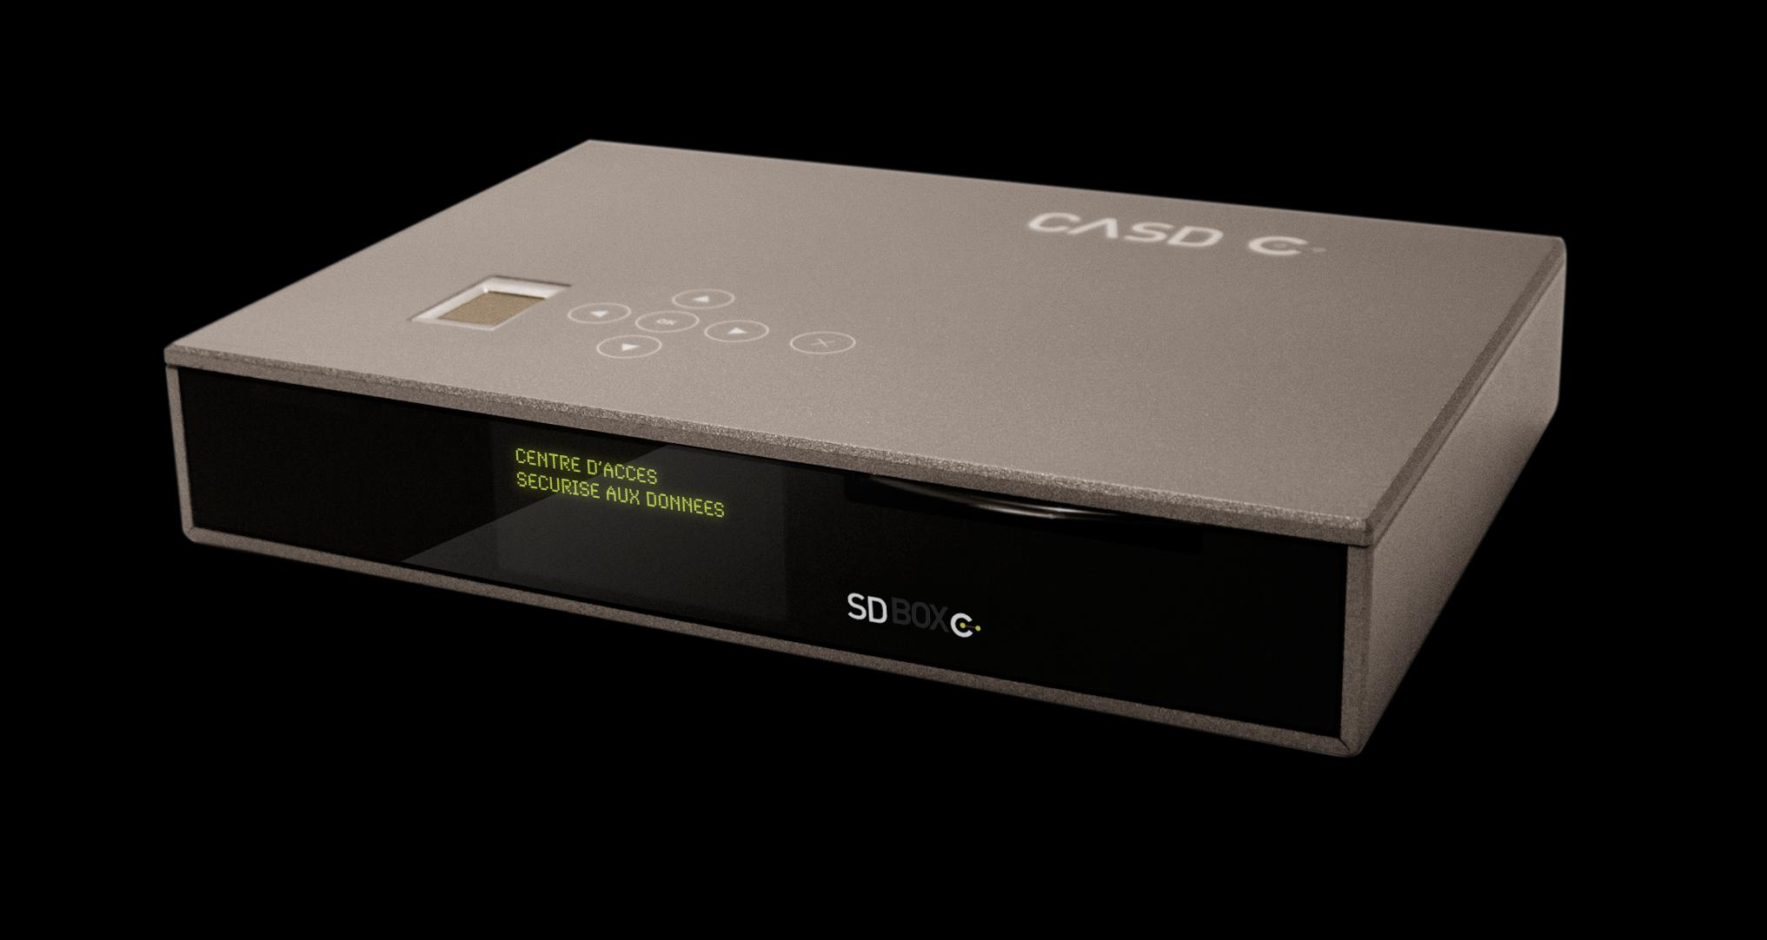

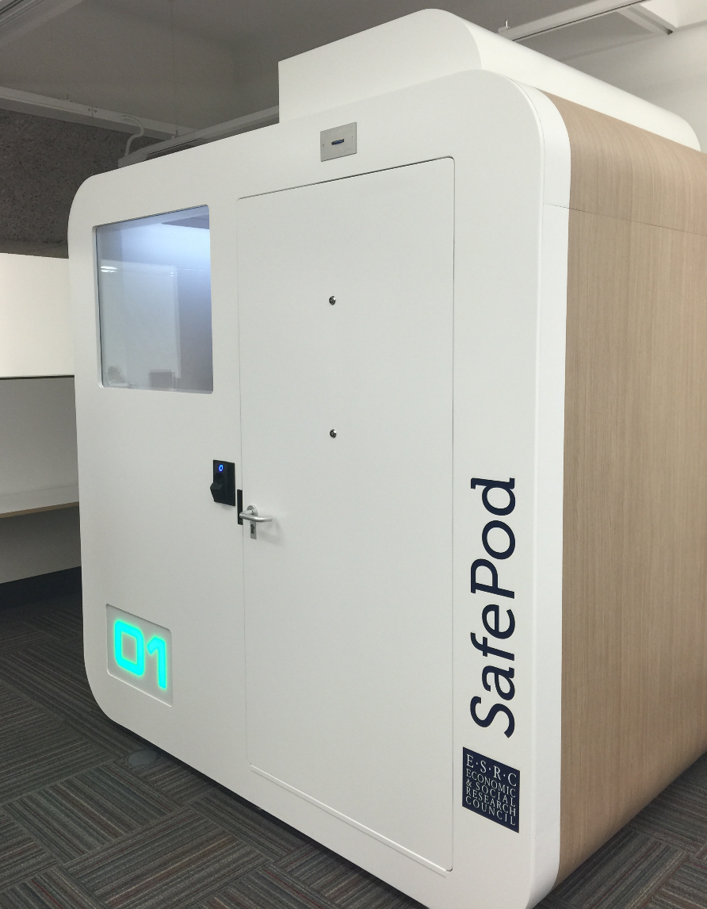
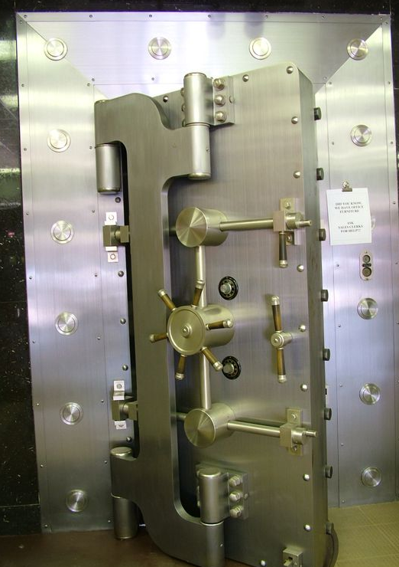
basic levers
Where?
How?
Notes:
The “where” and “how” of data access are the most obvious levers, ranging from complete freedom to Fort Knox-style security (the BJS HQ data center has been described to me like that). Relaxing the constraints on the where lead to RDCs or even location of thin clients in university offices.

Slide 16
access methods: enclaves
Tabulations
Tabulations
Public-use microdata
Ease of use
Privacy loss
RDC
Physically secure room housing access devices and/or data
← Loss of detail
Notes:
Mapping it back to the tradeoff between ease of use and loss of privacy, these systems tend to have similar loss of privacy – i.e., quite limited, but vary in the degress of ease of use.

Slide 17
access methods: enclaves
Tabulations
Tabulations
Public-use microdata
Software on your own PC giving a view onto secure data environment
Remote desktop
Ease of use
Thin client
Secondary secure PC giving a view onto secure data environment
Remote execution
Submitting analysis programs by email or through website (possibly combined with synthetic microdata)
RDC
← Loss of detail

Slide 18
What type of room?

Slide 19
Access matrix for confidential data
Control by data provider of:
 | # access points | Access computers | Access rooms | Avail. analysis methods | Type disclosure avoidance
FSRDC researcher | 24 sites (~700 users) | Full | Full (badge access) | Some (choice of software) | Manual/ variety of rules
Census staff researcher | n.d. | None (VDI) | None (VDI) | Some (choice of software) | Manual/ self/ variety of rules
IAB: JoSuA researcher | 414 users | None (Web application) | None (Web application) | Smaller (software, whitelist commands) | Manual/ variety of rules
CASD researcher | 371 sites (1471 users) | Extra Full (custom-built hardware) | Some (university office, EU) | Some (choice of software) | Manual/ variety of rules €300/ pack of 10
Stat.Denmark (typical EU) | ? | None (VDI) - Some (host institution) | None (VDI) -Some (host institution) | Some (choice of software) | Manual/ self/ variety of rules
Notes:
How can the broad network of CASD terminals (spread out across 300+ locations), the quasi-employee type of access in the Danish system be maintained?

Slide 20
How do results leave the room?
Notes:
As it turns out, there is surprisingly little variation in most of these systems in terms of the disclosure avoidance methods.

Slide 21
How do results leave the room?
Typically, the researcher asks an authorized agent of the data provider to review the results for risks of disclosure, and he will then send them to the researcher

Slide 22
What if the “authorized agent” were the researcher?
Notes:
So what if …

Slide 23
self-controlled release of results
Researcher controls release of results
Prepares results herself
According to certain prescribed rules
Sends them through a system
Automatically receives results typically per email
Used
Most often by contractually-controlled non-enclave data
Data in some university- or faculty-controlled enclaves (HRS, Dept. of Ed)
Danish researcher access system
Notes:
In this case, the researcher has control over the speed and timing of releases, while the agency still controls the rules. This is most often used when data are sent directly to the user or a university data enclave, where final control by the data provider is difficult or impossible. But it is also – radically? – used by the Danish system.

Slide 24
access methods: enclaves with researcher-controlled release
Tabulations
Tabulations
Public-use microdata
Self-controlled release
Raw microdata
Remote desktop
Ease of use
Thin client
Remote execution
RDC
← Loss of detail

Slide 25
access methods: enclaves with researcher-controlled release
Tabulations
Tabulations
Public-use microdata
Raw microdata
Remote desktop
Ease of use
Thin client
Self-controlled release
Remote execution
RDC
← Loss of detail

Slide 26
Access matrix for confidential data
Control by data provider of:
 | # access points | Access computers | Access rooms | Avail. analysis methods | Type disclosure avoidance
FSRDC researcher | 24 sites (~700 users) | Full | Full (badge access) | Some (choice of software) | Manual/ variety of rules
Census staff researcher | n.d. | None (VDI) | None (VDI) | Some (choice of software) | Manual/ self/ variety of rules
IAB: JoSuA researcher | 414 users | None (Web application) | None (Web application) | Smaller (software, whitelist commands) | Manual/ variety of rules
CASD researcher | 371 sites (1471 users) | Extra Full (custom-built hardware) | Some (university office, EU) | Some (choice of software) | Manual/ variety of rules €300/ pack of 10
Stat.Denmark (typical EU) | ? | None (VDI) - Some (host institution) | None (VDI) -Some (host institution) | Some (choice of software) | Manual/ self/ variety of rules
Notes:
So do we think that this is a radical system? Note the simulataneous flexibility in the Danish system as to the type of computer and the location of the access. But as it turns out, such a system is already applied in the US case: it is the system that Census staff researchers are subjected too. That should lead us to consider why we trust certain people with a more open approach, and not others. Two topics come to mind: the penalties applied, and the culture.

Slide 27
penalties

Slide 28
penalties
FSRDC and federal employee:
federal prison sentence of up to five (5) years, a fine of up to $250,000, or both.
France:
prison sentence of up to one (1) year, a fine of up to €15,000, or both.
Notes:
Note that this cannot explain the difference within the US between staff researchers and FSRDC researchers – they face the same penalties in case of breach of confidentiality.
However, notice that the more liberal systems also have more lenient penalties. France – with the broadest network – has lower penalties (but still prison)

Slide 29
penalties
IAB:
Loss of data access for up to two (2) years for researcher and institution
Contractual penalty up to €60,000 paid by the institution
Denmark:
Researcher: Loss of data access for life, or up to three (3) years for “minor breaches”
Institution: Loss of access for a positive but limited (undefined) period
No financial or penal penalties
Of Note: the FSRDC contract explicitly excludes a responsibility of the university for the actions of its employees, though university remains bound by FWA/IRB.
Notes:
IAB and Denmark – binds the institution, not just the researcher. Germany (€60,000 ~ $67000 but increasing…) has no prison, and still relatively puny monetary penalties, but allows for transnational access.

Slide 30
penalties
Does ease of application matter (penal vs. contractual rules)?
Is it conducive to more strongly engage the researcher’s employer (typically but not exclusively a university)?

Slide 31
trust and access

Slide 32
What type of person?
Notes:
Which addresses the question of “what type of person”

Slide 33
trust and access
Frequent discussion
Security measures are for (malevolent) intruders/opponents
Researchers are trusted collaborators…
… who know what they are doing
A corollary:
Protect against the bad guys
But let the “good” guys do their thing
Examples:
Network-moderated access
Contracts with disclosure avoidance rules
How do you know who the good guys are?
Also known as the “old boys’ network”

Slide 34
hypothesis: culture matters
Researchers and agencies create the communities in which rules are applied and enforced
Training and “indoctrination”:
Training of FSRDC researchers (short, decentralized) vs. FedStat employees (≥1 day on-site)
1 full day on-site (in Paris) training for French researchers
Common forums:
Conferences: Canadian, US (FSRDC, NCHS) yearly RDC conferences
Discussion, local groups: users of FSRDC share a common physical space
More or less tight binding of researchers into a community is important

Slide 35
training content, method, and frequency
 | Frequency | Access rules? | Disclosure rules? | Disclosure avoidance tools? | Method
FSRDC | yearly | Initial | As needed | No | Online
IAB RDC | Initial | Initial | Yes | No | PDF (Contract, other)
CASD (France) | Initial | Initial | Yes | No | In person (3h)
Denmark | Initial | Yes | No | No | PDF (Contract)
Notes:
Initial + PDF means that no formal training occurs; rather, the information is transmitted through a contract or initial set of materials

Slide 36
virtual enclave = centralization
Notes:
One final concern

Slide 37

Concerns about centralized compute infrastructure
Canada
Wayne Smith upon his resignation as Chief Statistician of Canada: “…this situation [transfer of IT to Shared Services Canada] has already led to a progressive degradation of informatics infrastructure support with significant consequences for our effectiveness, our budget and our program.” (Ottawa Citizen, Sept. 16, 2016, http://ottawacitizen.com/news/local-news/canadas-chief-statistician-quits-statistic-canada )
Continuing concerns amongst the Canadian RDCs about a central government-run IT infrastructure

Slide 38
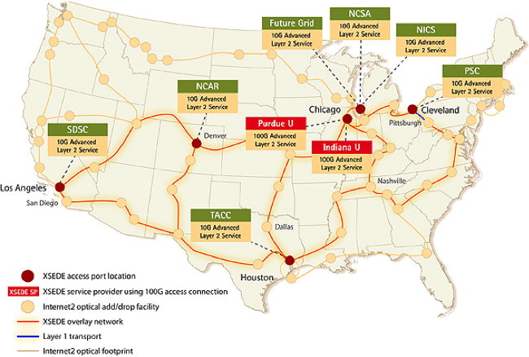
Concerns about centralized compute infrastructure
Scope
FSRDC infrastructure dwarfed by other federal research investments (e.g. XSEDE) that cannot be utilized
Cluster | Cores | Tflops | As a multiple of FSRDC
FSRDC | 240 | 4.36 | 1x
Wrangler (TACC) | 2304 | 62 | 14x
Stampede (TACC) | 102400 | 9600 | 2202x
Notes:
Wrangler is the smallest listed system on XSEDE as of Feb 2017, Stampede is the largest. Information obtained from https://www.xsede.org/web/guest/resources/overview on Feb 18, 2017. FSRDC estimated based on 10 dual-CPU, 12core systems.

Slide 39
summary

Slide 40
summary
Remote access of some type is the standard practice around the world
Access locations and ease of releasing results vary substantially
Disclosure avoidance process is still quite pedestrian in almost all cases, and DA methods are “old-fashioned”. Self-release of data is the exception.

Slide 41
some concluding thoughts
How to enable a scalable and secure system
Does it require changes in the legal framework?
How to build a culture of responsible and secure data access among researchers?
What kind of devices or access mechanisms do we want to enable?
Who gets to hold the data that researchers actually access?

Slide 42

thank you
lars.vilhuber@cornell.edu

Slide 43
Thanks
Stefan Bender (formerly IAB and now Bundesbank, Germany)
Jörg Heining (IAB, Germany)
Roxanne Silberman (CASD, France)
Kamel Gadouche (CASD, France)
Jean Poirier (CIQSS, Canada)

Slide 44
Some References
Walter Wilcox (1914) cited in Anderson, Margo J., and Seltzer, William. “Federal Statistical Confidentiality and Business Data: Twentieth Century Challenges and Continuing Issues’.” Journal of Privacy and Confidentiality 1.1 (2009): 7-52, 55-58.
Kohlmann, Annette (2005): “The Research Data Centre of the Federal Employment Service in the Institute for Employment Research.” In: Schmollers Jahrbuch 125, 437-447
Allmendinger, Jutta and Kohlmann, Annette (2005) “Datenverfügbarkeit und Datenzugang am Forschungsdatenzentrum der Bundesagentur für Arbeit im Institut für Arbeitsmarkt- und Berufsforschung”. In: Allgemeines Statistisches Archiv 89, S. 159-182
Heining, Jörg (2010): “The Research Data Centre of the German Federal Employment Agency: data supply and demand between 2004 and 2009.” In: Zeitschrift für ArbeitsmarktForschung, Jg. 42, H. 4, S. 337-350. http://www.iab.de/389/section.aspx/Publikation/k100128n09
Kargus, Andrea; Müller, Anne (2014): “Auch in Nürnberg möglich: Von der zweiten Liga in die Champions League - ein Gespräch mit Stefan Bender.” In: IAB-Forum, Nr. 2, S. 38-45. http://www.iab.de/188/section.aspx/Publikation/k141201301
Kraus, Rebecca S. (2011): “Statistical Déjà Vu: The National Data Center Proposal of 1965 and Its Descendants.” Presentation at JSM 2011. https://www.census.gov/history/pdf/kraus-natdatacenter.pdf

