Slide 1
Confidentiality protection and physical safeguards
Lars Vilhuber
Cornell University
Funding acknowledged under NSF-#1131848 (NCRN) and a grant from the Alfred P. Sloan Foundation
Notes:
What I will be describing here are the physical safeguards, as well as the context – historical, legal, and cultural – of secure access to confidential microdata, as observed in various systems around the world. I will draw on my personal experience with 4 such systems, and my participation in scientific committees and conferences on the topic for a few more.

Slide 2
Disclaimer
The opinions and observations expressed here are mine, and do not reflect any of the institutions I am affiliated or associated with, or funded by (U.S. Census Bureau, NSF, CASD, IZA, CIQSS).
Some of the information used in this presentation was collected and gathered with funding from the Sloan Foundation and NSF (#1131848 (NCRN) and #1012593 (TC-Large))

Slide 3
context of my talk today
Focus on researcher access to authorized microdata collections of federal statistical data
But private collections face similar issues and use similar mechanisms
Focus on the mechanisms for providing access
Mostly physical access controls
Role of disclosure avoidance mechanisms
Highlight the roles of “community”
Training
Legal framework
Role of institutions
Notes:
While the focus is not on building new data collections, the ability to protect existing data obviously has an impact on new data collections (see IMI,

Slide 4
publication trade-offs
Tabulations
Tabulations
Public-use microdata
Raw microdata
Ease of access
Privacy loss
← Loss of detail
Notes:
What will frame the analysis is the tension between undesirable (possibly illegal) publication of raw microdata, and the accessibility to a broader public of information on the contents of that raw microdata. The traditional solution was the publication of public-use microdata, but for a variety of reasons, that is no longer seen as the only possible solution, or not the ideal solution.

Slide 5
The goal of data access
How to provide easy and convenient access to data with more detail than public-use microdata, less privacy loss than direct publication of raw data?
Notes:
The goal thus of the systems I will describe is….

Slide 6
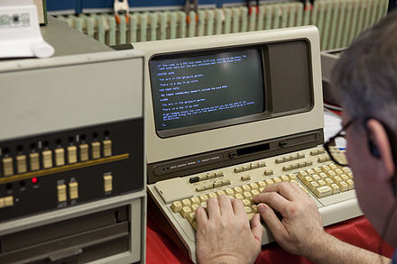


public use data
Data provider/ custodian
Data user/ researcher
Notes:
The reference to public-use microdata is useful because it defines the researchers’ expectations about how to access data in the United States – but not in other countries, which have not had the extensive access to public-use microdata that US researchers have enjoyed over the decades.

Slide 7


confidential data
What type of access device?
What type of person?
?
Where is the data?
What type of room?
How do results leave the room?
Notes:
When facing the need to provide access to confidential data, the approach has been to put the researcher into a closed room, and there provide her with access to the data. Questions then arising, and which I will talk about, involve defining the type of room, the type of computer used to access the data, the location of the data itself, who has the rights to access the data, and how results leave the room.

Slide 8
basic paradigm
“Data Enclave” or “Secure Room”
Where is the data?
What type of room?
Notes:
For instance, if the data provider ships the data directly to the secure room, we call it a “data enclave” or a “secure room”

Slide 9
the ideal
“My laptop”
“Data Enclave” or “Secure Room”
What type of access device?
Where is the data?
What type of room?
Notes:
From a physical point of view, not the best way to distribute data (loss of laptop…)

Slide 10
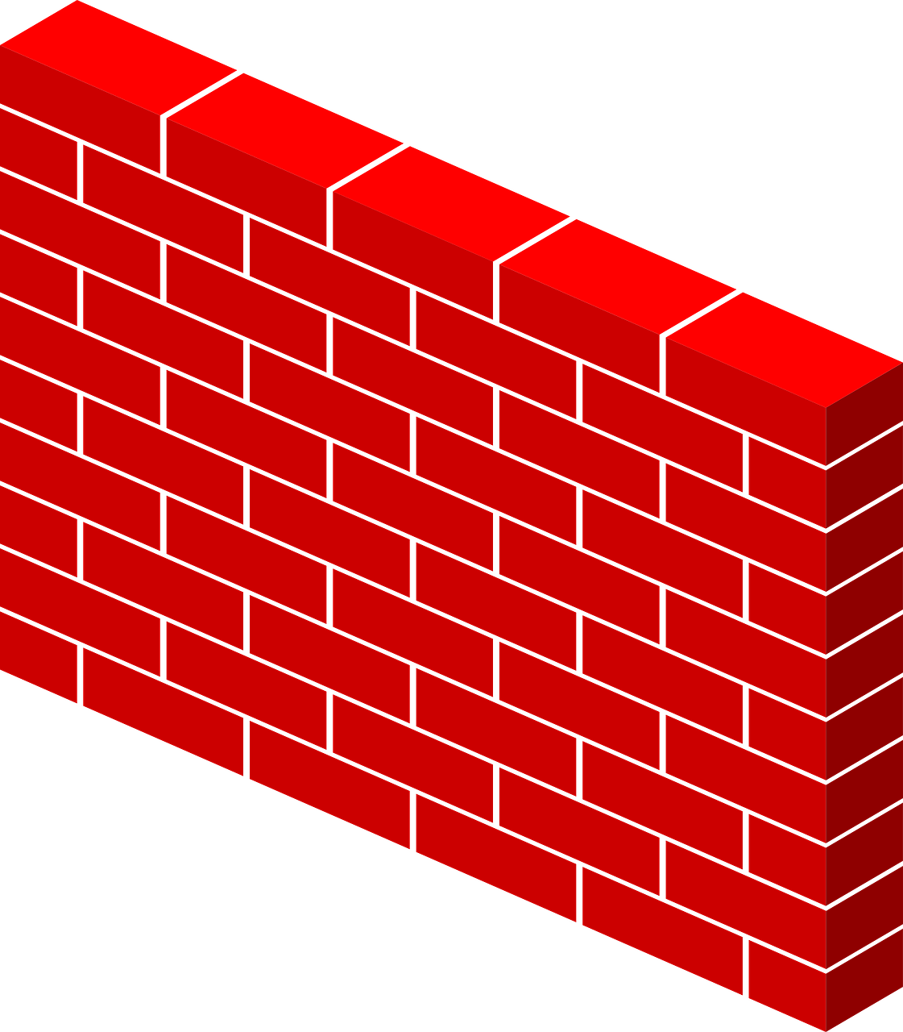
making things virtual
“Virtual Data Enclave”
What type of access device?
Where is the data?
What type of room?
Notes:
If on the other hand, the data provider retains custody of the data, and provides a remote access to the data through a firewall, we have virtualized the data enclave: the data enclave no longer physically houses the data. We may still walk into a well-defined space – a RDC – but as we will see, that is not always the case.

Slide 11
virtual data enclaves
Synonyms:
VDI
(virtual desktop infrastructure)
Thin clients
Remote desktop
Notes:
You may have seen synonyms for Virtual Data Enclave, such as these.

Slide 12
Examples in 1990s
Physical data enclaves
Virtual data enclaves
(data remains in secure data center)
BLS HQ
BJS data access
Department of Education data
Census Bureau RDCs
Canadian RDCs
HRS restricted-access data
and many more
Notes:
Physical data enclaves were widely used in the 1990s, when direct provision of the data to end users was not feasible, including at the pioneering Census and Canadian RDCs

Slide 13
Examples in 2017
Physical data enclaves
Virtual data enclaves
(data remains in secure data center)
BLS HQ ?
BJS data access
Department of Education data
Census Bureau RDCs
Canadian RDCs
HRS restricted-access data
and many more
Census Bureau/Federal Statistical RDCs (since early 2000s)
German IAB RDCs (since mid 2000s)
French CASD (since late 2000s)
Cornell’s CRADC, NORC (early 2000s)
HRS restricted access data (2015)
and many many more
Notes:
In 2017, some of these have switched to a virtual data enclave structure, most prominent among them the Census Bureau, which switched to a virtual data enclave structure in the early 2000s. Abroad, broader research access to data only began to emerge in the mid 2000s, and in most cases, arose as Virtual Data Enclaves from the start. Of note, Canadian RDC system is still fundamentally a physical data enclave system, but is considering moving part of its infrastructure to Virtual Data Enclave architecture

Slide 14
basic levers
What type of access device?
What type of room?

Slide 15
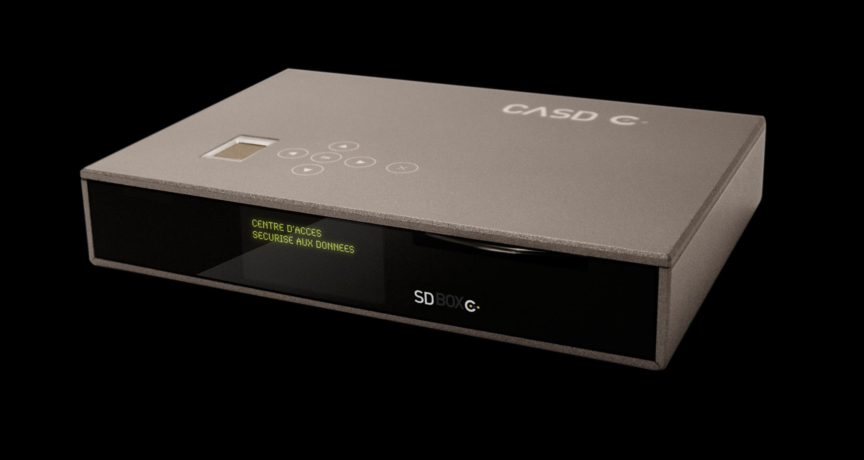

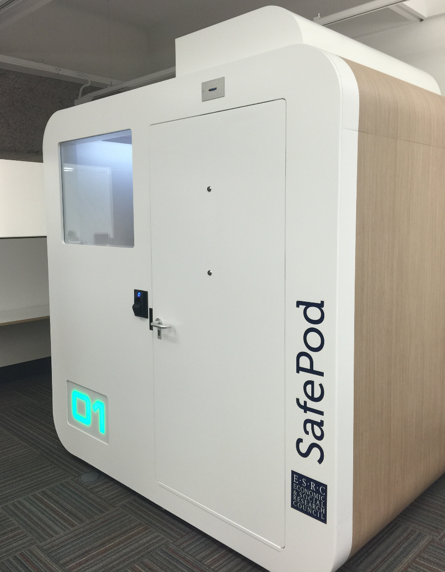
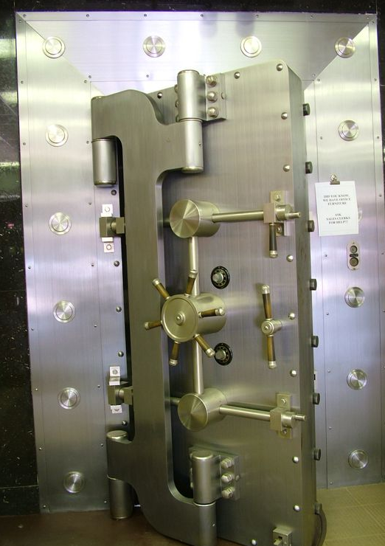
basic levers
Where?
How?
Notes:
The “where” and “how” of data access are the most obvious levers, ranging from complete freedom to Fort Knox-style security (the BJS HQ data center has been described to me like that). Relaxing the constraints on the where lead to RDCs or even location of thin clients in university offices.

Slide 16
access methods: enclaves
Tabulations
Tabulations
Public-use microdata
Ease of use
Privacy loss
RDC
Physically secure room housing access devices and/or data
← Loss of detail
Notes:
Mapping it back to the tradeoff between ease of use and loss of privacy, these systems tend to have similar loss of privacy – the disclosure avoidance mechanisms are mostly of the same type – but vary in the degree of ease of use.

Slide 17
access methods: enclaves
Tabulations
Tabulations
Public-use microdata
Software on your own PC giving a view onto secure data environment
Remote desktop
Ease of use
Thin client
Secondary secure PC giving a view onto secure data environment
Remote execution
Submitting analysis programs by email or through website (possibly combined with synthetic microdata)
RDC
← Loss of detail
Notes:
All but the RDC system are necessarily “virtual” data access modes, but not all of them require the researcher to be in an enclave, i.e., a secure room. Rather, it is the data that is secured.

Slide 18
What type of room?
Notes:
So let’s consider what type of constraints are put on the location of access

Slide 19
Access matrix for confidential data
Control by data provider of:
 | # access points | Access computers | Access rooms | Avail. analysis methods | Type disclosure avoidance
FSRDC researcher | 24 sites (~700 users) | Full | Full (badge access) | Some (choice of software) | Manual/ variety of rules
Census staff researcher | n.d. | None (VDI) | None (VDI) | Some (choice of software) | Manual/ self/ variety of rules
IAB: JoSuA researcher | 414 users | None (Web application) | None (Web application) | Smaller (software, whitelist commands) | Manual/ variety of rules
CASD researcher | 371 sites (1471 users) | Extra Full (custom-built hardware) | Some (university office, EU) | Some (choice of software) | Manual/ variety of rules €300/ pack of 10
Stat.Denmark (typical EU) | ? | None (VDI) - Some (host institution) | None (VDI) -Some (host institution) | Some (choice of software) | Manual/ self/ variety of rules
Notes:
This table has a select set of systems that highlight some key elements of the variation in access modalities. You have heard from representatives describing all of these systems in this commission. I would like to point out the middle-of-the-road access restriction of the French system, which limits access by a custom thin client to university offices (and needs to determine what are legitimate universities and research institutions). In contrast, Statistics Denmark does not impose strong limits on the VDI access it grants – access by any PC is allowed, as long as the access occurs from the university offices or the home of the researcher. In contrast, the FSRDC is a classic “virtual data enclave”, sending researchers to secure rooms under full access control of the Census Bureau, using dedicated thin clients.

Slide 20
How do results leave the room?
Notes:
The next question is how results are made available for later publication. As it turns out, there is surprisingly little variation in most of these systems in terms of the disclosure avoidance methods.

Slide 21
How do results leave the room?
Typically, the researcher asks an authorized agent of the data provider to review the results for risks of disclosure, and he will then send them to the researcher
Notes:
Typically, … But there is one alternate path for the data to exit by.

Slide 22
What if the “authorized agent” were the researcher?
Notes:
So what if …

Slide 23
self-controlled release of results
Researcher controls release of results
Prepares results herself
According to certain prescribed rules
Sends them through a system
Automatically receives results typically per email
Used
Most often by contractually-controlled non-enclave data
Data in some university- or faculty-controlled enclaves (HRS, Dept. of Ed)
Danish researcher access system
Notes:
In this case, the researcher has control over the speed and timing of releases, while the agency still controls the rules. This is most often used when data are sent directly to the user or a university data enclave, where final control by the data provider is difficult or impossible. But it is also – radically? – used by the Danish system.

Slide 24
access methods: enclaves with researcher-controlled release
Tabulations
Tabulations
Public-use microdata
Self-controlled release
Raw microdata
Remote desktop
Ease of use
Thin client
Remote execution
RDC
← Loss of detail
Notes:
This could be described as the ultimate “ease-of-access” nearly on par with the classic public-use microdata mechanism…

Slide 25
access methods: enclaves with researcher-controlled release
Tabulations
Tabulations
Public-use microdata
Raw microdata
Remote desktop
Ease of use
Thin client
Self-controlled release
Remote execution
RDC
← Loss of detail
Notes:
In theory, this could be combined with nearly all of these systems. So do we think that the Danish system is a radical system?

Slide 26
Access matrix for confidential data
Control by data provider of:
 | # access points | Access computers | Access rooms | Avail. analysis methods | Type disclosure avoidance
FSRDC researcher | 24 sites (~700 users) | Full | Full (badge access) | Some (choice of software) | Manual/ variety of rules
Census staff researcher | n.d. | None (VDI) | None (VDI) | Some (choice of software) | Manual/ self/ variety of rules
IAB: JoSuA researcher | 414 users | None (Web application) | None (Web application) | Smaller (software, whitelist commands) | Manual/ variety of rules
CASD researcher | 371 sites (1471 users) | Extra Full (custom-built hardware) | Some (university office, EU) | Some (choice of software) | Manual/ variety of rules €300/ pack of 10
Stat.Denmark (typical EU) | ? | None (VDI) - Some (host institution) | None (VDI) -Some (host institution) | Some (choice of software) | Manual/ self/ variety of rules
Notes:
Let’s turn back to my little table: The Danish system combines relaxed controls as to the type of computer and location of the access, with very liberal disclosure avoidance mechanism. But as it turns out, such a system already exists in the US case: it is the system that Census staff researchers are subjected too.
That should lead us to consider why we trust certain people with a more open approach, and not others. Two topics come to mind: the penalties applied to failure to comply with rules, and the culture of trust.

Slide 27
penalties
Notes:
Let’s turn first to some of the penalties.

Slide 28
penalties
FSRDC and federal employee:
federal prison sentence of up to five (5) years, a fine of up to $250,000, or both.
France:
prison sentence of up to one (1) year, a fine of up to €15,000, or both.
Notes:
In the case of the US and France, breaches are punishable under national law with prison and monetary fines.
Note that this cannot explain the difference within the US between staff researchers and FSRDC researchers – they face the same penalties.

Slide 29
penalties
IAB:
Loss of data access for up to two (2) years for researcher and institution
Contractual penalty up to €60,000 paid by the institution
Denmark:
Researcher: Loss of data access for life, or up to three (3) years for “minor breaches”
Institution: Loss of access for a positive but limited (undefined) period
No financial or penal penalties
Of Note: the FSRDC contract explicitly excludes a responsibility of the university for the actions of its employees, though university remains bound by FWA/IRB.
Notes:
IAB and Denmark have no prison sentences, and relatively low or no financial penalties. Their lever is access to the data – do something stupid, and you and the institution lose access to the data for some amount of time, potentially forever.
They do however strongly engage the institution, not just the researcher. Germany (but not Denmark) also rely on the contractual nature – and thus easier enforceability without reliance on specific laws - to allow for transnational access.
Notice that in the case of the FSRDC, the contract with the university explicitly excludes institutional liability for a researcher’s potential misdoings.
Finally, notice that surprisingly the more liberal systems also have more lenient penalties. However, one can imagine that precisely because they are more lenient, they are more easy to impose.

Slide 30
penalties
Does ease of application matter (penal vs. contractual rules)?
Is it conducive to more strongly engage the researcher’s employer (typically but not exclusively a university)?
Notes:
Thus we can ask…

Slide 31
trust
or “what type of person?”
Notes:
But this did not, for instance, explain the difference in access modes for the US system, between university and staff researchers. Why do we trust certain people and not others?

Slide 32
trust and access
Frequent discussion
Security measures are for (malevolent) intruders/opponents
Researchers are trusted collaborators…
… who know what they are doing
A corollary:
Protect against the bad guys
But let the “good” guys do their thing
Examples:
Network-moderated access
Contracts with disclosure avoidance rules
How do you know who the good guys are?
Also known as the “old boys’ network”

Slide 33
hypothesis: culture matters
Researchers and agencies create the communities in which rules are applied and enforced
Training and “indoctrination”:
Training of FSRDC researchers (short, decentralized) vs. FedStat employees (≥1 day on-site)
1 full day on-site (in Paris) training for French researchers
Common forums:
Conferences: Canadian, US (FSRDC, NCHS) yearly RDC conferences
Discussion, local groups: users of FSRDC share a common physical space
More or less tight binding of researchers into a community is important
Notes:
Some of the more liberal systems (Paris, FedStat employees) provide for strong on-site, personal “indoctrination” of the principles of confidentiality – typically a trip to the headquarters and a full-day training session. I will also note that the German system requires the presence of a representative of the data custodian to be personally present each time a researcher logs into the system (has to type a system-level password). While providing extra security, it also is a reminder of the importance of security at each step.
Actually, there is already a lot of community building going on in the US (and Canadian) RDC systems. Regular conferences by and for data users, and the sharing of a common physical space foster a sense of community.

Slide 34
training content, method, and frequency
 | Frequency | Access rules? | Disclosure rules? | Disclosure avoidance tools? | Method
FSRDC | yearly | Initial | As needed | No | Online
IAB RDC | Initial | Initial | Yes | No | PDF (Contract, other)
CASD (France) | Initial | Initial | Yes | No | In person (3h)
Denmark | Initial | Yes | No | No | PDF (Contract)
Notes:
Initial + PDF means that no formal training occurs; rather, the information is transmitted through a contract or initial set of materials

Slide 35
virtual enclave = centralization
Notes:
One final concern. A virtual data enclave (as currently implemented in the US) implies centralization.

Slide 36
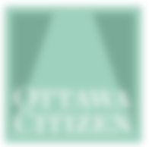
Concerns about centralized compute infrastructure
Canada
Wayne Smith upon his resignation as Chief Statistician of Canada: “…this situation [transfer of IT to Shared Services Canada] has already led to a progressive degradation of informatics infrastructure support with significant consequences for our effectiveness, our budget and our program.” (Ottawa Citizen, Sept. 16, 2016, http://ottawacitizen.com/news/local-news/canadas-chief-statistician-quits-statistic-canada )
Continuing concerns amongst the Canadian RDCs about a central government-run IT infrastructure

Slide 37
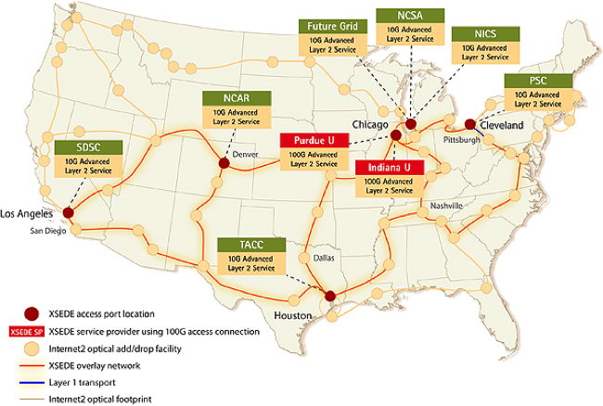
Concerns about centralized compute infrastructure
Scope
FSRDC infrastructure dwarfed by other federal research investments (e.g. XSEDE) that cannot be utilized
Cluster | Cores | Tflops | As a multiple of FSRDC
FSRDC | 240 | 4.36 | 1x
Wrangler (TACC) | 2304 | 62 | 14x
Stampede (TACC) | 102400 | 9600 | 2202x
Notes:
If I compare the computing resources available to the FSRDC with that of other federally funded computational infrastructure, it is abysmal. Just to illustrate: Wrangler is the smallest listed system on XSEDE as of Feb 2017, and has 14x the computational power of the entire FSRDC. It is only one of many XSEDE systems. Stampede is the largest – with 2000x the computational capacity of the FSRDC. We should thus consider the possibility of….
. Information obtained from https://www.xsede.org/web/guest/resources/overview on Feb 18, 2017. FSRDC estimated based on 10 dual-CPU, 12core systems.

Slide 38
many virtual enclaves
= decentralization

Slide 39
summary

Slide 40
summary
Remote access of some type is the standard practice around the world
Access locations and ease of releasing results vary substantially
Disclosure avoidance process is still quite pedestrian in almost all cases, and DA methods are “old-fashioned”. Self-release of data is the exception.

Slide 41
some concluding thoughts
How to enable a scalable and secure system?
Does it require changes in the legal framework?
How to build a culture of responsible and secure data access among researchers?
What kind of devices or access mechanisms do we want to enable?
Who gets to hold the data that researchers actually access?
Notes:
What do I think are the conditions to be able to augment the US system to be scalable and secure? Does it require changes in the legal framework, or just changes in the contracts used to provide access? How to we create a culture of responsible use that is equivalent to the one our FedStat employees already demonstrate every day? Can we rethink what kinds of access devices and physical space researchers should use? And finally, should we rethink who gets to hold the data that researchers actually access – keyword decentralization.

Slide 42

thank you
lars.vilhuber@cornell.edu
Notes:
Thank you.

Slide 43
Thanks
Stefan Bender (formerly IAB and now Bundesbank, Germany)
Jörg Heining (IAB, Germany)
Roxanne Silberman (CASD, France)
Kamel Gadouche (CASD, France)
Jean Poirier (CIQSS, Canada)

Slide 44
Some References
Walter Wilcox (1914) cited in Anderson, Margo J., and Seltzer, William. “Federal Statistical Confidentiality and Business Data: Twentieth Century Challenges and Continuing Issues’.” Journal of Privacy and Confidentiality 1.1 (2009): 7-52, 55-58.
Kohlmann, Annette (2005): “The Research Data Centre of the Federal Employment Service in the Institute for Employment Research.” In: Schmollers Jahrbuch 125, 437-447
Allmendinger, Jutta and Kohlmann, Annette (2005) “Datenverfügbarkeit und Datenzugang am Forschungsdatenzentrum der Bundesagentur für Arbeit im Institut für Arbeitsmarkt- und Berufsforschung”. In: Allgemeines Statistisches Archiv 89, S. 159-182
Heining, Jörg (2010): “The Research Data Centre of the German Federal Employment Agency: data supply and demand between 2004 and 2009.” In: Zeitschrift für ArbeitsmarktForschung, Jg. 42, H. 4, S. 337-350. http://www.iab.de/389/section.aspx/Publikation/k100128n09
Kargus, Andrea; Müller, Anne (2014): “Auch in Nürnberg möglich: Von der zweiten Liga in die Champions League - ein Gespräch mit Stefan Bender.” In: IAB-Forum, Nr. 2, S. 38-45. http://www.iab.de/188/section.aspx/Publikation/k141201301
Kraus, Rebecca S. (2011): “Statistical Déjà Vu: The National Data Center Proposal of 1965 and Its Descendants.” Presentation at JSM 2011. https://www.census.gov/history/pdf/kraus-natdatacenter.pdf

