Slide 1
Wild fire occurrence data North Carolina
Steven Vandeleene, Laurens Van Paemel, Bart Moens, Herlinde Wynendaele

Slide 2
Introduction
Dataset
Wildfires in the U.S. from 1992 to 2015
Reporting systems of federal, state, and local fire organizations
Source: U.S. Department of Agriculture Forest Services
Objective
Investigate timing, causes & number of fire sizes
Focus: different counties in North Carolina

Slide 3
Methodology: step by step
Using SAS 9.4
North Carolina dataset was imported
Descriptive portion was examined
Permanent dataset was created with key variables
Notes:
Intro slide: beginnen met uitleg methodologie – rest slides gaat hierop verder.
Question 1 and 2

Slide 4
Levels for each character variable
Notes:
Question 3
- COUNTY = County, or equivalent, in which the fire burned (or originated), based on nominal designation in the fire report.
FIPS_CODE = Three-digit code from the Federal Information Process Standards (FIPS) publication 6-4 for representation of counties and equivalent entities.
FIRE_YEAR = Calendar year in which the fire was discovered or confirmed to exist.
STAT_CAUSE_CODE = Code for the (statistical) cause of the fire.
STAT_CAUSE_DESCR = Description of the (statistical) cause of the fire.

Slide 5
Inconsistencies, missing values, extreme observations
N=111277
No missing values
Notes:
Question 4
Voor de drie variabelen zijn er geen missings

Slide 6
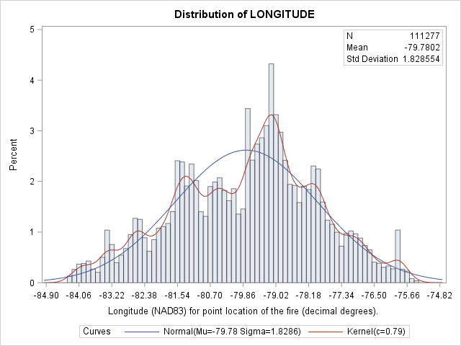
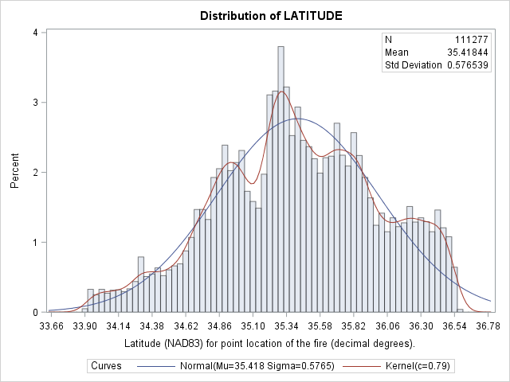
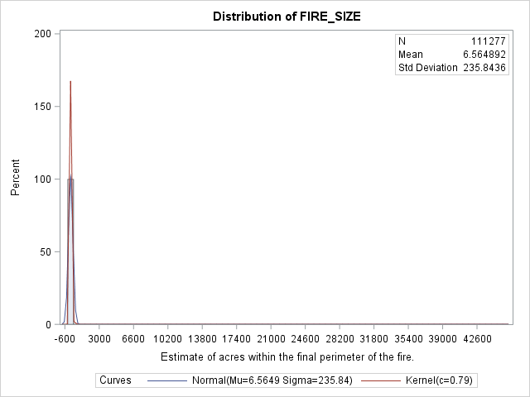
Notes:
Vervolg vraag 4
Inconsistenc? Ja: fire size : skewed to the right ! (cf. extreme observations)

Slide 7
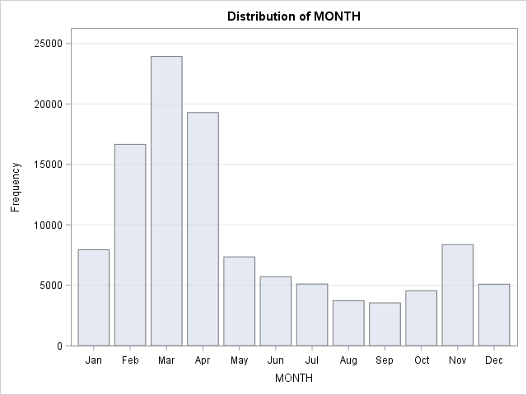
months with the highest number of fires
Notes:
Question 5, 6,
Create a new variable indicating the month of discovery using one or more SAS functions.
create a format for fire_size_class: (niet opgenomen in slideshow)
7

Slide 8
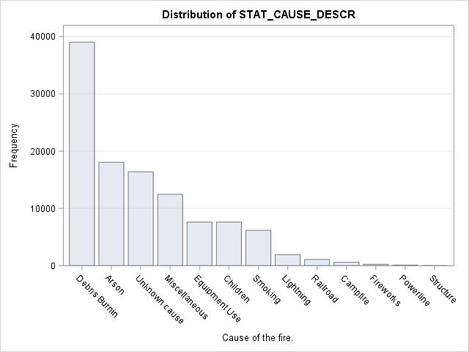
number of fires for each cause
Notes:
Question 8
Top 5 weergegeven;
We gaan in volgende vragen verder met 1,2, 5
→ 3 = missing; 4 = divers

Slide 9
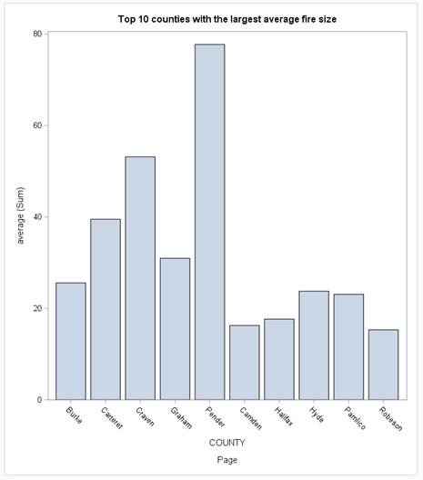
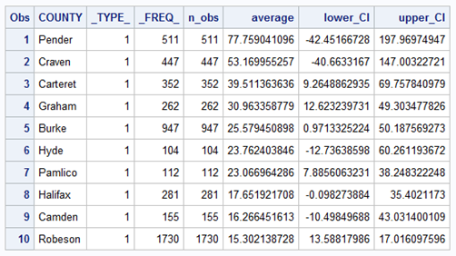
10 counties and their average fire size
Notes:
Question 10

Slide 10
County with the biggest fire on average
Notes:
The county Pender has in average the biggest wildfires. In addition to the average, the lower and upper confidence intervals were calculated.
Question 9

Slide 11
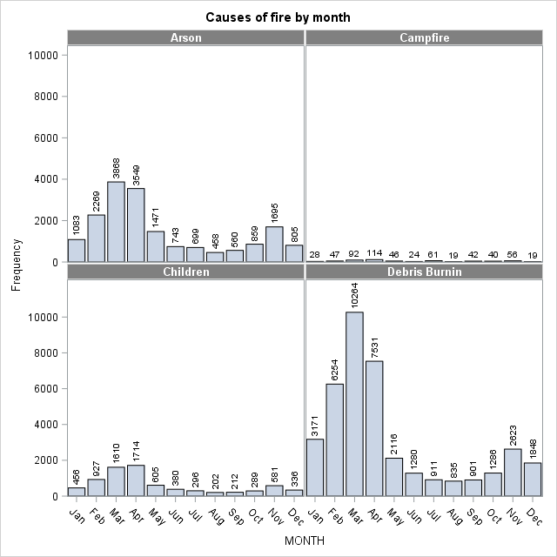
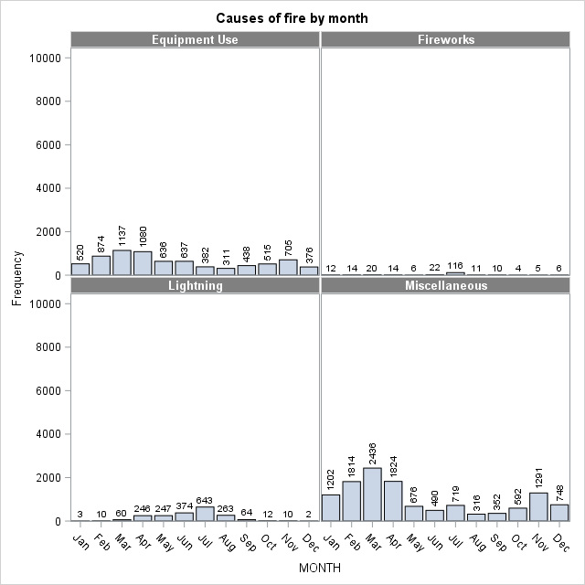
Causes of fire versus the size by month
Notes:
Question 11

Slide 12
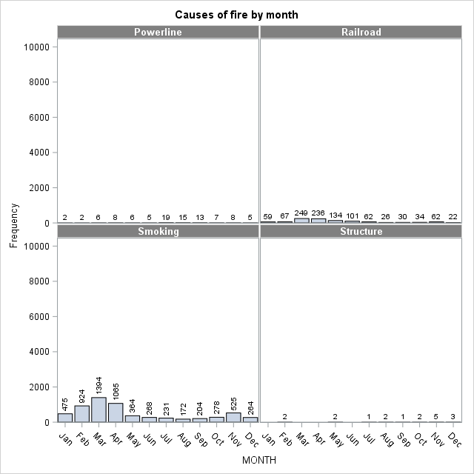
Causes of fire versus the size by month
Notes:
Question 11

Slide 13
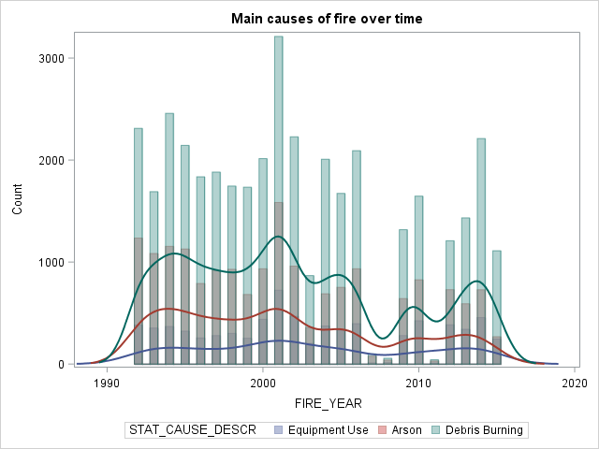
fires over time for the 3 main causes
Notes:
Question 12
De grafiek is onduidelijk voor mij: kleur label en bars?

Slide 14
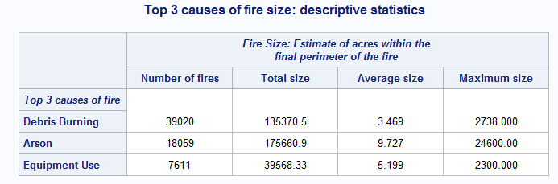
top 3 causes of fire: summary report
Notes:
Question 12
The top 3 causes of fire size are considered to be Debris burning, Arson and Equipment use.
The category wildfires with an unknown cause are not taken into account. For the category miscellaneous assumption is made that this category holds data for wildfires that can not be assigned to any other category, but holds data for numerous different reasons. 13

Slide 15
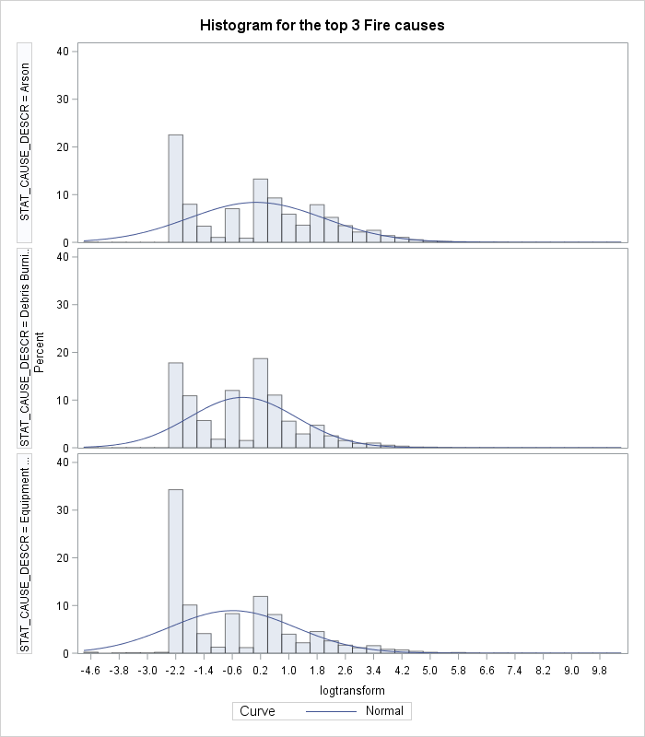
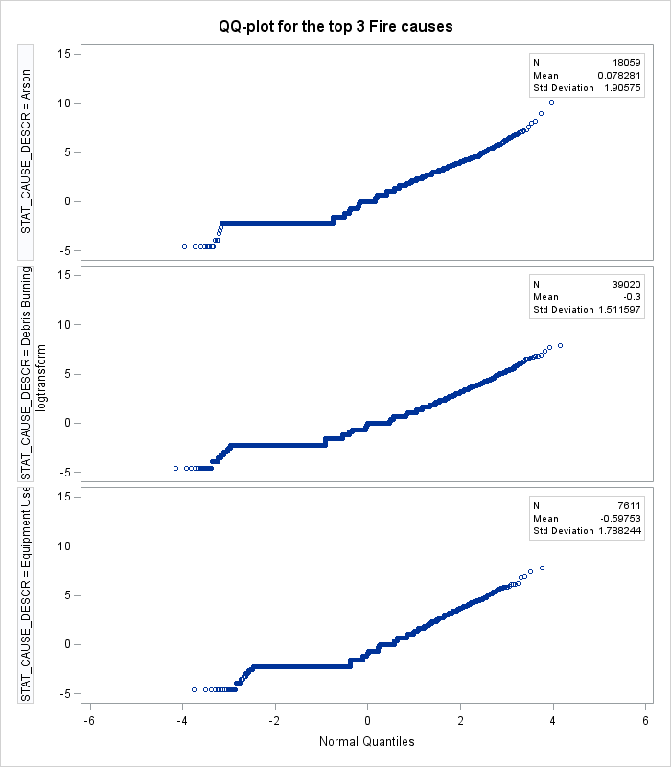
Distribution log transformed fire size Graphically
Notes:
Question 14

Slide 16
Distribution log transformed fire size Formal testing
Notes:
Question 14
log transformed data is not normally distributed - P-value is < 0.05 (we may assume data is not normally distributed);

Slide 17
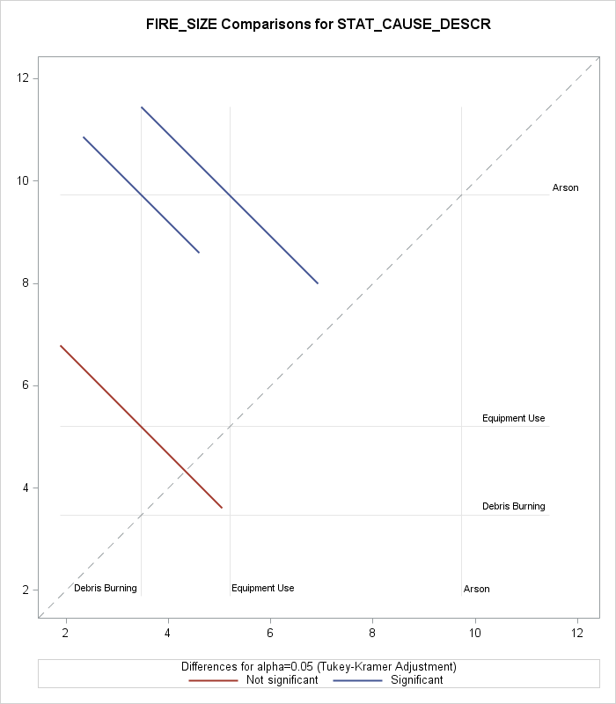
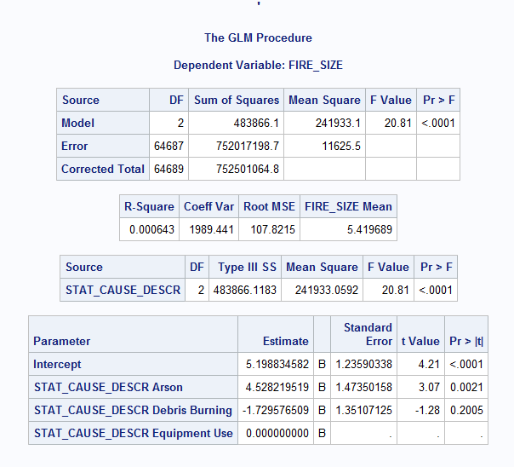
difference in fire size in the year 2015 3 main causes
Notes:
Question 15

Slide 18
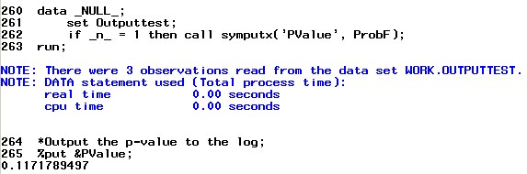
macro-value from the p-value: log
Notes:
Question 16

Slide 19

Questions?

