Slide 1
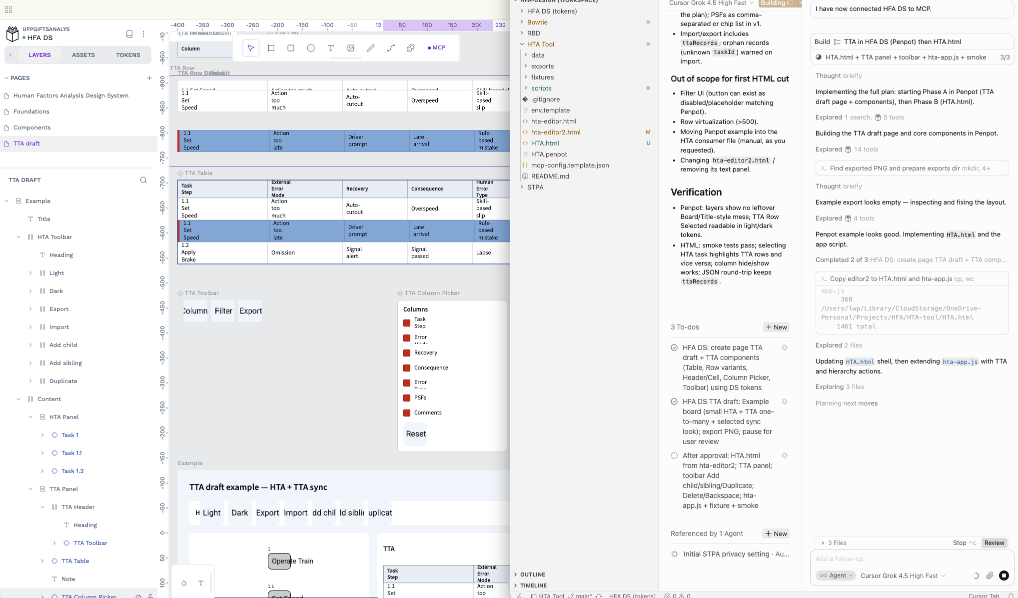

Slide 2
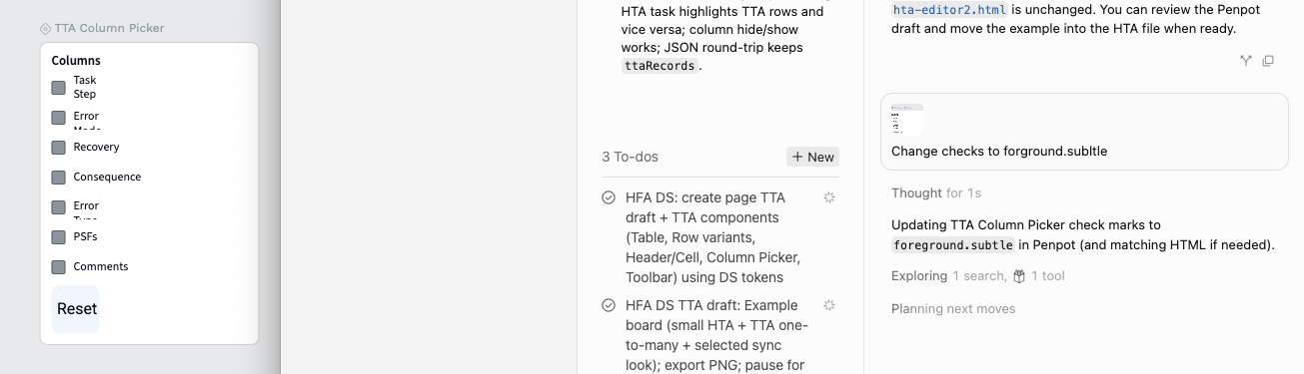

Slide 3
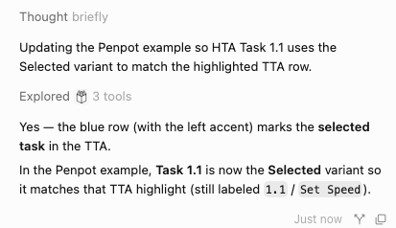
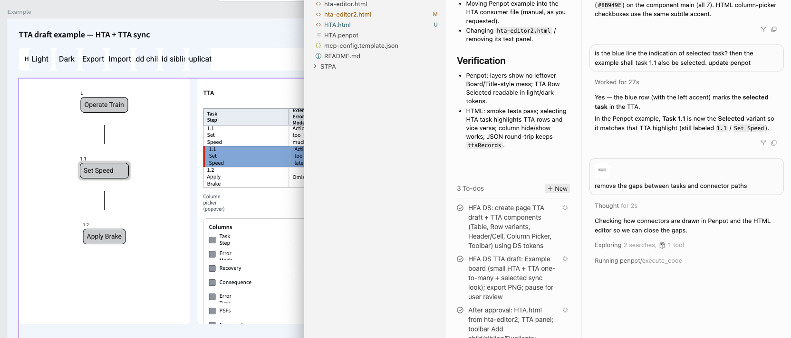
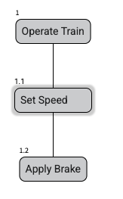
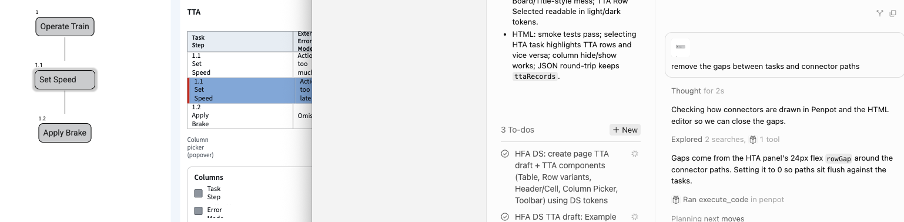

Slide 4
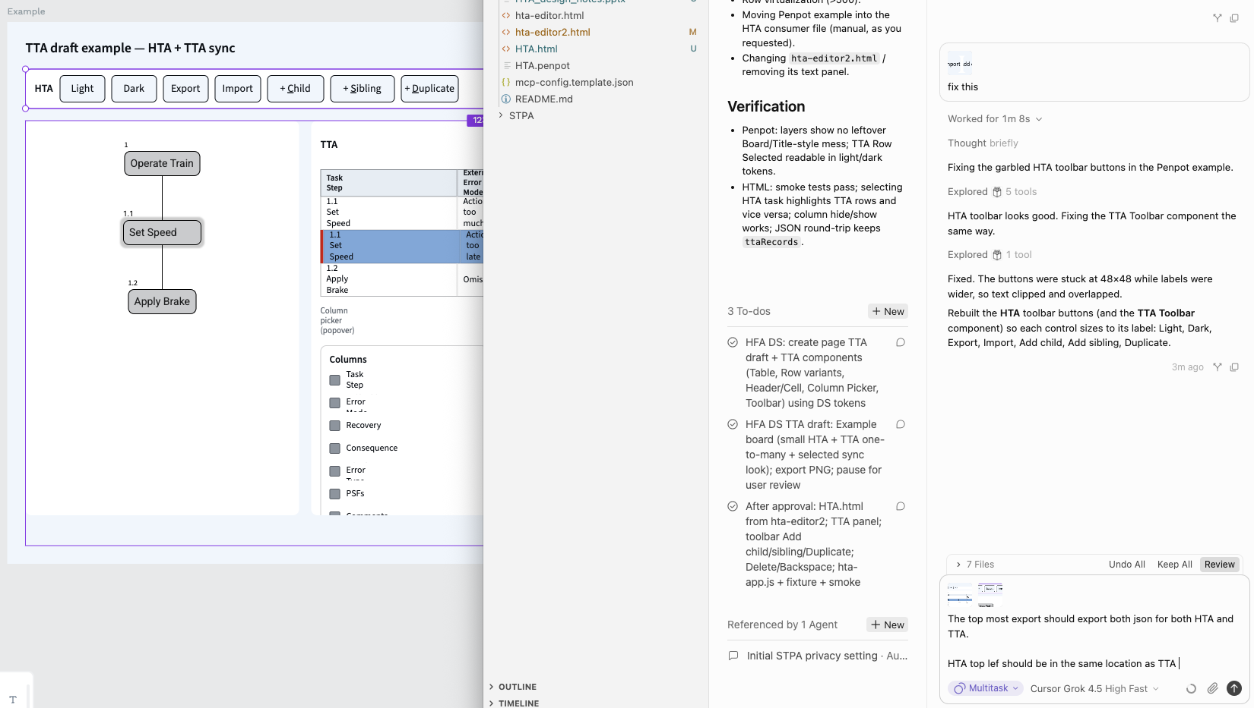
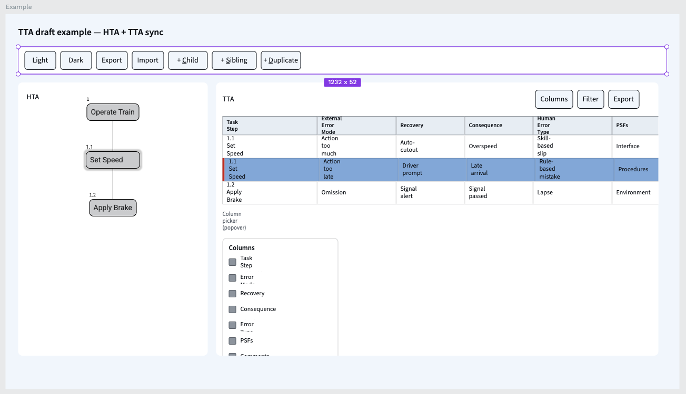

Slide 5
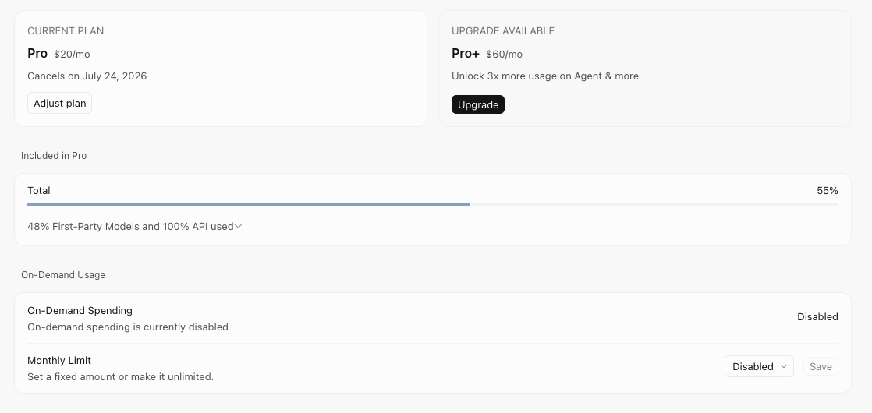

Slide 6
Penpot MCP only allows one file at the time. Therefore it is problematic to move examples outside of the design system liknked library
Manual steps (recommended if you want it in the HTA Penpot file)
In Penpot, open HFA DS → page TTA draft.
Select the Example board/frame (the HTA + TTA sync composition in your screenshot).
Copy (Cmd/Ctrl+C).
Open the HTA Penpot file (import [HTA.penpot](HTA-tool/HTA.penpot) into Penpot if it only exists on disk).
Paste (Cmd/Ctrl+V) onto a page (create e.g. TTA draft if missing).
If components look broken: Assets → connect library → HFA DS (or copy needed local components into the HTA file).
Optionally reconnect the MCP plugin to the HTA file so later MCP edits target that file.

Slide 7
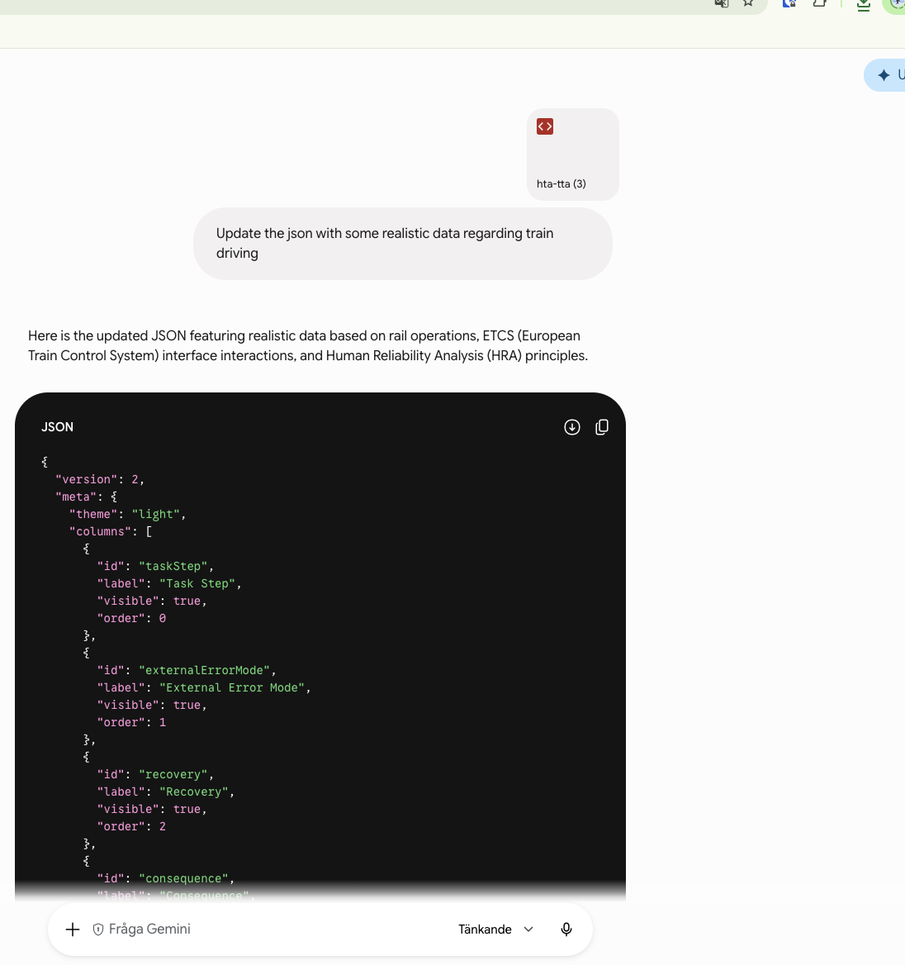

Slide 8
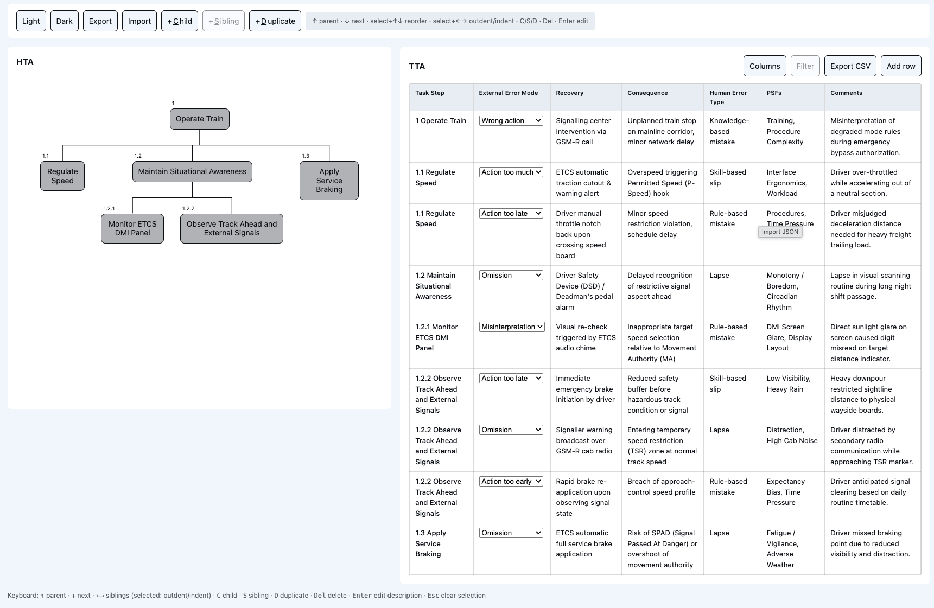
https://share.gemini.google/eP3YJwEQcFl4
Gemini generated example for HFA HTA

Slide 9
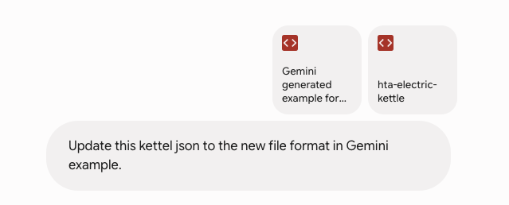
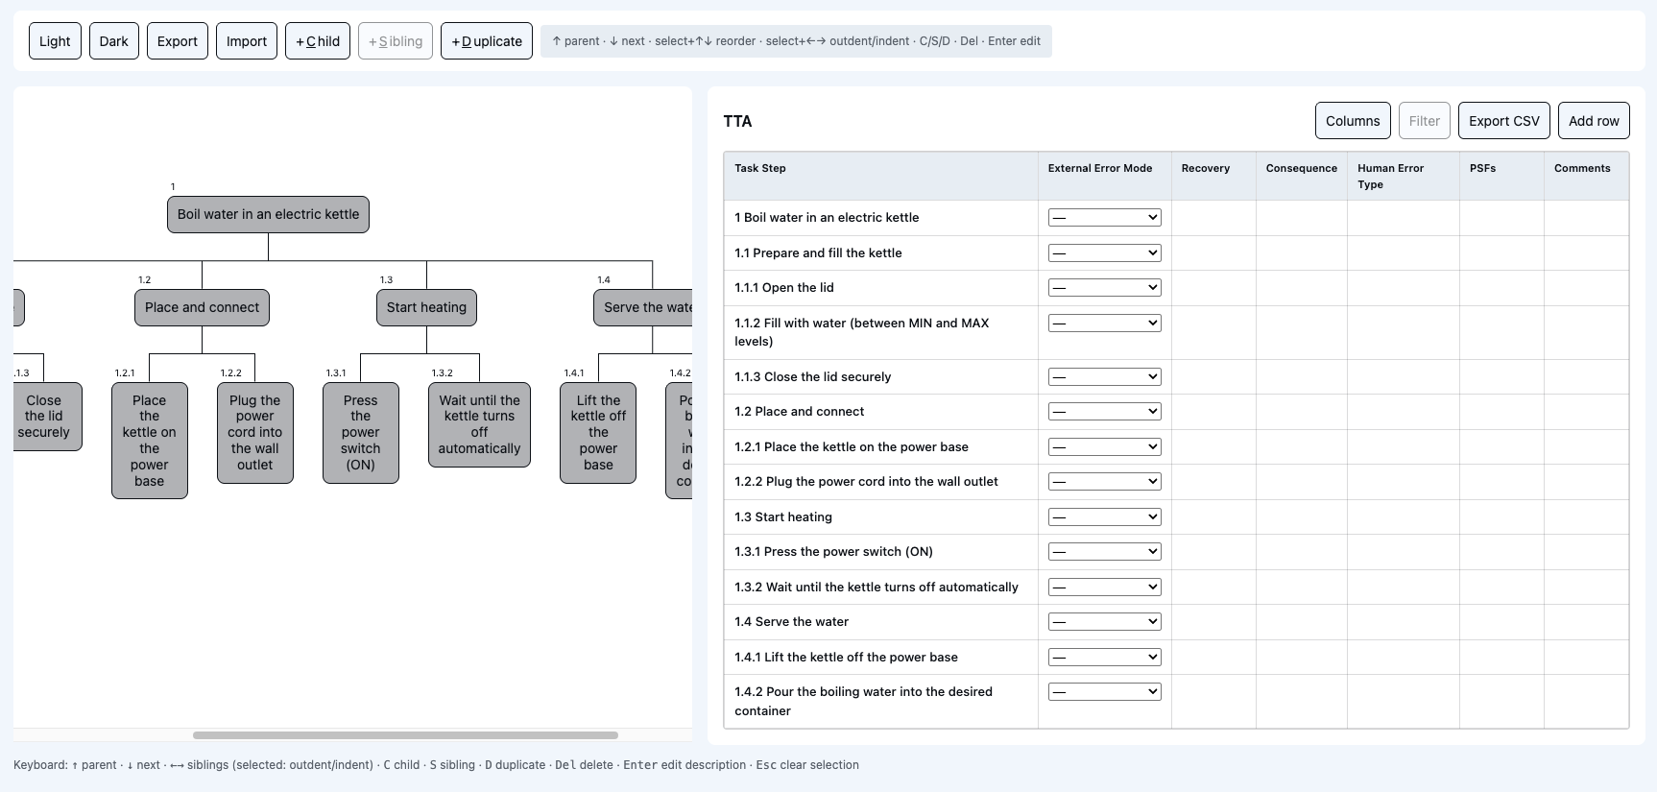
Manage changes in JSON structure

