Slide 1
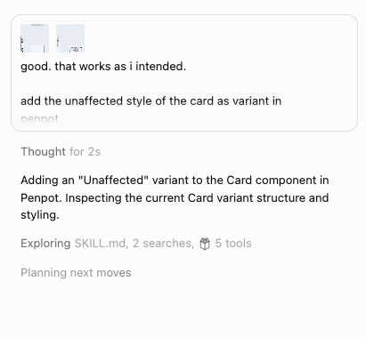
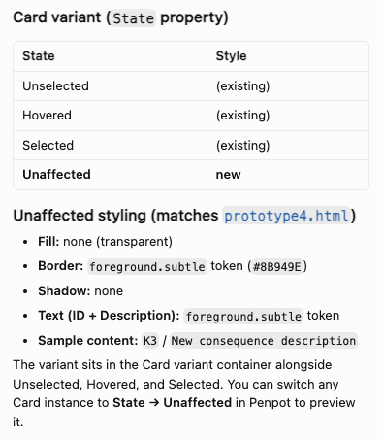
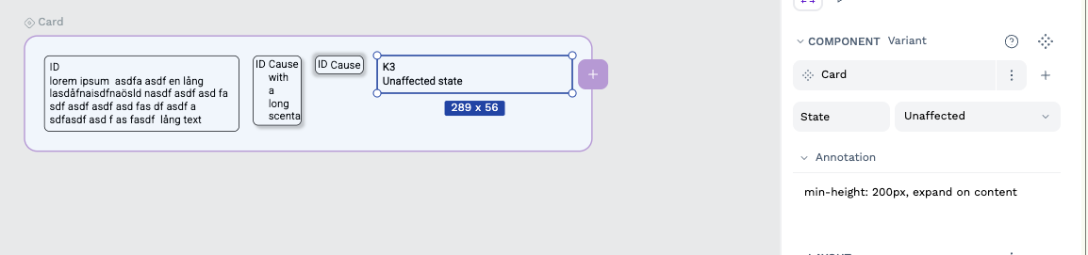
1
2
3

Slide 2
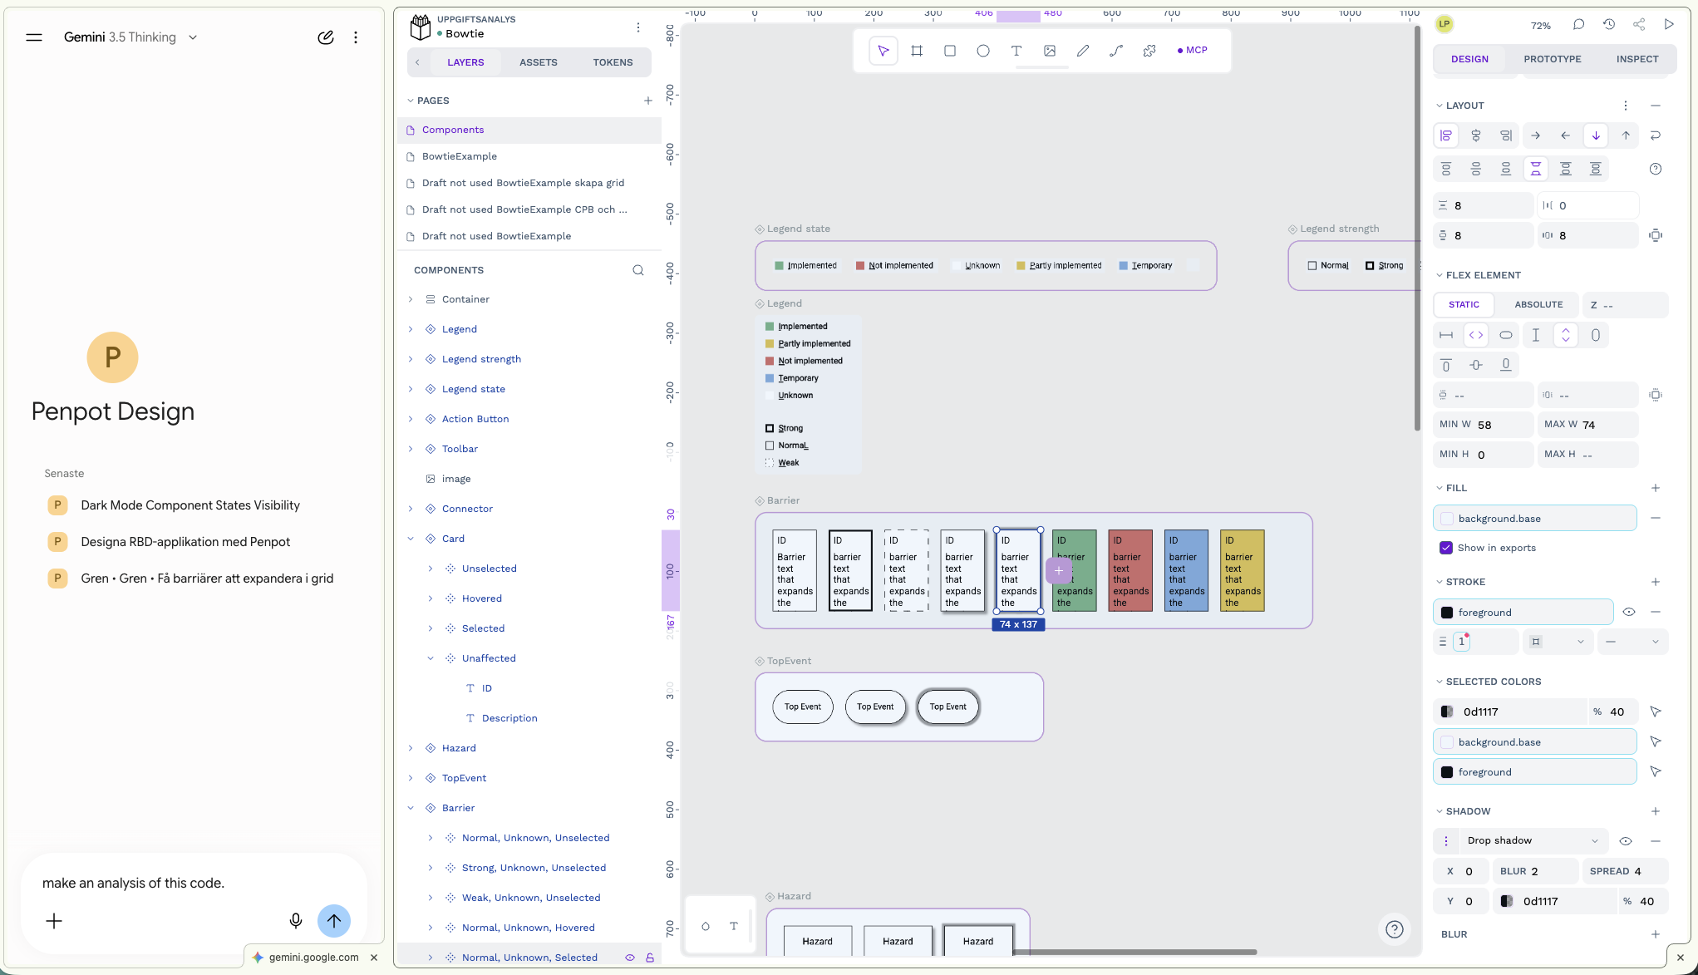

Slide 3
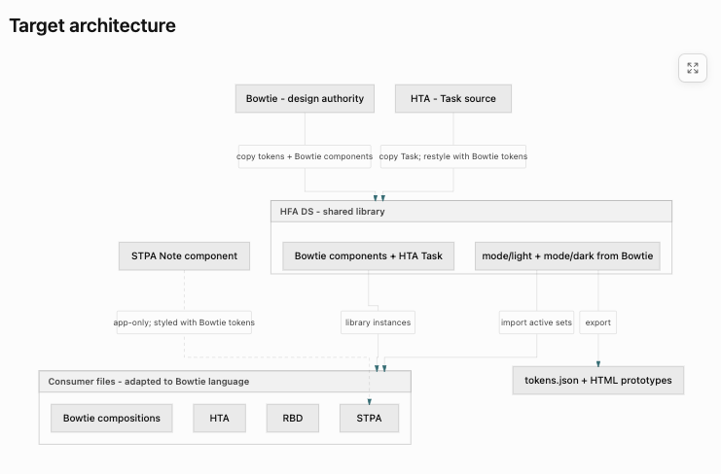
Refactoring the design system library HFA DS

Slide 4
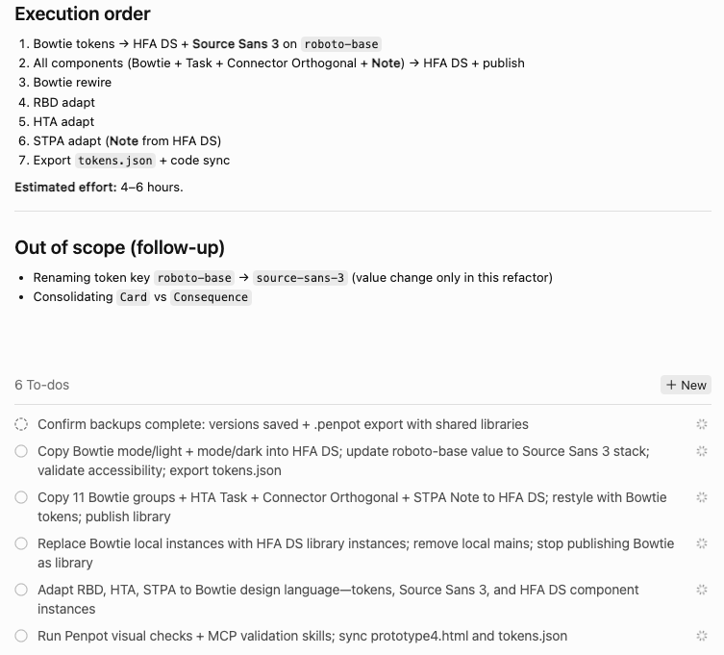
Execution order

Slide 5
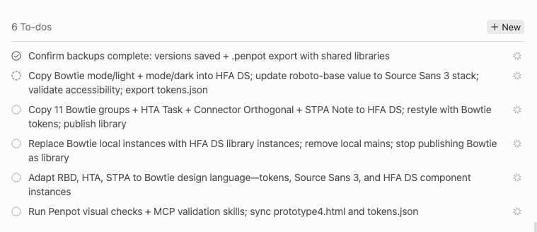
Plan To-dos

Slide 6
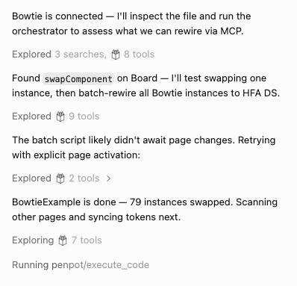

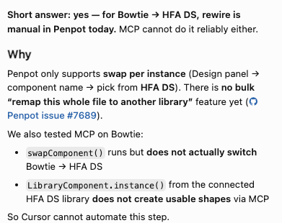
Not completely smooth

Slide 7
Component swap – need of UX
Title: Swap component picker should show variant property values, not duplicate component names
Problem: When swapping to a component with variants (e.g. HFA DS Action Button), the picker lists many rows all named “Action Button” with no Type/State (or Strength/Status) labels — indistinguishable without trial and error.
Expected: Each row shows variant props (e.g. Action Button · Cause · Unselected) or groups variants under one entry with a variant selector in the picker.
Workaround today: Swap to any entry in the family, then set Type / State (or other props) in the Design panel.
Where to file:
Comment on the community thread, or
New issue at github.com/penpot/penpot/issues with label enhancement and a screenshot like yours.
That’s a fair report — the swap search was improved in PR #3750, but variant labels in the swap list still aren’t there.

Slide 8
Possible MCP Bug?
Penpot (github.com/penpot/penpot) — bugs
Connected library sometimes shows inflated component count (69 vs 13) until reload
Swap fails with generic “Something wrong has happened” until library cache refresh
Penpot — enhancement 3. Swap picker should show variant props (Type/State, etc.) when a component has variants (HR.: not sure about this one – makes the interface clutered – but great feature if it works in MCP)
Penpot MCP / plugin (if you use Cursor’s Penpot MCP) — bug 4. swapComponent() succeeds but doesn’t change component().libraryId cross-library
5. LibraryComponent.instance() returns non-usable shapes from connected libraries

