Slide 1
Capstone: The millennial Entrepreneur
The millennial entrepreneur has saved enough money to open a small establishment in Europe.

Slide 2
Background
The world is seeing a huge displacement of the Generation Y workforce. The workforce is predominantly becoming occupied by millennials and as studies have shown, millennials differ very much from the Baby Boomer generation in the fact that they are not content with having one job for the rest of their life. The last twenties years have seen a huge increase in entrepreneurs creating their own businesses or goods. As such, technology has also increased, and entrepreneurs don’t have to just set up shop at a random location or design something and hope it is what the market needs. With the data available today, entrepreneurs can do their research before-hand to give them a higher probability of success. For this specific problem an EU millennial entrepreneur will be used. As we all know, millennials are very concerned about the environment, so “green” status we also be a determining factor.

Slide 3
Business Problem
To give the majority workforce a higher probability of success, specifically the entrepreneurial workforce, we the data scientists can assist them in choosing the right location to start their small business. As stated in the background, the business problem we face is to find not only the right location for the entrepreneur to set up shop, but what type of shop will most likely lead to success. This project aims to find an environmentally friendly location for the entrepreneur to set-up shop and give a list of the most shops/venues in the area, to increase his success.

Slide 4
Exploratory Data Analysis

Slide 5
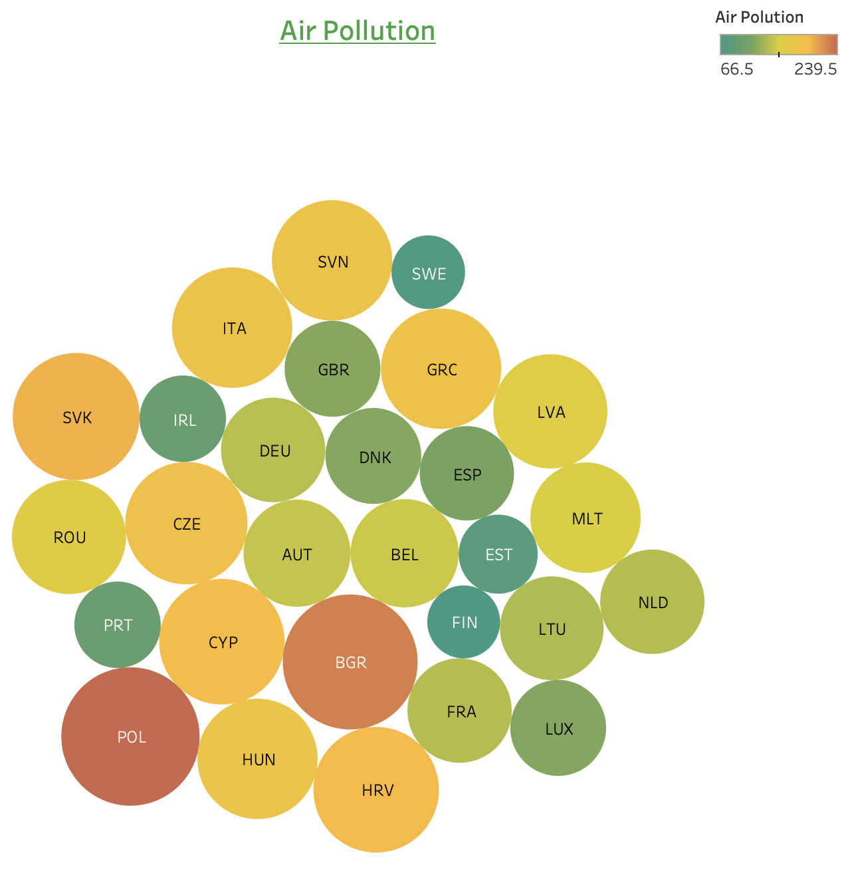
CO2 Emissions From the bubble chart we can clearly see the two countries with the lowest CO2 emissions are Sweden and Finland.

Slide 6

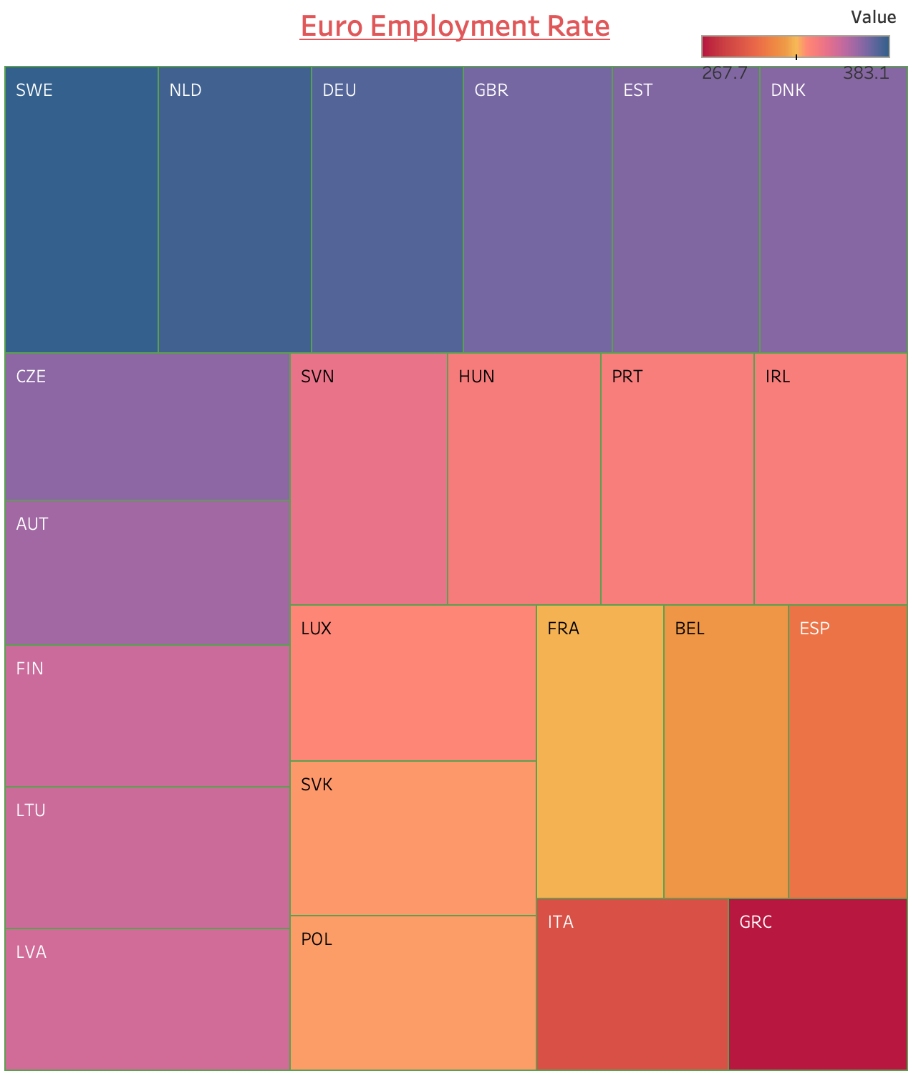
Employment Rate The two countries with the highest employment rate are Netherlands and Sweden.

Slide 7
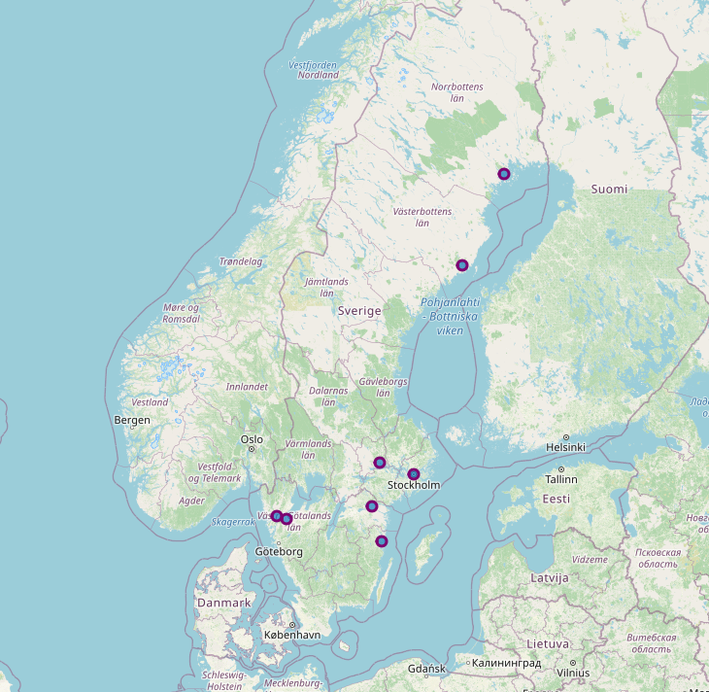
EU Country

Slide 8
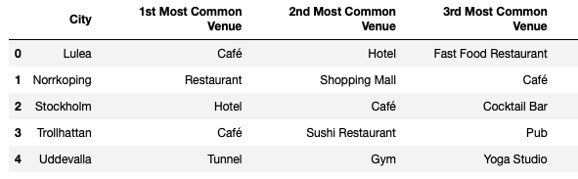
Foursquare Venues

Slide 9
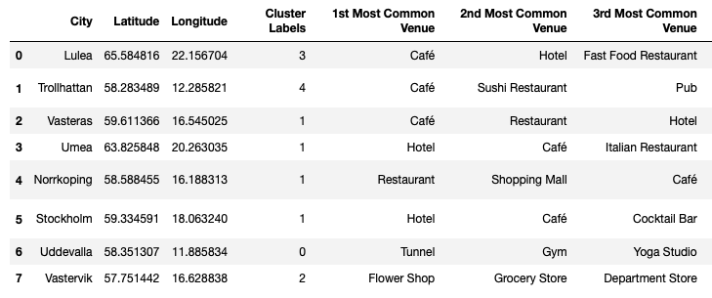
K-Mean Clusters
Now that we have the most common venues per city, K-Means Clustering can be applied. In this reason I used unsupervised learning K-means algorithm to cluster the boroughs. K-Means algorithm is one of the most common cluster method of unsupervised learning. A total of 5 cluster (K=5) will be used as it is determined to be the optimal number of clusters.

Slide 10
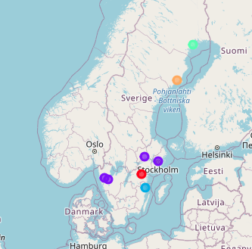
Clusters
To increase the entrepreneur chances for success, it is recommended to open a Café in Vasteras, Umea, Norrkoping or Stockholm (Purple Cluster). As it clearly shows that Cafés are quite popular in Vasteras, Umea, Norrkoping and Stockholm, it would be a good first choice to open for the young businessman.

Slide 11
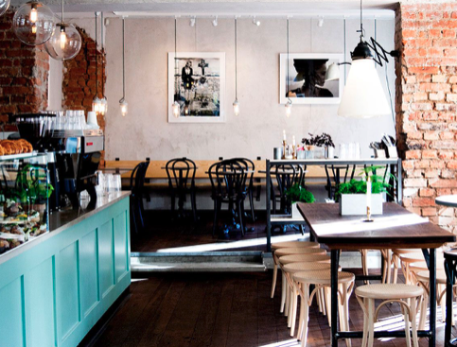
Conclusion
To conclude, it is suggested that the entrepreneur open a Café in Stockholm, as it is the country’s capital and receives the most tourists in a year.

