Slide 1

DEPARTMENT OF COMPUTER SCIENCE AND ENGINEERING
Professional Training I
Smart Digital Payment Transaction Analytics and Monitoring Dashboard
PROJECT STUDENT GUIDE
S LAJITHAN 44110407 Ms.D.Aishwarya,M.E,Ph.D,
M LARUN NISHAN 44110412 DR. S. Pothumani, M.E., Ph.D., Associate Professors, CSE

Slide 2
AGENDA
Certificate
Abstract
Introduction
Objective
System Architecture / Ideation Map
Module Implementation
Results and Discussions
Conclusion

Slide 3
COURSE CERTIFICATE

Slide 4
ABSTRACT
The Smart Digital Payment Transaction Analytics and Monitoring Dashboard is designed to analyze and monitor digital payment transactions efficiently. It collects important transaction details such as amount, date, time, payment method, and transaction status. The system processes transaction data to identify trends, patterns, and payment performance. An interactive dashboard presents the information using charts, graphs, tables, and key performance indicators. It helps users easily track successful, failed, and pending transactions.Real-time or regularly updated data enables quick monitoring of payment activities.The dashboard supports better decision-making through clear and meaningful visual insights. Overall, the proposed system provides a smart, centralized, and user-friendly solution for digital payment transaction analytics.

Slide 5
INTRODUCTION
Introduction – Digital Payment Transaction Analytics Dashboard
Digital payments are widely used for fast and convenient transactions.
Managing a large number of transactions manually can be difficult.
The dashboard collects important payment details such as amount, date, time, and payment method.
It analyzes transactions to identify useful patterns and trends.
Successful, failed, and pending transactions can be monitored easily.
Charts and graphs provide a simple visual view of payment activities.
Key performance indicators help users understand transaction performance.
The dashboard supports quick identification of unusual or failed transactions.
Regularly updated data helps users monitor recent payment activities.
Overall, the system provides a simple, centralized, and data-driven way to understand digital payment transactions.

Slide 6
OBJECTIVE
To analyze digital payment transaction data efficiently and accurately.
To monitor successful, failed, and pending transactions in a centralized dashboard.
To visualize transaction trends using interactive charts, graphs, and tables.
To identify unusual transaction patterns and potential suspicious activities.
To provide meaningful insights for better and faster decision-making.

Slide 7
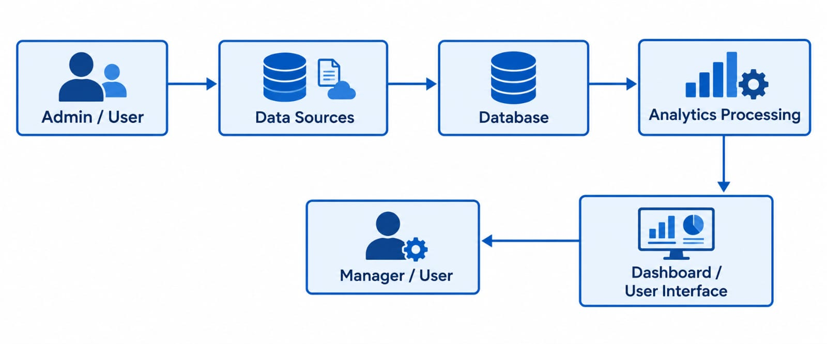

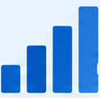
SYSTEM ARCHITECTURE / IDEATION MAP
in
Datasource
Database
Analytics Processing

Slide 8
MODULE IMPLEMENTATION
1. Transaction Data Acquisition Module
Collects payment information such as transaction ID, amount, date, payment method, and transaction status from different digital payment sources.
2. Data Cleaning & Transformation Module
Removes duplicate or incorrect records, handles missing values, and converts raw transaction data into a structured format suitable for analysis.
3. Payment Performance Analytics Module
Analyzes transaction volume, payment success rate, failed transactions, transaction amounts, and payment-method performance to identify important trends.
4. Anomaly Detection & Monitoring Module
Monitors transaction patterns and highlights unusual activities, unexpected changes, or suspicious transaction behavior for further investigation.
5. Interactive Visualization & Reporting Module
Presents the analyzed information through dashboards, KPIs, charts, graphs, tables, filters, and reports, allowing users to understand transaction performance quickly.
L

Slide 9
RESULTS AND DISCUSSION
The proposed Smart Digital Payment Transaction Analytics and Monitoring Dashboard successfully processes and analyzes transaction data. The dashboard displays transaction amounts, payment methods, dates, and transaction statuses clearly. It provides visual charts and graphs to identify transaction trends and patterns. Successful, failed, and pending transactions can be monitored easily through the dashboard. Interactive filters allow users to view specific transaction details quickly. The dashboard reduces manual effort and improves the efficiency of transaction monitoring. The visual presentation makes complex payment data easier to understand. The generated insights support faster and more informed decision-making. Overall, the system provides an effective and user-friendly platform for digital payment transaction analysis and monitoring.

Slide 10
CONCLUSION
The Smart Digital Payment Transaction Analytics and Monitoring Dashboard provides an efficient solution for managing and analyzing digital payment data. The system collects, processes, and visualizes transaction information through an interactive dashboard. It helps users monitor transaction status, payment trends, transaction volumes, and unusual activities. The use of charts, graphs, and key performance indicators makes complex data easier to understand. The system reduces manual analysis and saves time in monitoring large volumes of transactions. It also supports quick identification of failed or suspicious transactions for further investigation. The dashboard provides meaningful insights that can support effective data-driven decisions. Overall, the proposed system improves the efficiency, visibility, and organization of digital payment transaction monitoring.

Slide 11
REFERENCES
Indumathi.J (2025) Data Analytics: Transforming Data into Insights. 1st Edition, Cengage India. ISBN: 9789366601779

Slide 12
THANK YOU
We thank God, Our Department, Guide, Panel Members, Supportive Professors and all Technical and non Technical staff who helped us in our Project.

