Slide 1
Musiplectics Computational Assessment of the Complexity of Music Scores
Ethan Holder
Advisor: Eli Tilevich (CS)
Committee: Amy Gillick (Music) and R. Ben Knapp (ICAT)

Slide 2
Musiplectics
Music + Plectics (Greek for the study of complexity)
A systematic and objective approach to computational assessment of the complexity of a music score for any instrument.

Slide 3
Contents
Insights
Approach
Example
Proof of Concept
Musiplectics in Action
Future Work
Thesis Contributions

Slide 4


Insights
Musicians are a contentious and cantankerous bunch (i.e. two musicians, three opinions).
But, all can agree different notes pose different difficulties on wind instruments.
However, they may disagree on the magnitude of the differences.
[1]
?
2 3 4
1 2 1
Notes:
Depends on proficiency and opinions
On 1-10 scale

Slide 5

Insights
The same disparity of different difficulties can be observed with intervals.
What effects do articulations, dynamics, and tempo have on the disparity?
?
2 3 4

Slide 6
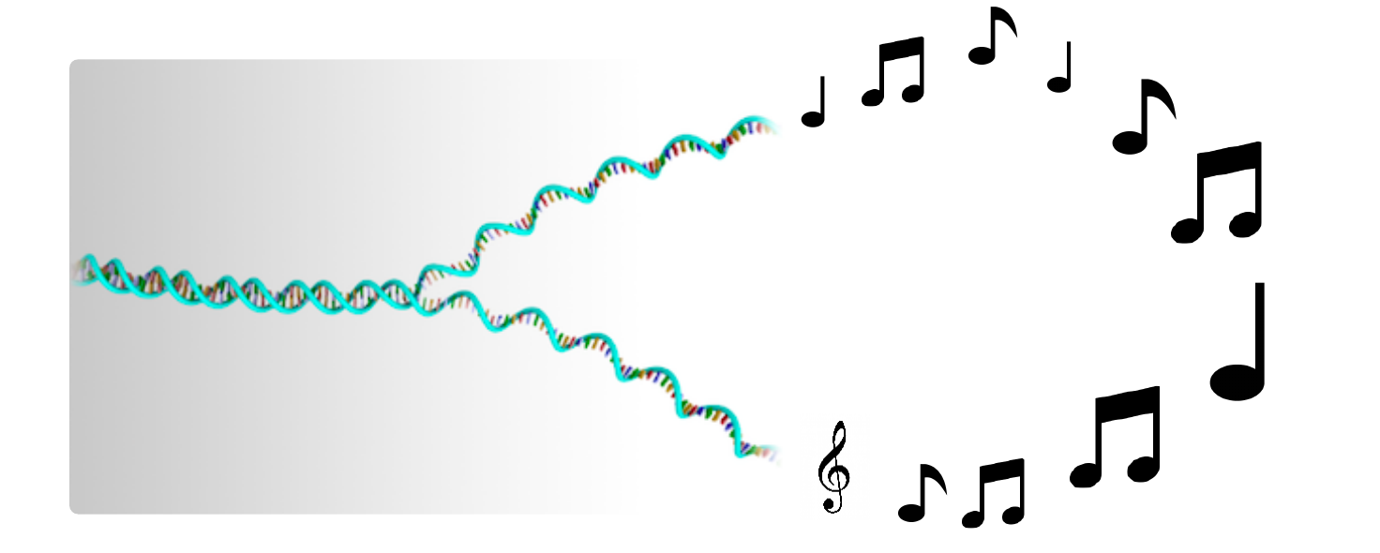
Insights
Computing offers us the capability to build upon these insights by eliminating the cognitive load required to assess the difficulty of realistic musical pieces.
We can “decipher the music genome” through computing.
[2]
Notes:
Mention bioinformatics
http://www.zsgenetics.com/sample-preparation/#!prettyPhoto

Slide 7
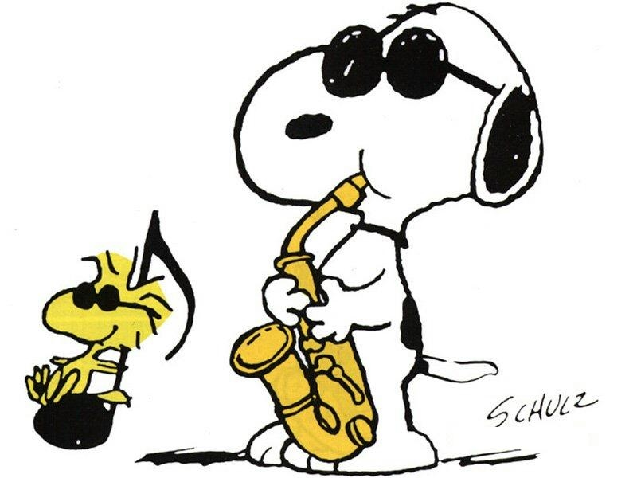
Insights
Educators, performers, professionals, composers, publishers, students, and more can leverage this technology to simplify their work.
[3]

Slide 8
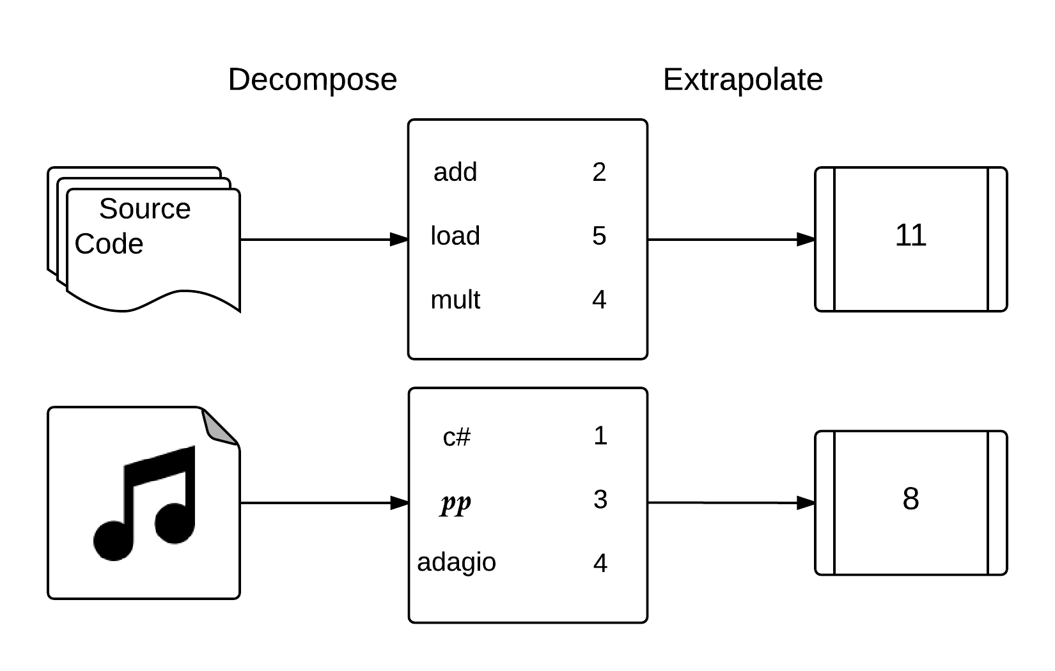
Approach
Decompose a piece into its musical elements and extrapolate complexity measurements from supplied weights (individual complexity parameters).
Draw on program performance estimation analogies.
Notes:
Computation thinking

Slide 9
Approach
Complexity parameters
“What” (i.e., is being played)
Individual notes
Intervals
“How” (i.e., how “what” components are played)
Key signature
Dynamics
Tempo/Duration
Articulation: Slurred/Separated (i.e., legato/staccato)

Slide 10
Approach
Rank each of the predefined complexity parameters.
Use default values for unranked parameters.
The “what” components get specific values.
The “how” parameters become multipliers for “what” components.

Slide 11
Approach
Leverage outside experts to determine complexity parameters for individual musical elements on each instrument.
Qualtrics Survey
Awaiting IRB Approval
Use our own parameters until we have conclusive new ones.

Slide 12
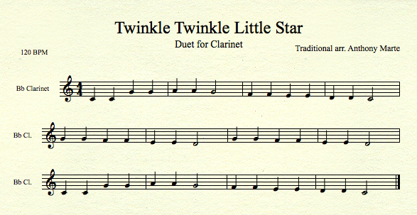
Example

Slide 13
Example
Notes
C4 C4 G4 G4 A4 A4 G4 F4 F4 E4 E4 D4 D4 C4
G4 G4 F4 F4 E4 E4 D4 G4 G4 F4 F4 E4 E4 D4
C4 C4 G4 G4 A4 A4 G4 F4 F4 E4 E4 D4 D4 C4

Slide 14
Example
Note Weights
1 1 1 1 2 2 1 1 1 1 1 1 1 1
1 1 1 1 1 1 1 1 1 1 1 1 1 1
1 1 1 1 2 2 1 1 1 1 1 1 1 1

Slide 15
Example
Note Weights with Articulations Multiplier
1 1 1 1 2 2 1 1 1 1 1 1 1 1
1 1 1 1 1 1 1 1 1 1 1 1 1 1
1 1 1 1 2 2 1 1 1 1 1 1 1 1
Notes:
No articulations so multiplied by 1

Slide 16
Example
Note Weights with Articulations and Dynamics Multipliers
1.5 1.5 1.5 1.5 3 3 1.5 1.5 1.5 1.5 1.5 1.5 1.5 1.5
1.5 1.5 1.5 1.5 1.5 1.5 1.5 1.5 1.5 1.5 1.5 1.5 1.5 1.5
1.5 1.5 1.5 1.5 3 3 1.5 1.5 1.5 1.5 1.5 1.5 1.5 1.5
Notes:
No dynamics so multiplied by 1.5 default

Slide 17
Example
Note Weights with Articulations, Dynamics, and Key Signature Multipliers
1.5 1.5 1.5 1.5 3 3 1.5 1.5 1.5 1.5 1.5 1.5 1.5 1.5
1.5 1.5 1.5 1.5 1.5 1.5 1.5 1.5 1.5 1.5 1.5 1.5 1.5 1.5
1.5 1.5 1.5 1.5 3 3 1.5 1.5 1.5 1.5 1.5 1.5 1.5 1.5
= 24
= 21
= 24
________
69
Notes:
Key of C so multiplier is 1

Slide 18
Example
Intervals
1 5 1 2 1 2 2 1 2 1 2 1 2
5 1 2 1 2 1 2 4 1 2 1 2 1 2
2 1 5 1 2 1 2 2 1 2 1 2 1 2

Slide 19
Example
Interval Weights
1 5 1 8 1 8 2 1 2 1 2 1 2
5 1 2 1 2 1 2 4 1 2 1 2 1 2
2 1 5 1 8 1 8 2 1 2 1 2 1 2

Slide 20
Example
Interval Weights with Articulations Multiplier
1 5 1 8 1 8 2 1 2 1 2 1 2
5 1 2 1 2 1 2 4 1 2 1 2 1 2
2 1 5 1 8 1 8 2 1 2 1 2 1 2

Slide 21
Example
Interval Weights with Articulations and Dynamics Multipliers
1.5 7.5 1.5 12 1.5 12 3 1.5 3 1.5 3 1.5 3
7.5 1.5 3 1.5 3 1.5 3 6 1.5 3 1.5 3 1.5 3
3 1.5 7.5 1.5 12 1.5 12 3 1.5 3 1.5 3 1.5 3

Slide 22
Example
Interval Weights with Articulations, Dynamics, and Key Signature Multipliers
1.5 7.5 1.5 12 1.5 12 3 1.5 3 1.5 3 1.5 3
7.5 1.5 3 1.5 3 1.5 3 6 1.5 3 1.5 3 1.5 3
3 1.5 7.5 1.5 12 1.5 12 3 1.5 3 1.5 3 1.5 3
= 52.5
= 40.5
= 55.5
________
148.5

Slide 23
Example
Note Duration Multiplier (Total Notes / Total Beats) * (Beats Per Minute / Sec Per Min)
1.75 = (42 / 48) * (120 / 60)
Total Notes
42
Total
Beats
48

Slide 24
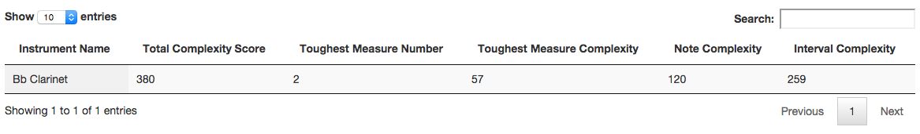
Example
Note Total
Interval Total
Total Score
= Note Weights * All Multipliers
= Interval Weights * All Multipliers
= Note Total + Interval Total
= 69 * 1.75
= 148.5 * 1.75
= 120.75 + 259.875
= 120.75
= 259.875
= 380.625

Slide 25
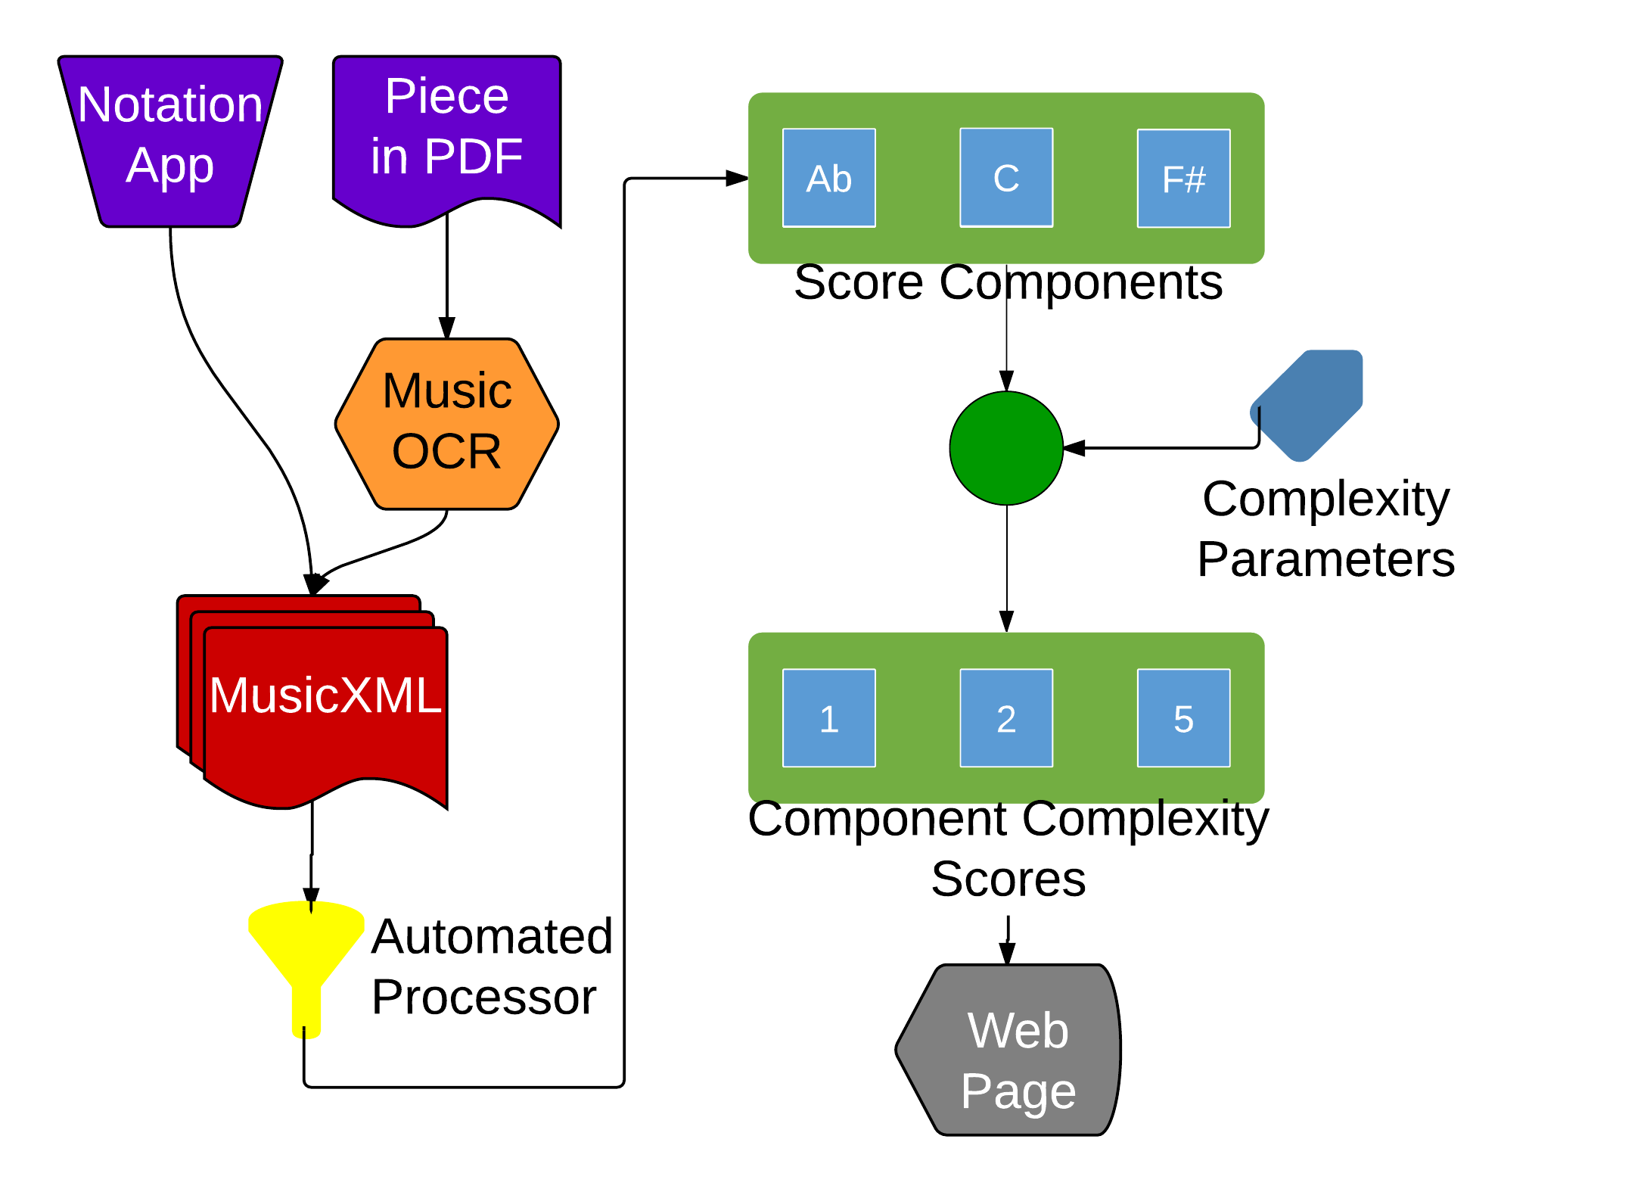
Proof of Concept
Accepts MusicXML files as input (via notation software or OCR conversion).
Tokenizes important musical elements for scoring (notes, intervals, dynamics, articulations, durations, and key signatures).
Weights tokens based on specified complexity parameters.
Aggregates and visualizes score data for consumption.

Slide 26
Proof of Concept
First, I created the Java backend code that worked with some hardcoded complexity parameters (5137 SLOC).

Slide 27
Proof of Concept
First, I created the Java backend code that worked with some hardcoded complexity parameters (5137 SLOC).
Second, I formalized the complexity parameters and abstracted them away from the implementation.

Slide 28
Proof of Concept
First, I created the Java backend code that worked with some hardcoded complexity parameters (5137 SLOC).
Second, I formalized the complexity parameters and abstracted them away from the implementation.
Third, I created the web frontend using outside libraries so users could interact with the software online (3061 SLOC).

Slide 29
Proof of Concept
First, I created the Java backend code that worked with some hardcoded complexity parameters (5137 SLOC).
Second, I formalized the complexity parameters and abstracted them away from the implementation.
Third, I created the web frontend using outside libraries so users could interact with the software online (3061 SLOC).
Finally, I added support for music OCR to the front of the pipeline.

Slide 30
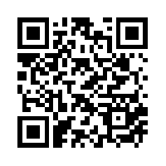
Proof of Concept
Cloud interface for generating complexity scores.
http://mickey.cs.vt.edu/
https://github.com/xwsxethan/MusicScoring

Slide 31
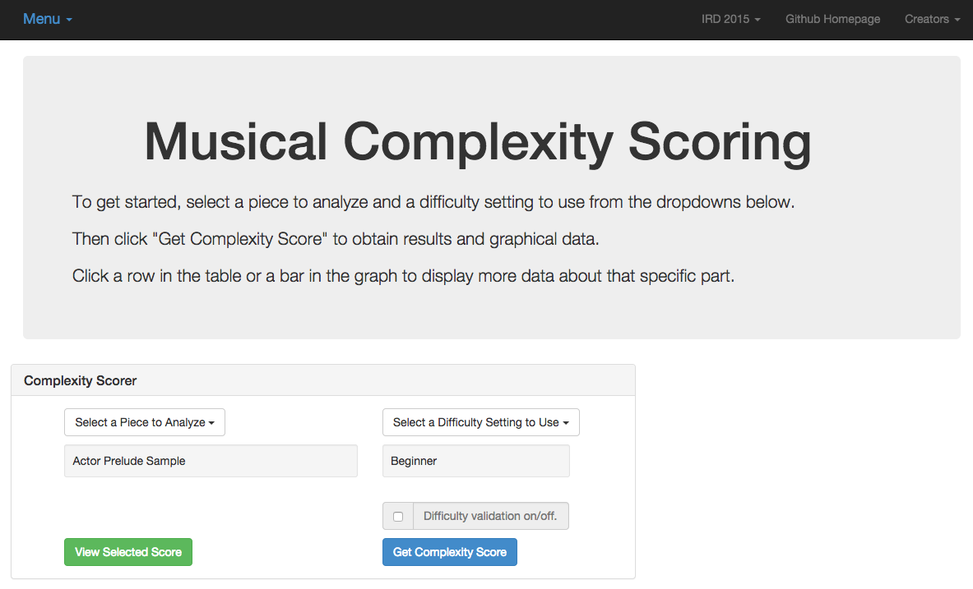
Proof of Concept

Slide 32
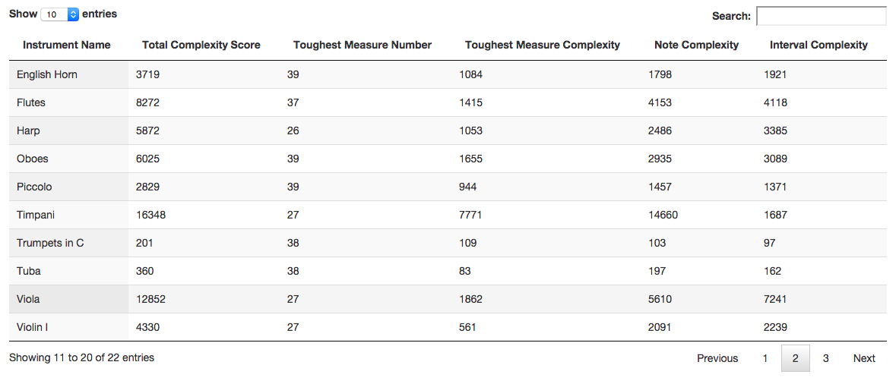
Proof of Concept

Slide 33
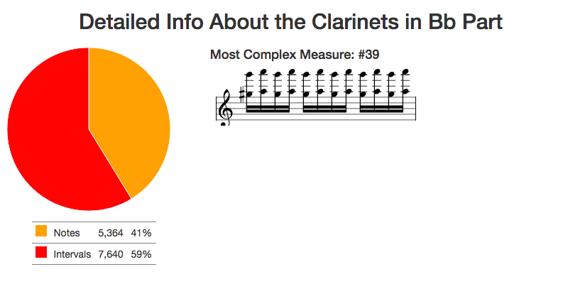
Proof of Concept

Slide 34
Musiplectics in Action
Experiment Setup:
Find manually scored pieces of music for Bb Clarinet from an outside source (Royal Conservatory syllabus).
Convert these manually scored pieces into MusicXML (music OCR software).
Generate complexity scores for these pieces with our system.
Compare our complexity scores to the manual scores.

Slide 35
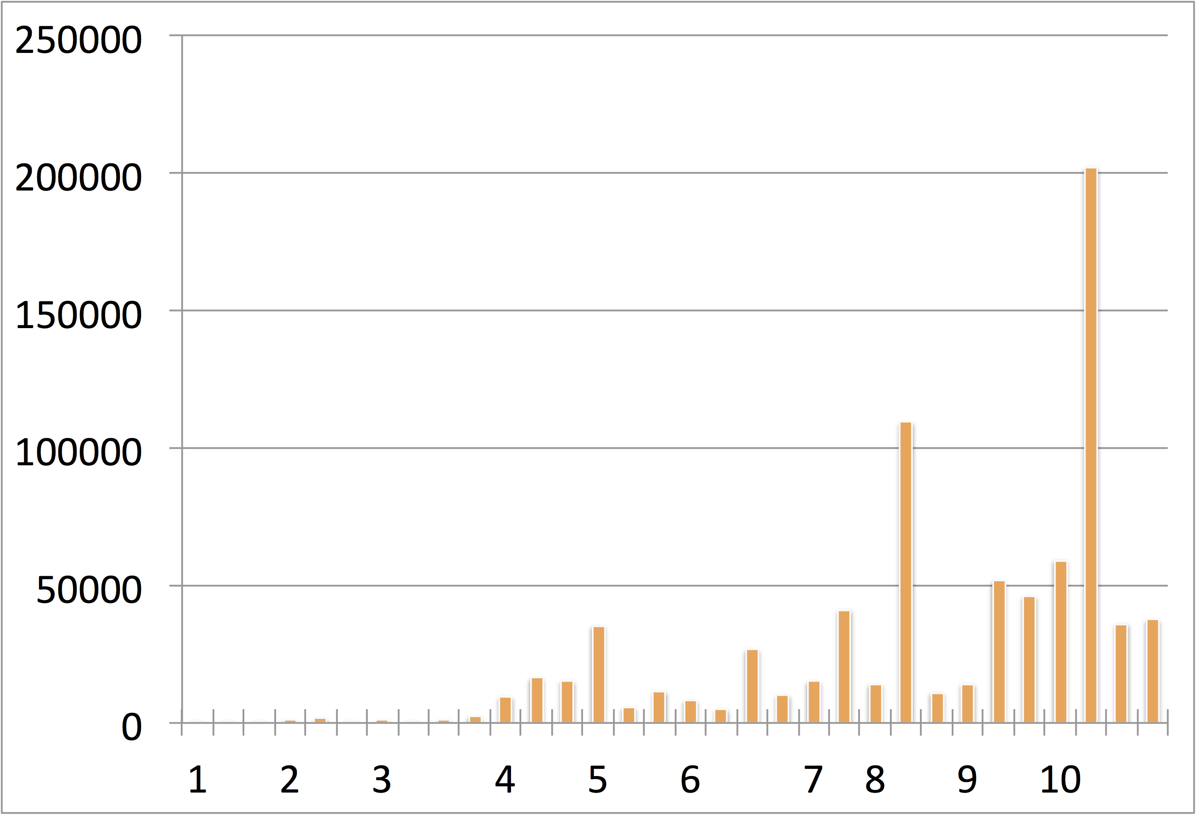
Musiplectics in Action
Complexity
Scores
Pieces by Manual Scores (Royal Conservatory)

Slide 36
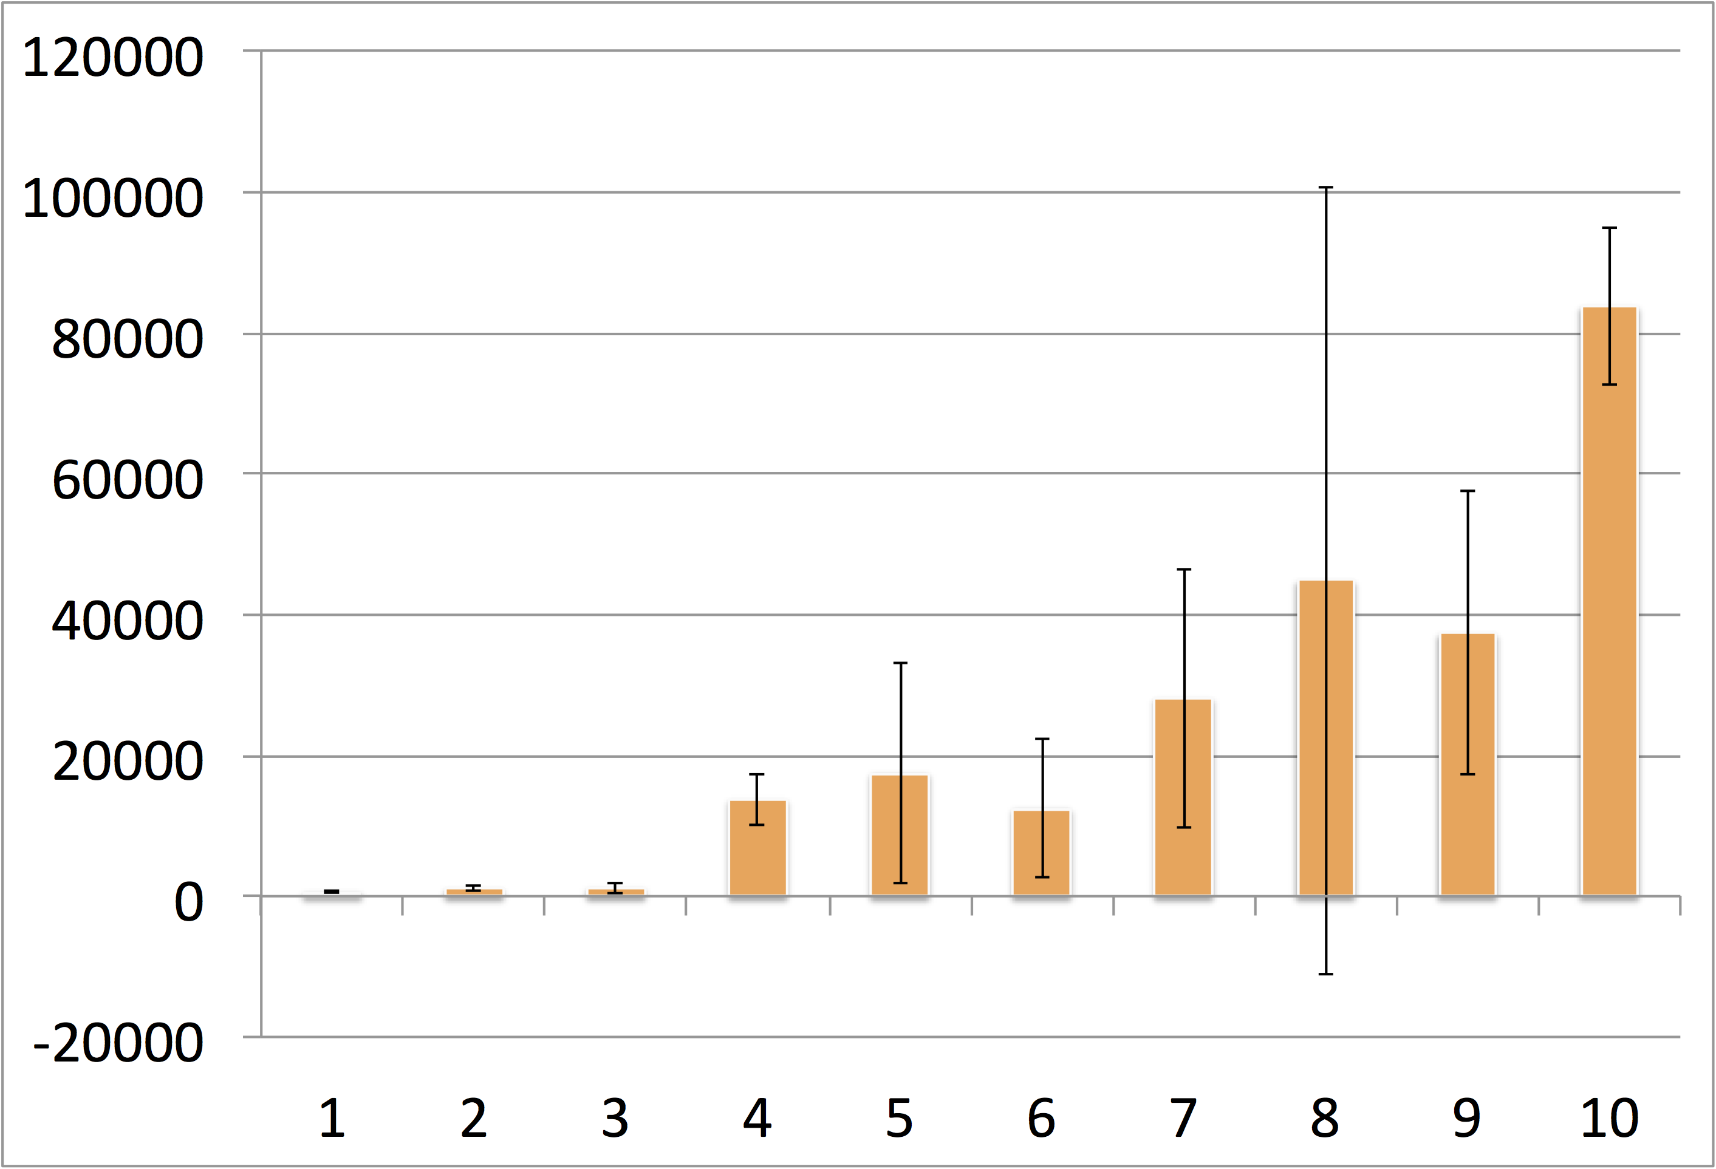
Musiplectics in Action
Average
Complexity
Scores
Pieces by Manual Scores (Royal Conservatory)

Slide 37
Future Work
Expanding instrument complexity parameters.
Presenting at ICAT day in the Moss Arts Center.
Leveraging other research to expand the tool chain.
Music OCR, MIDI conversion
Surveying experts for baseline complexity parameters.
Integrating with existing music libraries.
IMSLP.org, National Library
Adding reference pieces to relate complexity scores to well known works.
Measuring physiological signals to determine mental complexity.

Slide 38
Thesis Contributions
Our initial complexity scores show Musiplectics’ promise as viable approach to automate complexity assessment.
Largely agree with subjective grades (Royal Conservatory instructional syllabus) of publicly available music pieces for B♭ Clarinet.
Musiplectics can automate a meticulous, manual process, providing consistent results on a ubiquitous platform.
The preliminary results have been submitted to ONWARD’15 for publication.

Slide 39
Questions
?

Slide 40
Images
http://www.goodfuneralguide.co.uk/wordpress/wp-content/uploads/2013/04/two-cartoon-men-yelling.jpg
http://www.zsgenetics.com/wp-content/uploads/2013/01/dna-split-504x482.png
https://s-media-cache-ak0.pinimg.com/originals/49/0a/eb/490aeb9159c5b3044035cfbf7e4a19f3.jpg

Slide 41
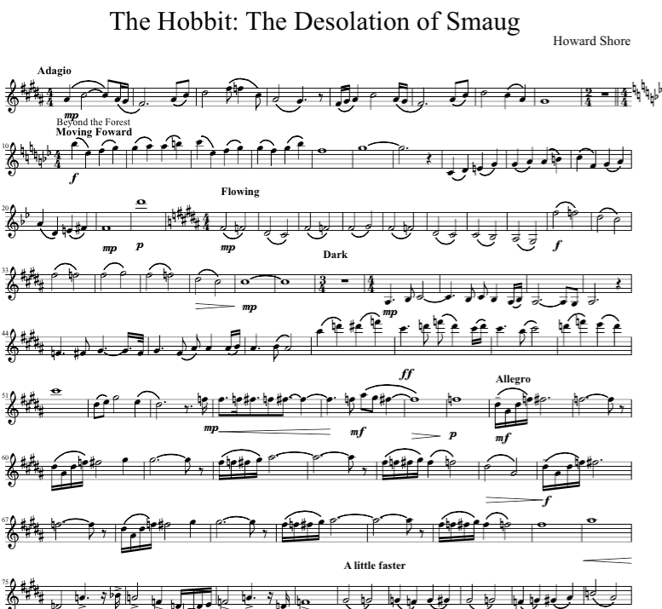
User Questions and Needs
How difficult is this piece of music?
What makes this piece of music more or less difficult than others?
What portion of this piece is the most difficult?
Why?

Slide 42
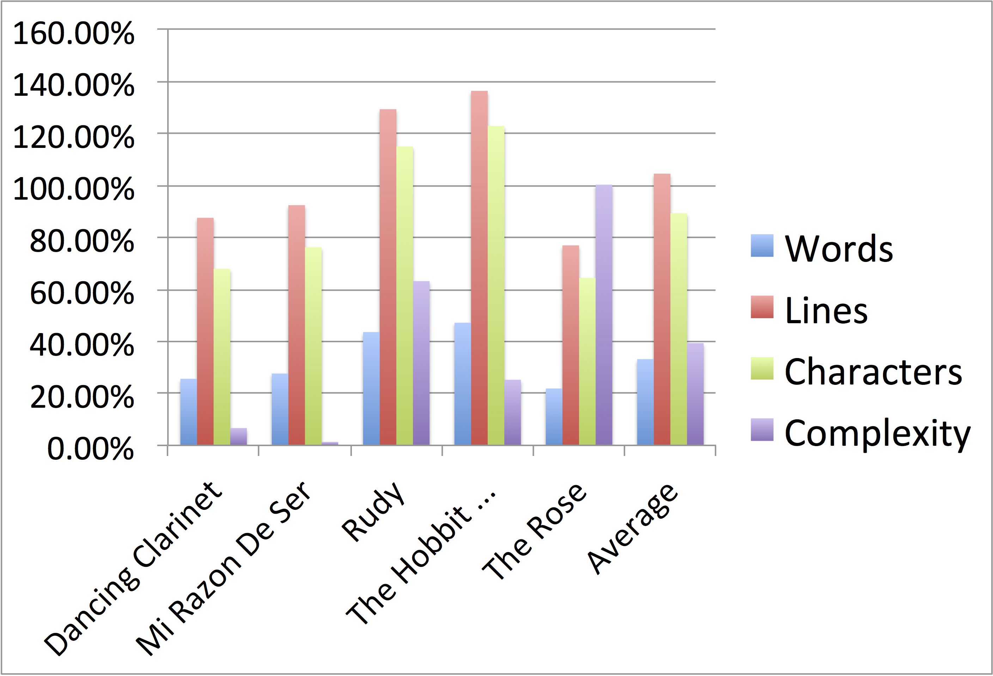
Reliability of Music OCR
Percentage
Difference
By Category
Music Pieces Converted with Music OCR (MuseScore)

Slide 43
Related Work
Complexity Analysis
Chiu2012 (just for piano) and Heijink2002 (just for guitar)
Liou2010 (L-system for trees on rhythm only)
VBODA and NYSSMA (state organizations manual rankings)
Madsen2006 and Streich2006 (listener complexity)

Slide 44
Related Work
Music Scan and Search
Byrd2001 shows why we need efficient means of searching for music which complexity scores can provide.
Allali2009 demonstrates how we can alter complexity by simplifying polyphonic music down to a monophonic equivalent.

Slide 45
Related Work
Music Classification
Cuthbert2011 shows how to extract features from pieces and apply machine learning to classify the genre of a work.
Cataltepe2007 are able to classify MIDI pieces of music by approximating the Kolmogorov distance with a string representation and matching based on that measurement.

Slide 46
Note Total = Note Weights * All Multipliers = 69 * 1.75 = 120.75
Interval Total = Interval Weights * All Multipliers = 148.5 * 1.75 = 259.875
Total Score = Note Total + Interval Total = 120.75 + 259.875 = 380.625

