Slide 1
Musical Complexity Scoring
Ethan Holder
Eli Tilevich, Amy Gillick, R. Ben Knapp

Slide 2
Contents
Intro
Problem
Background
Solution
Why is this Cool?
Future Work

Slide 3
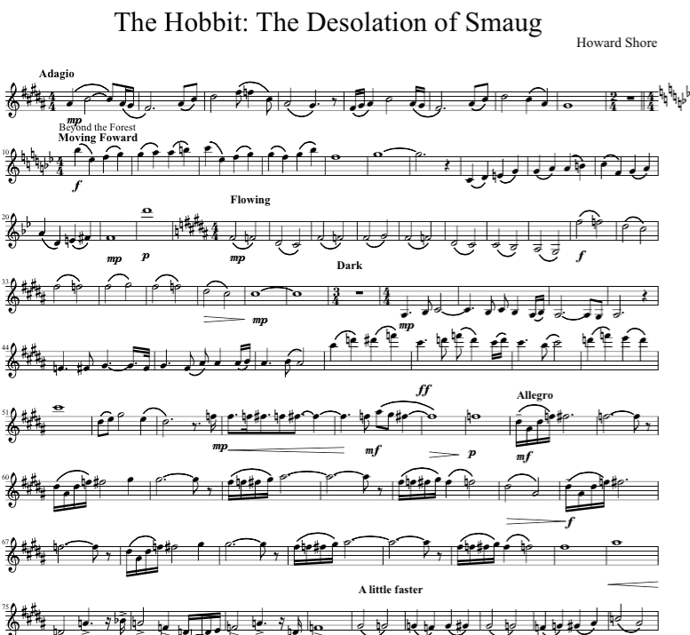
Intro
How difficult is this piece of music?
What makes this piece of music more or less difficult than others?
What portion of this piece is the most difficult?
Why?

Slide 4
Problem
Educators and performers need this information at a glance before they decide to purchase or practice a piece.
There is currently no objective process for this.
Determining this for your own playing level is a tedious, error prone process.

Slide 5
Background
How many of you are familiar with sheet music or standard music notation?

Slide 6
Background
Notes-the distinct sounds produced during a song. They have pitch (how high or low the sound is), duration (how long the sound is played), articulation (how the sound formed, such as TA versus LA), and timbre (how the sound differs by instrument, even with the same pitch, articulation, and duration).
Interval-the difference in pitch between a series of notes.
Measure-a fixed duration grouping of notes. Measures only last a certain total duration and can have infinite different combinations of notes that fit within that span of time.

Slide 7
Background
Notes/Rests
Measures
Time Signature
Tempo
Key Signature
Accidentals
Dynamics

Slide 8
Background
Programs exist to help musicians create sheet music, such as Finale Notepad or Sibelius, among others.
There is a universal format each accepts called MusicXML.
MusicXML is a standard xml file to us with the organization pattern necessary to easily parse music.

Slide 9
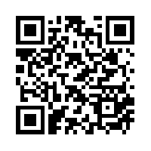
Solution
Give educators and performers an objective means to quickly determine the complexity of a piece of music relative to their own level of play.
http://mickey.cs.vt.edu/
https://github.com/xwsxethan/MusicScoring

Slide 10
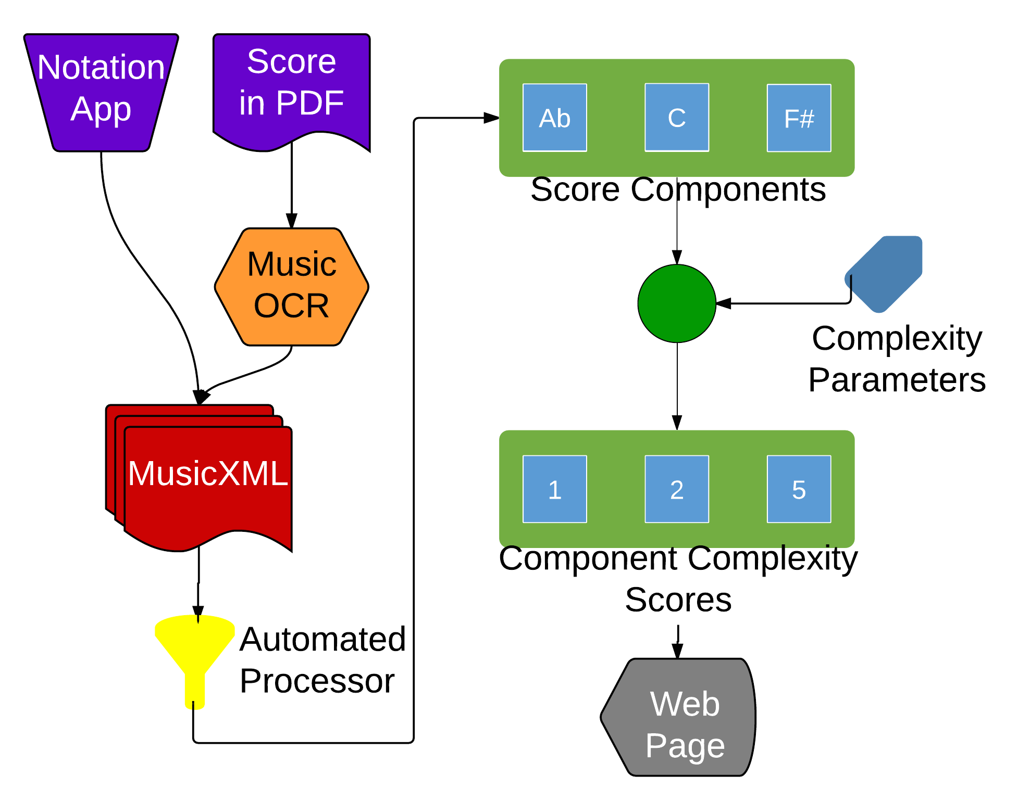
Solution

Slide 11
Why is this Cool?
Hasn’t really been done before. Could become a standard.
Can leverage other research to make the process easier.
Music OCR, mp3 conversion, dynamic assessment
It isn’t going to save the world, but it makes someone’s job easier.

Slide 12
Future Work
Presenting at the Arts Center
Leveraging Music OCR
Surveying Experts for Baseline
Integrating with Existing Music Publication Sites
Publishing (hopefully) Paper at ONWARD 2015

Slide 13
Questions
?

