Slide 1


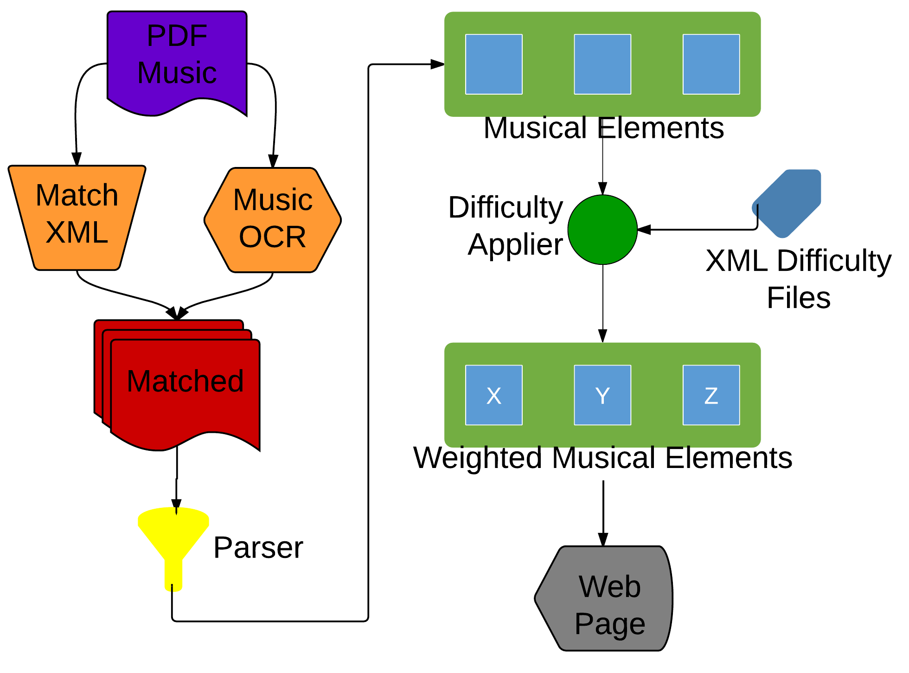
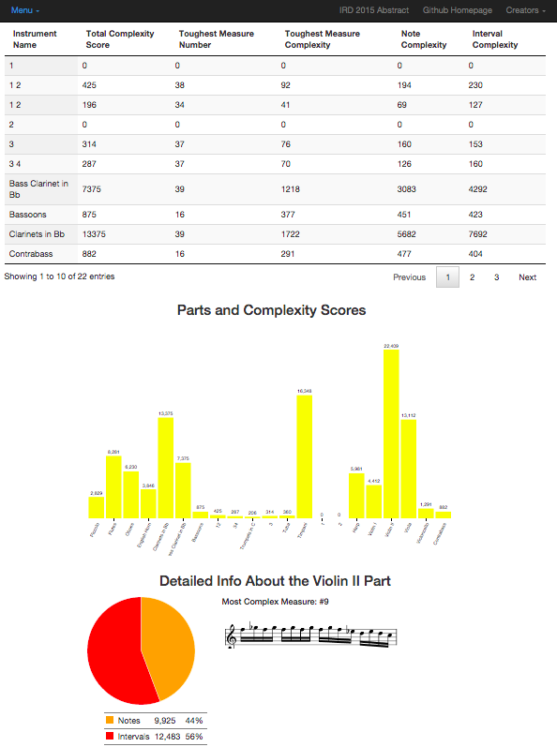








An Objective Assessment of Musical Complexity:
Translating Music Pedagogy’s Deep Insights with Novel Computing Paradigms
Ethan Holder
Advisors: Dr. Eli Tilevich, Dr. Amy Gillick, Dr. R. Ben Knapp
CS@VT
Problem Statement
Music educators and musicians need to accurately assess the complexity of music pieces to determine what they can best perform.
Current methods of scoring are subjective and are often inaccurate.
Users need a simple tool to quickly expose the underlying complexity of a piece automatically.
Inspiration
Which piano concerto is more difficult: Rachmaninoff’s Second or Third? Performers, band directors, educators, and publishers encounter these non-trivial questions throughout their professional careers. Currently, the only way to answer these questions in a viable way is to carefully analyze music scores by hand. Stakeholders would rather spend their precious time on more creative pursuits.
Solution Approach Overview
Step 1: Gathering Information
Survey instrument experts to determine a consensus for the difficulty of certain musical elements.
Step 2: Mapping Complexity
Statically analyze the musical elements of a piece and map them to the specified difficulties in Java.
Step 3: Passing Data
Determine the final score and meta data and pass it to the web interface as JSON.
Step 4: Revealing Insights
Leverage Javascript libraries to display the final score and meta data in an easily readable form.
Technical Solutions
Practical Impact
Offer an objective, error-free measurement of music pieces.
Automate tedious, subjective process.
Free user resources for creative tasks.
Apply music pedagogy insights to novel computing paradigms.
Applicability
Can analyze MusicXML for single or multi-part scores.
Limited instrument difficulty settings.
Need expert feedback to determine further difficulty settings.
Future Work
Leverage Audiveris to support PDF scores.
Support a broader set
of instruments.
Offer this software side by side with music libraries, such as imslp.org.

